Slide 1
Python Lab Pandas - III
Proteomics Informatics, Spring 2014
Week 11
11th Apr, 2014
Himanshu.Grover@nyumc.org

Slide 2
Data Aggregation, Transformations & Other Manipulations
Part of most data analysis workflows
Categorize data into groups, according to keys
Apply an operation to each group. For ex.
within group means/StDev etc.
within group normalizations, or other transformations etc.
Group-wise modeling (regression etc.)

Slide 3
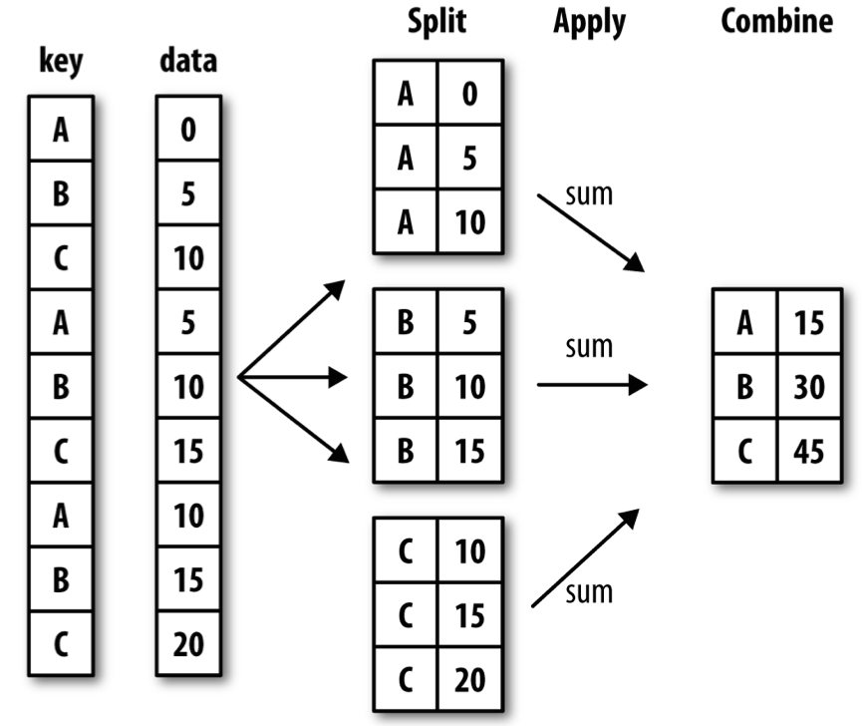
Pandas’ “groupby” Mechanics: Split-Apply-Combine
Split Pandas objects into pieces (groupby)
Apply:
Compute group statistics
Apply functions group-wise to columns (aggregate, transform)
Other, more generic manipulations (apply)
From “Python for Data Analysis”, Chapter 9

