Slide 1
Python Lab A Complex Example Using Control Statements
Proteomics Informatics, Spring 2014
Week 5
25th Feb, 2014
Himanshu.Grover@nyumc.org

Slide 2
Last week’s HW Assignment

Slide 3
Recap
Control statements
if/else branching operation
for loops and access patterns

Slide 4
Today
More complex example:
Compute Peptide Fragment Ions
Problem: Given a peptide sequence and charge state, compute m/z of various b- & y-ions

Slide 5
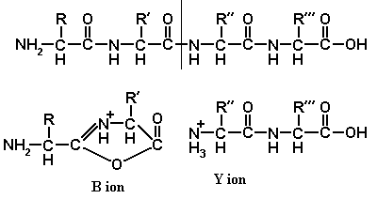
First, hand calculations
http://www.weddslist.com/ms/tandem.html

Slide 6
HW Assignment
Add remaining neutral losses
b-nh3
y-h2o
y-nh3
Add remaining multiply-charged fragments
y+

Slide 7
Next Class
Functions

