Slide 1
Proteomics Informatics –
Protein characterization I:
post-translational modifications (Week 10)

Slide 2
Post-translational modification
Biologically important post-translational modification (phosphorylation, acetylation, glycosylation, etc.)
Introduced on purpose during sample preparation (alkylation, iTRAQ, TMT etc.)
Side-products of sample preparation (oxidation, deamidation, carbamylation, formylation etc.)

Slide 3
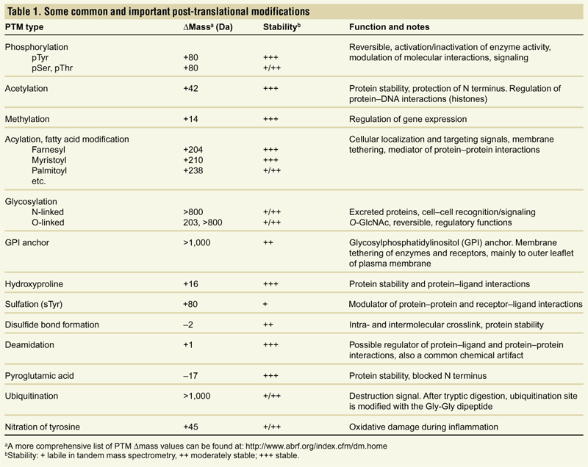
Post-translational modification
Mann and Jensen, Nature Biotech. 21, 255 (2003)

Slide 4
Phosphorylation examples

Slide 5
Potential modifications

Slide 6
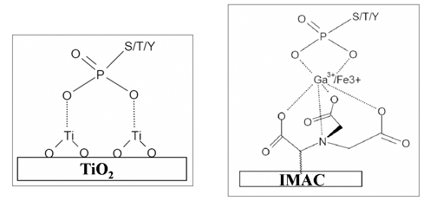
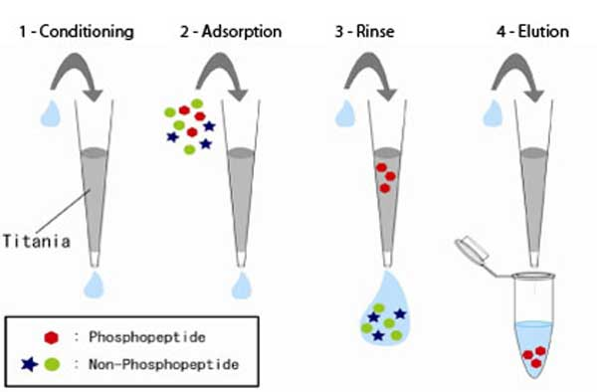
Enrichment Strategies for the Detection of Phosphorylated Peptides
Notes:
Works for PO4 but other modifications have other ways to enrich

Slide 7
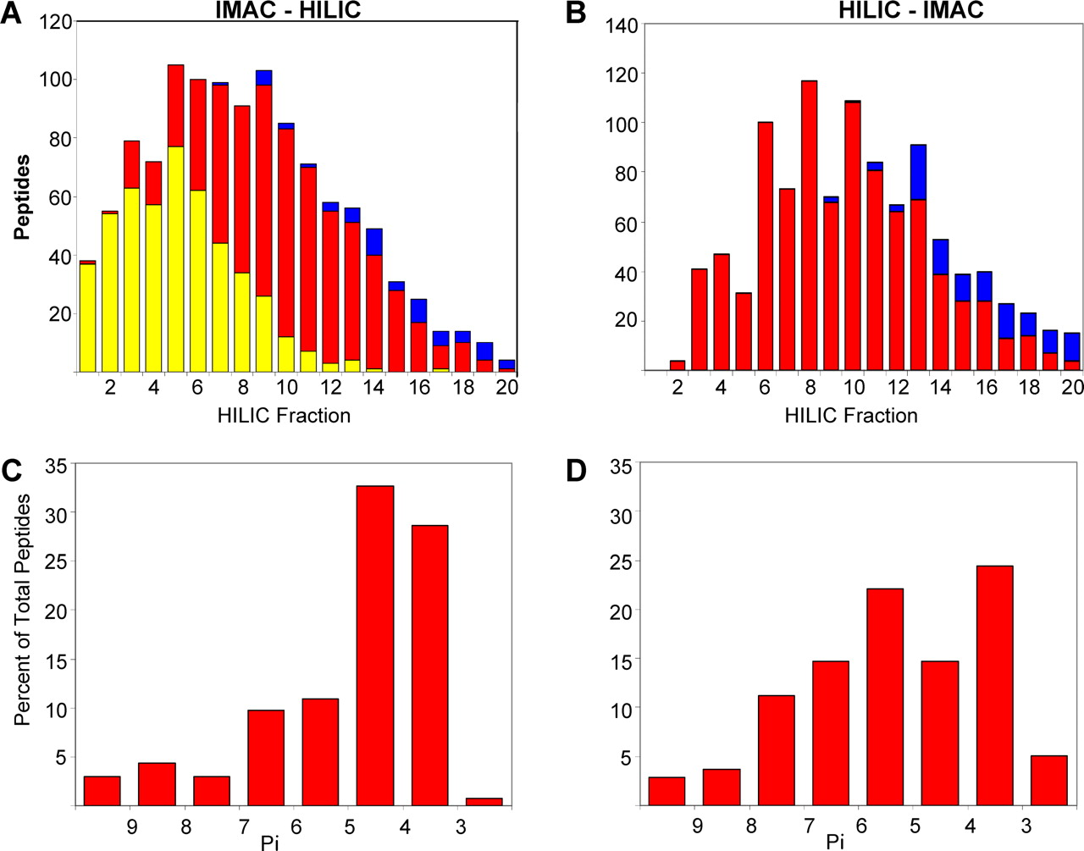
Enrichment Strategies for the Detection of Phosphorylated Peptides
Unphosphorylated
single phosphorylation
multiple phosphorylation
Hydrophilic Interaction Chromatography (HILIC)
Phosphopeptides elute later than their unphosphorylated counterparts
Stationary phase is hydrophilic
Mobile phase is hydrophobic
Notes:
Works for PO4 but other modifications have other ways to enrich

Slide 8
Enrichment Strategies for the Detection of Phosphorylated Peptides
SCX
Time (min)
neutral peptides
basic peptides
Strong Cation Exchange Chromatography
Stationary phase is negatively charged
Mobile phase is a buffer that is increasing the pH (if peptide becomes neutral it elutes)
Neutral peptides elute earlier: XXpSxxxxxR/K
Positive peptides elute late: XXXXHXXXXR/K

Slide 9
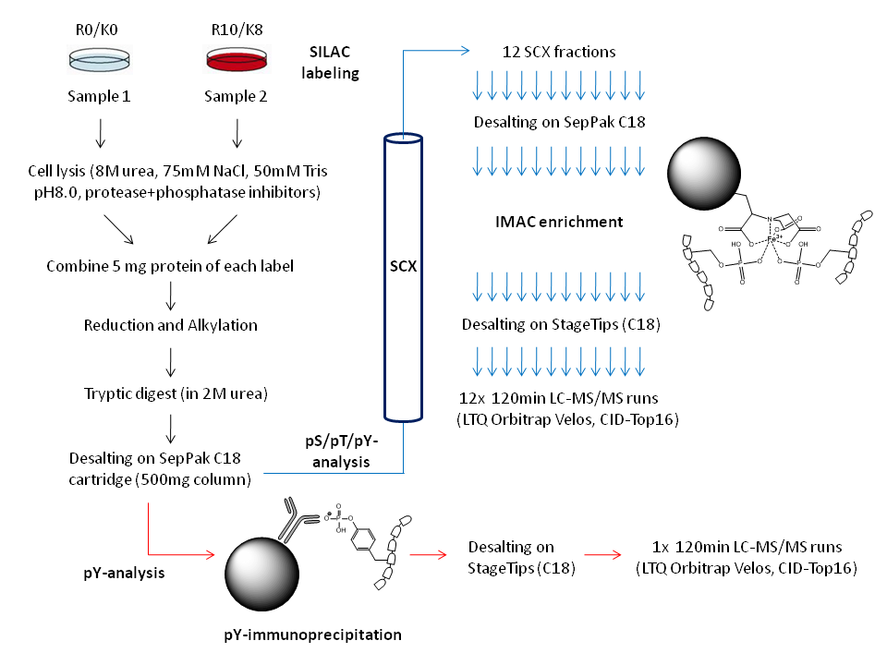
Several Strategies are often combined

Slide 10
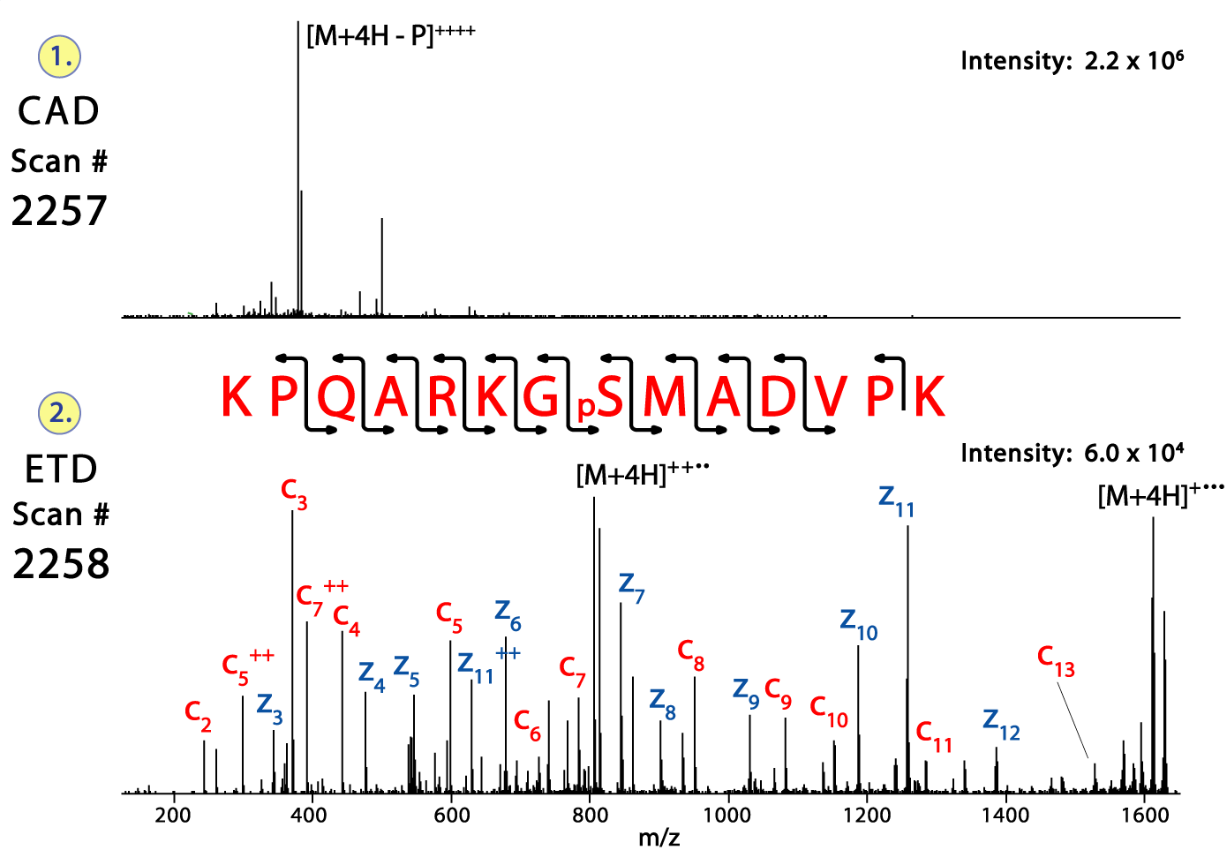
Loss of the phosphate group

Slide 11
Localization of modifications
Phosphopeptide identification
m_{precursor} = 2000 Da
Δm_{precursor} = 1 Da
Δm_{fragment} = 0.5 Da
Phosphorylation

Slide 12
Localization of modifications
d_{min}>=3 for 47% of human tryptic peptides
Localization (d_{min}=3)
m_{precursor} = 2000 Da
Δm_{precursor} = 1 Da
Δm_{fragment} = 0.5 Da
Phosphorylation
Notes:
12

Slide 13
Localization of modifications
d_{min}=2 for 33% of human tryptic peptides
Localization (d_{min}=2)
m_{precursor} = 2000 Da
Δm_{precursor} = 1 Da
Δm_{fragment} = 0.5 Da
Phosphorylation
Notes:
13

Slide 14
Localization of modifications
d_{min}=1 for 20% of human tryptic peptides
Localization (d_{min}=1)
m_{precursor} = 2000 Da
Δm_{precursor} = 1 Da
Δm_{fragment} = 0.5 Da
Phosphorylation
Notes:
14

Slide 15
Localization of modifications
Localization
(d=1*)
m_{precursor} = 2000 Da
Δm_{precursor} = 1 Da
Δm_{fragment} = 0.5 Da
Phosphorylation
Notes:
15

Slide 16
Localization of modifications
Peptide with two possible modification sites

Slide 17
Localization of modifications
Peptide with two possible modification sites
MS/MS spectrum
Intensity
m/z

Slide 18
Localization of modifications
Peptide with two possible modification sites
Matching
MS/MS spectrum
Intensity
m/z

Slide 19
Localization of modifications
Peptide with two possible modification sites
Matching
MS/MS spectrum
Intensity
m/z
Which assignment does
the data support?
1, 1 or 2, or 1 and 2?

Slide 20
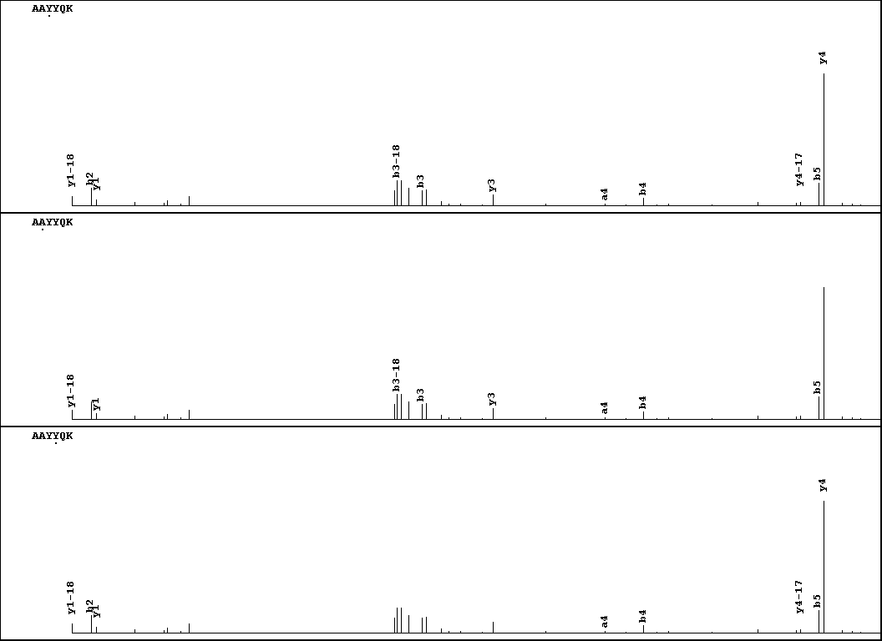
Visualization of evidence for localization
AAYYQK
AAYYQK

Slide 21
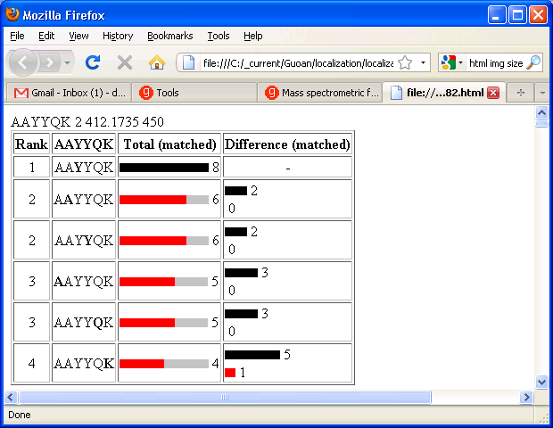
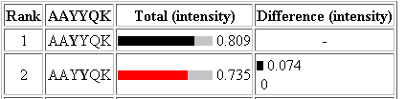
Visualization of evidence for localization

Slide 22
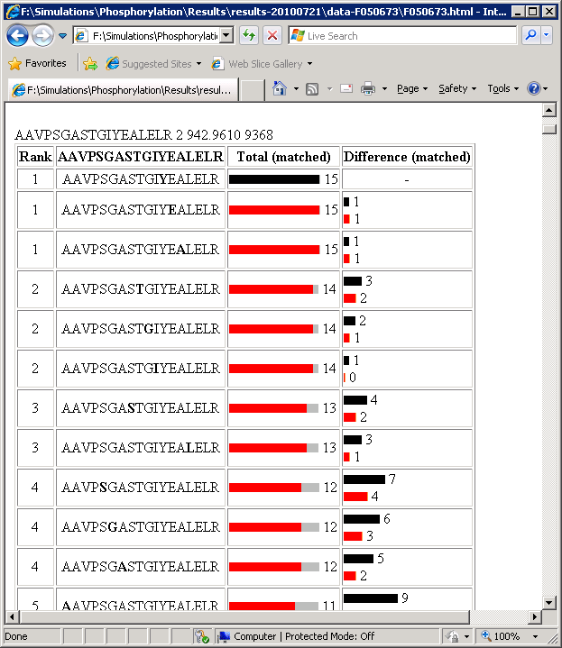
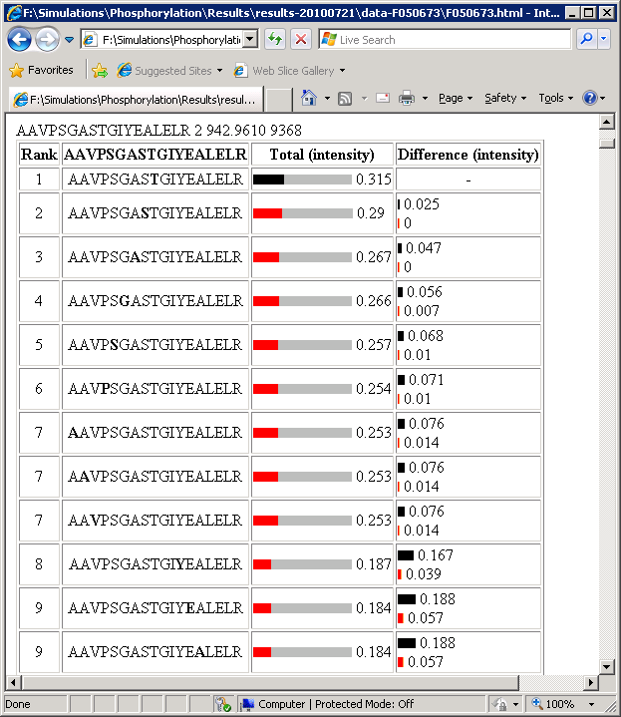
Visualization of evidence for localization
1
2
3
1
2
3

Slide 23
Estimation of global false
localization rate using decoy sites
By counting how many times the phosphorylation is localized to amino acids that can not be phosphorylated we can estimate the false localization rate as a function of amino acid frequency.
False localization frequency
Y
Amino acid frequency

Slide 24
How much can we trust a
single localization assignment?
If we can generate the distribution of scores for assignment 1 when 2 is the correct assignment, it is possible to estimate the probability of obtaining a certain score by chance for a given peptide sequence and MS/MS spectrum assignment.

Slide 25
Is it a mixture or not?
If we can generate the distribution of scores for assignment 2 when 1 is the correct assignment, it is possible to estimate the probability of obtaining a certain score by chance for a given peptide sequence and MS/MS spectrum assignment.

Slide 26
Localization of modifications
1 and 2
1
Ø
1 or 2

Slide 27
Top down / bottom up
Top down
Bottom up
intensity
mass/charge

Slide 28
Top down Bottom up
Charge distribution
2+
27+
31+
intensity
intensity
3+
4+
1+
mass/charge
mass/charge

Slide 29
Top down Bottom up
Isotope distribution
intensity
intensity
mass/charge
mass/charge

Slide 30
Fragmentation
Top down
Bottom up
Fragmentation

Slide 31
Alternative Splicing
Top down
Exon 1
2
3
Bottom up

Slide 32
Correlations between modifications
Top down
Bottom up

Slide 33
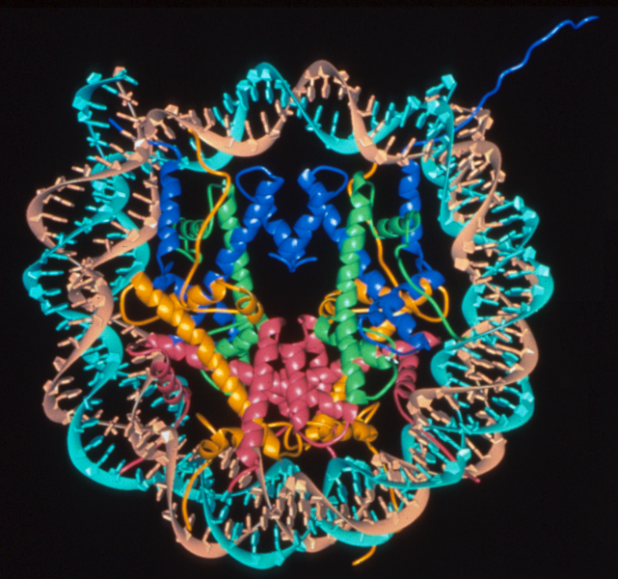
The Nucleosome Core Complex
H3
H4
H3 ‘tail’
H2A
H2B
Luger et al., Nature, 389, 251-260, 1997

Slide 34
The N-terminal Tails of Histone H3 and H4
M
M
Ac
P
Ac
M
P
M
P
Ac
M
Ac
P
M
M
P
M
M
H3 1-ARTKQTARKSTGGKAPRKQLATKAARKSAPATGGVKKPHRYRPTVALRE-50
Ac
P
M
Ac
Ac
Ac
Ac
M
Ac
H4 1-SGRGKGGKGLGKGGAKRHRKVLRDNIQGITKPAIRRLARRGGVKRISGLIYE-52
P
Phosphorylation
M
Methylation: mono-, di-, or trimethylation
Ac
Acetylation

Slide 35
The Histone Code Hypothesis
Specific post translational modifications (PTMs) of the N-terminal tails of histones function as a scaffold for binding of protein factors leading to transcriptional activation or inactivation.
Jenuwein, T., Allis, C.D., Science, 293, 2001

Slide 36
Interdependence of Modifications is lost in Standard Mass Spectrometry Analysis
M
M
Ac
P
Ac
Ac
P
M
P
Ac
M
Ac
P
M
M
M
P
M
M
H3 1-ARTKQTARKSTGGKAPRKQLATKAARKSAPATGGVKKPHRYRPTVALRE-50
M
TKQTAR 3-8
M
P
Ac
KSTGGKAPR 9-17
Ac
M
KQLATKAAR 18-26
Ac
M
KSAPATGGVKKPHR 27-40
41-50 YRPTVALRE

Slide 37
Histone Proteins are a Highly Complex Mixture of a Single Protein….
M
M
M
M
ARTKQTARKSTGAKAPRKQLASKAARKSAPATGGIKKPHRFRPGTVALRE
M
Ac
ARTKQTARKSTGAKAPRKQLASKAARKSAPATGGIKKPHRFRPGTVALRE
M
M
M
M
ARTKQTARKSTGAKAPRKQLASKAARKSAPATGGIKKPHRFRPGTVALRE
M
Ac
ARTKQTARKSTGAKAPRKQLASKAARKSAPATGGIKKPHRFRPGTVALRE
M
M
M
M
ARTKQTARKSTGAKAPRKQLASKAARKSAPATGGIKKPHRFRPGTVALRE
M
M
M
M
ARTKQTARKSTGAKAPRKQLASKAARKSAPATGGIKKPHRFRPGTVALRE
……………… and many many more!
Notes:
The histones all have the same nominal mass and even though the acetylations can be differentiated with accurate mass they can’t be excluded in isolation

Slide 38
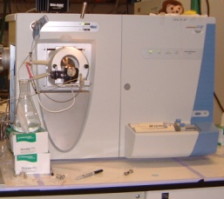
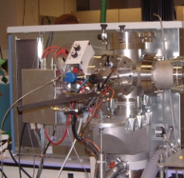
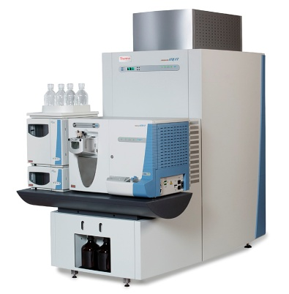
Protocol
LTQ-ETD/PTR
LTQ-FTMS
Glu-C generated N-terminal H3 peptide (1-50)
N
50
4
9
14
18
23
27
36
37
546.3
547.6
+10
+11
+9
Isolate m/z ± 0.5 Da
60 ms ETD
~ 3 min acquisition
549.1
+12
+8
550.4
551.9
+7
544.9
m/z
+ 10 charge states
245.2
346.3
Δ 1.4 Da
Δ 1.4 Da
502.4
982.5
Δ 1.4 Da
824.5
892.5
630.5
672.3
731.5
1055.6
1647.9
288.1
479.9
571.3
802.5
958.6
401.8
1129.6
1216.7
1255.2
1515.4
1715.0
1784.1
1878.2
1373.8
1424.8
1616.0
1937.8
m/z
m/z

Slide 39
Group ‘4’: 4 Acetyl Groups
100
c
2
c
3
c
z
9
4
z
7
*
Relative Abundance
c
5
c
6
*
z
z
z
*
z
14
2
z
5
6
c
7
c
z
z
4
*
c
8
c
9
z
10
z
15
z
3
*
*
10
z
11
12
*
c
16
16
*
*
*
*
*
c
c
12
c
*
*
c
*
*
*
*
11
13
*
17
*
*
*
*
0
400
800
m/z
1200
1600
2000
M
M
Ac
Ac
Ac
Ac
M
A R T K Q T A R K S T G A K A P R K Q L A S K A A R K S A P A T G G I K K P H R F R P G T V A L R E
M
Ac
Ac
Ac
Ac
M
M
A R T K Q T A R K S T G A K A P R K Q L A S K A A R K S A P A T G G I K K P H R F R P G T V A L R E
M
Ac
Ac
Ac
Ac
M
M
A R T K Q T A R K S T G A K A P R K Q L A S K A A R K S A P A T G G I K K P H R F R P G T V A L R E

Slide 40
Group ‘5’: 5 Acetyl Groups
c
4
100
c
K4: trimethyl
2
c
Relative Abundance
3
c
6
c
z
9
5
c
7
c
z
z
11
z
15
z
3
z
z
*
*
c
*
11
z
z
z
*
*
z
*
6
8
c
*
12
*
16
2
4
5
z
7
z
10
9
c
10
c
12
c
14
*
c
16
z
17
c
*
*
*
*
c
13
14
*
17
*
*
0
400
600
800
1000
1200
1400
1600
1800
2000
m/z
M
M
M
Ac
Ac
Ac
Ac
Ac
A R T K Q T A R K S T G A K A P R K Q L A S K A A R K S A P A T G G I K K P H R F R P G T V A L R E

Slide 41
Proteomics Informatics –
Protein characterization I:
post-translational modifications (Week 10)

