Slide 1
Proteomics Informatics (BMSC-GA 4437)
Course Director
David Fenyö
Contact information
David@FenyoLab.org
http://fenyolab.org/presentations/Proteomics_Informatics_2014/

Slide 2
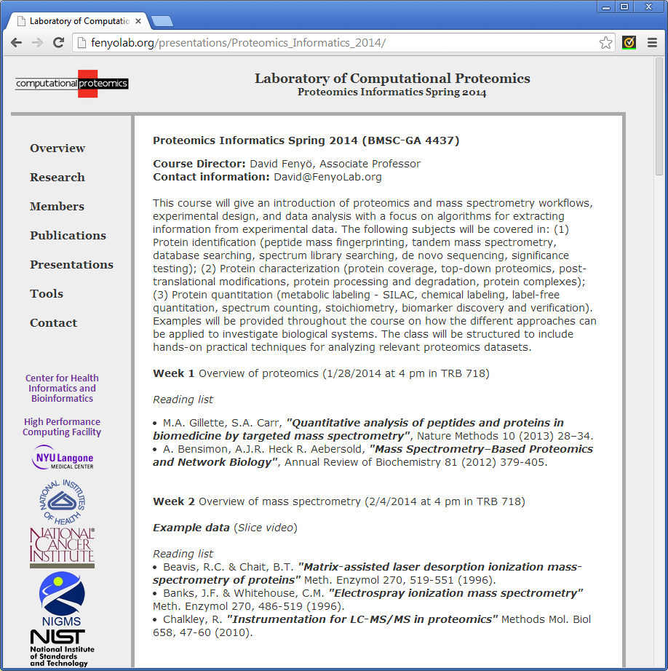
http://fenyolab.org/presentations/Proteomics_Informatics_2014/

Slide 3
Proteomics Informatics –
Learning Objectives
Be able analyze proteomics data sets and understand the limitations of the results.

Slide 4
Proteomics Informatics – Syllabus
Week 1 Overview of proteomics (1/28/2014 at 4 pm in TRB 718)
Week 2 Overview of mass spectrometry (2/4/2014 at 4 pm in TRB 718)
Week 3 Analysis of mass spectra: signal processing, peak finding, and isotope clusters (2/11/2014 at 4 pm in TRB 119)
Week 4 Protein identification I: searching protein sequence collections and significance testing (2/18/2014 at 4 pm in TRB 718)
Week 5 Protein identification II: de novo sequencing (2/25/2014 at 4 pm in TRB 718)
Week 6 Databases, data repositories and standardization (3/4/2014 at 4 pm in TRB 718)
Week 7 Proteogenomics (3/11/2014 at 4 pm in TRB 718)
Week 8 Protein quantitation I: Overview (3/18/2014 at 4 pm in TRB 718)
Week 9 Protein quantitation II: Targeted (3/25/2014 at 4 pm in TRB 718)
Week 10 Protein characterization I: post-translational modifications (4/1/2014 at 4 pm in TRB 718)
Week 11 Protein characterization II: Protein interactions (4/10/2014 at 4 pm in TRB 718)
Week 12 Molecular Signatures (4/17/2014 at 4 pm in TRB 718)
Week 13 Presentations of projects (4/22/2014 at 4 pm in TRB 718)

Slide 5
Proteomics Informatics –
Overview of Proteomics (Week 1)
Why proteomics?
Bioinformatics
Overview of the course

Slide 6
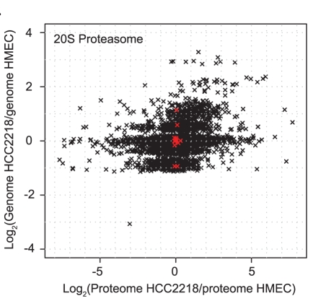
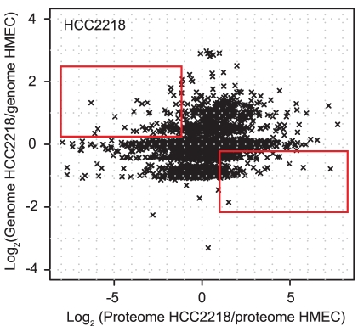
Motivating Example: Protein Regulation
Geiger et al., “Proteomic changes resulting from gene copy number variations in cancer cells”, PLoS Genet. 2010 Sep 2;6(9). pii: e1001090.

Slide 7
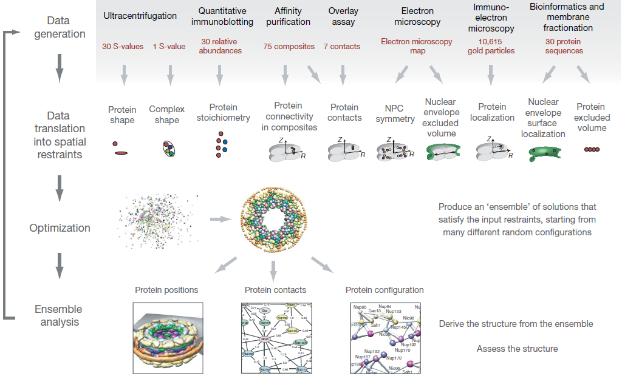
Motivating Example: Protein Complexes
Alber et al., Nature 2007

Slide 8
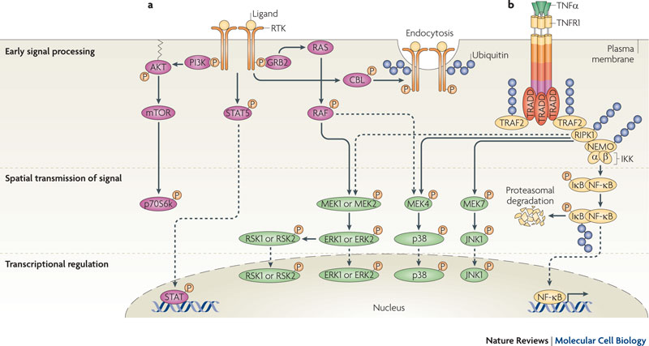
Motivating Example: Signaling
Choudhary & Mann, Nature Reviews Molecular Cell Biology 2010

Slide 9
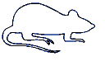
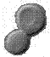
Bioinformatics
Biological System
Experimental Design
Samples
Measurements
Raw Data
Data Analysis
Information

Slide 10
Mass Spectrometry Based Proteomics
Lysis
Fractionation
Digestion
Mass spectrometry
Peak Finding
Charge determination
De-isotoping
Integrating Peaks
Searching
MS
Identified and Quantified Proteins

Slide 11
Proteomics Informatics –
Overview of Mass spectrometry (Week 2)
Ion Source
Mass Analyzer
Detector
intensity
mass/charge

Slide 12
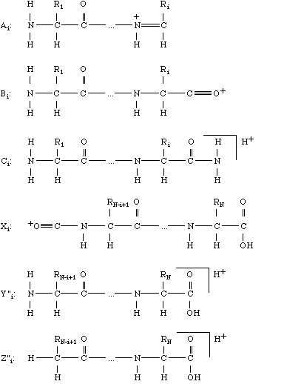
Proteomics Informatics –
Overview of Mass spectrometry (Week 2)
Ion Source
Mass Analyzer 1
Frag-mentation
Mass Analyzer 2
Detector
y
b

Slide 13
Proteomics Informatics –
Overview of Mass spectrometry (Week 2)
LC
Ion Source
Mass Analyzer 1
Frag-mentation
Mass Analyzer 2
Detector
intensity
intensity
intensity
intensity
intensity
intensity
intensity
intensity
intensity
intensity
intensity
intensity
intensity
intensity
intensity
mass/charge
mass/charge
mass/charge
mass/charge
mass/charge
mass/charge
mass/charge
mass/charge
mass/charge
mass/charge
mass/charge
mass/charge
mass/charge
mass/charge
mass/charge
Time

Slide 14
Proteomics Informatics –
Analysis of mass spectra: signal processing, peak finding, and isotope clusters (Week 3)
Intensity
m/z

Slide 15
Proteomics Informatics –
Protein identification I: searching protein sequence collections and significance testing (Week 4)

Slide 16
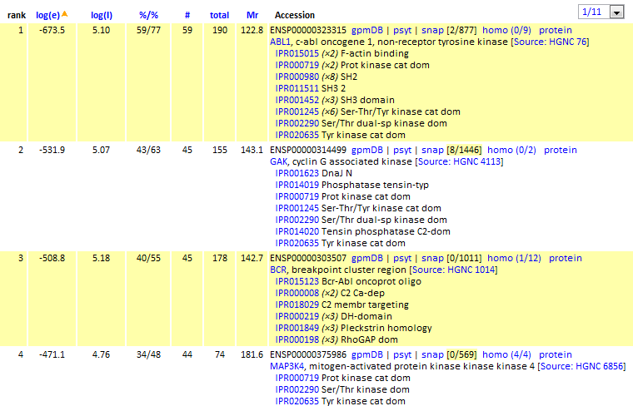
Proteomics Informatics –
Protein identification I: searching protein sequence collections and significance testing (Week 4)

Slide 17
Proteomics Informatics –
Protein identification II:
de novo sequencing (Week 5)
Amino acid masses
762
100
875
[M+2H]²⁺
% Relative Abundance
292
633
260
405
534
1022
389
504
907
1020
663
778
1080
0
250
500
750
1000
m/z
Mass Differences
Sequences
consistent
with spectrum

Slide 18
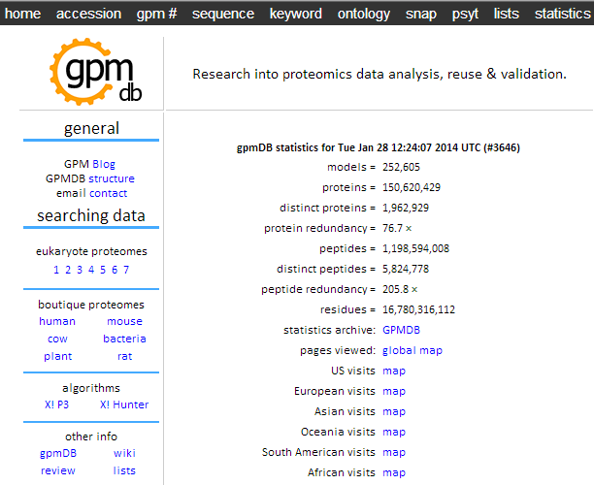
Proteomics Informatics –
Databases, data repositories and standardization (Week 6)

Slide 19
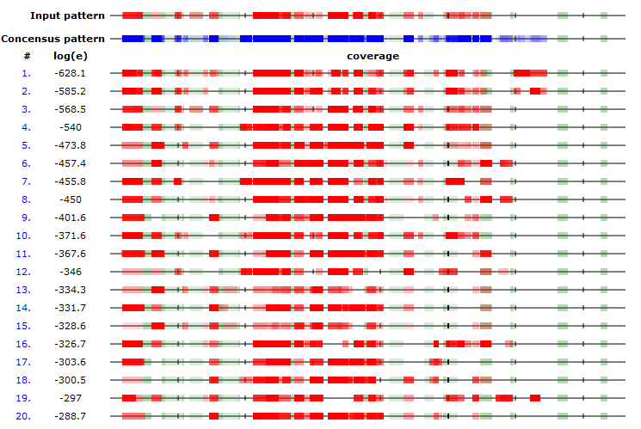
Proteomics Informatics –
Databases, data repositories and standardization (Week 6)
Most proteins show very reproducible peptide patterns

Slide 20
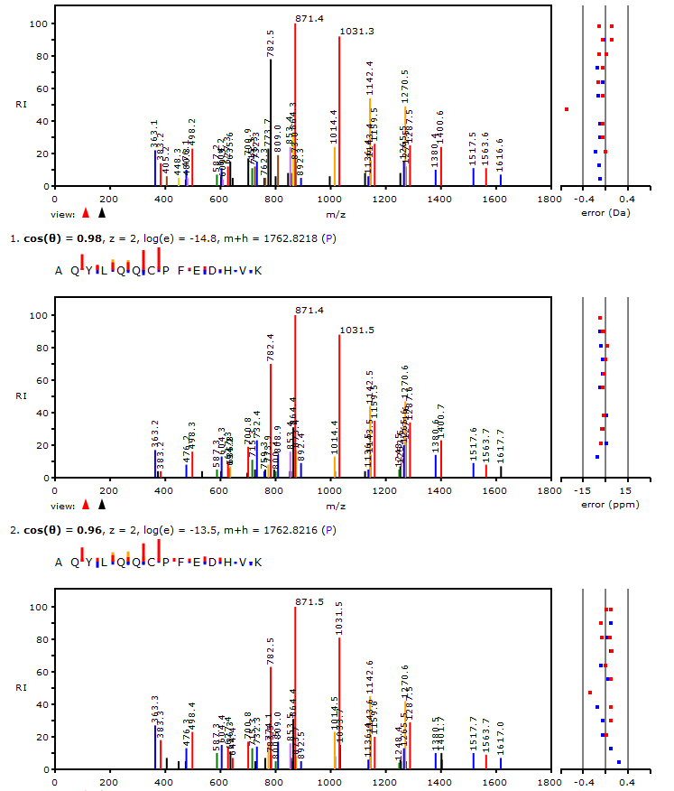
Proteomics Informatics –
Databases, data repositories and standardization (Week 6)
Query Spectrum
Best match
In GPMDB
Second
best match
In GPMDB

Slide 21
Proteomics Informatics –
Proteogenomics (Week 7)
Non-Tumor Sample
Genome sequencing
Identify germline variants
Genome sequencing
RNA-Seq
Identify alternative splicing,
somatic variants and
novel expression
Tumor Sample
Alt. Splicing
Novel Expression
Tumor Specific
Protein DB
Exon 1
Exon 2
Exon 3
Exon 1
Exon X
Exon 2
Reference Human Database (Ensembl)
Fusion Genes
Variants
TCGAGAGCTG
TCGAGAGCTG
TCGAGAGCTG
TCGAGAGCTG
TCGAGAGCTG
TCGATAGCTG
Gene X
Exon 1
Gene X
Exon 2
Gene Y
Exon 1
Gene Y
Exon 2
Exon 1
Gene X
Gene Y
Kelly Ruggles

Slide 22
Proteomics Informatics –
Protein quantitation I: Overview (Week 8)

Slide 23
Proteomics Informatics –
Protein quantitation I: Overview (Week 8)

Slide 24
Proteomics Informatics –
Protein quantitation II: Targeted (Week 9)
Shotgun proteomics
LC-MS
Targeted MS
1. Records M/Z
1. Select precursor ion
MS
MS
Digestion
2. Selects peptides based on abundance and fragments
Fractionation
2. Precursor fragmentation
MS/MS
MS/MS
Lysis
3. Protein database search for peptide identification
3. Use Precursor-Fragment pairs for identification
Data Dependent Acquisition (DDA)
Uses predefined set of peptides

Slide 25
Proteomics Informatics –
Protein characterization I: post-translational modifications (Week 10)
Peptide with two possible modification sites
Matching
MS/MS spectrum
Intensity
m/z
Which assignment does
the data support?
1, 1 or 2, or 1 and 2?

Slide 26
Proteomics Informatics –
Protein Characterization II: protein interactions (Week 11)
E
A
F
D
A
C
B
Digestion
Mass spectrometry
Identification

Slide 27
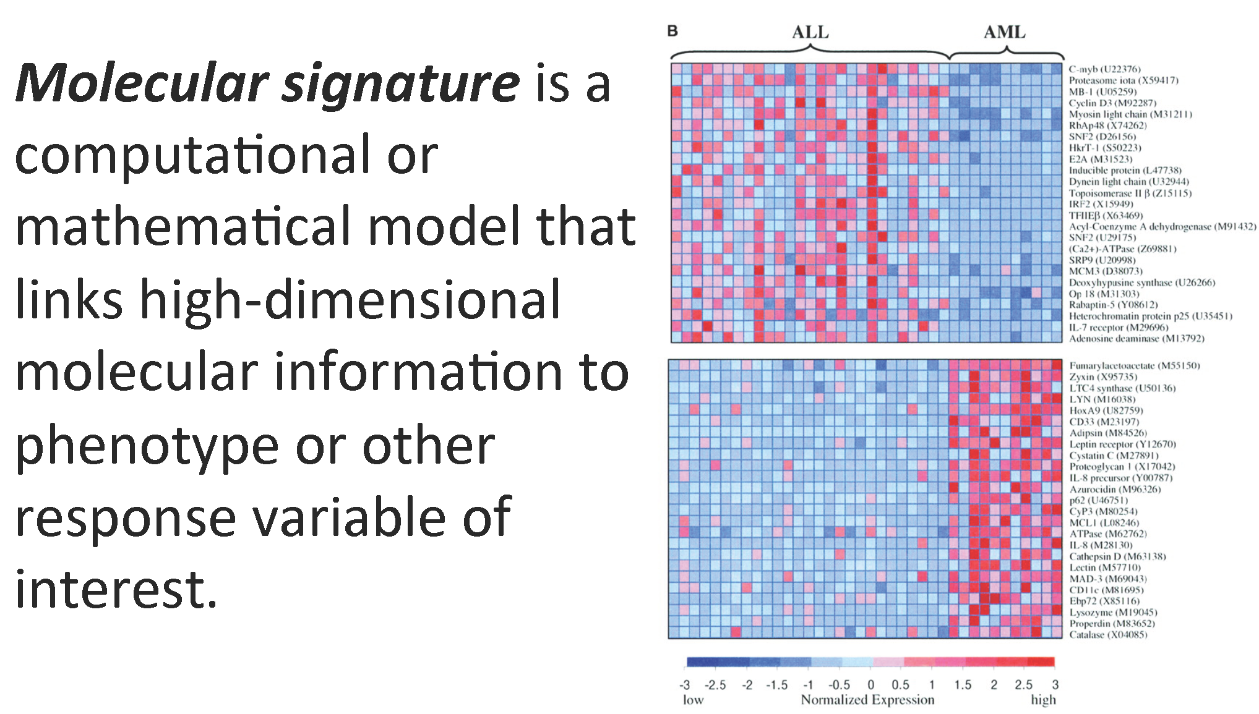
Proteomics Informatics –
Molecular Signatures (Week 12)

Slide 28
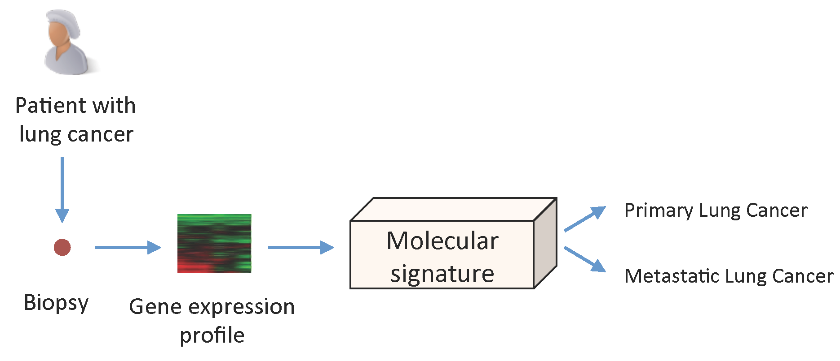
Proteomics Informatics –
Molecular Signatures (Week 12)

Slide 29
Proteomics Informatics –
Presentations of projects (Week 13)
Select a published data set that has been made public and reanalyze it.
Highlighted data sets: http://www.thegpm.org/
10 min presentations

Slide 30
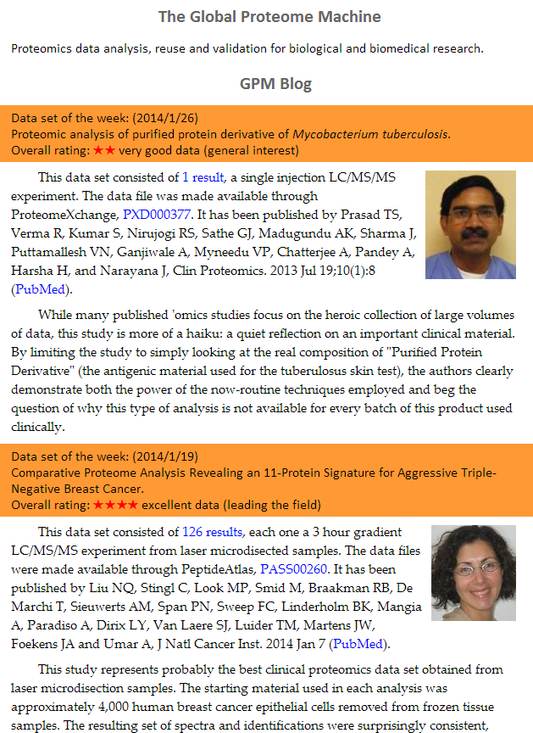

Slide 31
Proteomics Informatics (BMSC-GA 4437)
Course Director
David Fenyö
Contact information
David@FenyoLab.org
http://fenyolab.org/presentations/Proteomics_Informatics_2014/

