Slide 1
Proteomics Informatics –
Overview of Mass spectrometry (Week 2)
Ion Source
Mass Analyzer
Detector
intensity
mass/charge

Slide 2
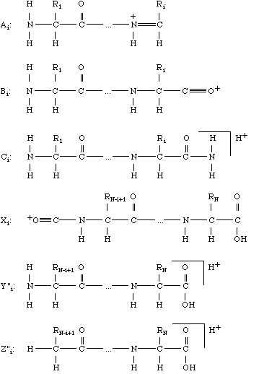
Peptide Fragmentation
Ion Source
Mass Analyzer 1
Frag-mentation
Mass Analyzer 2
Detector
b
y

Slide 3
Liquid Chromatography (LC)-MS/MS
LC
Ion Source
Mass Analyzer 1
Frag-mentation
Mass Analyzer 2
Detector
intensity
intensity
intensity
intensity
intensity
intensity
intensity
intensity
intensity
intensity
intensity
intensity
intensity
intensity
intensity
mass/charge
mass/charge
mass/charge
mass/charge
mass/charge
mass/charge
mass/charge
mass/charge
mass/charge
mass/charge
mass/charge
mass/charge
mass/charge
mass/charge
mass/charge
Time

Slide 4
Ion Sources
Ion Source
Mass Analyzer
Detector
MALDI
ESI
intensity
mass/charge

Slide 5
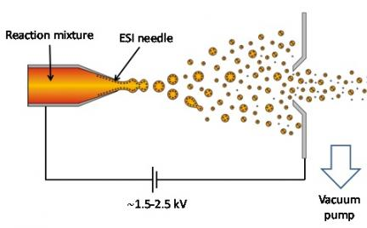
Electrospray
Mass Analyzer
Detector

Slide 6
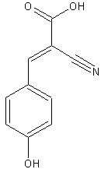
Matrix Assisted Laser Desorption Ionization (MALDI)
Mass Analyzer
Detector
Laser
Matrix
alpha-cyano-4-hydroxycinnamic acid

Slide 7
Detectors
Ion Source
Mass Analyzer
Detector
Electron Multiplier
Image Current
intensity
mass/charge

Slide 8
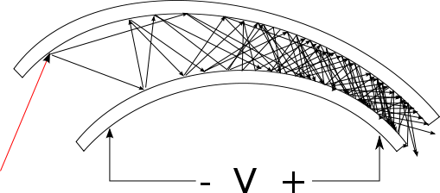
Electron Multiplier Detector

Slide 9
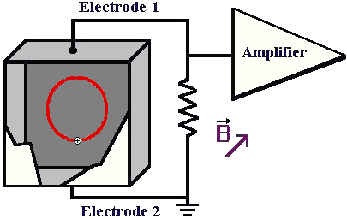
Image Current Detector

Slide 10
Mass Analyzers
Ion Source
Mass Analyzer
Detector
Time-of-Flight
Magnetic Sector
Quadrupole
Ion Trap (3D, linear)
FTICR
Orbitrap
intensity
mass/charge

Slide 11
Mass Spectrometry (MS)

Slide 12
Time-of-Flight Mass Spectrometry
Ion Source
Mass Analyzer
Detector
Time-of-Flight
Detector
Ion mirror
Detector

Slide 13
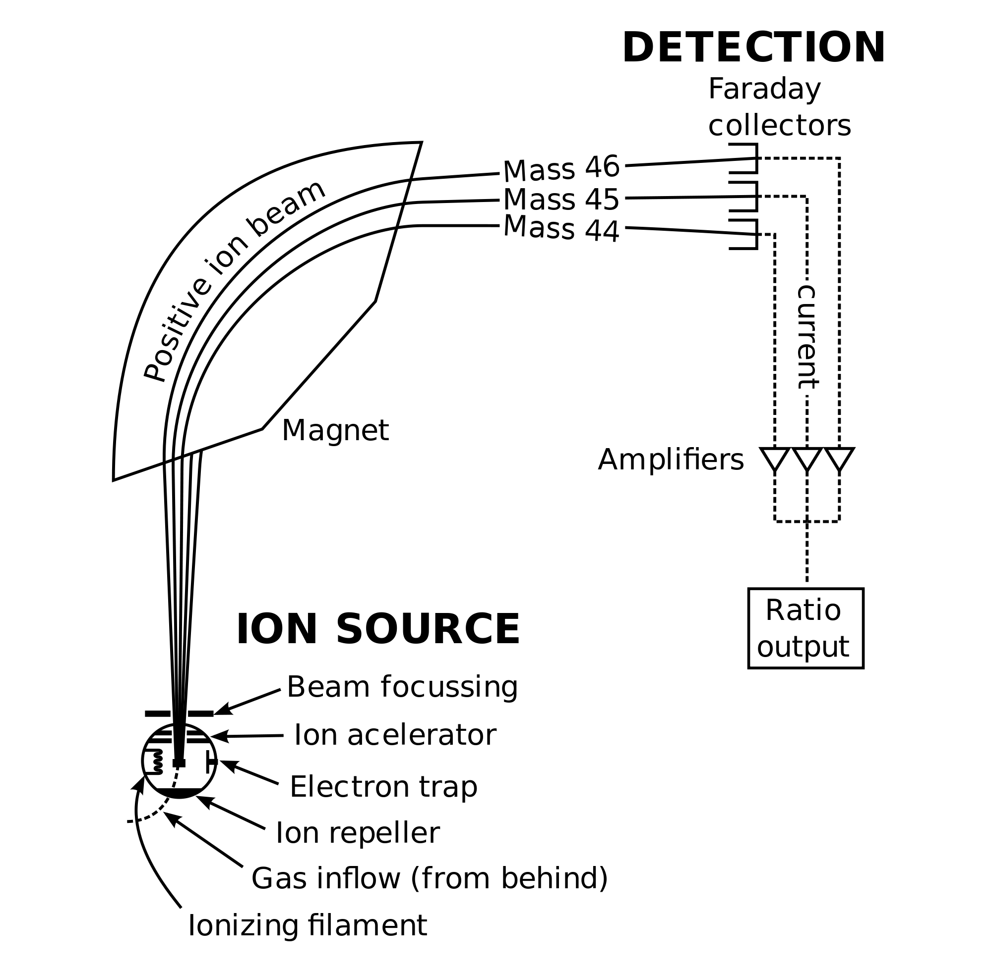
Magnetic Sector

Slide 14
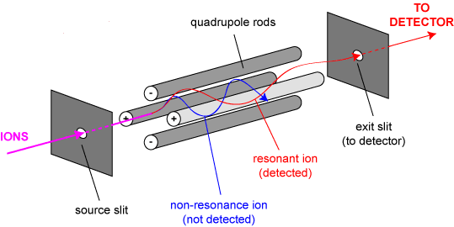
Quadrupole Mass Filter
y
x

Slide 15
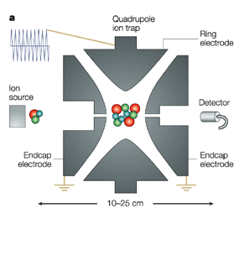
Ion Trap

Slide 16
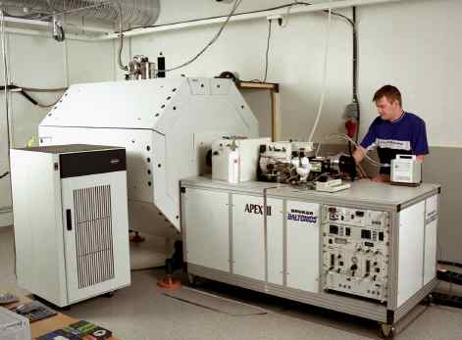
Fourier transform ion cyclotron resonance

Slide 17
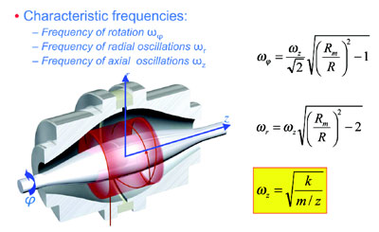
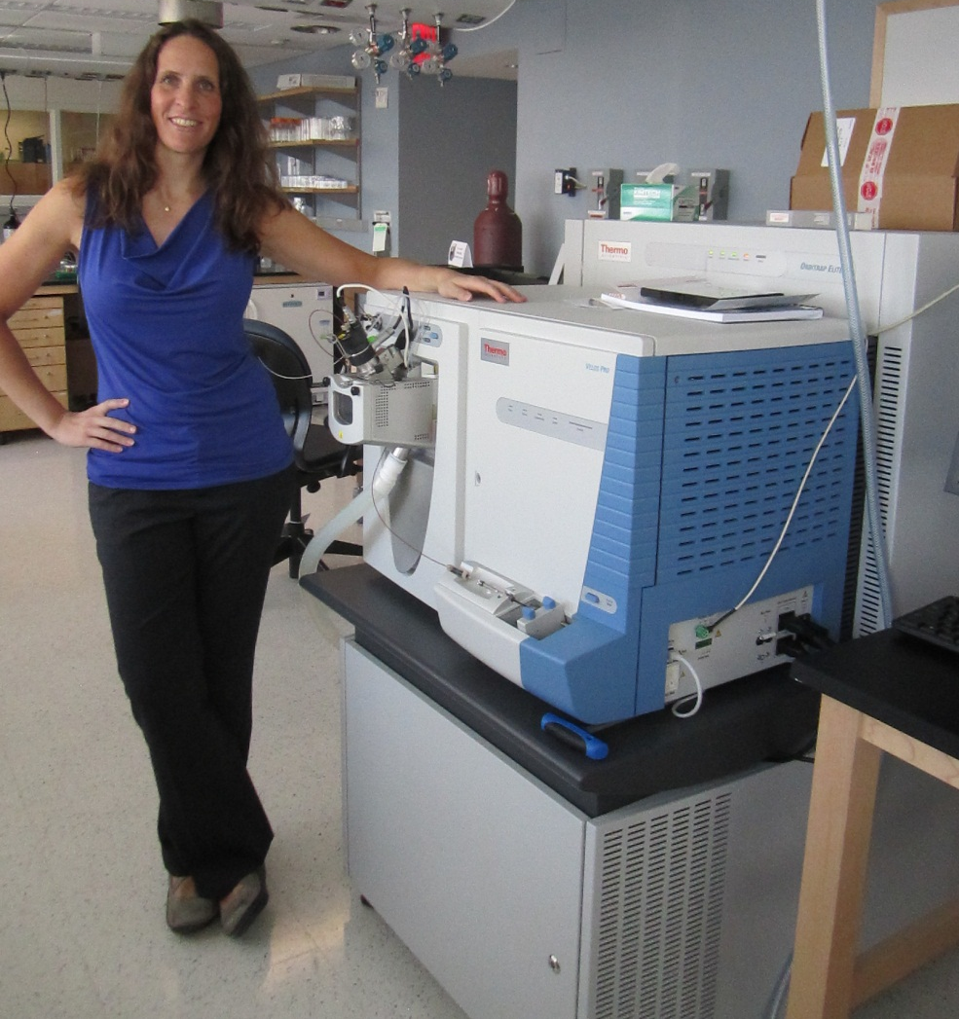
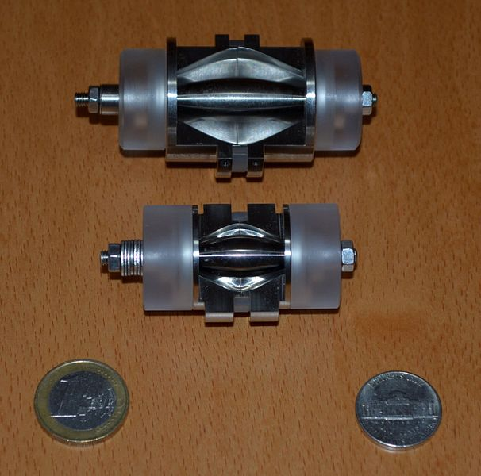
Orbitrap

Slide 18
Quadrupole Time-of-Flight Mass Spectrometer
Ion Source
Detector
CAD – Collision
Activated
Dissociation
Mass Analyzer 1
Frag-mentation
Mass Analyzer 2
Quadrupole
Time-of-Flight
Video

Slide 19
Triple Quadrupole
Ion Source
Detector
CAD – Collision
Activated
Dissociation
Mass Analyzer 1
Frag-mentation
Mass Analyzer 2
Quadrupole
Quadrupole
Quadrupole
m/z
m/z
NO
m/z
time
time
intensity
time
m/z
m/z
YES
m/z
time
time
mass/charge
time
m/z
m/z
YES
m/z
time
time
time
Δm/z is constant

Slide 20
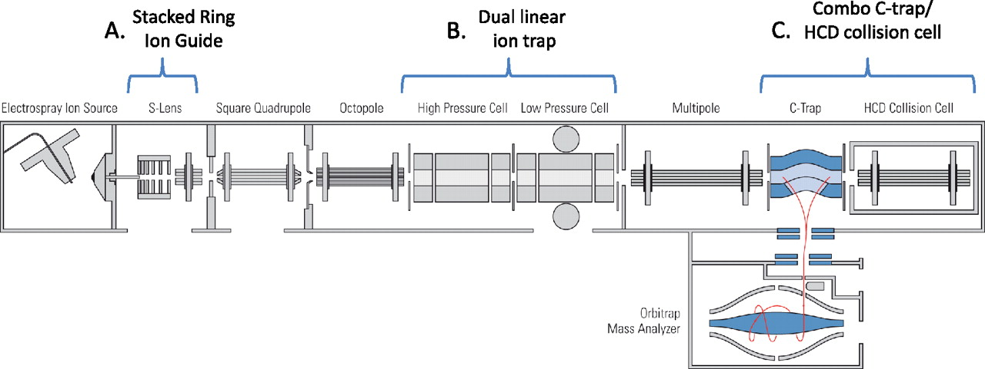
Linear Ion Trap / Orbitrap
ESI
Linear Ion Trap
HCD
Ion Source
Mass Analyzer 1
Frag-mentation
CAD
ETD
Detector
Frag-mentation
Mass Analyzer 2
Detector
Orbitrap
Olsen J V et al. Mol Cell Proteomics 2009;8:2759-2769
Video

Slide 21
Data Independent Acquisistion
1. MS
2. MS/MS 1
3. MS/MS 2
4. MS/MS 3
intensity
5. MS
6. MS/MS 1
7. MS/MS 2
8. MS/MS 3
mass/charge
intensity
9. MS
10. MS/MS 1
11. MS/MS 2
12. MS/MS 3
mass/charge
intensity
13. MS
14. MS/MS 1
15. MS/MS 2
16. MS/MS 3
mass/charge
intensity
17. MS
18. MS/MS 1
19. MS/MS 2
20. MS/MS 3
mass/charge
intensity
21. MS
22. MS/MS 1
23. MS/MS 2
24. MS/MS 3
…
mass/charge
intensity
mass/charge

Slide 22
Data Dependent Acquisistion
12. MS
13. MS/MS 1
14. MS/MS 2
15. MS/MS 3
16. MS/MS 4
17. MS/MS 5
18. MS/MS 6
19. MS/MS 7
20. MS/MS 8
21. MS/MS 9
22. MS/MS 10
…
MS
MS/MS 1
MS/MS 2
MS/MS 3
MS/MS 4
MS/MS 5
MS/MS 6
MS/MS 7
MS/MS 8
MS/MS 9
MS/MS 10
intensity
mass/charge
intensity
mass/charge

Slide 23
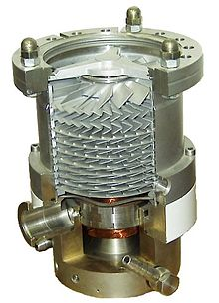
Vacuum System
Vacuum System
Ion Source
Mass Analyzer
Detector
Atmosphere

Slide 24
Mass Spectrometry Data
Ion Source
Mass Analyzer
Detector
intensity
mass/charge

Slide 25
Mass Spectrometry Data
Dimensions:
Time
Peptide m/z
Peptide Intensity
Petide fragment m/z
Peptide fragment intensity
...

Slide 26
Example data – MALDI-TOF
Peptide intensity vs m/z

Slide 27
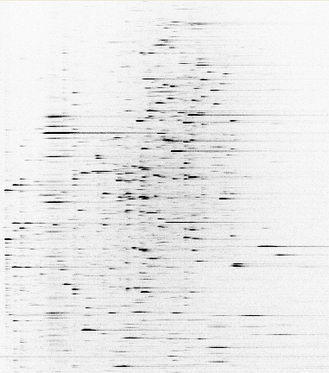
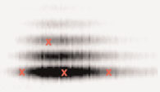
Example data – ESI-LC-MS/MS
Peptide intensity vs m/z vs time
m/z
762
MS/MS
100
875
[M+2H]²⁺
% Relative Abundance
292
633
260
405
534
1022
389
504
907
1020
663
778
1080
0
250
500
750
1000
m/z
Fragment intensity vs m/z
Time

Slide 28
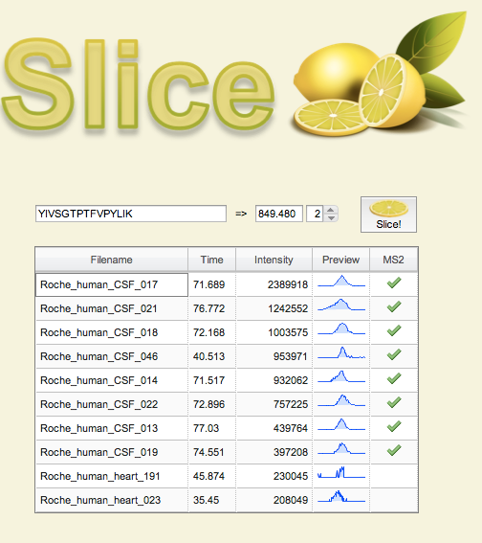
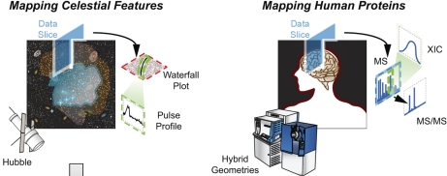
Slice - Scalable Data Sharing for
Remote Mass Informatics
Developed by Manor Askenazi
slice.ionomix.com
Most mass spectrometry data is acquired in discovery mode, meaning that the data is amenable to open-ended analysis as our understanding of the target biochemistry increases. In this sense, mass spectrometry based discovery work is more akin to an astronomical survey, where the full list of object-types being imaged has not yet been fully elucidated, as opposed to e.g. micro-array work, where the list of probes spotted onto the slide is finite and well understood.

Slide 29
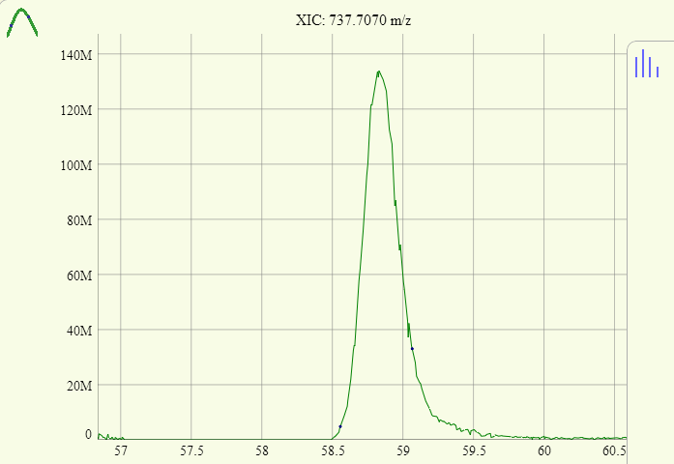
Example Mass Spectrometry Data
Peptide intensity vs time
For 737.707 m/z which corresponds to 3+ of LGEHNIDVLEGNEQFINAAK

Slide 30
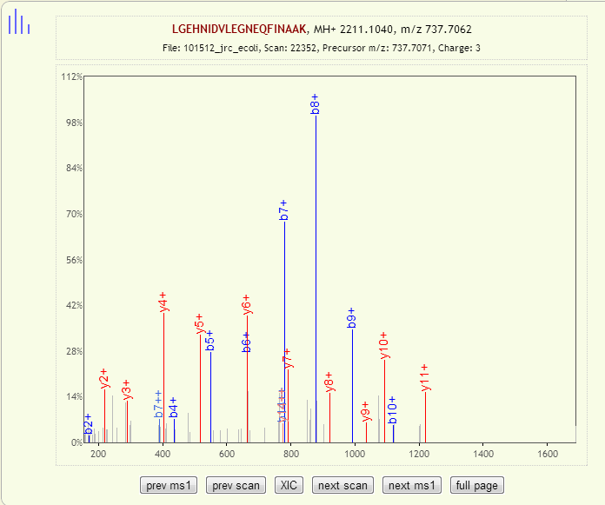

Example Mass Spectrometry Data
Fragment intensity vs m/z
For 3+ of LGEHNIDVLEGNEQFINAAK

Slide 31
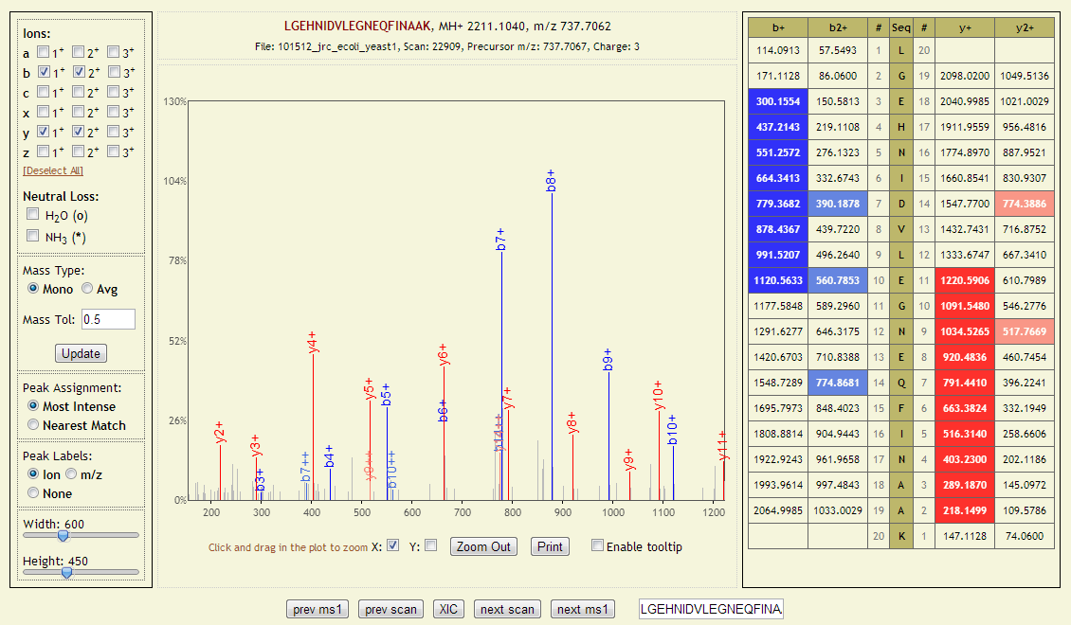
Example Mass Spectrometry Data
Fragment intensity vs m/z
For 3+ of LGEHNIDVLEGNEQFINAAK

Slide 32
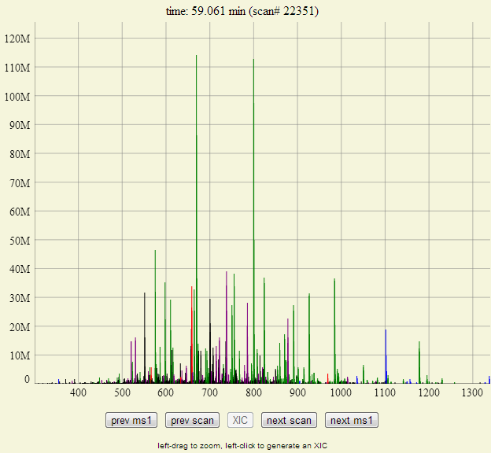
Example Mass Spectrometry Data
3+ of LGEHNIDVLEGNEQFINAAK
Peptide intensity vs m/z

Slide 33
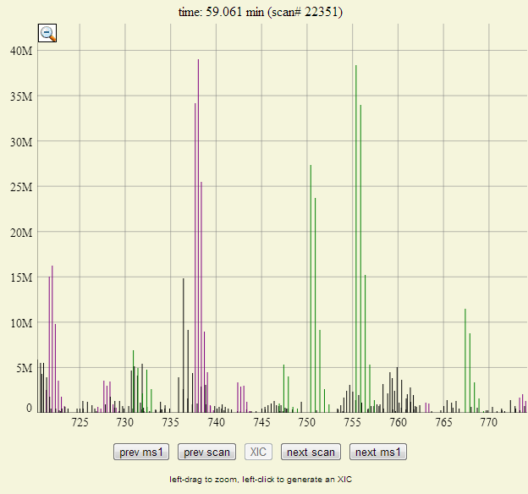
Example Mass Spectrometry Data
3+ of LGEHNIDVLEGNEQFINAAK
Peptide intensity vs m/z

Slide 34
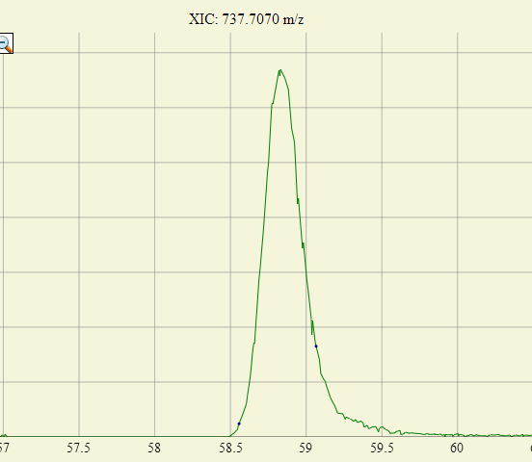
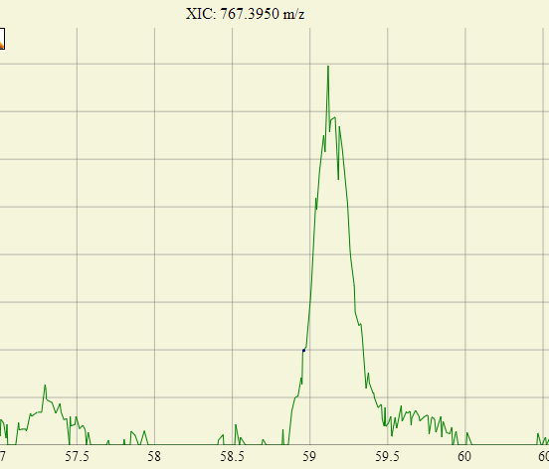
Example Mass Spectrometry Data
Peptide intensity vs m/z
Peptide intensity vs time

Slide 35
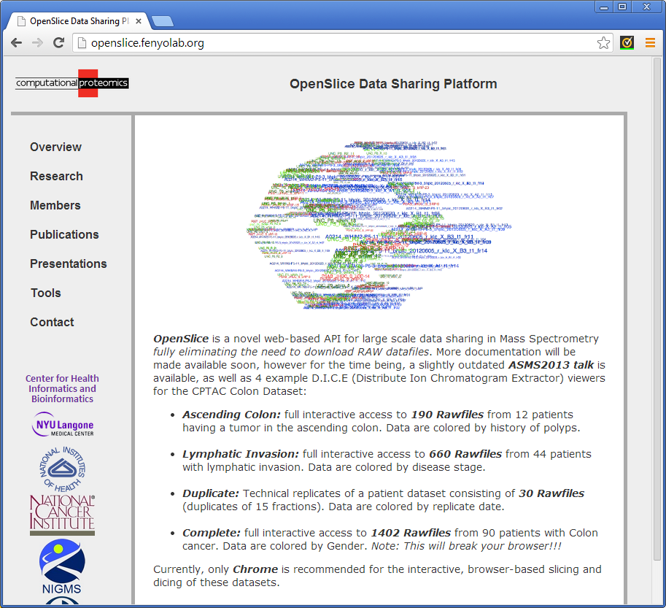
Openslice.fenyolab.org

Slide 36
Proteomics Informatics –
Overview of Mass spectrometry (Week 2)
Ion Source
Mass Analyzer
Detector
intensity
mass/charge

