Slide 1
Proteomics Informatics –
Analysis of mass spectra: signal processing, peak finding, and isotope clusters (Week 3)

Slide 2
Charge-State Distributions
MALDI
ESI
1+
2+
Peptide
intensity
intensity
3+
2+
4+
1+
mass/charge
mass/charge
M - molecular mass
n - number of charges
H – mass of a proton
MALDI
ESI
2+
3+
1+
27+
Protein
31+
intensity
4+
intensity
5+
mass/charge
mass/charge

Slide 3
Charge-State
M - molecular mass
n - number of charges
H – mass of a proton
Example:
peptide of mass 898 carrying 1 H⁺ = (898 + 1) / 1 = 899 m/z
carrying 2 H⁺ = (898 + 2) / 2 = 450 m/z
carrying 3 H⁺ = (898 + 3) / 3 = 300.3 m/z

Slide 4
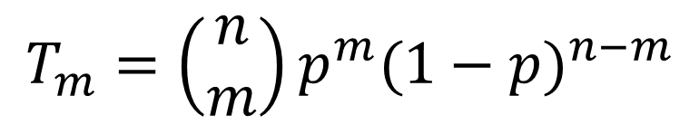
Isotope Distributions
¹²C
¹⁴N
¹⁶O
¹H
³²S
Intensity
+1Da
+2Da
+3Da
m/z
m/z
m/z
0.015% ²H
1.11% ¹³C
0.366% ¹⁵N
0.038% ¹⁷O, 0.200% ¹⁸O,
0.75% ³³S, 4.21% ³⁴S, 0.02% ³⁶S
Only ¹²C and ¹³C:
p=0.0111
n is the number of C in the peptide
m is the number of ¹³C in the peptide
T_{m} is the relative intensity of
the peptide m ¹³C
$$T_{m}=\left(\begin{matrix}n \\ m\end{matrix}\right)p^{m}{(1−p)}^{n−m}$$

Slide 5
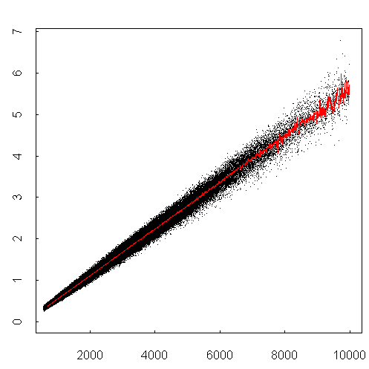
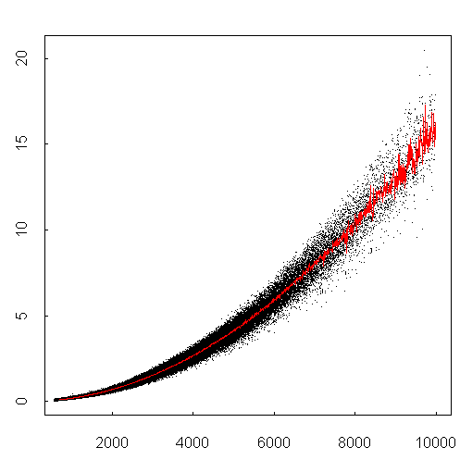
Isotope distributions
Intensity ratio
Intensity ratio
Peptide mass
Peptide mass
GFP 29kDa
monoisotopic
mass
m/z

Slide 6
Resolution
M
R =
= resolving power
ΔM
Resolution = minimum peak separation, ΔM,
which allows to distinguish two ion species
ΔM = full width at half maximum (FWHM)
500
Relative Intensity
50 %
I
I
I
I
I
499.5
500.0
500.5
501.5
502.0
m/z
Resolution = M/ΔM = 500/0.5 = 1000

Slide 7
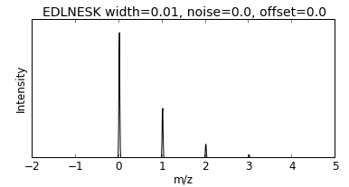
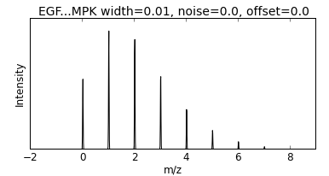
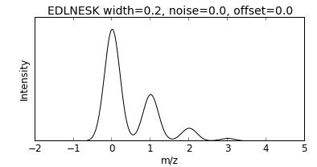
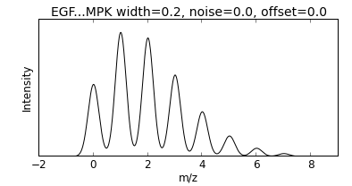
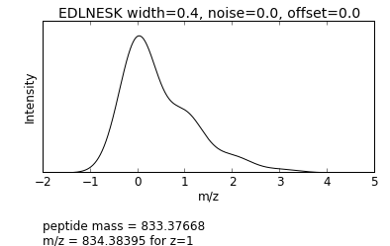
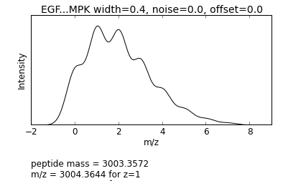
Resolution

Slide 8
Resolution
M
R =
= resolving power
ΔM
What resolution do we need to differentiate a 1600 Da peptide that carries either an acetylation (+ 42.0100) or trimethylation (42.0464 )?
R = 1600/0.0364 = 43,956

Slide 9
Isotope Clusters and Charge State
1
1+
Intensity
1
1
m/z
0.5
2+
Intensity
0.5
0.5
m/z
0.33
3+
Intensity
0.33
0.33
m/z

Slide 10
Isotope Clusters and Charge State
Possible to
Determine Charge?
Yes
Yes
Maybe
No
Intensity
m/z

Slide 11
What is the Charge State?
713.3225
432.8990
713.8239
433.2330
714.3251
433.5671
714.8263
433.9014
between the isotopes is 0.5 Da
between the isotopes is 0.33 Da

Slide 12
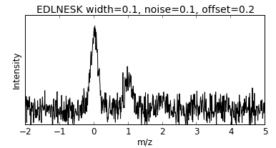
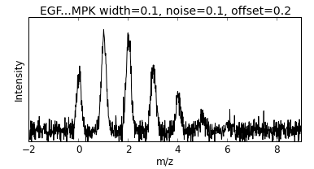
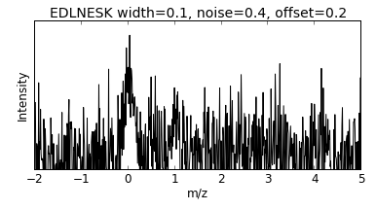
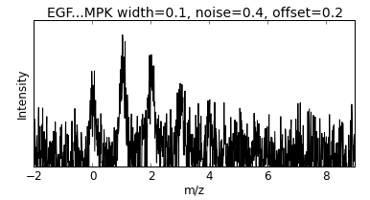
Noise

Slide 13
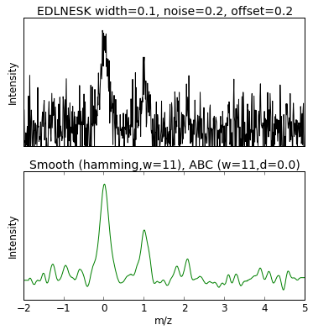
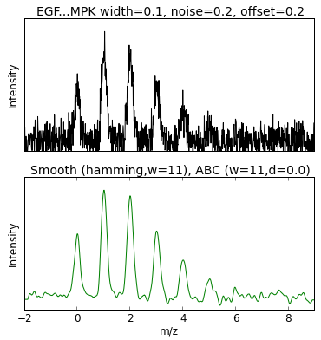
Smoothing

Slide 14
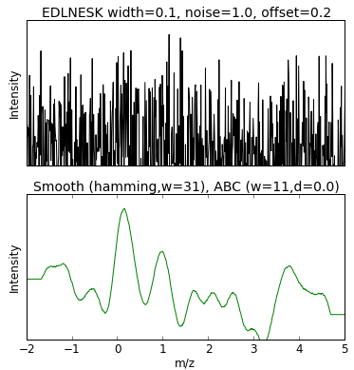
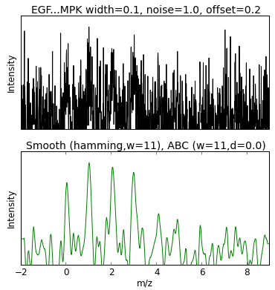
Smoothing

Slide 15

Adaptive Background Correction (Unsharp masking)
Original
Unsharp masking

Slide 16
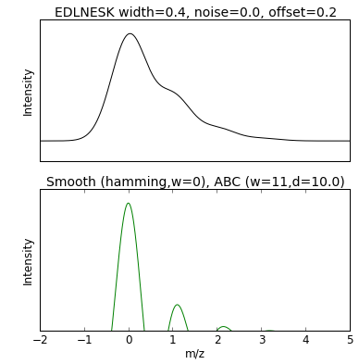
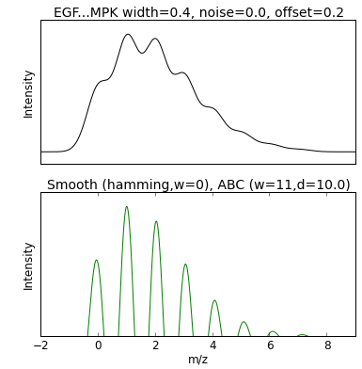
Adaptive Background Correction

Slide 17
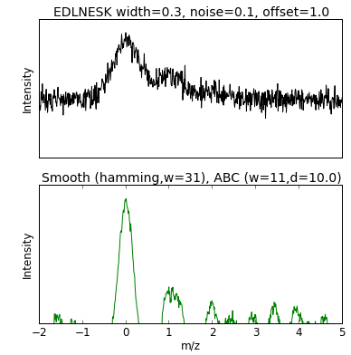
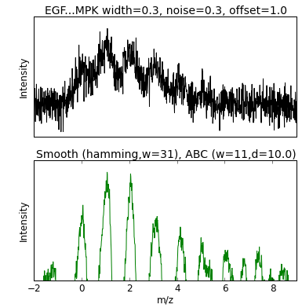
Smoothing and Adaptive Background Correction

Slide 18
Peak Finding
Intensity
Find maxima of
m/z
The centroid m/z of a peak

Slide 19
Peak Finding
Intensity
The signal in a peak can be
estimated with the RMSD
m/z
and the signal-to-noise ratio of a peak
can be estimated by dividing the signal
with the RMSD of the background

Slide 20
Estimating peptide quantity
Peak height
Peak height
Curve fitting
Curve fitting
Intensity
Peak area
m/z

Slide 21
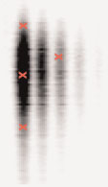
Time dimension
Intensity
m/z
Time
Time
m/z

Slide 22
Sampling
Intensity
Retention Time

Slide 23
Sampling
5%
5%
Acquisition time = 0.05σ

Slide 24
Sampling

Slide 25
What is the best way to estimate quantity?
Peak height - resistant to interference
- poor statistics
Peak area - better statistics
- more sensitive to interference
Curve fitting - better statistics
- needs to know the peak shape
- slow

Slide 26
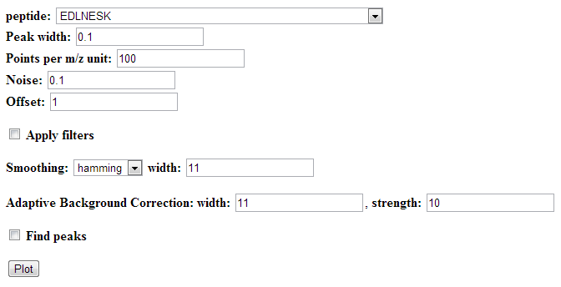
Web Tool
http://10.193.36.101/plot-filter-cgi/plot_filter.pl or
http://10.193.36.219/plot-filter-cgi/plot_filter.pl

Slide 27
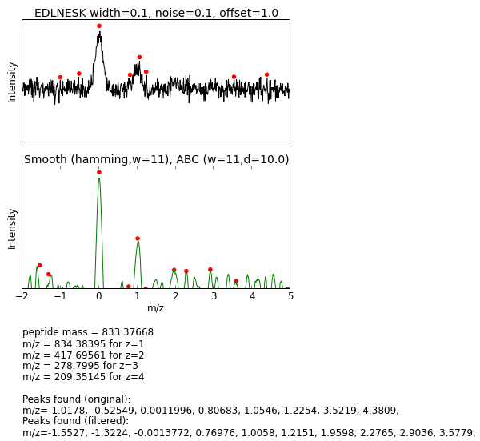
Web Tool
http://10.193.36.101/plot-filter-cgi/plot_filter.pl or
http://10.193.36.219/plot-filter-cgi/plot_filter.pl

Slide 28
Proteomics Informatics –
Analysis of mass spectra: signal processing, peak finding, and isotope clusters (Week 3)

