Slide 1
Proteomics Informatics –
Protein identification I: searching protein sequence collections and significance testing (Week 4)

Slide 2
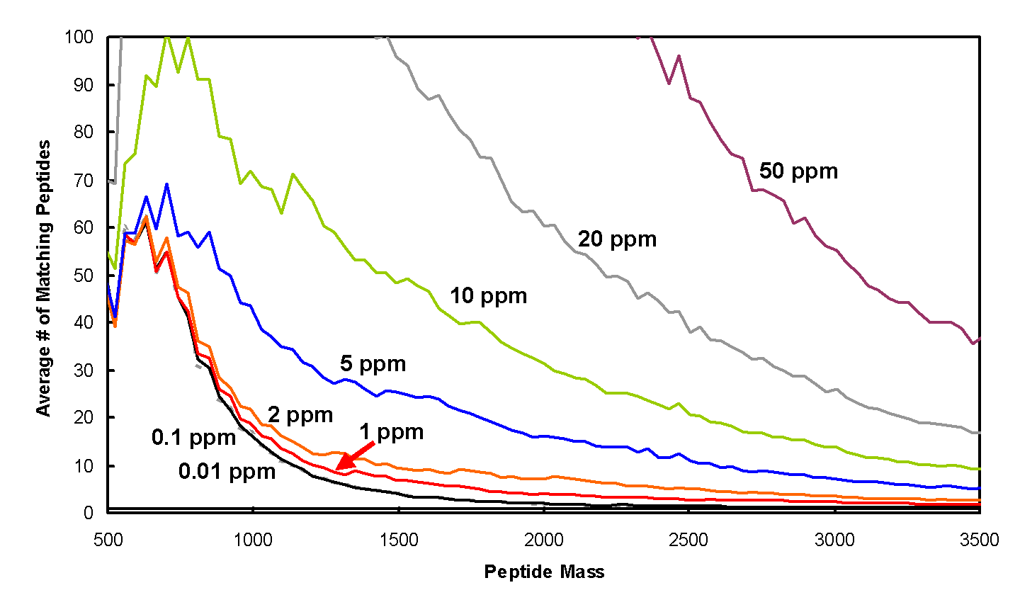
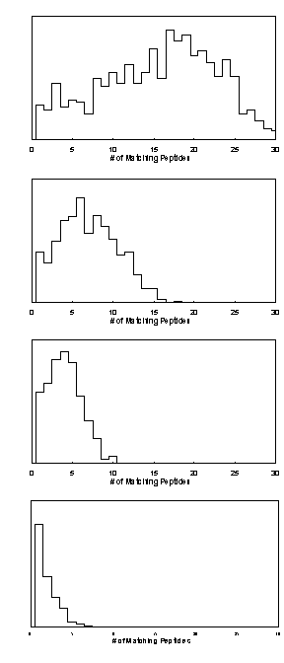
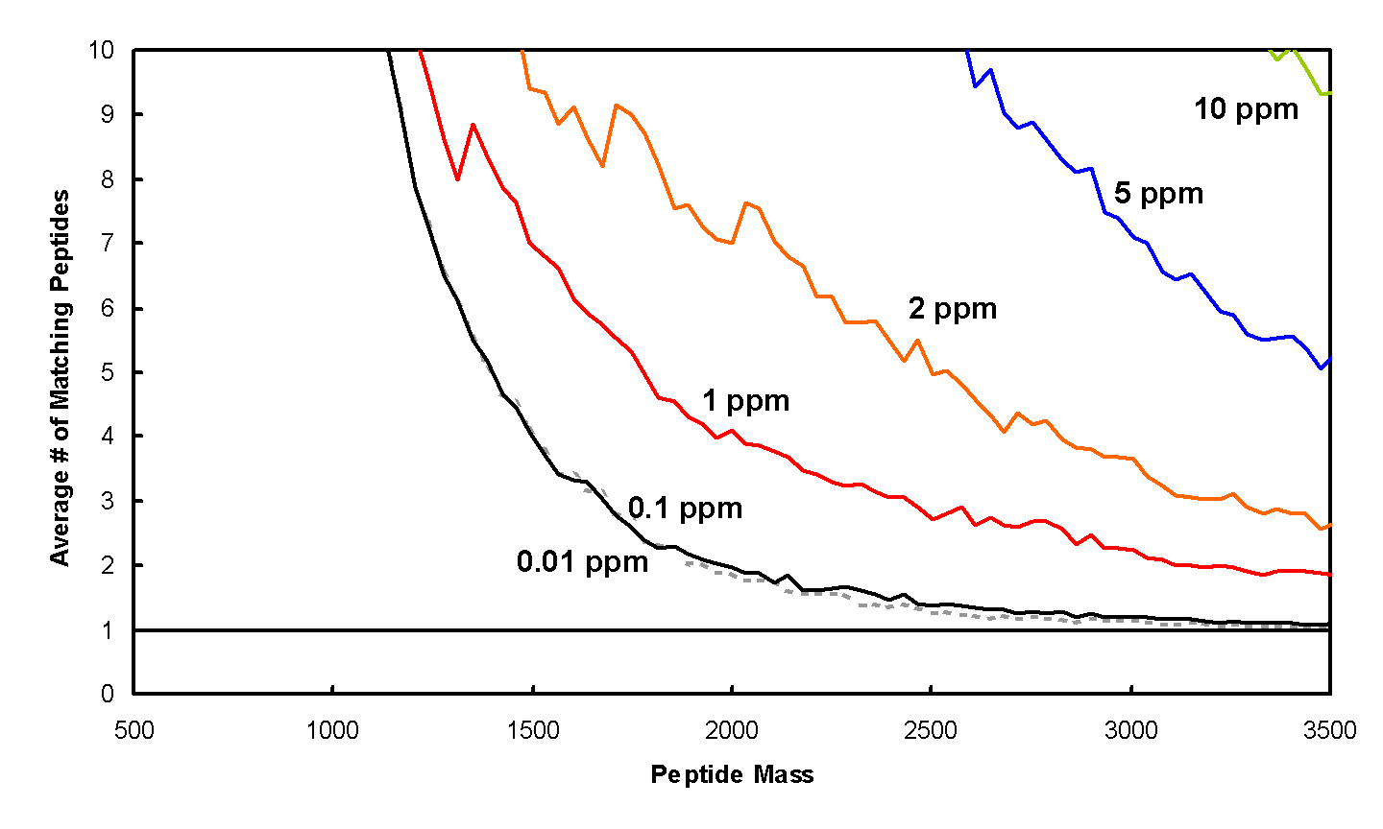
Peptide Mapping - Mass Accuracy

Slide 3
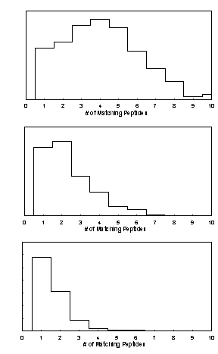
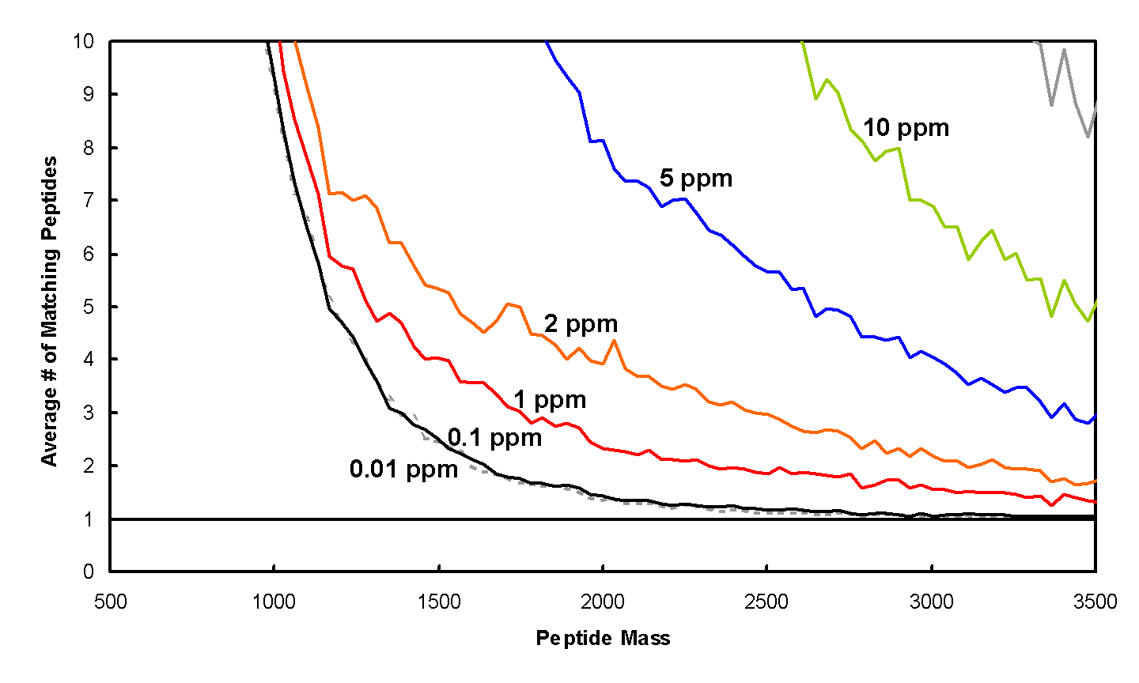
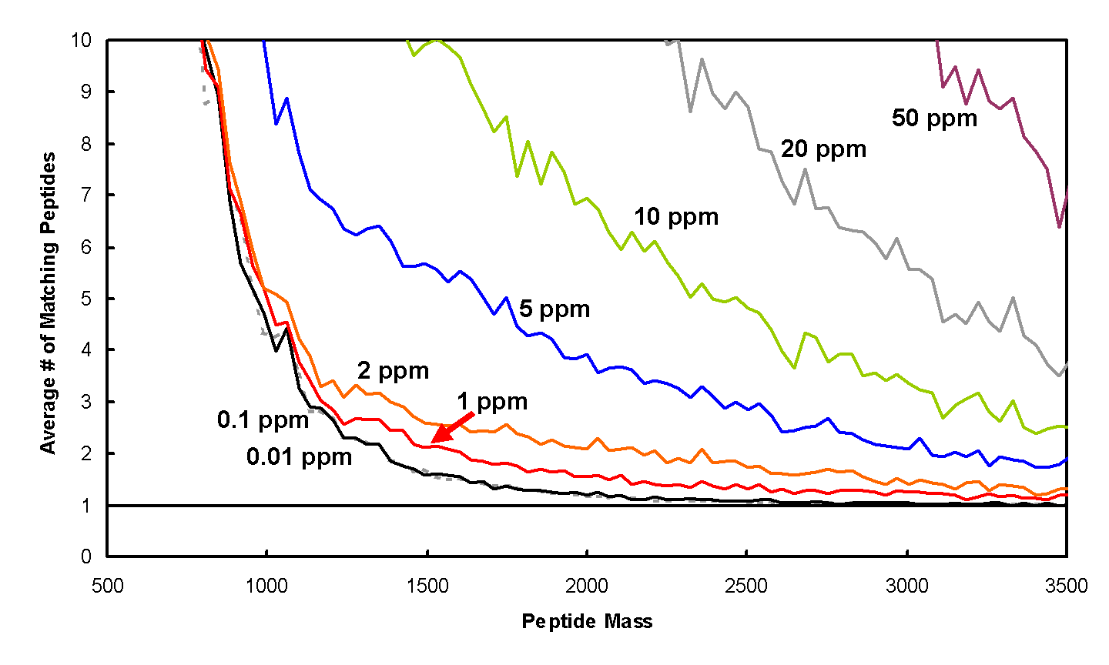
Peptide Mapping
Database Size
Human
C. elegans
S. cerevisiae

Slide 4
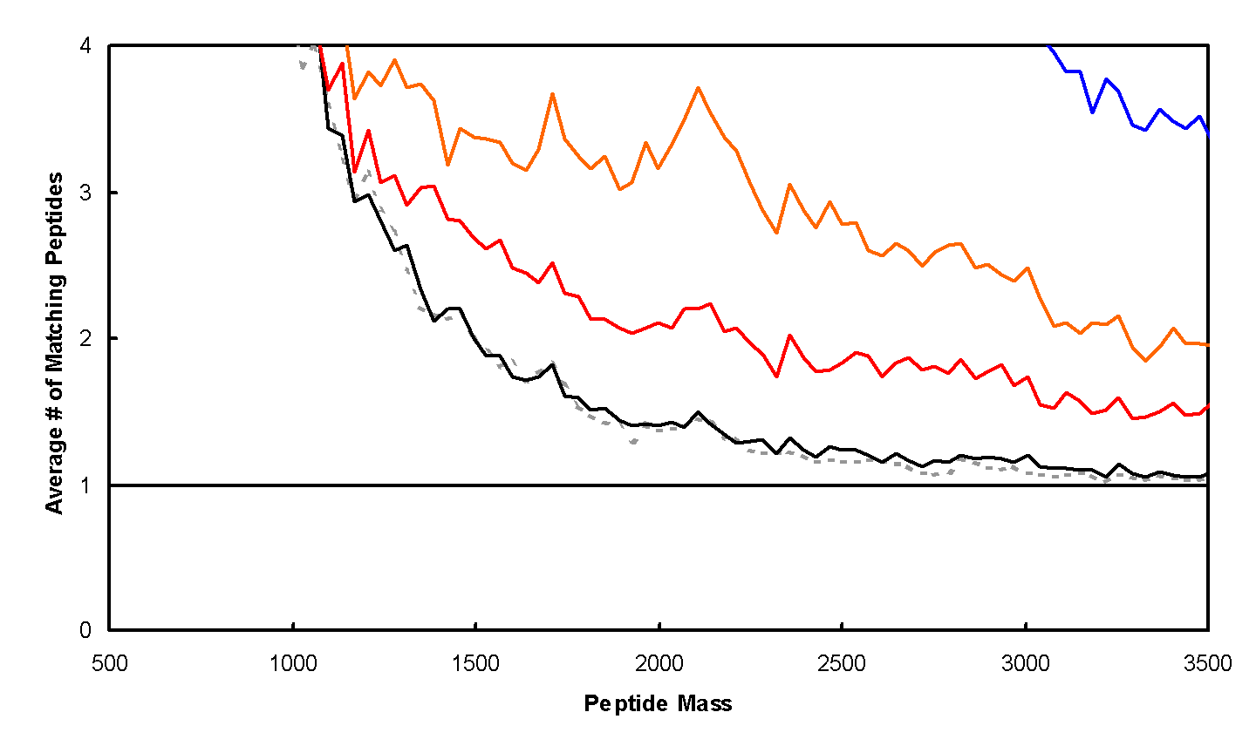
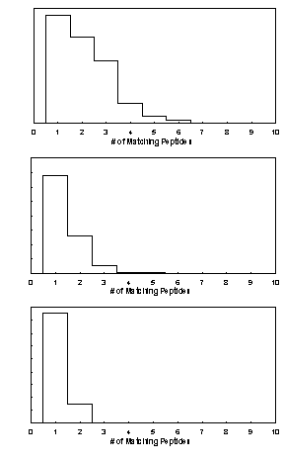
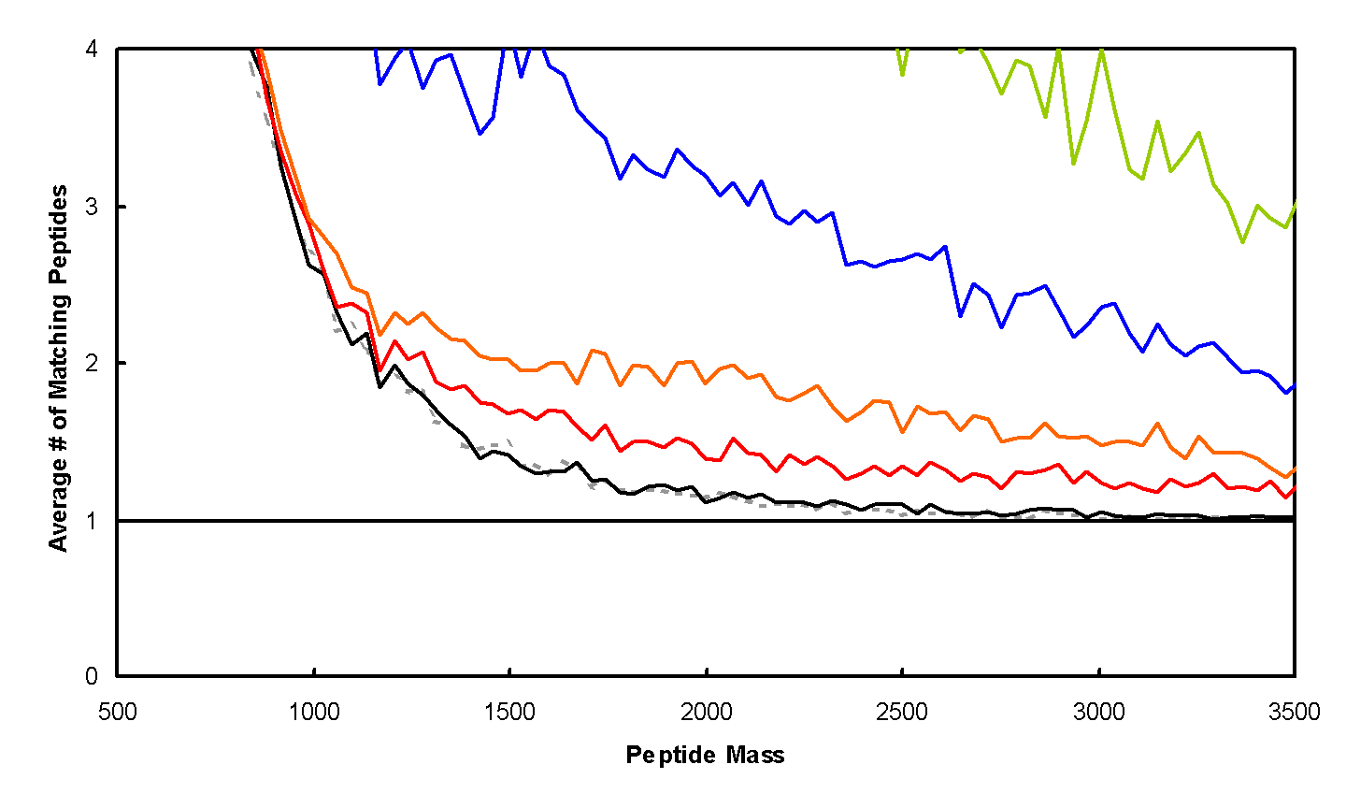
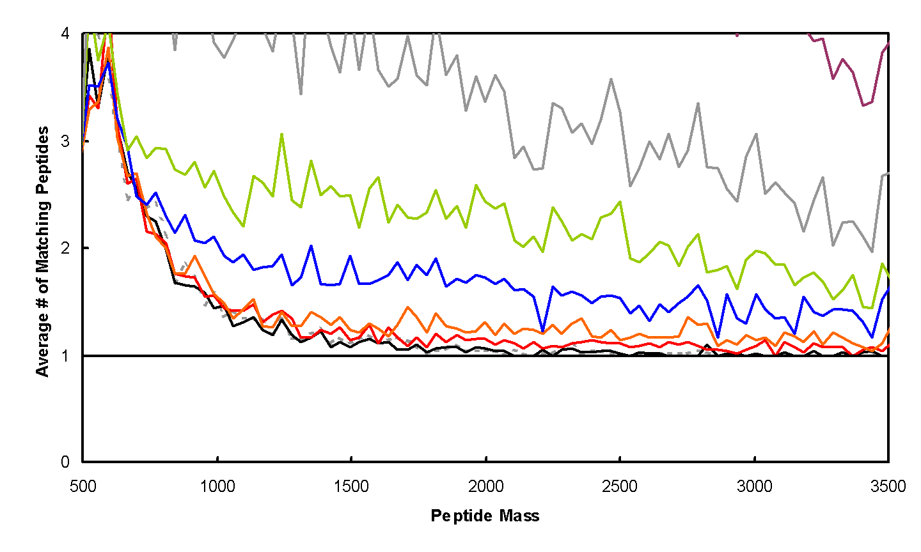
Peptide Mapping
Cys-Containing
Peptides
Human
C. elegans
S. cerevisiae

Slide 5
Identification – Peptide Mass Fingerprinting
Sequence
DB
Pick Protein
Digestion
MS
All Peptide
Masses
Repeat for each protein
MS
Compare, Score, Test Significance
Identified Proteins

Slide 6
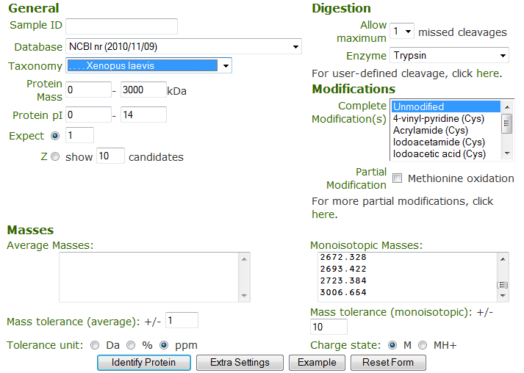
ProFound – Search Parameters
http://prowl.rockefeller.edu/

Slide 7
ProFound – Protein Identification by Peptide Mapping
W. Zhang & B.T. Chait,
Analytical Chemistry
72 (2000) 2482-2489

Slide 8
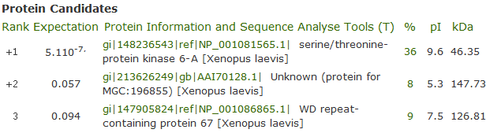
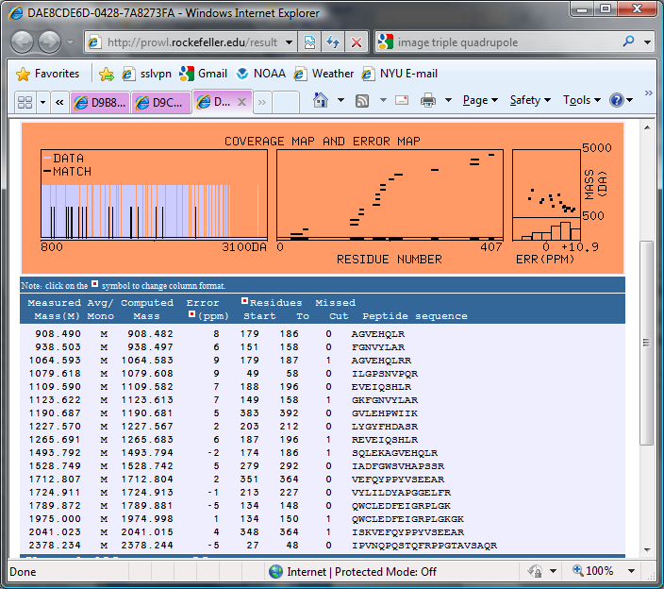
ProFound Results

Slide 9
Peptide Mapping – Mass Accuracy

Slide 10
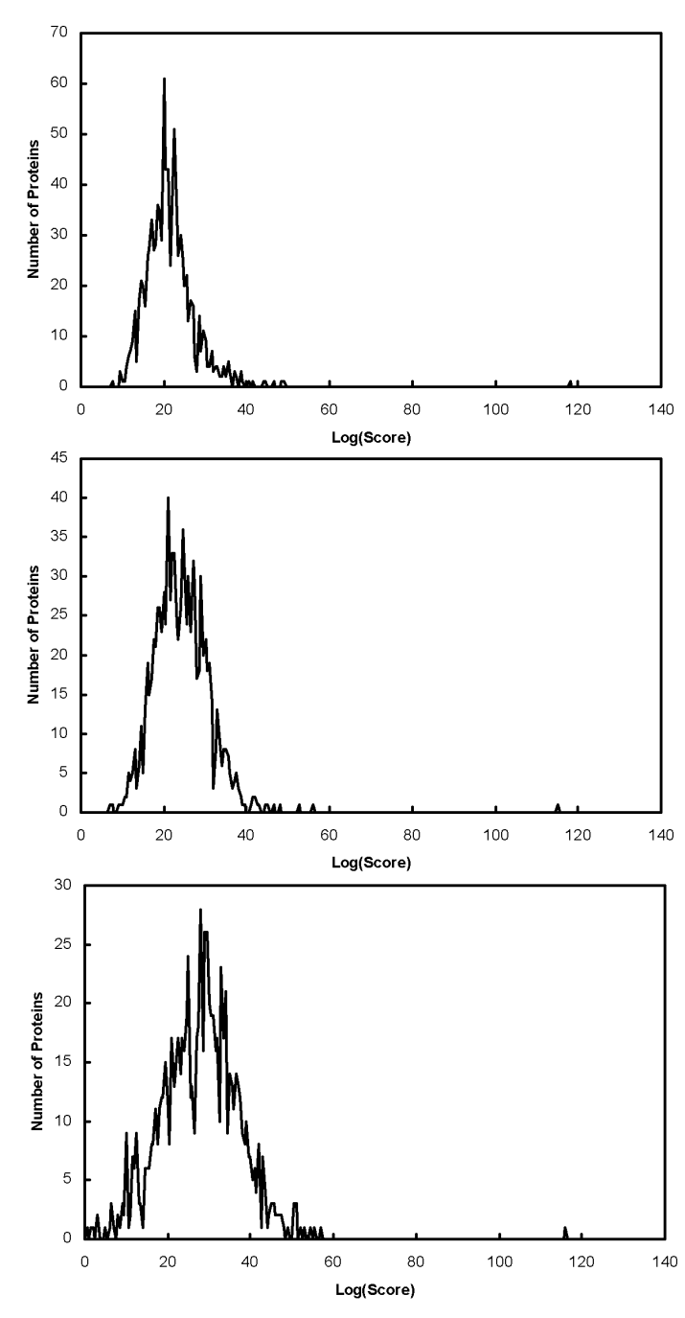
Peptide Mapping - Database Size
S. cerevisiae
Expectation Values
Peptide mapping example:
S. Cerevisiae 4.8e-7
Fungi 8.4e-6
All Taxa 2.9e-4
Fungi
All Taxa

Slide 11
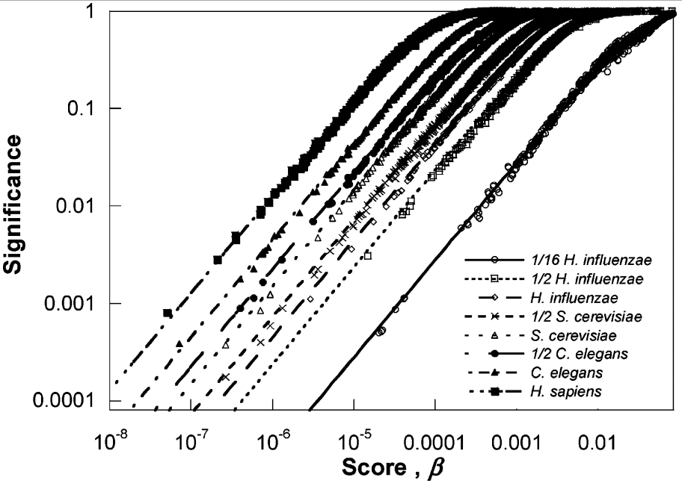
Database size

Slide 12
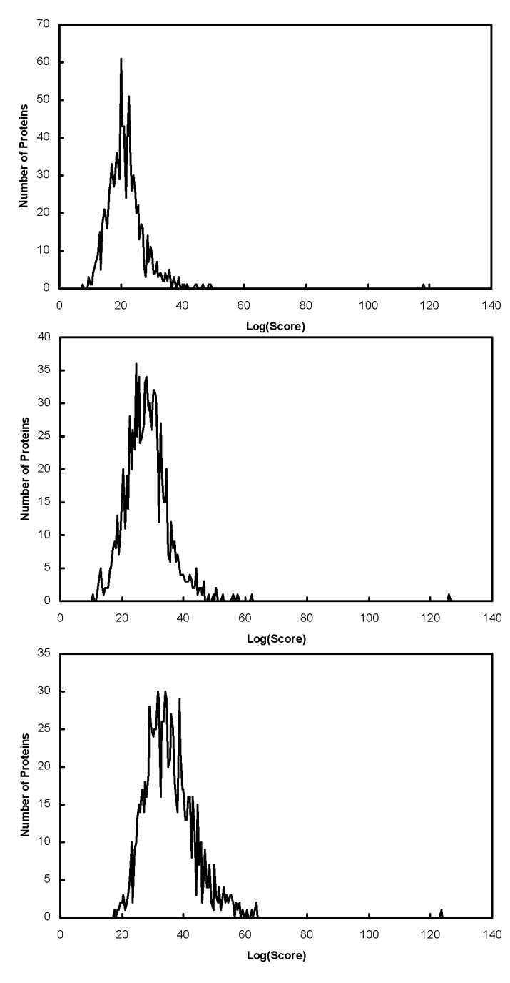
Missed Cleavage Sites
u = 1
Expectation Values
Peptide mapping example:
u=1 4.8e-7
u=2 1.1e-5
u=4 6.8e-4
u = 2
u = 4

Slide 13
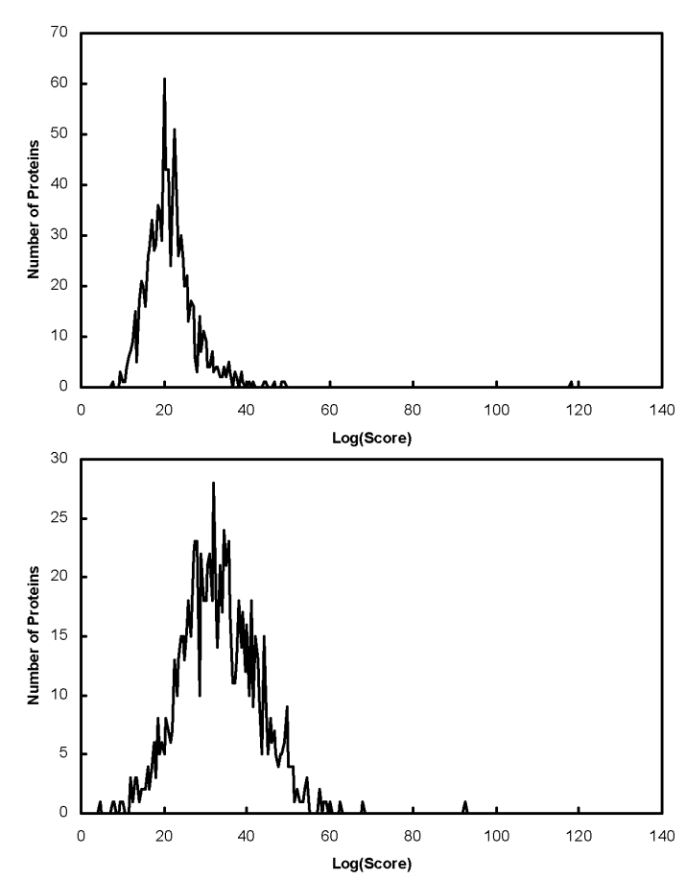
Peptide Mapping - Partial Modifications
No Modifications
Searched Searched With
Without Possible
Modifications Phosphorylation
of S/T/Y
DARPP-32 0.00006 0.01
CFTR 0.00002 0.005
Even if the protein is modified it is usually better to search a protein sequence database without specifying possible modifications using peptide mapping data.
Phophorylation (S, T, or Y)

Slide 14
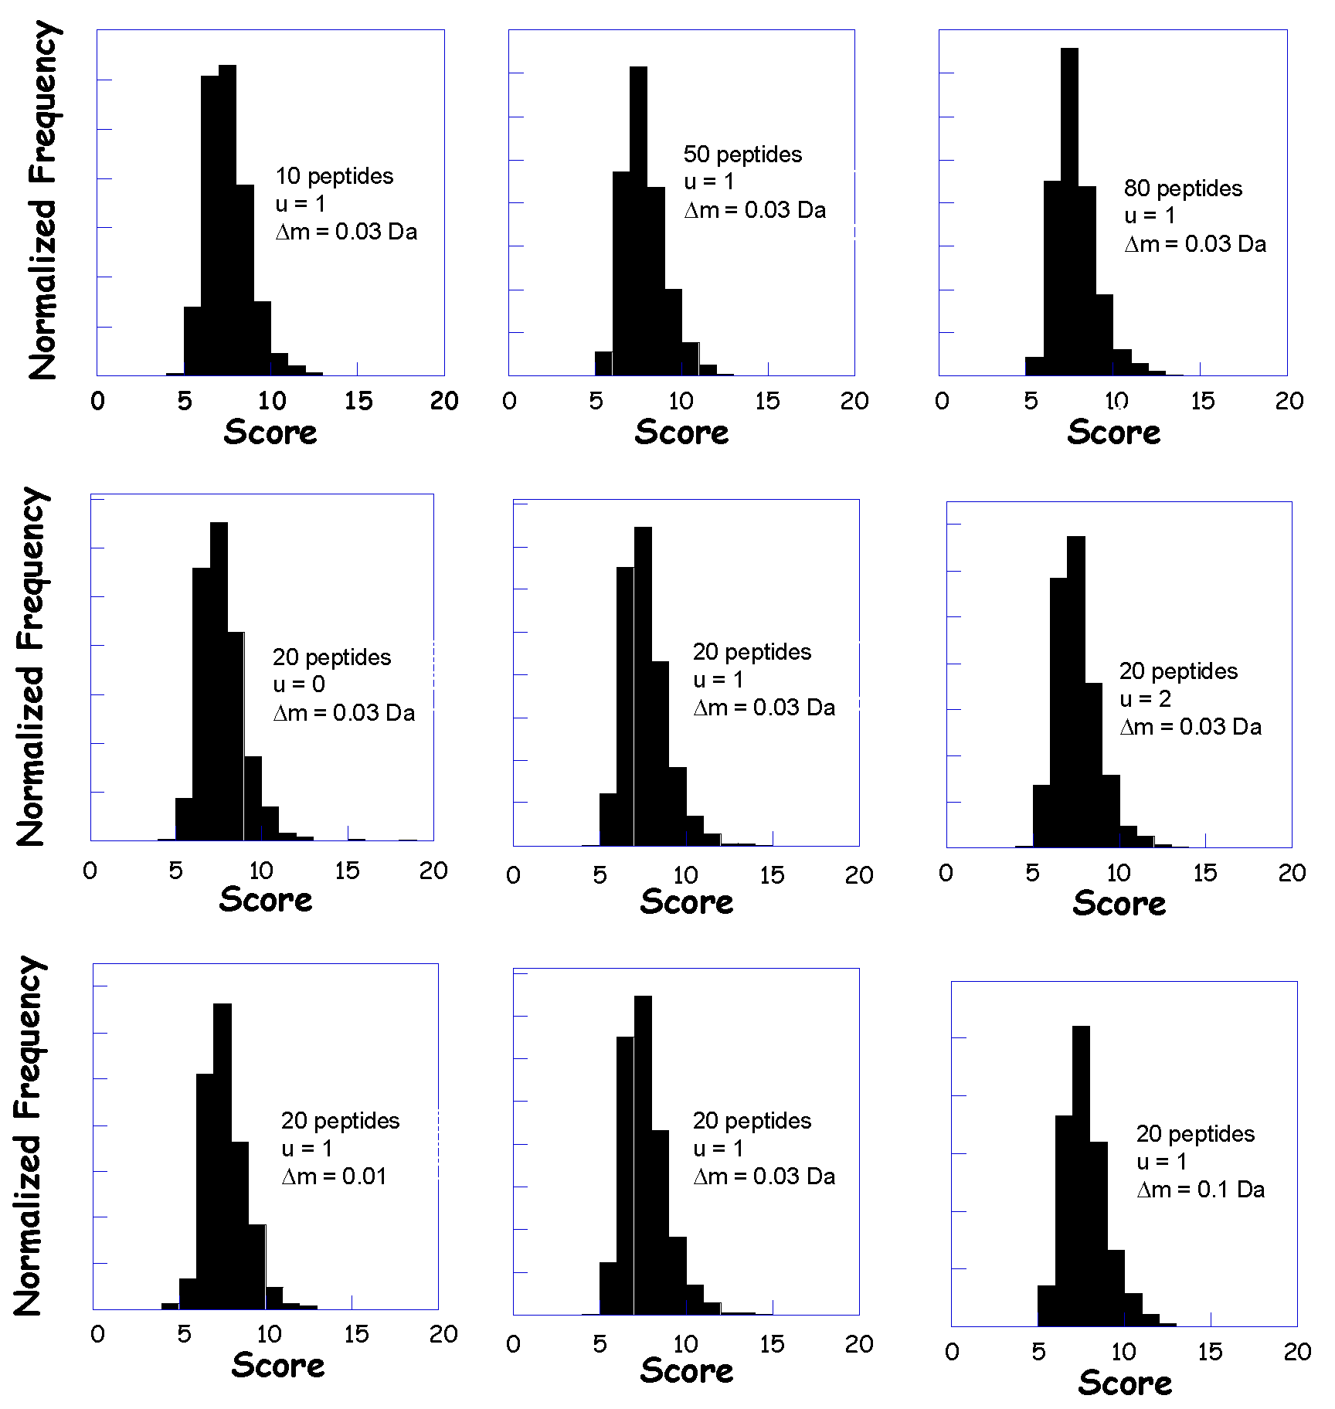
Peptide Mapping - Ranking by
Direct Calculation of the Significance

Slide 15
General Criteria for a Good Protein Identification Algorithms
The response to random input data should be random.
Maximum number of correct identification and minimum number of incorrect identifications for any data set.
Maximal separation between scores for correct identifications and the distribution of scores for random matching proteins for any data set.
The statistical significance of the results should be calculated.
The searches should be fast.

Slide 16
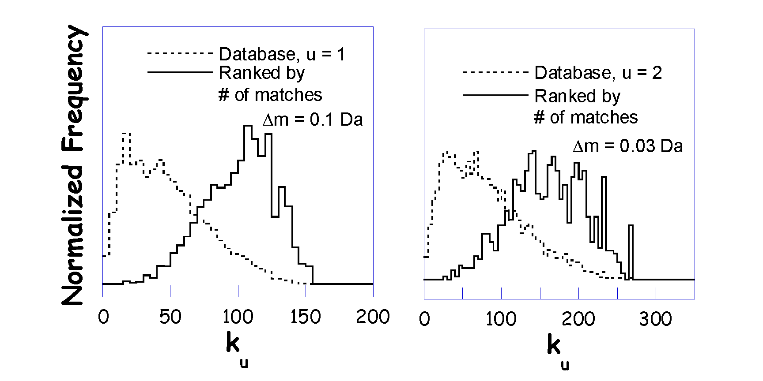
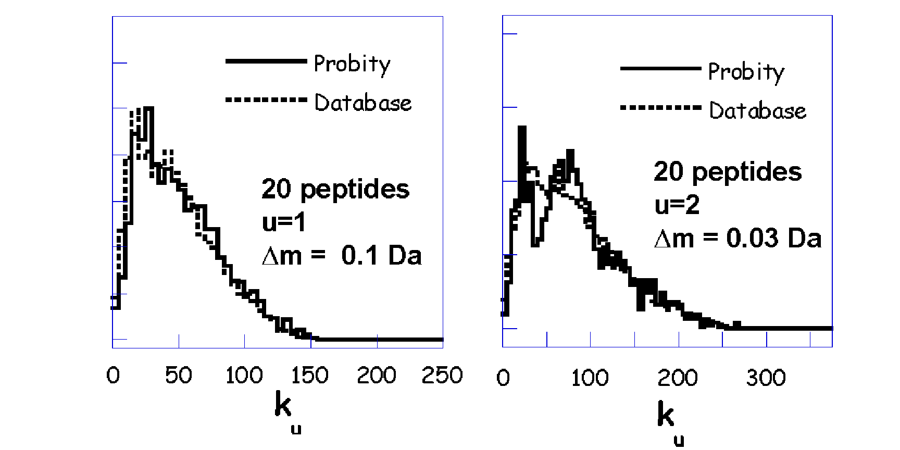
Response to Random Data
Normalized Frequency

Slide 17
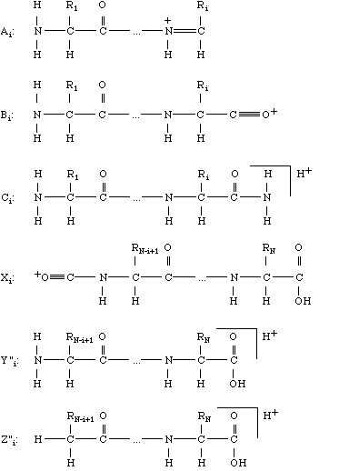
Peptide Fragmentation
Ion Source
Mass Analyzer 1
Frag-mentation
Mass Analyzer 2
Detector
b
y

Slide 18
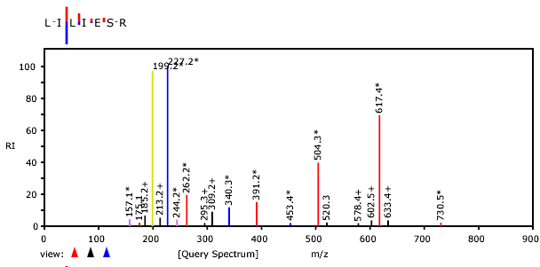
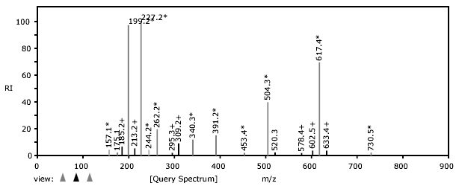
Identification – Tandem MS

Slide 19
Tandem MS – Sequence Confirmation
S
G
F
L
E
E
D
E
L
K
100
% Relative Abundance
0
250
500
750
1000
m/z

Slide 20
Tandem MS – Sequence Confirmation
S
G
F
L
E
E
D
E
L
K
88
145
292
405
534
663
778
907
1020
1166
b ions
S
G
F
L
E
E
D
E
L
K
100
% Relative Abundance
0
250
500
750
1000
m/z

Slide 21
Tandem MS – Sequence Confirmation
S
G
F
L
E
E
D
E
L
K
88
145
292
405
534
663
778
907
1020
1166
b ions
S
G
F
L
E
E
D
E
L
K
1166
1080
1022
875
762
633
504
389
260
147
y ions
100
% Relative Abundance
0
250
500
750
1000
m/z

Slide 22
Tandem MS – Sequence Confirmation
S
G
F
L
E
E
D
E
L
K
88
145
292
405
534
663
778
907
1020
1166
b ions
S
G
F
L
E
E
D
E
L
K
1166
1080
1022
875
762
633
504
389
260
147
y ions
762
100
875
[M+2H]²⁺
% Relative Abundance
633
292
405
534
260
389
1022
504
907
1020
663
778
1080
0
250
500
750
1000
m/z

Slide 23
Tandem MS – Sequence Confirmation
S
G
F
L
E
E
D
E
L
K
88
145
292
405
534
663
778
907
1020
1166
b ions
S
G
F
L
E
E
D
E
L
K
1166
1080
1022
875
762
633
504
389
260
147
y ions
762
100
875
[M+2H]²⁺
% Relative Abundance
633
292
405
534
260
389
1022
504
907
1020
663
778
1080
0
250
500
750
1000
m/z

Slide 24
Tandem MS – Sequence Confirmation
S
G
F
L
E
E
D
E
L
K
88
145
292
405
534
663
778
907
1020
1166
b ions
S
G
F
L
E
E
D
E
L
K
1166
1080
1022
875
762
633
504
389
260
147
y ions
762
100
875
[M+2H]²⁺
113
113
% Relative Abundance
633
292
405
534
260
389
1022
504
907
1020
663
778
1080
0
250
500
750
1000
m/z

Slide 25
Tandem MS – Sequence Confirmation
S
G
F
L
E
E
D
E
L
K
88
145
292
405
534
663
778
907
1020
1166
b ions
S
G
F
L
E
E
D
E
L
K
1166
1080
1022
875
762
633
504
389
260
147
y ions
762
100
129
875
[M+2H]²⁺
% Relative Abundance
129
633
292
405
534
260
389
1022
504
907
1020
663
778
1080
0
250
500
750
1000
m/z

Slide 26
Tandem MS – Sequence Confirmation
S
G
F
L
E
E
D
E
L
K
88
145
292
405
534
663
778
907
1020
1166
b ions
S
G
F
L
E
E
D
E
L
K
1166
1080
1022
875
762
633
504
389
260
147
y ions
762
100
875
[M+2H]²⁺
% Relative Abundance
633
292
405
534
260
389
1022
504
907
1020
663
778
1080
0
250
500
750
1000
m/z

Slide 27
Tandem MS – Sequence Confirmation
S
G
F
L
E
E
D
E
L
K
88
145
292
405
534
663
778
907
1020
1166
b ions
S
G
F
L
E
E
D
E
L
K
1166
1080
1022
875
762
633
504
389
260
147
y ions
762
100
875
[M+2H]²⁺
% Relative Abundance
633
292
405
534
260
389
1022
504
907
1020
663
778
1080
0
250
500
750
1000
m/z

Slide 28
Tandem MS – Sequence Confirmation
S
G
F
L
E
E
D
E
L
K
88
145
292
405
534
663
778
907
1020
1166
b ions
S
G
F
L
E
E
D
E
L
K
1166
1080
1022
875
762
633
504
389
260
147
y ions
762
100
875
[M+2H]²⁺
% Relative Abundance
633
292
405
534
260
389
1022
504
907
1020
663
778
1080
0
250
500
750
1000
m/z

Slide 29
Tandem MS – de novo Sequencing
762
100
Amino acid masses
875
[M+2H]²⁺
% Relative Abundance
292
633
260
405
534
1022
389
504
907
1020
663
778
1080
0
250
500
750
1000
m/z
Mass Differences
Sequences
consistent
with spectrum

Slide 30
Tandem MS – de novo Sequencing

Slide 31
Tandem MS – de novo Sequencing

Slide 32
Tandem MS – de novo Sequencing
X
X
X
SGF(I/L)EEDE(I/L)…
1166 – 1020 – 18 = 128
K or Q
SGF(I/L)EEDE(I/L)(K/Q)
…GF(I/L)EEDE(I/L)…
…(I/L)EDEE(I/L)FG…
…GF(I/L)EEDE(I/L)…
…(I/L)EDEE(I/L)FG…
Peptide M+H = 1166
1166 -1079 = 87 => S
SGF(I/L)EEDE(I/L)…
X
X
X

Slide 33
Tandem MS – de novo Sequencing
Challenges in de novo sequencing
Neutral loss (-H₂O, -NH₃)
Modifications
Background peaks
Incomplete information
Challenges in de novo sequencing
Neutral loss (-H₂O, -NH₃)
Modifications
Background peaks
Incomplete information

Slide 34
Tandem MS – Database Search
Sequence
DB
Lysis
Fractionation
Pick Protein
Digestion
LC-MS
Pick Peptide
MS/MS
Repeat for all proteins
All Fragment
Masses
Repeat for
all peptides
MS/MS
Compare, Score, Test Significance

Slide 35
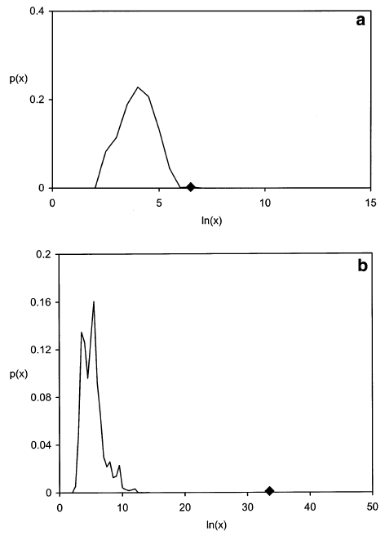
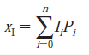
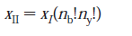
Algorithms

Slide 36
Comparing and Optimizing Algorithms

Slide 37
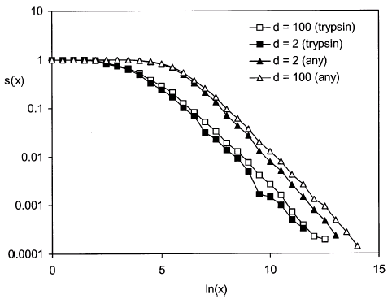
MS/MS - Parent Mass Error
and Enzyme Specificity
Expectation Values
MS/MS example:
Δm=2, Trypsin 2.5e-5
Δm=100, Trypsin 2.5e-5
Δm=2, non-specific 7.9e-5
Δm=100, non-specific 1.6e-4

Slide 38
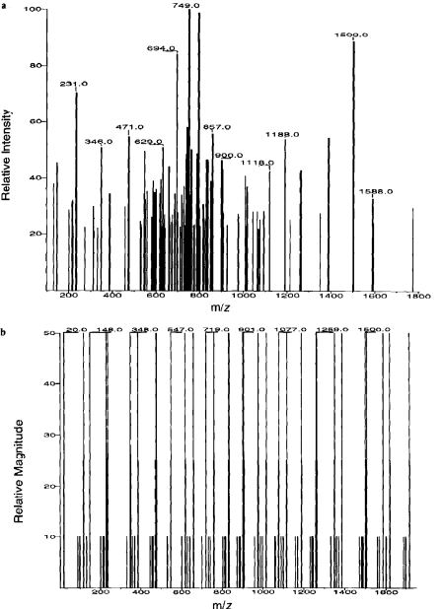
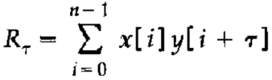
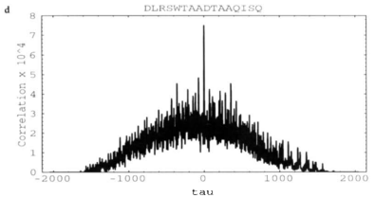
Sequest
Cross-correlation

Slide 39
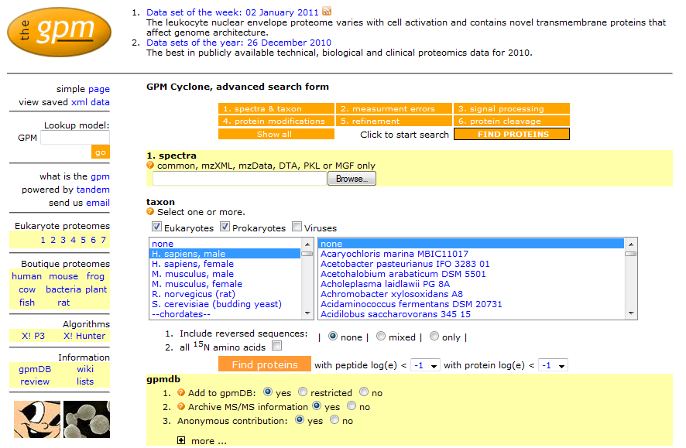
X! Tandem - Search Parameters
http://www.thegpm.org/

Slide 40
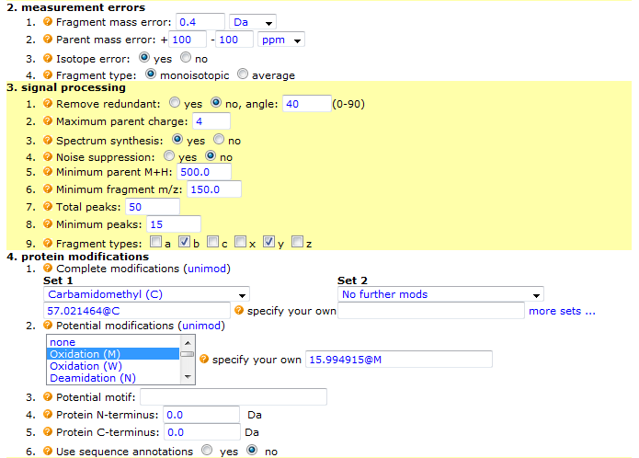
X! Tandem - Search Parameters

Slide 41
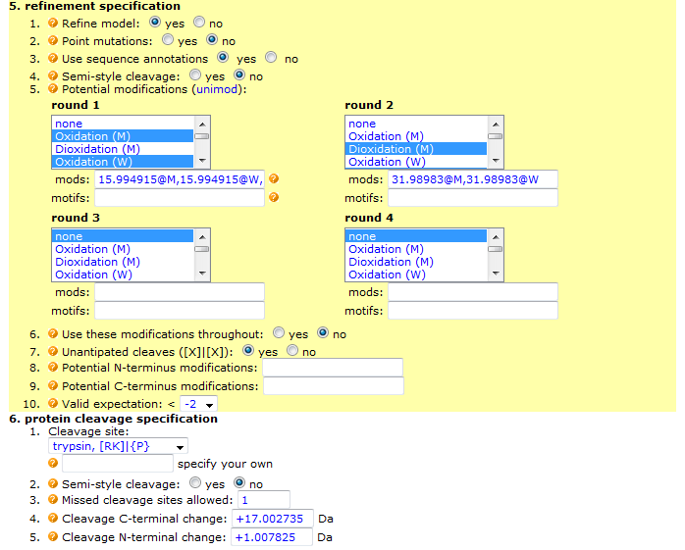
X! Tandem - Search Parameters

Slide 42
spectra
Generic search engine
Test all
cleavages,
modifications,
& mutations
for all sequences
sequences
sequences
Conventional,
single stage searching

Slide 43
Some hard problems in MS/MS
analysis in proteomics
Allowing for unanticipated peptide cleavages
- e.g., chymotryptic contamination in trypsin
- calculation order ~ 200 × tryptic cleavage
- “unfortunate” coefficient
Determining potential modifications
- e.g., oxidation, phosphorylation, deamidation
- calculation order 2^{n}
- NP complete
Detecting point mutations
- e.g., sequence homology
- calculation order 18^{N}
- NP complete

Slide 44
Multi-stage searching
spectra
Tryptic
cleavage
Modifications #1
sequences
Modifications #2
sequences
Point mutation
X! Tandem

Slide 45
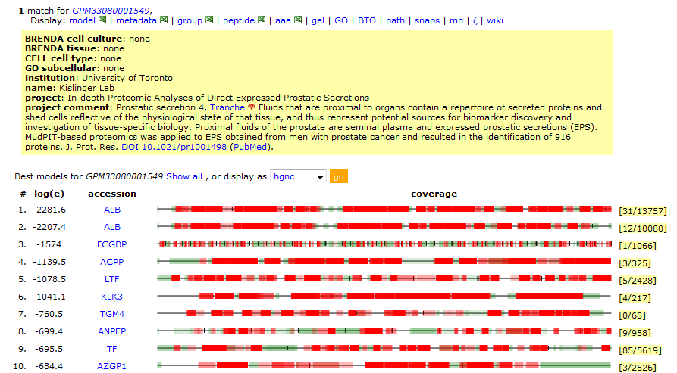
Search Results

Slide 46
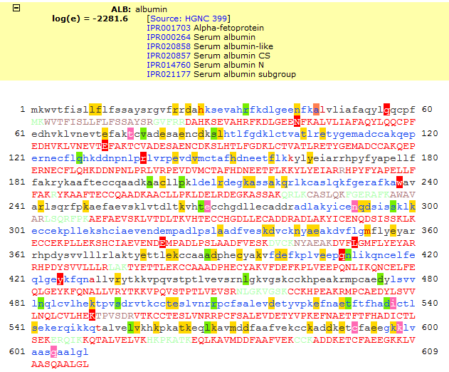
Search Results

Slide 47
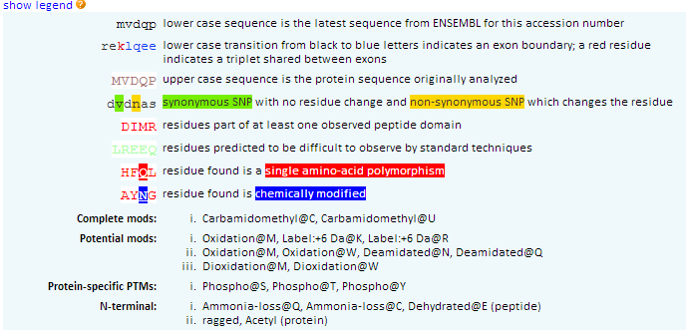
Sequence Annotations

Slide 48
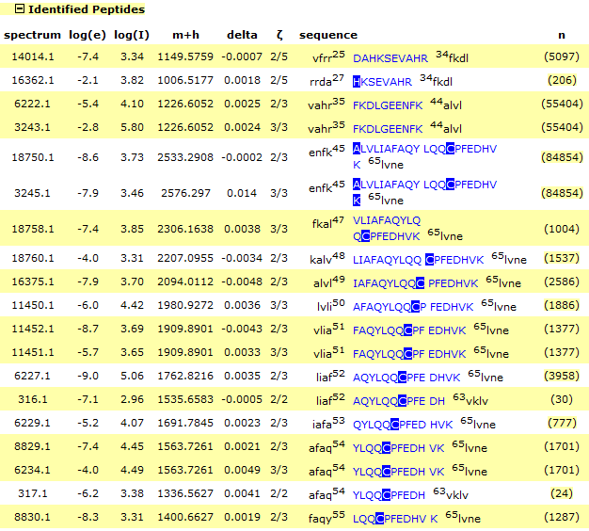
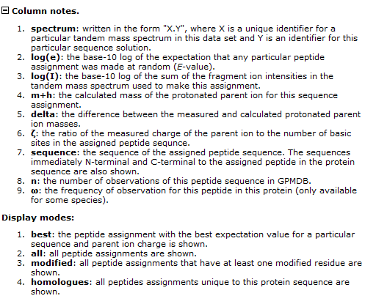
Search Results

Slide 49
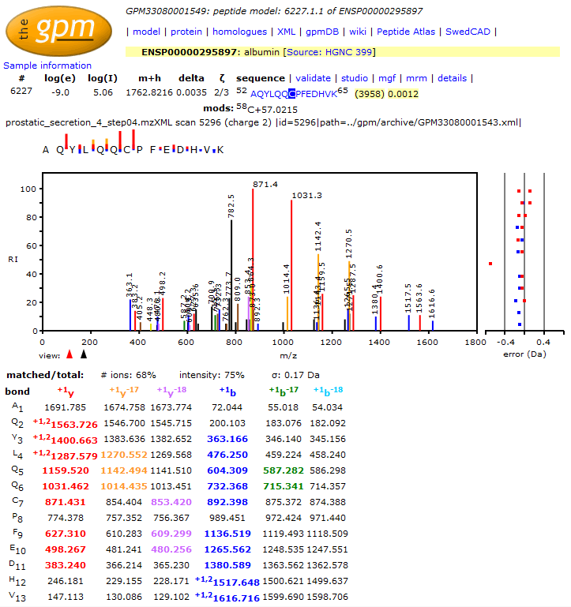
Search Results

Slide 50
Identification – Spectrum Library Search
Spectrum
Library
Lysis
Fractionation
Digestion
LC-MS/MS
Pick
Spectrum
Repeat for
all spectra
MS/MS
Compare, Score, Test Significance
Identified Proteins

Slide 51
Steps in making an
Annotated Spectrum Library (ASL):
1. Find the best 10 spectra for a particular sequence, with the same PTMs and charge.
2. Add the spectra together and normalize the intensity values.
3. Assign a “quality” value: the median expectation value of the 10 spectra used.
4. Record the 20 most intense peaks in the averaged spectrum, it’s parent ion z, m/z, sequence, protein accessions & quality.

Slide 52
Spectrum Library Characteristics – Peptide Length

Slide 53
Spectrum Library Characteristics – Protein Coverage

Slide 54
Identification – Spectrum Library Search
Library spectrum
(5:25)
Test spectrum
(5:25)
Results: 4 peaks selected, 1 peak missed

Slide 55
Identification – Spectrum Library Search
How likely is this?
Apply a hypergeometric probability model:
- 25 possible m/z values;
- 5 peaks in the library spectrum; and
- 4 selected by the test spectrum.
Matches | Probability
1 | 0.45
2 | 0.15
3 | 0.016
4 | 0.00039
5 | 0.0000037

Slide 56
Identification – Spectrum Library Search
If you have 1000 possible m/z values and 20 peaks in test and library spectrum?
1 matched: p = 0.6
5 matched: p = 0.0002
10 matched: p = 0.0000000000001

Slide 57
Identification – Spectrum Library Search
Library of Assigned
Mass Spectra
Experimental
Mass Spectrum
☹
✓
M/Z
Best search result

Slide 58
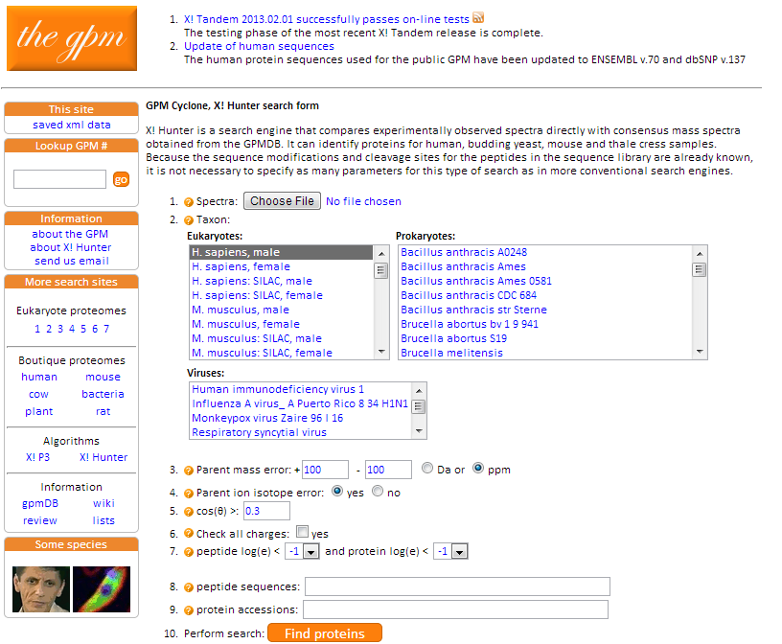
X! Hunter

Slide 59
X! Hunter algorithm:
1. Use dot product to find a library spectrum that best matches a test spectrum.
2. Calculate p-value with hypergeometric distribution.
3. Use p-value to calculate expectation value, given the identification parameters.
4. If expectation value is less than the median expectation value of the library spectrum, report the median value.

Slide 60

X! Hunter Result
Query Spectrum
Library Spectrum

Slide 61
Significance Testing
False protein identification is caused by random matching
An objective criterion for testing the significance of protein identification results is necessary.
The significance of protein identifications can be tested once the distribution of scores for false results is known.

Slide 62
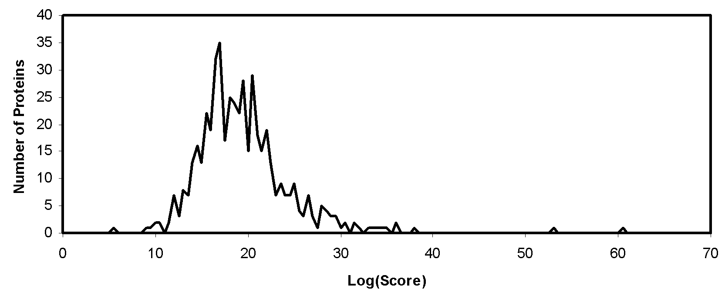
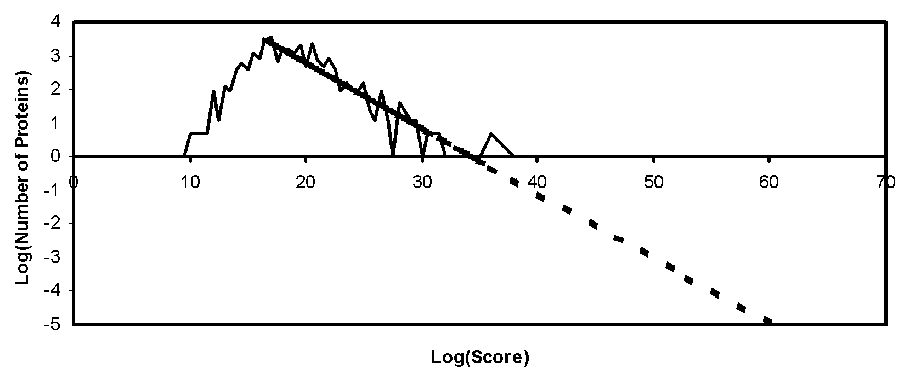
Significance Testing - Expectation Values
The majority of sequences in a collection will give a score due to random matching.

Slide 63
Significance Testing - Expectation Values
Database Search
List of Candidates
M/Z
Distribution of Scores
for Random and False
Identifications
Extrapolate
And Calculate
Expectation Values
List of Candidates With Expectation Values

Slide 64
Proteomics Informatics –
Protein identification I: searching protein sequence collections and significance testing (Week 4)

