Slide 1

Cloud Native Architecture
Docker
Basics

Slide 2


About me
PhD in Telecommunications @ BME
Worked with 5G technology
SDN & NFV → Cloud Native Network Functions
Graduated in the EIT Digital Doctoral School
Co-founder & CTO @ LeanNet Ltd.
Consulting, training, implementing
Cloud Native, Microservices, DevOps
Cloud Native Competence Center Leaders of adesso Hungary
Team building, strategy creation, sales
Freelancer, Consultant
linkedin.com/in/szabvid

Slide 3
Course Outline
Introduction and Motivation
Kafka Architecture
Core Kafka Concepts:
  Brokers and Clusters, Topics, Partitions, Offsets
  Producers, Message Keys, Acknowledgments
  Consumers, Consumer Groups, Offsets
  Zookeeper and KRaft
Kafka Configuration and Access:
  Starting Kafka with and without Zookeeper
  Basic CLI Commands
  Producer Configuration
  Consumer Configuration
Advanced Producer Configuration
Advanced Consumer Configuration
Broker Configuration
  Kafka Ecosystem:
    Kafka Connect, Kafka Streams, Schema Registry
Additional Kafka Ecosystem Components:
  Kafka Bridge,
  Kafka Mirror Maker,
  ksqlDB
Examples / Case Studies
Kafka Graphical Interfaces:
  Kafka UI, Kafdrop
Administrative Considerations:
  Topic Configuration
  Log Retention
  Kafka Mirror Maker
  Strimzi Kafka Operator
Monitoring:
  JMX Exporters
  Prometheus
  Grafana

Slide 4

What is Apache Kafka?
An open-source distributed event streaming platform for
  data integration,
  mission-critical applications,
  streaming analytics and
  high-performance data pipelines

Slide 5
What is Event Streaming?
It is the practice of capturing data in
  i) real-time from event sources (e.g. databases, sensors, applications) in the form of streams of events;
  ii) storing these event streams durably for later retrieval;
  iii) manipulating, processing, and reacting to the event streams in real-time as well as retrospectively;
  iv) and routing the event streams to different destination technologies as needed.
A typical challenge is data integration:
  Protocol –
    how the data is transported?
    TCP, HTTP, REST, FTP, JDBC…
  Data format –
    how the data is parsed?
    Binary, CSV, JSON, Avro…
  Data schema & evolution –
    how the data is shaped and may change?
Source System
Source System
Source System
. . .
data
data
data
Target System
Target System
Target System
. . .
Notes:
vaccounting, billing, CRM, websites

Slide 6
What is Event Streaming?
It is the practice of capturing data in
  i) real-time from event sources (e.g. databases, sensors, applications) in the form of streams of events;
  ii) storing these event streams durably for later retrieval;
  iii) manipulating, processing, and reacting to the event streams in real-time as well as retrospectively;
  iv) and routing the event streams to different destination technologies as needed.
A typical challenge is data integration:
  Protocol –
    how the data is transported?
    TCP, HTTP, REST, FTP, JDBC…
  Data format –
    how the data is parsed?
    Binary, CSV, JSON, Avro…
  Data schema & evolution –
    how the data is shaped and may change?
Website Events
Pricing Data
Sensor Data
. . .
data
data
data
Database
Analytics
Audit
. . .
Notes:
vaccounting, billing, CRM, websites

Slide 7
Kafka to the Rescue
Kafka was created at LinkedIn at 2011 to service internal stream processing
Written in Java
Quickly gained popularity and became an Apache Foundation project
Nowadays mainly maintained by Confluent, IBM, Yelp, Netflix, ...
Typical use-cases:
  Messaging systems
  Activity Tracking
  Gather metrics from many different locations, for example, IoT devices
  Application logs analysis
  De-coupling of system dependencies
  Integration with Big Data technologies like Spark,
  Flink, Storm, Hadoop.
  Event-sourcing store
Website Events
Pricing Data
Sensor Data
. . .
Database
Analytics
Audit
. . .
Notes:
accounting, billing, CRM, websites

Slide 8
Kafka and Event-Driven Systems
Event-Driven System / Architecture:
  Architectural concept where system components communicate by producing and responding to events.
Key characteristics:
  Loose Coupling: Producers don’t need to know about consumers.
  Asynchronous Communication: Events are sent and received independently.
  Scalability: Services can scale independently with increased event load.
  Real-Time Responsiveness: Enables systems to react instantly to change.
Event Producer
{ event }
Event Broker
{ event }
Event Consumer

Slide 9
What is an Event-Driven System?
Event-Driven System / Architecture:
  Architectural concept where system components communicate by producing and responding to events.
Common use-cases:
  Microservices communication
  User activity tracking
  Financial transactions
  IoT sensor updates
Event Streaming feeds EDS by
delivering events reliably
Event Producer
Website Events
Pricing Data
Sensor Data
. . .
{ event }
{ event }
Event Broker
{ event }
{ event }
Event Consumer
Database
Analytics
Audit
. . .

Slide 10
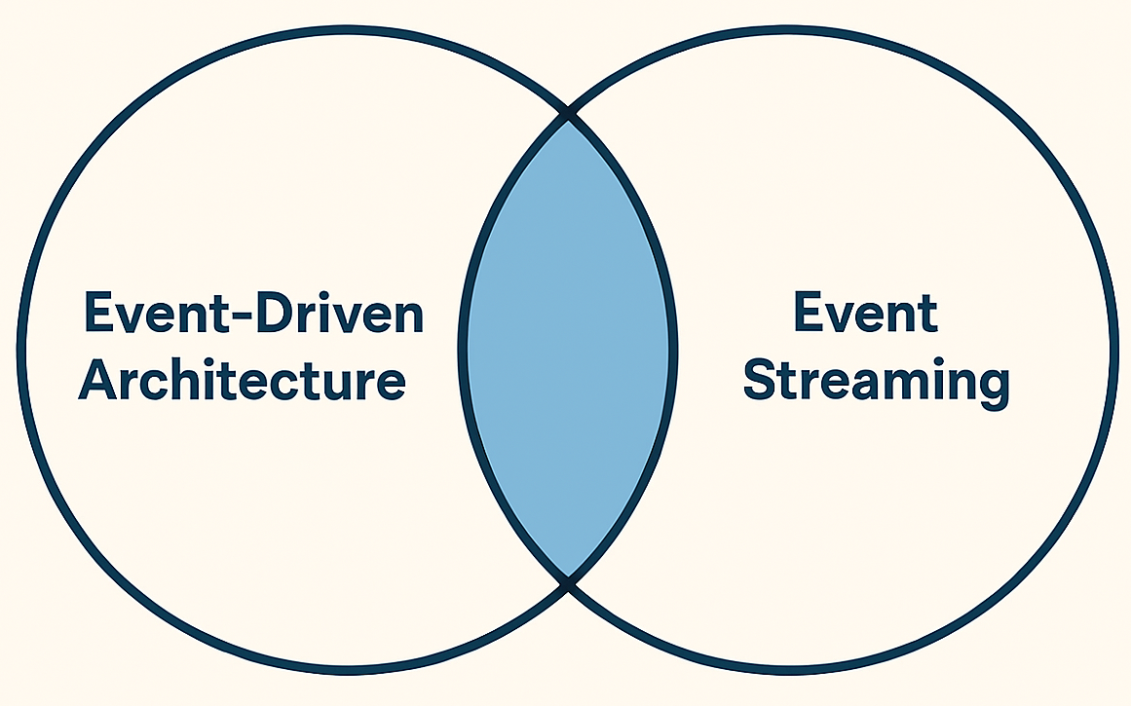



Side Note
Difference in Focus:
  Event-Driven Systems focuses on reacting to events
  —it's about event-triggered behavior and loosely coupled service interactions.
  Event Streaming focuses on capturing and processing a continuous flow of events
  —it's about real-time data movement and processing over time.
EDA but not Event Streaming
Event Steaming but not EDA
A package delivery
service emits “Parcel
Shipped” events via
a message queue,
triggering customer
notifications — no
streaming or historical
playback is needed.
A telemetry pipeline
continuously streams
sensor data from wind
turbines into a data
lake via Kafka for
analytics—no services
react to events
in real time.
Smart traffic
management
system

Slide 11
Kafka Core Concepts – Overview
Topics oragnize related events:
  E.g. logs of a specific application
  Rougly analogous to SQL tables
Producers are applications that send data into topics:
  They are deployed outside Kafka and only interact with it
  At code level they integrate with Kafka client libraries (Java, Python, Go, etc.)
Consumers are applications that pull data from topics:
  They are deployed outside Kafka and only interact with it
  At code level they integrate with Kafka client libraries (Java, Python, Go, etc.)
Client-server architecture:
  Topics are stored on servers, called Kafka brokers
  Producers and consumers are the clients
Can scale to 100s of brokers
Can scale to millions of messages per second
Latency of less than 10 ms ~ real time
Producer
...
broker
broker
.
.
.
.
.
.
topic
topic
topic
topic
Consumer

Slide 12
Comparing Kafka to Other Message Brokers?
Feature / Broker | Apache Kafka | RabbitMQ | Redis Streams | Cloud-Native Brokers (AWS, Azure, GCP)
Message Retention | ✅ Long-term, configurable (disk-based) | ⚠️ Short-term (until consumed) | ⚠️ Short-term (memory-based, optional persistence) | ⚠️ Limited (varies by service; often time-bound)
Throughput | 🔥 Extremely high (millions/sec) | ⚠️ Moderate | ✅ High (in-memory, low latency) | ⚠️ Moderate to high (depends on service tier)
Replay Support | ✅ Native replay from log | ❌ Not supported | ⚠️ Limited (manual tracking needed) | ❌ Typically not supported (some exceptions)
Ordering Guarantees | ✅ Per partition (strong ordering) | ✅ Per queue (FIFO optional) | ✅ Per stream (by ID) | ⚠️ Varies: some offer FIFO queues, others don’t
Use Case Fit | ❌ Not lightweight (requires cluster) | ✅ Lightweight, easy to deploy | ✅ Lightweight, in-memory | ✅ Lightweight, fully managed (cloud-native)
Kafka isn’t just a message broker—it’s a distributed event streaming platform

Slide 13
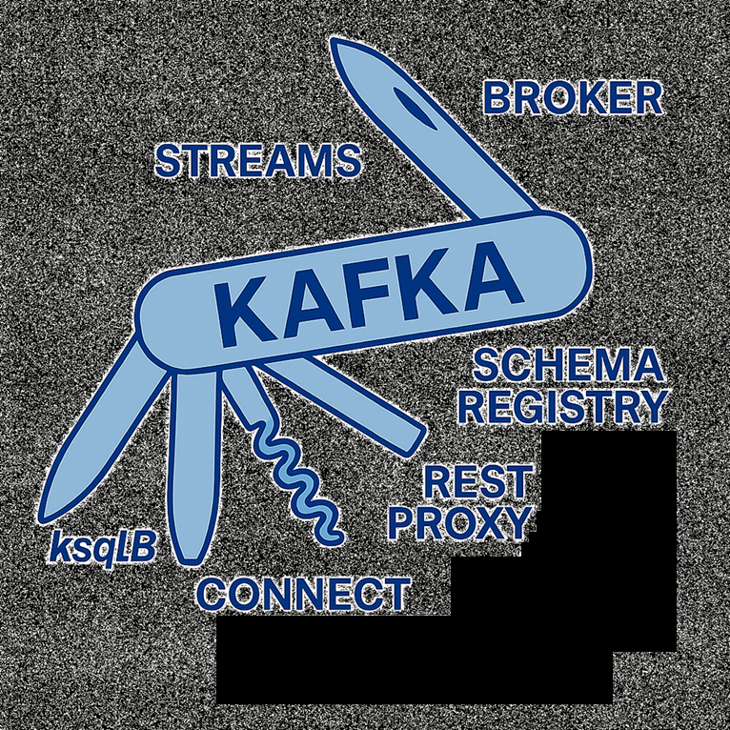
Kafka Core & Ecosystem

Slide 14
Cloud Native Architecture
Kafka Core Concepts

Slide 15
Kafka Core Concepts – Overview
Topics organize related events:
  E.g. logs of a specific application
  Rougly analogous to SQL tables
Producers are applications that send data into topics:
  They are deployed outside Kafka and only interact with it
  At code level they integrate with Kafka client libraries (Java, Python, Go, etc.)
Consumers are applications that pull data from topics:
  They are deployed outside Kafka and only interact with it
  At code level they integrate with Kafka client libraries (Java, Python, Go, etc.)
Producer
topic
Consumer

Slide 16
Kafka Core Concepts – Overview
Topics oragnize related events:
  E.g. logs of a specific application
  Rougly analogous to SQL tables
Producers are applications that send data into topics:
  They are deployed outside Kafka and only interact with it
  At code level they integrate with Kafka client libraries (Java, Python, Go, etc.)
Consumers are applications that pull data from topics:
  They are deployed outside Kafka and only interact with it
  At code level they integrate with Kafka client libraries (Java, Python, Go, etc.)
Client-server architecture:
  Topics are stored on servers, called Kafka brokers
  Producers and consumers are the clients
Producer
. . .
...
broker
broker
.
.
.
.
.
.
topic
topic
topic
topic
Consumer
. . .

Slide 17
Kafka Core Concepts – Overview
Topics oragnize related events:
  E.g. logs of a specific application
  Rougly analogous to SQL tables
Producers are applications that send data into topics:
  They are deployed outside Kafka and only interact with it
  At code level they integrate with Kafka client libraries (Java, Python, Go, etc.)
Consumers are applications that pull data from topics:
  They are deployed outside Kafka and only interact with it
  At code level they integrate with Kafka client libraries (Java, Python, Go, etc.)
Client-server architecture:
  Topics are stored on servers, called Kafka brokers
  Producers and consumers are the clients
Can scale to 100s of brokers
Can scale to millions of messages per second
Latency of less than 10 ms ~ real time
Producer
. . .
...
broker
broker
.
.
.
.
.
.
topic
topic
topic
topic
Consumer
. . .

Slide 18
Kafka Core Concepts – Topics
A topic is a particular stream of data
  Stream: sequence of messages
Similar to a table in a database
Identified by its name
Any kind of message format (JSON, Avro, binary, ...)
You can have as many as you want
Its not queryable, use producers to write them and consumers to read them
Producer
broker
traffic
logs
orders
Consumer
Notes:
Logical (message sending perspective) Architecture -> partitions and so
Physicyal: Zookeeper and so ->

Slide 19
Kafka Core Concepts – Partitions and Offsets
Topics are broken down into a number of partitions
A single topic may have multiple partitions:
  no hard limit on how many (up to 100 its quite common)
The number is specified at topic creation
Messages within each partition are ordered
  but not accross partitions
Each message within a partition gets incremental id, called offset:
  an offset only have meaning for a specific partition
  same offset for another partition does not guarantee the same message
Kafka topics are immutable: once message is written it cannot be modified
Message is assigned randomly to a partition if no message key is provided
Partition 0
0
1
2
3
4
5
.
.
.
Producer
write
Partition 1
0
1
2
3
.
.
.
topic
.
.
.
Partition N
0
1
2
3
4
5
6
.
.
.
message offset
Notes:
Logical (message sending perspective) Architecture -> partitions and so
Physicyal: Zookeeper and so ->

Slide 20
Kafka Core Concepts – Message Keys
Producer can send key with the message (number, string, ...)
Based on the key the producer decides to which partition it sends the message:
Partition 0
0
1
2
3
4
5
.
.
.
write
Partition 1
0
1
2
3
Producer
.
.
.
topic
.
.
.
Partition N
0
1
2
3
4
5
6
.
.
.
message offset
Notes:
Logical (message sending perspective) Architecture -> partitions and so
Physicyal: Zookeeper and so ->

Slide 21
Kafka Core Concepts – Message Keys
Producer can send key with the message (number, string, ...)
Based on the key the producer decides to which partition it sends the message:
  If key == null partition is selected at random
Partition 0
0
1
2
3
4
5
.
.
.
key: null
Producer
Partition 1
0
1
2
3
.
.
.
topic
.
.
.
Partition N
0
1
2
3
4
5
6
.
.
.
message offset
Notes:
Logical (message sending perspective) Architecture -> partitions and so
Physicyal: Zookeeper and so ->

Slide 22
Kafka Core Concepts – Message Keys
Producer can send key with the message (number, string, ...)
Based on the key the producer decides to which partition it sends the message:
  If key == null partition is selected at random
  If key != null same partition is assigned to the same key
Partition 0
0
1
2
3
4
5
.
.
.
key (person_id): 1
Producer
Partition 1
0
1
2
3
.
.
.
topic
.
.
.
key (person_id): 6
0
1
2
3
4
5
6
Partition N
.
.
.
message offset
Notes:
Logical (message sending perspective) Architecture -> partitions and so
Physicyal: Zookeeper and so ->

Slide 23
Kafka Core Concepts – Message Keys
Producer can send key with the message (number, string, ...)
Based on the key the producer decides to which partition it sends the message:
  If key == null partition is selected at random
  If key != null same partition is assigned to the same key
Use key if order is important
person_id_1
person_id_2
Partition 0
0
1
2
3
4
5
.
.
.
Producer
Partition 1
0
1
2
3
.
.
.
topic
.
.
.
person_id_6
person_id_7
0
1
2
3
4
5
6
Partition N
.
.
.
message offset
Notes:
Logical (message sending perspective) Architecture -> partitions and so
Physicyal: Zookeeper and so ->

Slide 24
Kafka Core Concepts – Message Keys
Producer can send key with the message (number, string, ...)
Based on the key the producer decides to which partition it sends the message:
  If key == null partition is selected at random
  If key != null same partition is assigned to the same key
Use key if order is important
(Typically a broker does not contain all the partitions for a topic (there are parameters to fine-tune this))
person_id_1
person_id_2
Partition 0
0
1
2
3
4
5
.
.
.
Producer
Partition 1
0
1
2
3
.
.
.
topic
.
.
.
person_id_6
person_id_7
0
1
2
3
4
5
6
Partition N
.
.
.
message offset
Notes:
Logical (message sending perspective) Architecture -> partitions and so
Physicyal: Zookeeper and so ->

Slide 25
Kafka Core Concepts – Message Anatomy
So Kafka only accepts bytes
Clients obviously uses higher-level objects (Integer, String, etc.) for Key and Value
  To transform these objects into binaries a Producer Serializer is needed
  To transform the binaries into objects a Consumer Deserializer is needed
Key-binary
(can be null)
Value-binary
(can be null)
Compression Type
(none, gzip, snappy, lz4, zstd)
Producer
write
Headers (optional)
Key
Value
Key
Value
Partition + Offset
Timestamp (system or user set)

Slide 26
Kafka Core Concepts – Serialization / Deserialization
Producer
Consumer
Key-object
123
Value-object
„hello world”
Key-object
123
Value-object
„hello world”
int
string
int
string
Key Serializer=
Integer Serializer
Value Serializer=
String Serializer
Key Deserializer=
Integer Deserializer
Value Deserializer=
String Deserializer
bytes
bytes
bytes
bytes
Key-binary
01110011
Value-binary
101011101110000001010110
Key-binary
01110011
Value-binary
101011101110000001010110
The serialization/deserialization is an important implementation choice
Changing the serialization type for the topic breaks the client at code level (better to create a new topic)
Notes:
Logical (message sending perspective) Architecture -> partitions and so
Physicyal: Zookeeper and so ->

Slide 27
Kafka Core Concepts – Consumers
Consumer reads data from a topic in a pull model
A consumer can read multiple partitions
  Each partition is being read in order, from lower to higher offset values
Typically a broker does not contain all partitions, but a consumer knows which broker to read from
  In case of broker failure, a consumer knows how to recover
0
1
2
3
4
5
.
.
.
Consumer 1
Partition 0
Partition 1
0
1
2
3
.
.
.
Topic
.
.
.
Partition N
0
1
2
3
4
5
6
.
.
.
Consumer 2
message offset
Notes:
Logical (message sending perspective) Architecture -> partitions and so
Physicyal: Zookeeper and so ->

Slide 28
Kafka Core Concepts – Consumer Groups
A set of consumers from the same application
A consumer always belong to a group, even if it is a lonely consumer
Each consumer in the same group reads exlusive partitions
Partition 0
Consumer 1
Partition 1
Consumer 2
Topic
Partition 2
Consumer 3
Partition 3
app-1-consumer-group
Partition 4
Notes:
a set of consumers from the same application that work together to consume and process messages from one or more topics.

Slide 29
Kafka Core Concepts – Consumer Groups
If there are more consumers than partitions:
Partition 0
Consumer 1
Topic
Partition 1
Consumer 2
Partition 2
Consumer 3
inactive
Consumer 4
app-1-consumer-group
Notes:
a set of consumers from the same application that work together to consume and process messages from one or more topics.

Slide 30
Kafka Core Concepts – Consumer Groups
If there are more consumer groups on one topic:
Partition 0
Consumer 1
Topic
Partition 1
Consumer 2
Partition 2
app-1-consumer-group
Consumer 1
Consumer 2
app-2-consumer-group
Consumer 1
app-3-consumer-group
Notes:
a set of consumers from the same application that work together to consume and process messages from one or more topics.

Slide 31
Kafka Core Concepts – Consumer Groups
A consumer in a group can read from one of more topics:
Partition 0
Consumer 1
Topic
Partition 1
Consumer 2
Partition 2
app-1-consumer-group
Consumer 1
Topic 2
Partition 0
Consumer 2
app-2-consumer-group
Consumer 1
app-3-consumer-group
Notes:
a set of consumers from the same application that work together to consume and process messages from one or more topics.

Slide 32
Kafka Core Concepts – Consumer Offset
After a consumer reads a message it sends commit to Kafka regarding the offset
Kafka keep track of this information in the __consumer_offsets topic
If a consumer fails and recover it can continue from where it was
There are multiple strategies from consumers side when to send the commit (see later)
0
1
2
3
4
5
.
.
.
Consumer 1
Partition 0
Topic
Partition 1
0
1
2
3
4
5
6
.
.
.
message offset
Notes:
a set of consumers from the same application that work together to consume and process messages from one or more topics.

Slide 33
Kafka Core Concepts – Brokers and Topics
A Kafka cluster contains multiple brokers („bootstrap servers”)
Each broker stores only certain topic partitions:
  It’s common that a broker contains no partition at all from a topic
  A partition is stored on one broker (if there is no replication configured)
By connecting to a broker a client is automatically connected to the whole cluster
  In case the needed partition is not on the accessed broker, clients can get where to connect
  After connecting the broker sends back the list of brokers and the stored partitions
Client
3.
Connect to proper broker
1. Connect to bootstrap server
2.
List of brokers and topics
Broker 1
Broker 2
Broker 3
Topic A
Partition 0
Partition 2
Partition 1
Topic B
Partition 1
Partition 0

Slide 34
Kafka Core Concepts – Topic Replication
We can configure replicaton number for a topic (ideally should be 2-3)
Each partition is replicated to another broker (or brokers)
For every partition there is one leader and multiple ISR (in-sync replica)
Producer can send data only to the partition leader broker
Consumer by default can pull data only from the partition leader:
  This can be configured to be able to use the closest ISR for cost and latency optimization
When a leader broker fails another takes its place
So for a replication factor of N the topic can be recovered until N-1 broker failures
Broker 1
Broker 2
Broker 3
Partition 0
replication
Partition 1
replication
Partition 1
Leader
ISR
replication
Partition 0
Partition 0

Slide 35
Kafka Core Concepts – Producer Acknowledgement Options
acks=0 :
  No Acknowledgement: Producer does not wait for any acknowledgment from the broker.
  Use Case: High throughput, low latency, but risk of data loss.
acks=1
  Leader Acknowledgement: Producer waits for the leader to write the record to its local log.
  Use Case: Balanced approach, moderate latency, and throughput.
acks=all / -1
  All Replicas Acknowledgement: Producer waits for all in-sync replicas to acknowledge the record.
  Use Case: Highest reliability, ensures no data loss, but higher latency.
Broker 1
Partition 0
0
1
2
3
4
5
.
.
.
Producer
write
Partition 1
0
1
2
3
.
.
.
topic
.
.
.
Partition N
0
1
2
3
4
5
6
.
.
.
message offset

Slide 36

(Zookeeper – Brief Overview)
Zookeper tracks the status of brokers, topics and partitions.
Key functions:
  Controller Election: Ensures a single active controller for leader-follower management.
  Metadata Storage: Maintains information about brokers, topics, and partitions.
  Failover Handling: Automatically selects new leaders if nodes fail.
Zookeeper operates as a separate cluster:
  It typically consists of an odd number of nodes (3, 5, or more)
ZK 1
ZK 2
ZK 3
Broker 1
Broker 2
Broker 3
Broker 4
Broker 5

Slide 37
(Zookeeper – Depreciation)
Zookeeper is replaced with Kraft (Kafka Raft) from Kafka 4.0
  from Kafka 3.x KRaft is in preview mode, so Kafka can be started without Zookeper
  from Kafka 3.3 KRaft becomes production ready
Reasons:
  Simplifies architecture by consolidating metadata management within Kafka.
  Improves scalability and resiliency (from < 100 000 partitions to the scale of millions)
  Enhances control plane performance and stability
Since Kafka 2.2, the kafka-topic.sh CLI references Kafka brokers instead of Zookeeper.
All APIs and command that were previously used Zookeeper are migrated to Kafka instead.
  So any client should only use Kafka.
KRaft is integrated directly into the Kafka brokers
  Kafka brokers themselves act as Kraft controllers.

Slide 38
Cloud Native Architecture
Kafka CLI Tool

Slide 39
Kafka CLI tool
A suite of command-line tools for managing and interacting with Kafka
It is bundled with Kafka binaries
Key Features:
  Start and stop Kafka
  Manage topics (create, list, and delete)
  Manage partitions and replicas
  Monitor and Debug Kafka clusters

Slide 40
Kafka CLI tool – Kafka Topics
Demo
The kafka-topics.sh tool is used to manage topics in Kafka.
Create, list, describe, and delete topics
Alter topic configurations
Add partitions to existing topics
Example:
  kafka-topics.sh --create
  --topic my-topic
  --bootstrap-server localhost:9092
  --partitions 3
  --replication-factor 1

Slide 41
Kafka CLI tool – Kafka Topics
Output example:
Topic description:
Partition-level details:
  Topic: test_topic TopicId: JwOcC6OzTqSfzbf_57DJMw PartitionCount: 1 ReplicationFactor: 1 Configs: segment.bytes=1073741824
  Topic: test_topic Partition: 0 Leader: 1 Replicas: 1 Isr: 1 Elr: LastKnownElr:
Topic | The name of the Kafka topic (test_topic)
TopicId | Unique identifier for the topic (used internally by Kafka)
PartitionCount | Number of partitions in the topic (here: 1)
ReplicationFactor | Number of replicas per partition (here: 1, meaning no redundancy)
Configs | Topic-level configuration; in this case, segment.bytes=1073741824 means each log segment is 1 GB in size
Partition | Partition number (here: 0)
Leader | Broker ID that is currently the leader for this partition (here: broker 1)
Replicas | List of broker IDs that hold a copy of this partition (here: only broker 1)
Isr (In-Sync Replicas) | List of broder IDs that are fully caught up with the leader (here: broker 1)
Elr (Eligible Leader Replicas) | Replicas eligible to become leader in case of failure (empty here, since there's only one replica)
LastKnownElr | Last known eligible leader replicas (also empty here)

Slide 42
* Brief Note on Log Segments
Demo
Kafka stores messages in append-only log files per partition.
These logs are broken into segments to make storage and deletion more manageable
A log segment is a chunk of data stored on disk for a given partition.
If segment.bytes=1073741824:
  each segment file will grow up to 1 GB before Kafka rolls over and starts a new segment.
Each segment:
  Contains a sequence of messages with increasing offsets
  Is stored as a .log file (plus an .index file for fast lookup)
  Is written to until it reaches the configured size (log.segment.bytes)
  Is then closed and a new segment is created
The optimization is a tradeoff: fewer files → less overhead, less frequent cleanup
Log directory is configured by log.dirs parameter.

Slide 43
Kafka CLI tool – Kafka Console Producer
Demo
The kafka-console-producer.sh tool is used to send messages to a Kafka topic from the command line.
Produce messages to a specified topic.
  With key
  Without key
Read input from standard input (stdin).
Example:
  kafka-console-producer.sh --topic my-topic
  --bootstrap-server localhost:9092

Slide 44
Kafka CLI tool – Kafka Console Consumer
Demo
The kafka-console-consumer.sh tool is used to read messages from a Kafka topic from the command line
Consume messages from a specified topic:
  From tail of the topic
  From the beginning of the topic
Can display key and value as well
Example:
  kafka-console-consumer.sh --topic my-topic
  --bootstrap-server localhost:9092
  --from-beginning

Slide 45
Kafka CLI tool – Kafka Consumer Groups
Demo
The kafka-consumer-groups.sh tool is used to manage consumer groups
Describe consumer groups
List consumer groups
Delete consumer groups
Example:
  kafka-consumer-groups.sh --bootstrap-server localhost:9092
  --describe
  --group my-group

Slide 46
Kafka CLI tool – Kafka Server Start
The kafka-server-start.sh tool is used to start a Kafka broker.
Start a Kafka broker using a specified properties file.
Example:
  kafka-server-start.sh config/server.properties

Slide 47
Kafka CLI tool – Kafka Server Stop
The kafka-server-stop.sh tool is used to stop a running Kafka broker.
Stop a Kafka broker.
Example:
  kafka-server-stop.sh

