Slide 1
WebService
Raul Laredo
Andy Bazualdo
Fernando Hinojosa

Slide 2
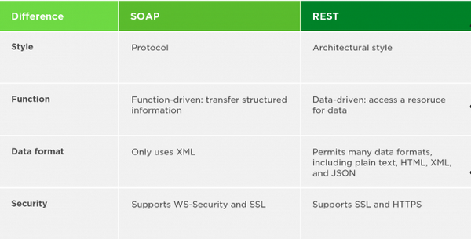
Introduction
We implemented a Webservice, lets you convert your files so they can easily be download in other.

Slide 3
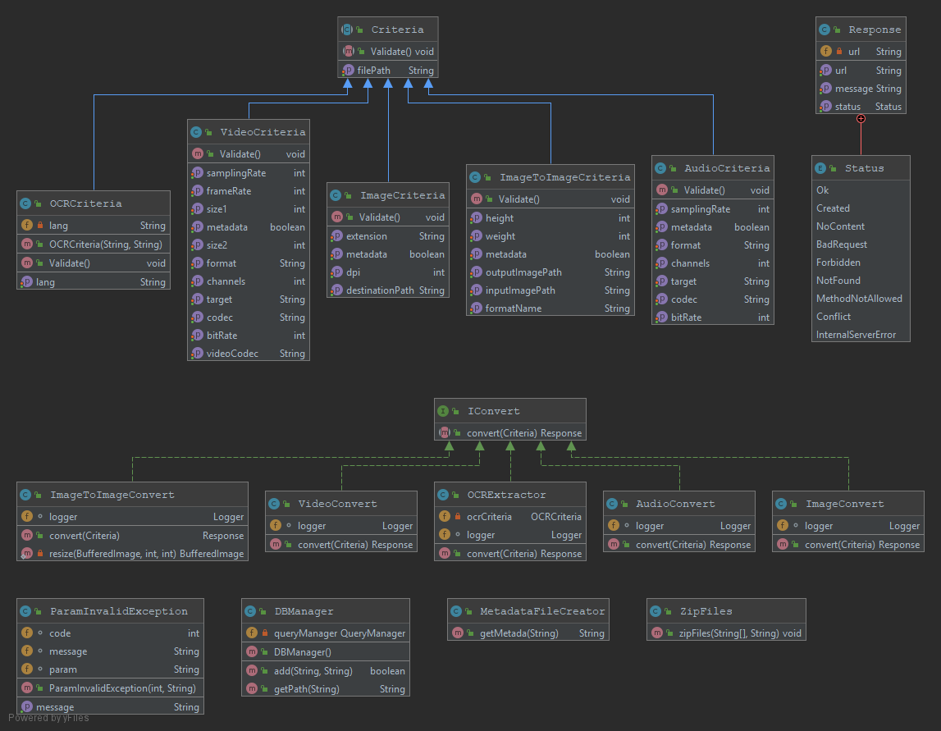
Diagram classes

Slide 4
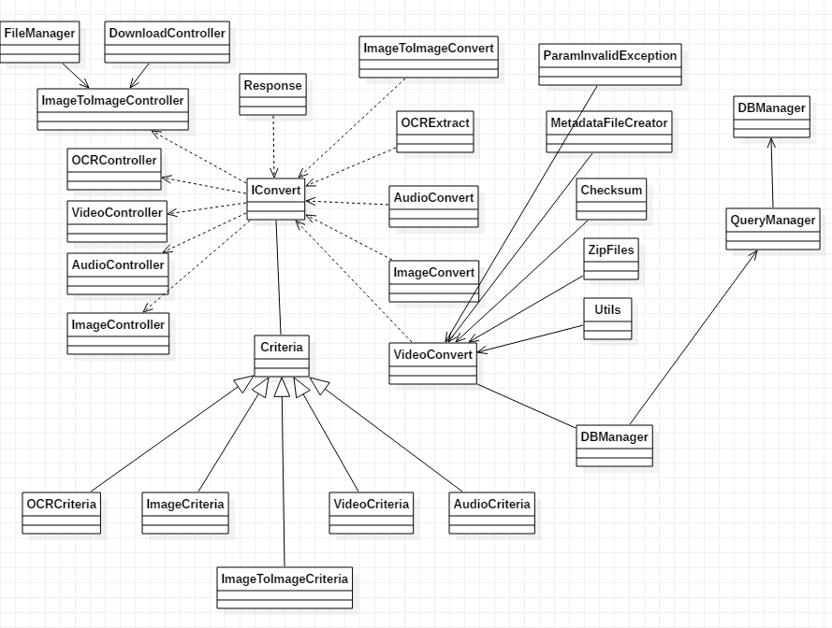

Slide 5
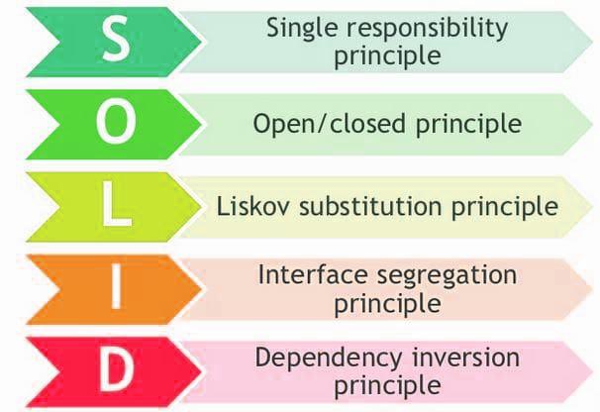
SOLID

Slide 6
EndPoint
* OCRConvert * ImageConvert
* ImageToImageConvert * VideoConvert
* AudioConvert

Slide 7
To Do / Enhancement
Implement Strategy pattern in Validator classes.
Refactor packages.
Implement Builder pattern in Criteria classes.
Create a SQL script.
Increment code coverage Unit Test.
Build war file.

Slide 8
Know Bugs
Zip files downloaded have 0 mb size fixed
File Path saved in data base saved incomplete fixed
The response message shows “bad request” even after made the successfully conversion fixed
The metada file generates the values inside arrays not fixed
Validator
Checksum file is not added to zip files fixed
Test allowed extensions for VideoConvert fixed
Logger don’t export log file only display info on console fixed
Error message when checksum not match is not correct fixed
Create a SQL script to generate data base not fixed
Logger displays a binding error message at start not fixed
Response message shows null value instead a confirmation message after complete successfully the task not fixed
Delete un used files from temp folder after complete the task not fixed
Delete un used files from publics folder after complete the task not fixed

Slide 9
Unit Tests
public class DownloadControllerTest {
@Test
public void download() {
HttpServletResponse response = null;
String file = "";
boolean thrown = false;
Utils utils = new Utils();
try {
response.setContentType("application/octet-stream");
InputStream inputStream = new BufferedInputStream(new
FileInputStream(file));
FileCopyUtils.copy(inputStream,response.getOutputStream());
} catch (Exception e) {
thrown= true;
}
assertTrue(thrown);
}
}

Slide 10
Thank you!

