Slide 2
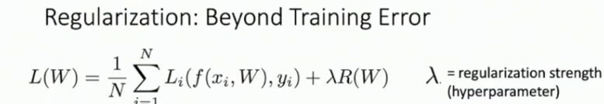

REGULARIZATION

Slide 3
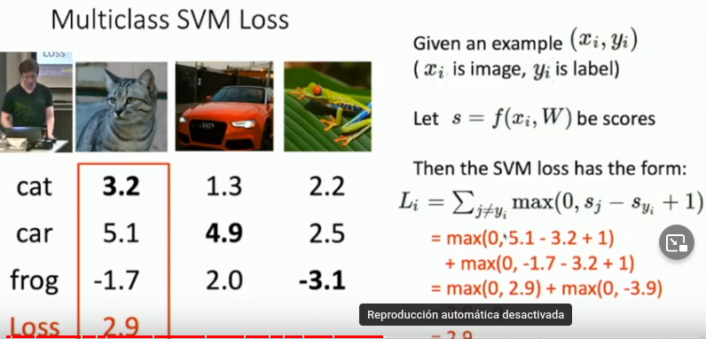
SVM Loss
LOSS
LOSS

Slide 4
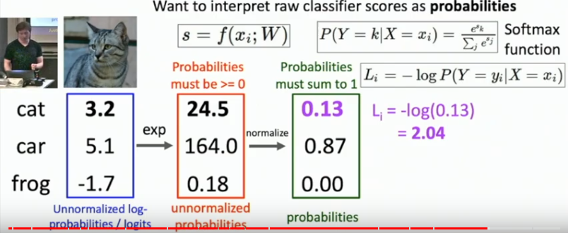
SoftMax
LOSS

