Slide 2
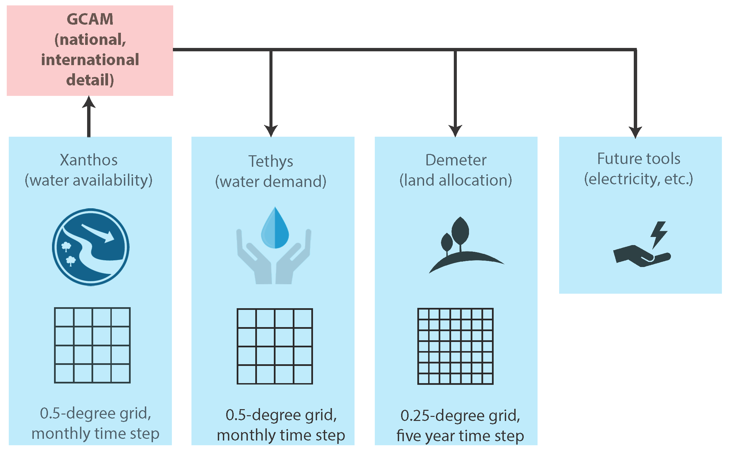

Slide 3
SRN
Phase 1
SRN
Phase 2
WEL accounting by sub-region
WEL
inter-sectoral dynamics

Slide 4
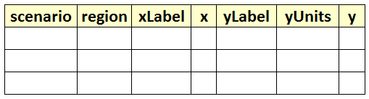
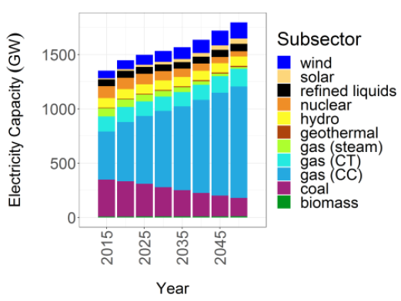
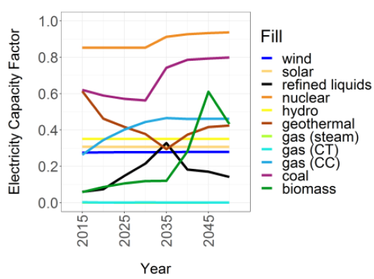
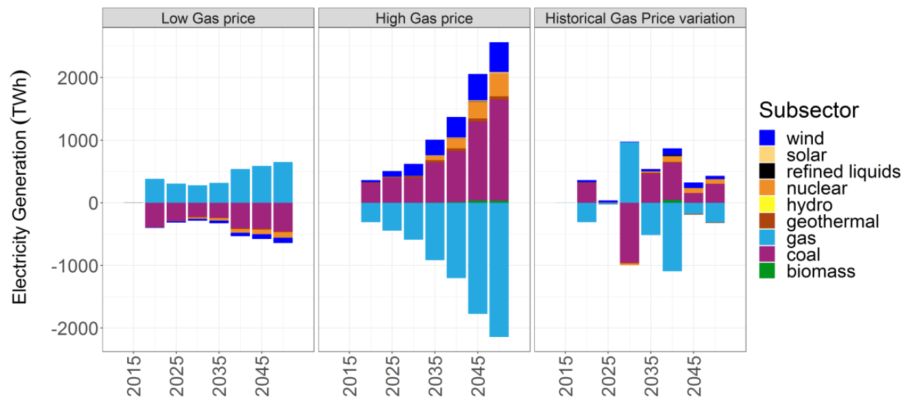
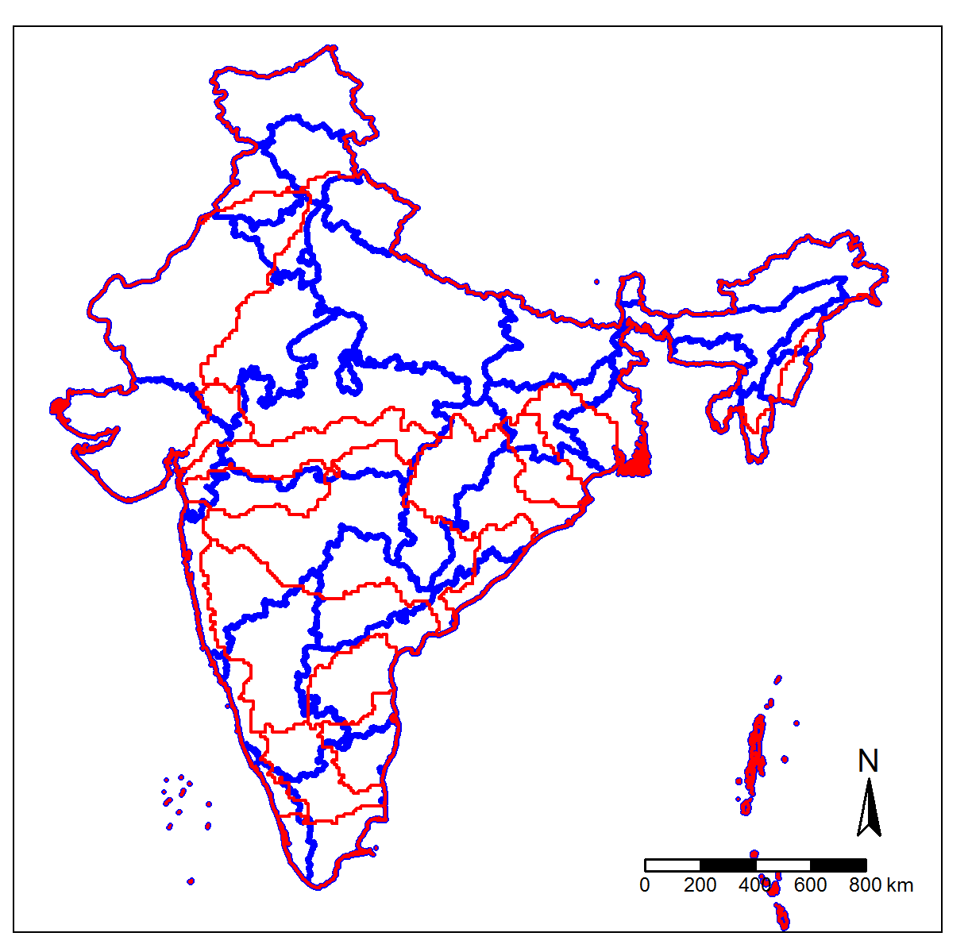
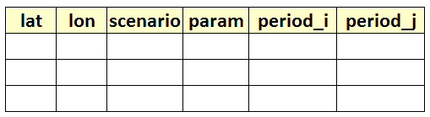
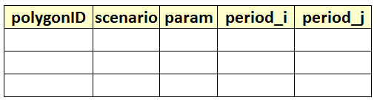
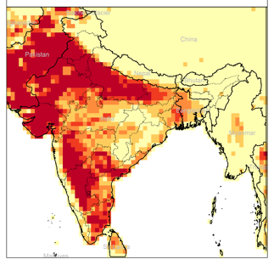
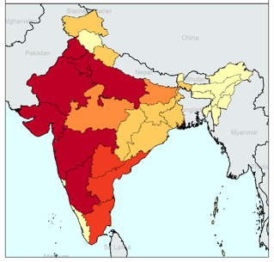
SRN
Phase 1
Standardized Tables
GCAM database
1. Default Values
2. Blank Template for users
srn.readgcam.R
Any Standardized Table
Charts
srn.chart.R
Any Standardized Grid Table
Any Shapefile
Standardized Polygon Tables
srn.grid2poly.R
1. Default Values
2. Blank Template for users
Any Standardized Polygon Table
Polygon Shapefile
Maps
1. Gridded
2. Polygons
srn.maps.R

