Slide 1
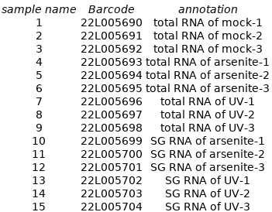
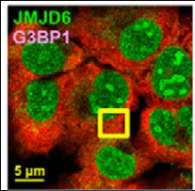
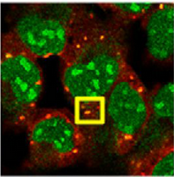
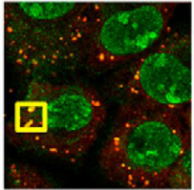
2201_Zhou_Akhtar_stressGranules
Human cells -
mock arsenite UV
total_RNA
- rep: 1, 2, 3
total_RNA
- rep: 4, 5, 6
sg_RNA
- rep: 10, 11, 12
total_RNA
- rep: 7, 8, 9
sg_RNA
- rep: 13, 14, 15

Slide 2
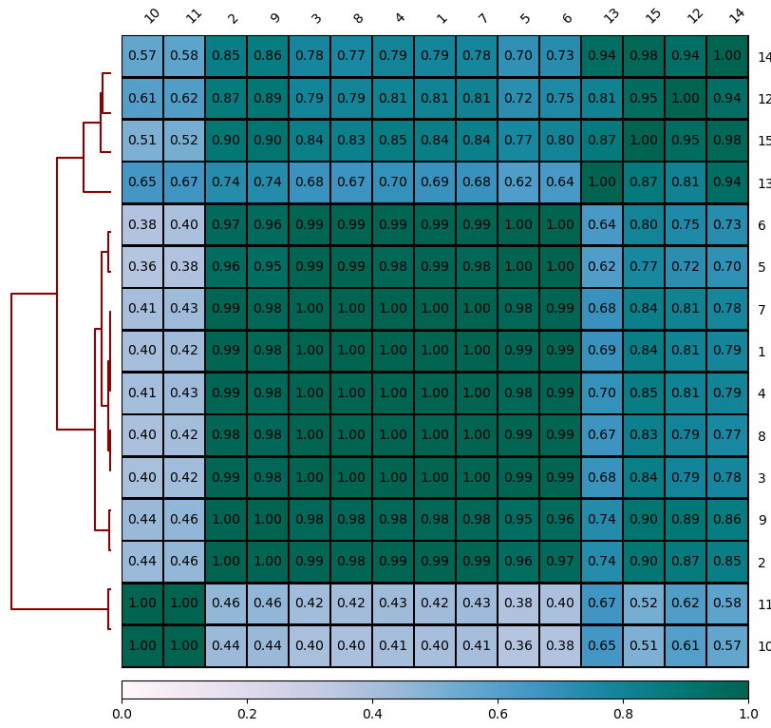
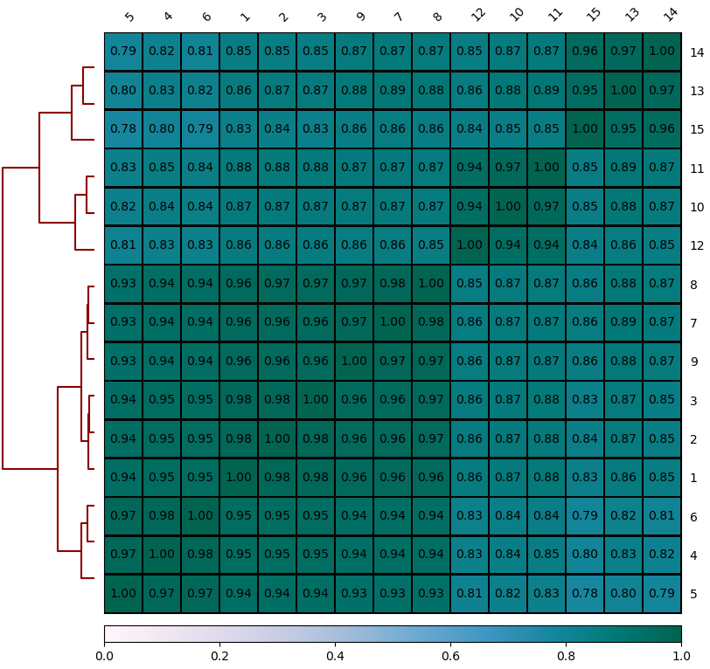
deepTools_qc: Spearman correlation is better than Pearson's correlation
Pearson correlation of genes coverage
Spearman correlation of genes coverage
Pearson is most appropriate for measurements taken from an interval scale, while the Spearman is more appropriate for measurements taken from ordinal scales.

Slide 3
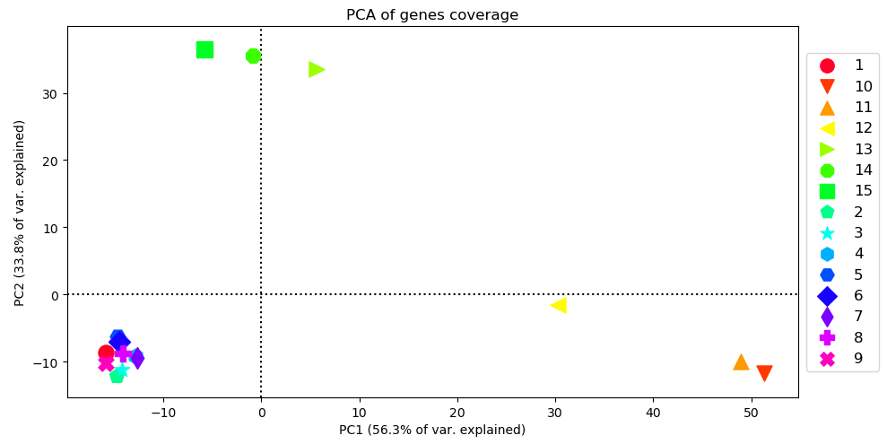
Samples separate on PCA
12

Slide 4
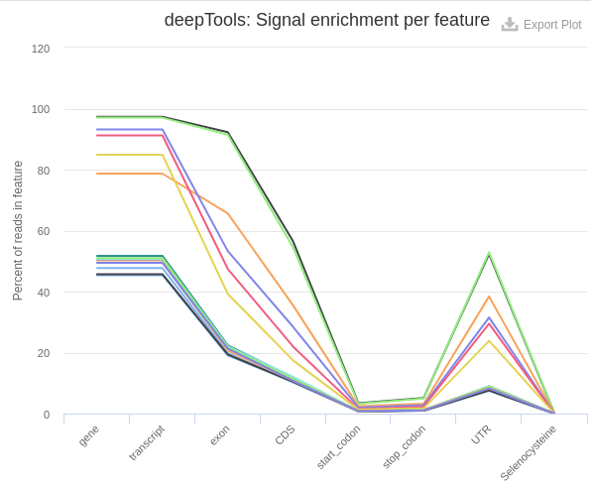
Feature enrichment in stress granules
10
11
12
13
14
15
10
11
12
13
14
15

Slide 5
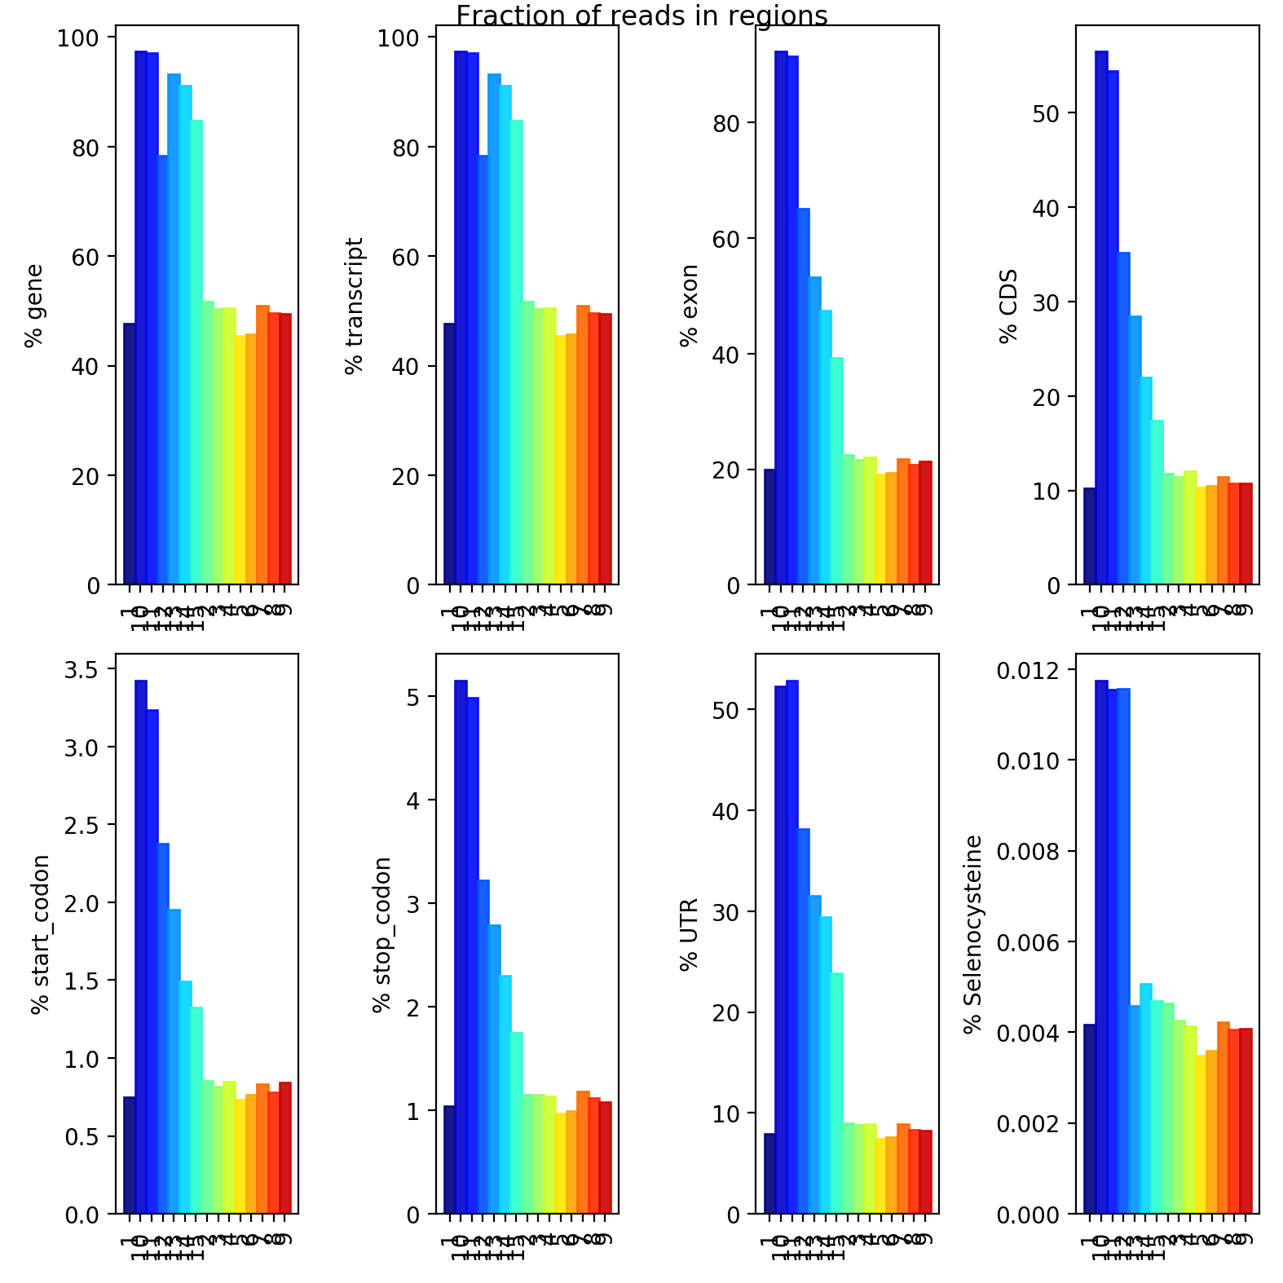
Feature enrichment in stress granules
The odd one out

Slide 6
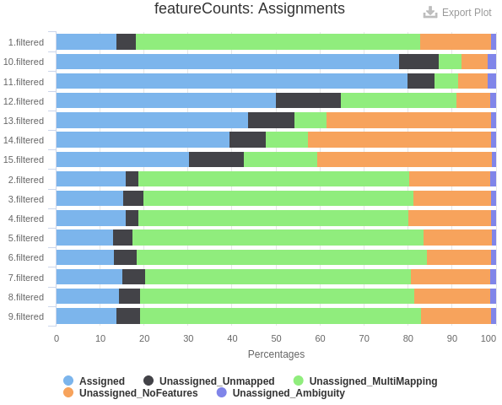
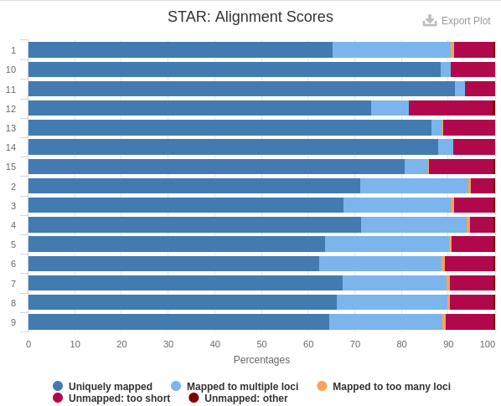
Sample 12 in context

Slide 7
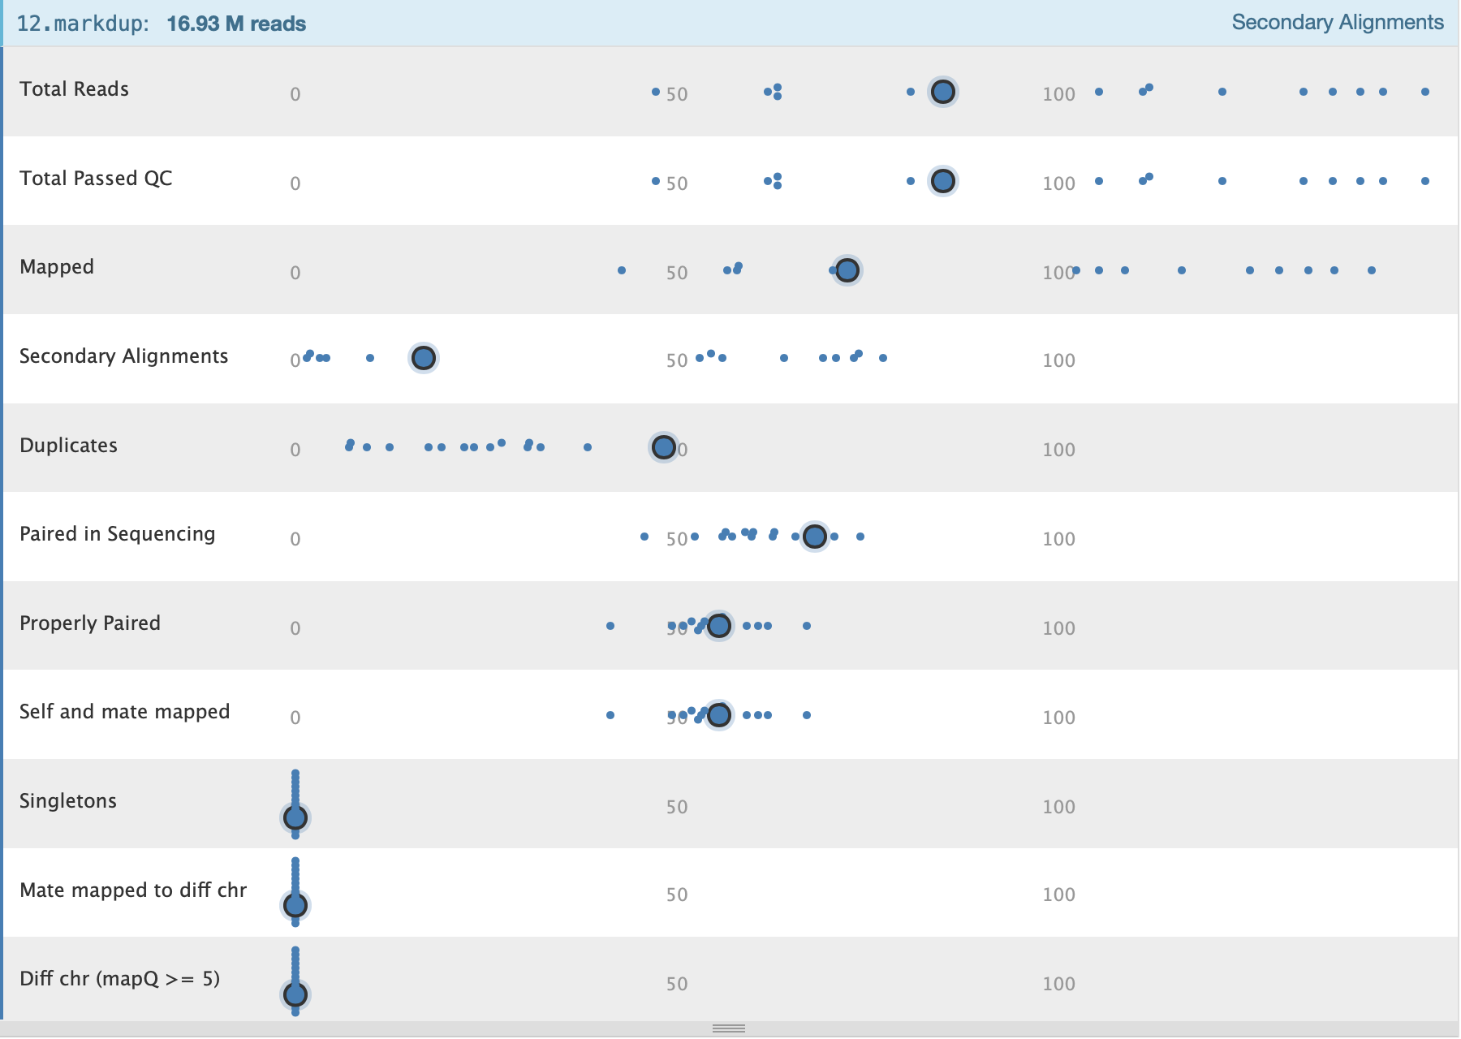
Sample 12 in context

Slide 8
2218_Zhou_Akhtar_stressGranules
Human cells – 3 reps/ experimental condition
mock other treatments UV
total_RNA
total_RNA
sg_RNA
total_RNA
sg_RNA

Slide 9
Uneven experimental design
Human cells – 3 reps/ experimental condition
name | batch | condition | group |  | name | batch | condition | group
s1 | collA | totRNA_mock | All
s2 | collA | totRNA_mock | All
s3 | collB | totRNA_mock | All
s4 | collA | totRNA_arsenite | treatment1 |  | s16 | collA | sgRNA_arsenite | treatment1
s5 | collB | totRNA_arsenite | treatment1 |  | s17 | collB | sgRNA_arsenite | treatment1
s6 | collB | totRNA_arsenite | treatment1 |  | s18 | collB | sgRNA_arsenite | treatment1
s7 | collB | totRNA_HS | treatment2 |  | s19 | collB | sgRNA_HS | treatment2
s8 | collB | totRNA_HS | treatment2 |  | s20 | collB | sgRNA_HS | treatment2
s9 | collB | totRNA_HS | treatment2 |  | s21 | collB | sgRNA_HS | treatment2
s10 | collA | totRNA_NaCl | treatment3 |  | s22 | collA | sgRNA_NaCl | treatment3
s11 | collB | totRNA_NaCl | treatment3 |  | s23 | collB | sgRNA_NaCl | treatment3
s12 | collB | totRNA_NaCl | treatment3 |  | s24 | collB | sgRNA_NaCl | treatment3
s13 | collA | totRNA_UV | treatment4 |  | s25 | collA | sgRNA_UV | treatment4
s14 | collA | totRNA_UV | treatment4 |  | s26 | collA | sgRNA_UV | treatment4
s15 | collB | totRNA_UV | treatment4 |  | s27 | collB | sgRNA_UV | treatment4
mock other treatments UV
total_RNA
total_RNA
sg_RNA
total_RNA
sg_RNA

Slide 10
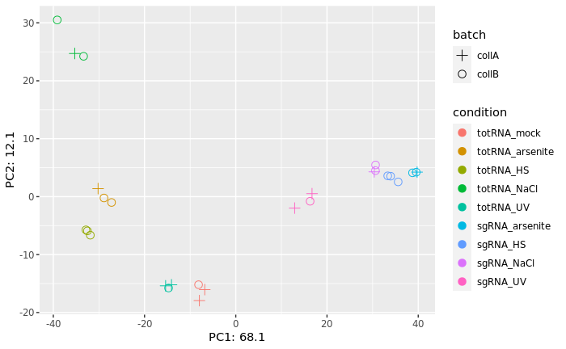
PCA plots

Slide 11
> resultsNames(dds_batch)
[1] "Intercept" "batch_collB_vs_collA" "condition_totRNA_arsenite_vs_totRNA_mock"
[4] "condition_totRNA_HS_vs_totRNA_mock" "condition_totRNA_NaCl_vs_totRNA_mock" "condition_totRNA_UV_vs_totRNA_mock"
[7] "condition_sgRNA_arsenite_vs_totRNA_mock" "condition_sgRNA_HS_vs_totRNA_mock" "condition_sgRNA_NaCl_vs_totRNA_mock"
[10] "condition_sgRNA_UV_vs_totRNA_mock"
> dfmeta_all$condition
[1] totRNA_mock totRNA_mock totRNA_mock totRNA_arsenite totRNA_arsenite totRNA_arsenite totRNA_HS totRNA_HS
[9] totRNA_HS totRNA_NaCl totRNA_NaCl totRNA_NaCl totRNA_UV totRNA_UV totRNA_UV sgRNA_arsenite
[17] sgRNA_arsenite sgRNA_arsenite sgRNA_HS sgRNA_HS sgRNA_HS sgRNA_NaCl sgRNA_NaCl sgRNA_NaCl
[25] sgRNA_UV sgRNA_UV sgRNA_UV
Levels: totRNA_mock totRNA_arsenite totRNA_HS totRNA_NaCl totRNA_UV sgRNA_arsenite sgRNA_HS sgRNA_NaCl sgRNA_UV
log2 fold change (MLE): condition totRNA_arsenite vs totRNA_mock
Wald test p-value: condition totRNA arsenite vs totRNA mock
DataFrame with 63236 rows and 6 columns
baseMean log2FoldChange lfcSE stat pvalue padj
<numeric> <numeric> <numeric> <numeric> <numeric> <numeric>
ENSG00000000003.14 224.427 -0.622499 0.231434 -2.689752 0.00715051 0.0579688
ENSG00000000005.5 0.000 NA NA NA NA NA
ENSG00000000419.12 223.727 -0.315568 0.206968 -1.524720 0.12732889 0.3699957
ENSG00000000457.13 208.469 0.203102 0.203419 0.998440 0.31806601 0.6060230
ENSG00000000460.16 377.746 -0.103939 0.142973 -0.726982 0.46723693 0.7300349
Apeglm:log2 fold change (MAP): condition totRNA_arsenite vs totRNA_mock
Wald test p-value: condition totRNA arsenite vs totRNA mock
DataFrame with 63236 rows and 5 columns
baseMean log2FoldChange lfcSE pvalue padj
<numeric> <numeric> <numeric> <numeric> <numeric>
ENSG00000000003.14 224.427 -0.456661 0.250447 0.00715051 0.0579688
ENSG00000000005.5 0.000 NA NA NA NA
ENSG00000000419.12 223.727 -0.181854 0.180017 0.12732889 0.3699957
ENSG00000000457.13 208.469 0.109160 0.157738 0.31806601 0.6060230
ENSG00000000460.16 377.746 -0.062468 0.119723 0.46723693 0.7300349
Ashr:log2 fold change (MMSE): condition totRNA_arsenite vs totRNA_mock
Wald test p-value: condition totRNA arsenite vs totRNA mock
DataFrame with 63236 rows and 5 columns
baseMean log2FoldChange lfcSE pvalue padj
<numeric> <numeric> <numeric> <numeric> <numeric>
ENSG00000000003.14 224.427 -0.2885846 0.224399 0.00715051 0.0579688
ENSG00000000005.5 0.000 0.0000000 0.669554 NA NA
ENSG00000000419.12 223.727 -0.1215441 0.140512 0.12732889 0.3699957
ENSG00000000457.13 208.469 0.0754157 0.128744 0.31806601 0.6060230
ENSG00000000460.16 377.746 -0.0523490 0.103433 0.46723693 0.7300349

Slide 12
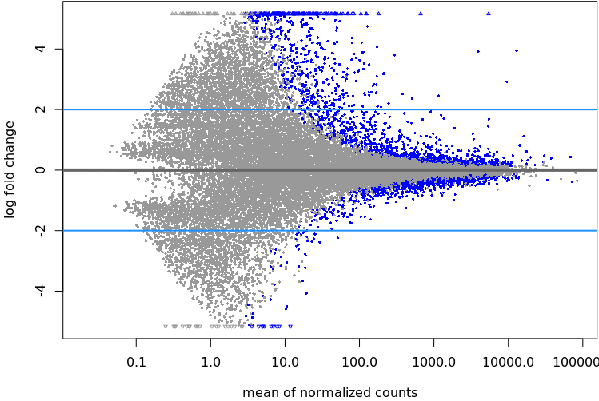
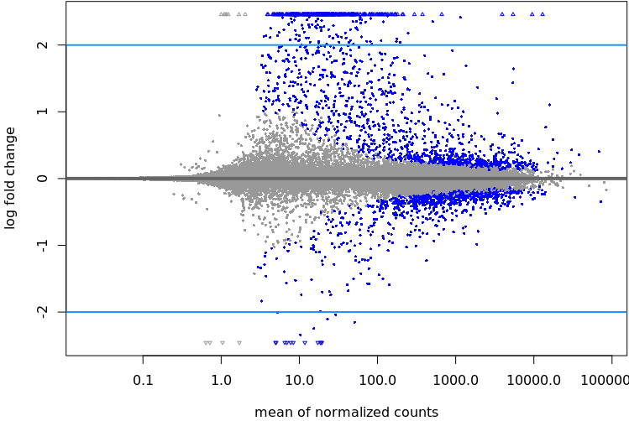
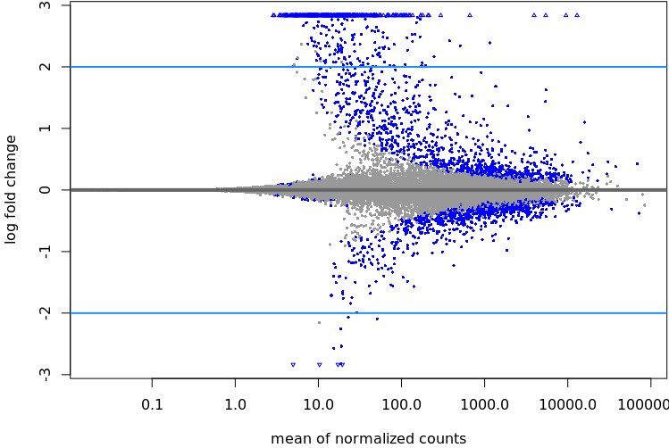
dds_res
dds_res.apeglm
dds_res.ashr
Not filtered
> summary(DE_gene_totRNA_arsenite_vs_totRNA_mock, alpha = 0.05)
out of 36102 with nonzero total read count
adjusted p-value < 0.05
LFC > 0 (up) : 1432, 4%
LFC < 0 (down) : 887, 2.5%
outliers [1] : 0, 0%
low counts [2] : 16134, 45%
(mean count < 3)
[1] see 'cooksCutoff' argument of ?results
[2] see 'independentFiltering' argument of ?results
> summary(DE_gene_totRNA_arsenite_vs_totRNA_mock_apeglm, alpha = 0.05)
out of 36102 with nonzero total read count
adjusted p-value < 0.05
LFC > 0 (up) : 1432, 4%
LFC < 0 (down) : 887, 2.5%
outliers [1] : 0, 0%
low counts [2] : 16134, 45%
(mean count < 3)
[1] see 'cooksCutoff' argument of ?results
[2] see 'independentFiltering' argument of ?results
> summary(DE_gene_totRNA_arsenite_vs_totRNA_mock_ashr, alpha = 0.05)
out of 36102 with nonzero total read count
adjusted p-value < 0.05
LFC > 0 (up) : 1432, 4%
LFC < 0 (down) : 887, 2.5%
outliers [1] : 0, 0%
low counts [2] : 16134, 45%
(mean count < 3)
[1] see 'cooksCutoff' argument of ?results
[2] see 'independentFiltering' argument of ?results

Slide 13
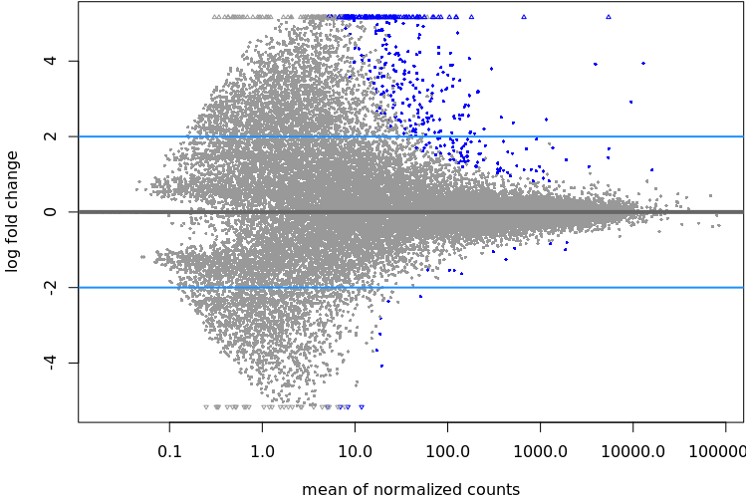
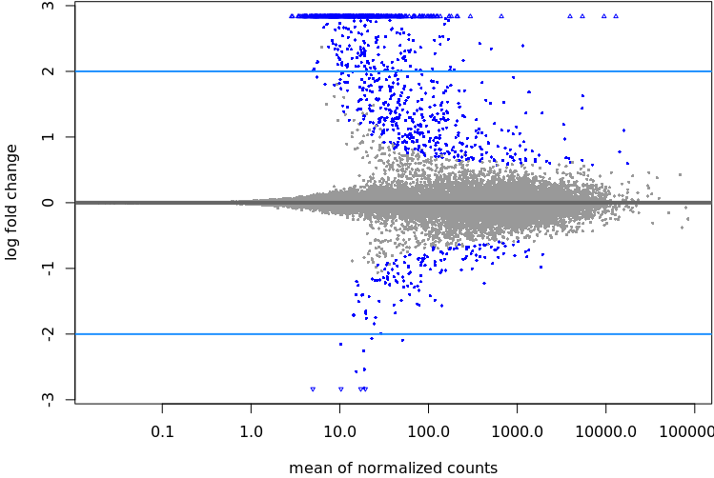
dds_res
dds_res.apeglm
dds_res.ashr
LfcThreshold=0.5
> summary(DE_gene_totRNA_arsenite_vs_totRNA_mock_0.5, alpha=0.05)
out of 36102 with nonzero total read count
adjusted p-value < 0.05
LFC > 0.50 (up) : 377, 1%
LFC < -0.50 (down) : 20, 0.055%
outliers [1] : 0, 0%
low counts [2] : 16134, 45%
(mean count < 3)
[1] see 'cooksCutoff' argument of ?results
[2] see 'independentFiltering' argument of ?results
> summary(DE_gene_totRNA_arsenite_vs_totRNA_mock_apeglm_0.5, alpha=0.05)
out of 36102 with nonzero total read count
s-value < 0.05
LFC > 0.50 (up) : 835, 2.3%
LFC < -0.50 (down) : 142, 0.39%

Slide 14
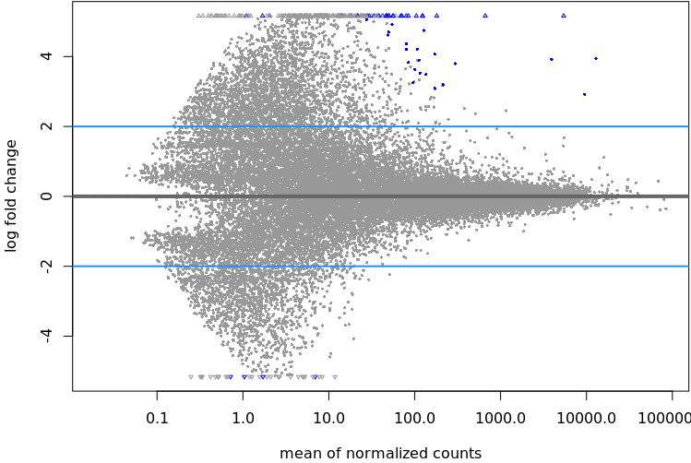
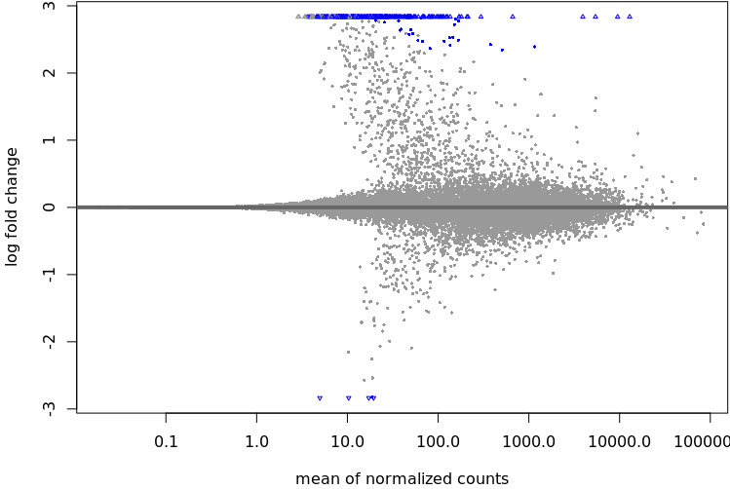
dds_res
dds_res.apeglm
dds_res.ashr
lfcThreshold=2
> summary(DE_gene_totRNA_arsenite_vs_totRNA_mockTH, alpha=0.05)
out of 36102 with nonzero total read count
adjusted p-value < 0.05
LFC > 2.00 (up) : 51, 0.14%
LFC < -2.00 (down) : 4, 0.011%
outliers [1] : 0, 0%
low counts [2] : 7395, 20%
(mean count < 0)
[1] see 'cooksCutoff' argument of ?results
[2] see 'independentFiltering' argument of ?results
> summary(DE_gene_totRNA_arsenite_vs_totRNA_mock_apeglmTH, alpha=0.05)
out of 36102 with nonzero total read count
s-value < 0.05
LFC > 2.00 (up) : 295, 0.82%
LFC < -2.00 (down) : 5, 0.014%
> can’t use thresholds filtering with ashr

Slide 15
DESeq2_totalRNA – batch vs no_batch
(gene lvl)
Adjp < 0.05
No threshold on lfc
Collection dates | Sample name | No batch in design |  |  | Batch considered in design
 |  | Up DE genes | Down DE genes | total | Up DE genes | Down DE genes | total
AAB vs ABB | totalRNA_ars_vs_mock (treat1) | 1024 | 294 | 1318 | 853 | 179 | 1032
AAB vs BBB | totalRNA_HS_vs_mock (treat2) | 2506 | 1986 | 4492 | 1253 | 984 | 2237
AAB vs ABB | totalRNA_NaCl_vs_mock (treat3) | 2923 | 1935 | 4858 | 2310 | 1675 | 3985
AAB vs AAB | totalRNA_UV_vs_mock (treat4) | 2636 | 2489 | 5125 | 2596 | 2438 | 5034

Slide 16
DESeq2_sgRNA – batch vs no_batch
(gene lvl)
Adjp < 0.05
No threshold on lfc
Collection dates | Sample name | No batch in design |  |  | Batch considered in design
 |  | Up DE genes | Down DE genes | total | Up DE genes | Down DE genes | total
ABB vs BBB | sgRNA_ars_vs_HS | 4240 | 4363 | 8603 | 4135 | 4253 | 8388
ABB vs ABB | sgRNA_ars_vs_NaCl | 3934 | 4102 | 8036 | 3999 | 4261 | 8260
ABB vs AAB | sgRNA_ars_vs_UV | 7524 | 5395 | 12919 | 6850 | 5122 | 11972
BBB vs ABB | sgRNA_HS_vs_NaCl | 5169 | 5188 | 10357 | 4780 | 4905 | 9685
BBB vs AAB | sgRNA_HS_vs_UV | 7252 | 5771 | 13023 | 5119 | 4924 | 10043
ABB vs AAB | sgRNA_NaCl_vs_UV | 6912 | 6094 | 13006 | 6382 | 5837 | 12219

Slide 17
DESeq2_totalRNA – batch vs no_batch
(transcript lvl)
> wc -l sleuth_Salmon_batch_totalRNA_corrected_sampleSheet.treatment1/Wald-test.results.tsv
182 513 - all transcripts

Slide 18
DESeq2_totalRNA – batch vs no_batch
(transcript lvl)
Collection dates | Sample name | No batch in design |  |  | Batch considered in design
 |  | Up DE genes | Down DE genes | total | Up DE genes | Down DE genes | total
AAB vs ABB | totalRNA_ars_vs_mock (treat1) | 387 | 120 | 454 | 359 | 95 | 507
AAB vs BBB | totalRNA_HS_vs_mock (treat2) | 1386 | 973 | 1152 | 733 | 419 | 2359
AAB vs ABB | totalRNA_NaCl_vs_mock (treat3) | 1469 | 1180 | 2242 | 1220 | 1022 | 2649
AAB vs AAB | totalRNA_UV_vs_mock (treat4) | 1713 | 1546 | 3256 | 1698 | 1558 | 3259

Slide 19
DESeq2_sgRNA – batch vs no_batch
(transcript lvl)
Collection dates | Sample name | No batch in design |  |  | Batch considered in design
 |  | Up DE genes | Down DE genes | total | Up DE genes | Down DE genes | total
ABB vs BBB | sgRNA_ars_vs_HS | 3897 | 3913 | 7810
ABB vs ABB | sgRNA_ars_vs_NaCl | 3473 | 3643 | 7116
ABB vs AAB | sgRNA_ars_vs_UV | 5767 | 4684 | 10451
BBB vs ABB | sgRNA_HS_vs_NaCl | 4772 | 4743 | 9515
BBB vs AAB | sgRNA_HS_vs_UV | 5577 | 5000 | 10577
ABB vs AAB | sgRNA_NaCl_vs_UV | 5655 | 5290 | 10945

Slide 20
CIRI2 – output
CIRI2
- detect circRNAs from transcriptome
CIRI_AS
- detects circRNAs internal components and alternative splicing events
CIRI_full
- uses both BSJ and reverse overlap (RO) features to reconstruct and quantify full-length circular RNAs
CIRI_VIS
- visualizing alignments of BSJ & RO merged reads and estimating the related abundance of isoforms
CIRIquant
- quantification and DE

Slide 21
A) CIRI2 – output
- detect circRNAs from transcriptome
1 2 3 4 5 6
circRNA_ID chr circRNA_start circRNA_end junction_reads SM_MS_SMS
1:11070900|11076948 1 11070900 11076948 2-58 1_1_2
7 8 9 10
non_junction_reads junction_reads_ratio circRNA_type gene_id
1-1570 0.11-0.857 97-exon; 17 intergenic; 9 intron ENSG00000171824, n/a
11 12
strand junction_reads_ID
-/+ A00931:420:H7M2JDMXY:1:2141:12020:5901,A00931:420:H7M2JDMXY:1:2460:24252:18035,etc,
CIRI2
.ciri
Column Description
1 ID of a predicted circRNA in the pattern of "chr:start:end”
2 chromosome of a predicted circRNA (1-22, X, Y)
3 start loci of a predicted circRNA on the chromosome
4 end loci of a predicted circRNA on the chromosome
5 circular junction read (also called as BSJ read) count of a predicted circRNA
6 unique CIGAR types of a predicted circRNA. For example, a circRNAs have three junction reads: read A (80M20S, 80S20M), read B (80M20S, 80S20M), read C (40M60S, 40S30M30S, 70S30M), then its has two SM types (80S20M, 70S30M), two MS types (80M20S, 70M30S) and one SMS type (40S30M30S). Thus its SM_MS_SMS should be 2_2_1.
7 non-junction read count of a predicted circRNA that mapped across the circular junction but consistent with linear RNA instead of being back-spliced
8 ratio of circular junction reads calculated by 2*junction_reads/(2*junction_reads+non_junction_reads).
9 type of a circRNA according to positions of its two ends on chromosome (exon, intron or intergenic_region)
10 ID of the gene(s) where an exonic or intronic circRNA locates
11 strand info of a predicted circRNAs (new in CIRI2)
12 all of the circular junction read IDs (split by ",")
CIRI_AS
CIRI_full
CIRI_VIS

Slide 22
A) CIRI2 – output
- detect circRNAs from transcriptome
Nr_circRNA File
123 ./s1_out/CIRI_output/ciri_f.ciri
85 ./s2_out/CIRI_output/ciri_f.ciri
75 ./s3_out/CIRI_output/ciri_f.ciri
98 ./s4_out/CIRI_output/ciri_f.ciri
100 ./s5_out/CIRI_output/ciri_f.ciri
102 ./s6_out/CIRI_output/ciri_f.ciri
116 ./s7_out/CIRI_output/ciri_f.ciri
148 ./s8_out/CIRI_output/ciri_f.ciri
169 ./s9_out/CIRI_output/ciri_f.ciri
82 ./s10_out/CIRI_output/ciri_f.ciri
109 ./s11_out/CIRI_output/ciri_f.ciri
126 ./s12_out/CIRI_output/ciri_f.ciri
169 ./s13_out/CIRI_output/ciri_f.ciri
212 ./s14_out/CIRI_output/ciri_f.ciri
150 ./s15_out/CIRI_output/ciri_f.ciri
167 ./s16_out/CIRI_output/ciri_f.ciri
266 ./s17_out/CIRI_output/ciri_f.ciri
226 ./s18_out/CIRI_output/ciri_f.ciri
229 ./s19_out/CIRI_output/ciri_f.ciri
300 ./s20_out/CIRI_output/ciri_f.ciri
164 ./s21_out/CIRI_output/ciri_f.ciri
392 ./s22_out/CIRI_output/ciri_f.ciri
379 ./s23_out/CIRI_output/ciri_f.ciri
296 ./s24_out/CIRI_output/ciri_f.ciri
230 ./s25_out/CIRI_output/ciri_f.ciri
280 ./s26_out/CIRI_output/ciri_f.ciri
358 ./s27_out/CIRI_output/ciri_f.ciri
total: 5151
CIRI2
.ciri
CIRI_AS
CIRI_full
CIRI_VIS

Slide 23
B) CIRI2_AS – output
- detects circRNAs internal components and alternative splicing events
_AS.list
circRNA_id alternatively_spliced_exon AS_type psi_estimation_without_correction psi_estimation_after_correction
empty
CIRI2
_coverage.list
_jav.list
CIRI_AS
_length.list
.list
.log
.log2
_splice.list
CIRI_full
CIRI_VIS

Slide 24
B) CIRI2_AS – output
- detects circRNAs internal components and alternative splicing events
_AS.list
1 2 3
chr location coverage
1-22, X 11070900 0-6986
wc -l: 2289879
CIRI2
_coverage.list
_jav.list
CIRI_AS
_length.list
.list
.log
.log2
_splice.list
CIRI_full
CIRI_VIS

Slide 25
B) CIRI2_AS – output
- detects circRNAs internal components and alternative splicing events
_AS.list
1 2 3 4
circRNA_id chr start end
1:11070900|11076948 1-22, X 11070900 11076948
5 6
known_linear_exon predicted_cirexon 11070900:11070973,11070900:11070988,11070900:11073026/ 137448780:137448933(ICF), n/a
7
sequencing_depth
24,24,24,24,24,25,25,25,25,25,25,25,25,26, etc
8
junction_read_mapping
<NULL::A00931:420:H7M2JDMXY:1:2460:24252:18035(11076888-11076949!60|11070899-11070936!60|)(11076887-11076949!60|11070899-11070935!60|)A00931:420:H7M2JDMXY:1:2141:12020:5901(11076888-11076949!60|11070899-11070936!60|)(11076887-11076949!60|11070899-11070935!60|)A00931:420:H7M2JDMXY:2:2432:28158:28025(11076888-11076949!60|11070899-11070936!60|)(11076887-11076949!60|11070899-11070935!60|)>
CIRI2
_coverage.list
_jav.list
CIRI_AS
_length.list
.list
.log
.log2
_splice.list
CIRI_full
CIRI_VIS

Slide 26
B) CIRI2_AS – output
- detects circRNAs internal components and alternative splicing events
_AS.list
CIRI2
_coverage.list
_jav.list
CIRI_AS
_length.list
.list
.log
.log2
_splice.list
A00931:420:H7M2JDMXY:1:2370:16559:34428 1 202879616 202879716 101 1 202878957 202881223
A00931:420:H7M2JDMXY:1:2370:16559:34428 0 202879708 202879808 101 1 202878957 202881223
0: 202879616,202879708 202879716,202879808 92
A00931:420:H7M2JDMXY:2:1432:14986:21840 1 202879616 202879716 101 1 202878957 202881223
A00931:420:H7M2JDMXY:2:1432:14986:21840 0 202879708 202879808 101 1 202878957 202881223
0: 202879616,202879708 202879716,202879808 92
CIRI_full
CIRI_VIS

Slide 27
B) CIRI2_AS – output
- detects circRNAs internal components and alternative splicing events
_AS.list
CIRI2
_coverage.list
1 2 3 4 5 6 7
circRNA_id chr start end strand junction_reads PCC(MS_SM_SMS)
1:32094784|32100562 1-22, X 32094784 32100562 -/+ 2-58 1_2_1
8 9 10 11
non_junction_reads junction_reads_ratio circRNA_type gene_id
1-1570 0.11 – 0.857 74exon/16intergenic/5 intron ENSG00000121775, n/a
12 13 14 15 16
cirexon_id cirexon_start cirexon_end start_supporting_BSJ_read end_supporting_BSJ_read
cirexon1/2/3/4 32100442 32100562 start/0-11 end/ 0-7
17 18
sequencing_depth_median if_ICF
3-1669 ICF/non_ICF
_jav.list
CIRI_AS
_length.list
.list
.log
.log2
_splice.list
CIRI_full
CIRI_VIS

Slide 28
B) CIRI2_AS – output
- detects circRNAs internal components and alternative splicing events
_AS.list
43684 candidate splice junctions within circRNAs from 32040 reads are recognized, of which 166 are from known BSJ reads.
43094 candidate splice junctions have splicing signals.
In sum, 1206 non-redundant splice junctions within circRNAs are detected.
splice:11070973:11072087in_1:11070900|11076948: etc
CIRI2
_coverage.list
_jav.list
CIRI_AS
_length.list
.list
.log
.log2
_splice.list
CIRI_full
CIRI_VIS

Slide 29
B) CIRI2_AS – output
- detects circRNAs internal components and alternative splicing events
_AS.list
1 2 3 4 5 6
1:71592817|71611146->path:2 0->0=>71592817:71592968,1->1=>71611026:71611146,
11:452521|452682->path:1 0->0=>452521:452682,
11:12988402|13027038->path:2 0->0=>12988402:12988466,1->1=>13026918:13027038,
11:62638983|62639731->path:2 0->0=>62638983:62639110,1->1=>62639627:62639731,
11:63976302|63976453->path:1 0->0=>63976302:63976453,
14:69952137|69953532->path:2 0->0=>69952137:69952303,1->1=>69953420:69953532,
15:25405461|25411971->path:2 0->0=>25405461:25405502,1->1=>25411908:25411971,
16:56899530|57061531->path:2 0->0=>56899530:56899616,1->1=>57061448:57061531,
CIRI2
_coverage.list
_jav.list
CIRI_AS
_length.list
.list
.log
.log2
_splice.list
CIRI_full
CIRI_VIS

Slide 30
B) CIRI2_AS – output
- detects circRNAs internal components and alternative splicing events
_AS.list
1 2 3 4 5 6
ID chr splice_start splice_end supporting_reads SM_MS_SMS 1:11072087|11070973 1-22, X 11072087 11070973 1-2496 8_7_2
7
junction_reads_ID
A00931:420:H7M2JDMXY:1:2452:8332:34491(),A00931:420:H7M2JDMXY:1:2452:8332:34491(),A00931:420:H7M2JDMXY:2:2469:10158:22748(),A00931:420:H7M2JDMXY:2:1355:7310:36135(),A00931:420:H7M2JDMXY:2:1171:22923:7999(),A00931:420:H7M2JDMXY:1:1464:24668:25019(),A00931:420:H7M2JDMXY:1:2370:24216:36292(),A00931:420:H7M2JDMXY:1:2168:13928:19476(),A00931:420:H7M2JDMXY:1:1479:5240:35274(),A00931:420:H7M2JDMXY:1:1479:5240:35274(),A00931:420:H7M2JDMXY:2:2320:22544:27445(),A00931:420:H7M2JDMXY:1:1366:4978:25833(),A00931:420:H7M2JDMXY:1:2235:1841:4178(),A00931:420:H7M2JDMXY:1:2235:1841:4178(),A00931:420:H7M2JDMXY:1:2234:2582:35744(),A00931:420:H7M2JDMXY:1:2234:2582:35744(),A00931:420:H7M2JDMXY:1:1171:9552:11177(),
CIRI2
_coverage.list
_jav.list
CIRI_AS
_length.list
.list
.log
.log2
_splice.list
CIRI_full
CIRI_VIS

Slide 31
C) CIRI2_full – output
- uses both BSJ and reverse overlap (RO) features to reconstruct and quantify full-length circular RNAs
1 2 3 4
BSJ Chr Start End
1:11070900|11076948 1-22, X 11070900 11076948
5 6
GTF-annotated_exon Cirexon
11070900:11070973,11070900:11070988,etc, n/a 127224400:127224475(ICF), n/a
7
Coveage
24,24,24,24,24,25,25,25,25,25,25,25,25,26, etc, n/a
8
BSJ_reads_information
<NULL::A00931:420:H7M2JDMXY:1:2460:24252:18035(11076888-11076949!60|11070899-11070936!60|)(11076887-11076949!60|11070899-11070935!60|)>
9
RO_reads_information
A00931:420:H7M2JDMXY:2:2477:25229:3349##620983-621036,620962-621033,&& n/a
10 11
Original_gene strain
ENSG00000171824, n/a -/+
CIRI2
CIRI_AS
_detail.anno
CIRI_full
_ro1_align.txt
_ro1.fq
_ro2_info.list
_ro2.sam
CIRI_VIS

Slide 32
C) CIRI2_full – output
- uses both BSJ and reverse overlap (RO) features to reconstruct and quantify full-length circular RNAs
CIRI2
1 2 3 4 5 6
@A00931:420:H7M2JDMXY:1:1377:11686:36824 1:N:0:TGCCGGTC+TTGTATCA 95-100% 1-3 13-101 1-89 99-101 101
@A00931:420:H7M2JDMXY:1:1285:26693:25989 1:N:0:TGCCGGTC+TTGTATCA 98.0% 1 85 17 101 101
@A00931:420:H7M2JDMXY:1:1165:10791:26162 1:N:0:TGCCGGTC+TTGTATCA 97.0% 1 96 6 101 101
CIRI_AS
_detail.anno
CIRI_full
_ro1_align.txt
_ro1.fq
_ro2_info.list
_ro2.sam
CIRI_VIS

Slide 33
C) CIRI2_full – output
- uses both BSJ and reverse overlap (RO) features to reconstruct and quantify full-length circular RNAs
CIRI2
@A00931:420:H7M2JDMXY:1:1377:11686:36824 1:N:0:TGCCGGTC+TTGTATCA
TGACAGAGTAAAACCCTATGTGGGGAAAAAAAAAAAAAAAAGGTAAAAAGTTTCATATAATGAGGCCAGGTGTGGTGGCTCACTTCCGTAATCCCAGCA
+
FFFFFFFFFFFFFFFFFF:FFFFFFFFFFFFFFFFFFFFFFF:,FFFF:FFF,FF,F,FFFFFF:FFFFFFFFF:FFFF:FFFF,FFF,FF,FFFFFFF
CIRI_AS
_detail.anno
CIRI_full
_ro1_align.txt
_ro1.fq
_ro2_info.list
_ro2.sam
CIRI_VIS

Slide 34
C) CIRI2_full – output
- uses both BSJ and reverse overlap (RO) features to reconstruct and quantify full-length circular RNAs
1 2 3 4 5
Read_ID Chr BSJ_position Strand Reconstructed_state
A00931:420:H7M2JDMXY:1:2411:8522:35697 1-22, X 1:17029862|17029970, no BSJ +/- Full/Part
6 7 8 9
Cirexon Mapping_order Splice_site_state+ Splice_site_state-
17029862-17029970, 17029900-17029970,17029862-17029962, readposBound+:0-5/-1 readposBound-:0-5/ -1
CIRI2
CIRI_AS
_detail.anno
CIRI_full
_ro1_align.txt
_ro1.fq
_ro2_info.list
_ro2.sam
CIRI_VIS

Slide 35
C) CIRI2_full – output
- uses both BSJ and reverse overlap (RO) features to reconstruct and quantify full-length circular RNAs
CIRI2
A00931:420:H7M2JDMXY:1:2250:31485:12148 2064 1 36288187 60 31M106H * 0 0 GAATAGGTGGTGTTTGGTTACATGGATAAGT FFF:FFFFFFFFF,FFFF:F:F:FFF:FFFF NM:i:0 MD:Z:31 AS:i:31 XS:i:0 SA:Z:1,36288134,-,26S84M27S,60,0;1,36288134,-,105S32M,10,0;
CIRI_AS
_detail.anno
CIRI_full
_ro1_align.txt
_ro1.fq
_ro2_info.list
_ro2.sam
CIRI_VIS

Slide 36
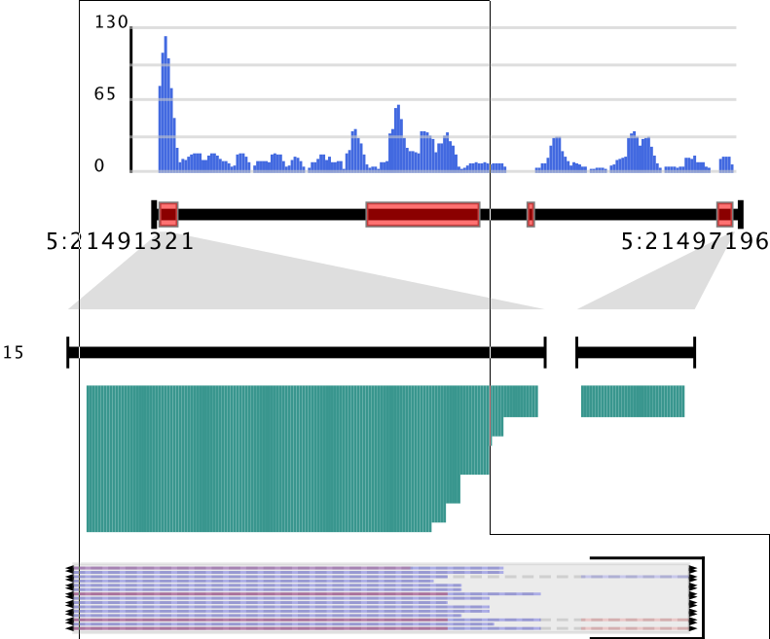
D) CIRI2_VIS – output
- tool for visualizing alignments of BSJ & RO merged reads and estimating the related abundance of isoforms
CIRI2
CIRI_AS
CIRI_full
CIRI_VIS
stout_X.pdf
stout.gtf
stout.list
_circle.fa

Slide 37
D) CIRI2_VIS – output
- tool for visualizing alignments of BSJ & RO merged reads and estimating the related abundance of isoforms
CIRI2
1 2 3 4 5 6 7 8
Chr progr
1-22,X CIRI-Full cirexon/ circRNA_transcript 63976302 63976453 . +/- .
9
gene_id: "ENSG00000176340"; transcript_id: "11:63976302|63976453.1"; BSJ_count: "3"; Isoform_BSJ_count: "3";
CIRI_AS
CIRI_full
CIRI_VIS
stout_X.pdf
stout.gtf
stout.list
_circle.fa

Slide 38
D) CIRI2_VIS – output
- tool for visualizing alignments of BSJ & RO merged reads and estimating the related abundance of isoforms
1 2 3 4 5 6 7 8
Image_ID Circle_ID Chr start end total_exp isoform_number isoform_exp
Stout_2 5:36211844|36227565 1-22,X 36211844 36227565 1-58 1 1-58
9 10 11 12
isoform_length isoform_state strain isoform_cirexon
39-418 Break/ Full +/- ENSG00000152620 36211844-36211922,0-0,36227560-36227565, n/a
CIRI2
CIRI_AS
CIRI_full
CIRI_VIS
stout_X.pdf
stout.gtf
stout.list
_circle.fa

Slide 39
D) CIRI2_VIS – output
- tool for visualizing alignments of BSJ & RO merged reads and estimating the related abundance of isoforms
CIRI2
>stout_16#1:247155566|247159813 length=194 13/13 -
AGAAGTCTTAGATTTCTTGAAGAATTTTTGTACTGATCTTCAATGCTCTGGTCTTCCCCTTTGTTTCCTATGGAAGCCAGATTCCTGAAGGTTTCCTGCATCACGTCTCTATAGAGATTCTTCTGGGAAGGATCCAACAAAGCCCACTCCTCCTGGGTGAAGTTCACAGCCACATCCTCAAAGGCAACCGAGTT
CIRI_AS
CIRI_full
CIRI_VIS
stout_X.pdf
stout.gtf
stout.list
_circle.fa

Slide 40
E) CIRI2quant – output 1
- circRNA quantifcation
1 2 3 4 5 6 7 8
chr source type start end score/CPM strand .
1 CIRIquant circRNA 1495485 1529331 0.3614 + .
9
attributes
circ_id "1:1495485|1529331";
circ_type "exon";
bsj 9.000;
fsj 138.000;
junc_ratio 0.115;
gene_id "ENSG00000197785,ENSG00000160072,ENSG00000284740";
gene_name "ATAD3A,ATAD3B,AL645728.2";
gene_type "protein_coding,protein_coding,transcribed_unprocessed_pseudogene";
CIRI2
CIRI_AS
CIRI_full
CIRI_VIS
CIRIquant
1) .gtf

Slide 41
E) CIRI2quant – output
- Differential expression analysis
CIRI2
CIRI_AS
CIRI_full
CIRI_VIS
CIRIquant
3)

Slide 42
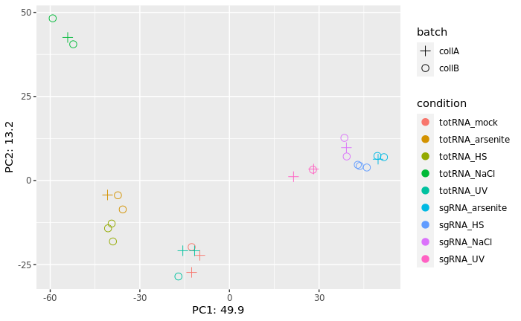
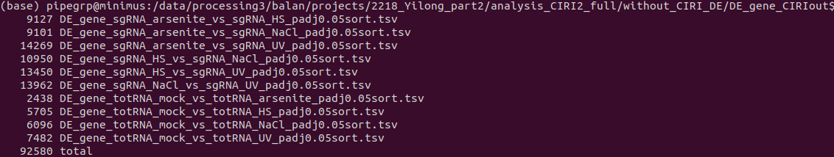
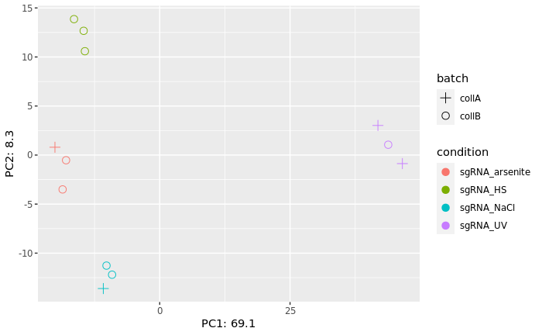
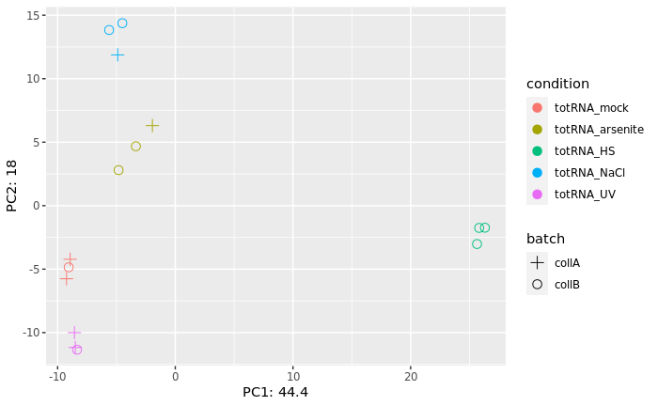
CIRIquant_totalRNA – batch(gene lvl)
Adjp < 0.05
No threshold on lfc

Slide 43
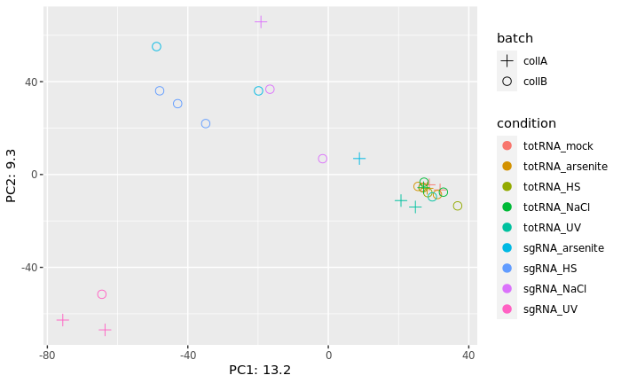
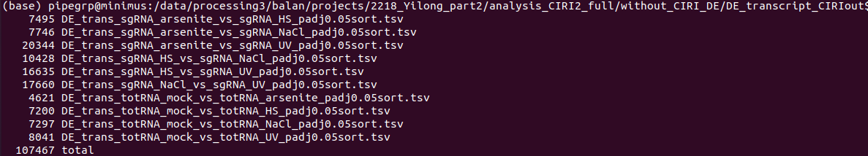
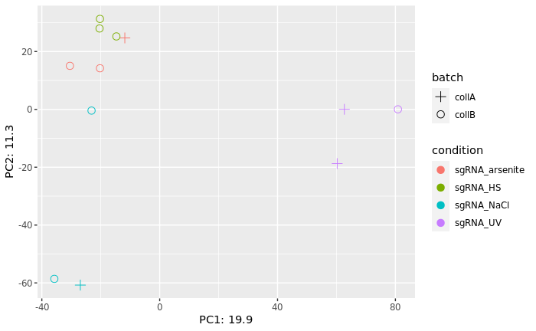
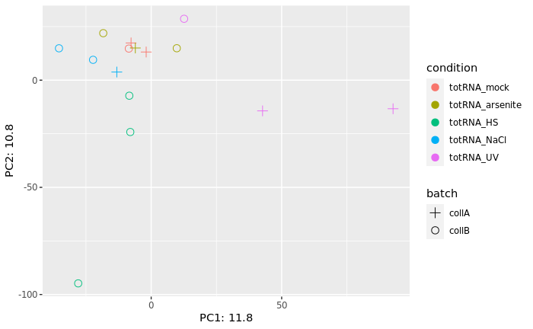
CIRIquant_totalRNA – batch (transcript lvl)
Adjp < 0.05
No threshold on lfc

Slide 44
STAR alignment for CIRCexplorer2
Compare:
/data/processing1/bioinfo_core/requests/FANCI_RNA_seq_4stresses/analysis_fastq_free_trim_gtffilter_STARopt/STAR/s9/s9.Chimeric.out.junction: 242 202
/data/processing1/bioinfo_core/requests/FANCI_RNA_seq_4stresses/analysis_circRNAprofiler/STAR_align/s9_outSTAR/s9Chimeric.out.junction: 241 880
* run1: /processing1/.../analysis_fastq_free_trim_gtffilter_STARopt
* run2: /processing1/../analysis_circRNAprofiler/STAR_align/ - kept only the 'Chimeric.out.junctions' files
* run3: /processing3/../2218_Yilong_part2/STAR_out – identical to run2
1 2 3 4 5 6 7 8 9
Chr 1st base of donor intron strand_of_donor acceptor_chr 1st base of acceptor intron strand_of_acceptor N/A N/A N/A
10 96868202 - 10 96868294 - 0 0 1
10 11 12 13
read_name 1st base of 1st segm, on + strand CIGAR of 1st segm 1st base of 2nd segm
A00931:420:H7M2JDMXY:1:1236:14769:18740 96868203 61S40M 96868184
14
CIGAR of 2nd segm
1S100M-51p61M40S
Are unsorted both of them!!! Jumbled
But both have unique values on col 10!
Each have unique rows; about 2.5% of the common rows; ~25% of them map to contigs

Slide 45
CIRCexplorer2 annotation
1. Download human RefSeq gene annotation file fetch_ucsc.py hg19 ref hg19_ref.txt fetch_ucsc.py hg38 ref hg38_ref.txt
2. Download human KnownGenes gene annotation file fetch_ucsc.py hg19 kg hg19_kg.txt fetch_ucsc.py hg38 kg hg38_kg.txt
3. Download human Ensembl gene annotation file fetch_ucsc.py hg19 ens hg19_ens.txt
- doesn't exist for hg38
4. Download human reference genome sequence file fetch_ucsc.py hg19 fa hg19.fa fetch_ucsc.py hg38 fa hg38.fa cat hg19_ref.txt hg19_kg.txt hg19_ens.txt > hg19_ref_all.txt
5. Convert gene annotation file to GTF format cut -f2-11 hg19_ref.txt|genePredToGtf file stdin hg19_ref.gtf cut -f2-11 hg19_kg.txt|genePredToGtf file stdin hg19_kg.gtf cut -f2-11 hg19_ens.txt|genePredToGtf file stdin hg19_ens.gtf
CIRCexplorer2 \ annotate -r hg19_ref_all.txt
-g hg19.fa \
-b back_spliced_junction.bed \
-o circularRNA_known.txt > CIRCexplorer2_annotate.log
Annotation: /data/repository/organisms/GRCh38_ensembl/Ensembl/release-91/genes.gtf
Genome: /data/repository/organisms/GRCh38_ensembl/genome_fasta/genome.fa

Slide 46
CIRCexplorer2 annotation
1. Download human RefSeq gene annotation file (> refFlat.txt.gz & hg19_ref.txt) fetch_ucsc.py hg19 ref hg19_ref.txt fetch_ucsc.py hg38 ref hg38_ref.txt
2. Download human KnownGenes gene annotation file (> knownGene.txt & hg_19_kg.txt) fetch_ucsc.py hg19 kg hg19_kg.txt fetch_ucsc.py hg38 kg hg38_kg.txt
3. Download human Ensembl gene annotation file fetch_ucsc.py hg19 ens hg19_ens.txt
- doesn't exist for hg38 cat hg19_ref.txt hg19_kg.txt hg19_ens.txt > hg19_ref_all.txt
4. Download human reference genome sequence file fetch_ucsc.py hg19 fa hg19.fa fetch_ucsc.py hg38 fa hg38.fa
Cross reference:
- kgXref.txt.gz
- ensemblToGeneName.txt.gz
DDX11L10 NR_045117 chr16 + 61554 64090 64090 64090 3 61554,62293,62901, 61908,62402,64090,
DDX11L1 NR_046018 chr1 + 11873 14409 14409 14409 3 11873,12612,13220, 12227,12721,14409,
DDX11L16 NR_110561 chrX - 155255322 155257848 155257848 155257848 3 155255322,155257000,
DDX11L1 uc001aaa.3 chr1 + 11873 14409 11873 11873 3 11873,12612,13220, 12227,12721,14409,
DDX11L1 uc010nxr.1 chr1 + 11873 14409 11873 11873 3 11873,12645,13220, 12227,12697,14409,
DDX11L1 uc010nxq.1 chr1 + 11873 14409 12189 13639 3 11873,12594,13402, 12227,12721,14409,
DDX11L1 ENST00000456328 chr1 + 11868 14409 14409 14409 3 11868,12612,13220, 12227,12721,14409,
DDX11L1 ENST00000515242 chr1 + 11871 14412 14412 14412 3 11871,12612,13224, 12227,12721,14412,
DDX11L1 ENST00000518655 chr1 + 11873 14409 14409 14409 4 11873,12594,13402,13660, 12227,12721,

Slide 47
CIRCexplorer2 \ annotate -r hg19_ref_all.txt
-g hg19.fa \
-b back_spliced_junction.bed \
-o circularRNA_known.txt > CIRCexplorer2_annotate.log
CIRCexplorer2 annotation
CIRCexplorer2 – ver19
.txt (Ref?) ref genome
>chr1
DDX11L1 ENST00000456328 chr1 + 11868 14409 14409 14409 3 11868,12612,13220, 12227,12721,14409,
DDX11L1 ENST00000515242 chr1 + 11871 14412 14412 14412 3 11871,12612,13224, 12227,12721,14412,
DDX11L1 ENST00000518655 chr1 + 11873 14409 14409 14409 4 11873,12594,13402 12227,12721,
.gtf
chr5 stdin transcript 133307562 133340459 . - . gene_id "NR_036625"; transcript_id "NR_036625";
chr5 stdin exon 133307562 133308553 . - . gene_id "NR_036625"; transcript_id "NR_036625"; exon_number "1"; exon_id "NR_036625.1";
chr5 stdin z 133309482 133309539 . - . gene_id "NR_036625"; transcript_id "NR_036625"; exon_number "2"; exon_id "NR_036625.2";
Ours - ver38
.gtf - annotation
1 havana gene 11869 14409 . + . gene_id "ENSG00000223972"; gene_version "5"; gene_name "DDX11L1";
gene_source "havana"; gene_biotype "transcribed_unprocessed_pseudogene";
ref genome
>1 dna_sm:chromosome chromosome:GRCh38:1:1:248956422:1 REF
.bed
10 5788766 85117915 FUSIONJUNC_0/1 0 +
10 96868201 96868292 FUSIONJUNC_1/1 0 +
7 12986338 102646109 FUSIONJUNC_2/1 0 +
8 17030900 70643232 FUSIONJUNC_3/1 0 +

Slide 48
head s9.circRNA_known.txt2
20 3801349 3801388 circular_RNA/1 1 + 3801349 3801349 0,0,0 1 39 0 1 ciRNA AP5S1 ENST00000379567 1 20:3801349-3802748
19 803560 805187 circular_RNA/2 1 + 803560 803560 0,0,0 6 76,173,147,171,111,175 0,475,731,971,1268,1452 2 circRNA PTBP1 ENST00000356948 3,4,5,6,7,8 19:799443-803560|19:805187-805491
19 1415939 1416090 circular_RNA/1 1 + 1415939 1415939 0,0,0 1 151 0 1 ciRNA DAZAP1 ENST00000587833 1 19:1415939-1417498
19 1510148 1510916 circular_RNA/1 0 - 1510148 1510148 0,0,0 4 109,61,92,73 0,218,489,695 1 circRNA ADAMTSL5 ENST00000413997 5,4,3,2 19:1508569-1510148|19:1510916-1511623
19 3939969 3940005 circular_RNA/2 1 + 3939969 3939969 0,0,0 1 36 0 2 ciRNA NMRK2 ENST00000168977 6 19:3939969-3941068
19 4454027 4454077 circular_RNA/2 1 + 4454027 4454027 0,0,0 1 50 0 2 ciRNA CTB-50L17.9 ENST00000592034 1 19:4454027-4454790
19 16102875 16102923 circular_RNA/1 1 - 16102875 16102875 0,0,0 1 48 0 1 ciRNA CYP4F9P ENST00000589847 6 19:16101123-16102923
19 37997102 37997146 circular_RNA/2 1 - 37997102 37997102 0,0,0 1 44 0 2 ciRNA CTD-3064H18.1 ENST00000585397 1 19:37996942-37997146
19 43584851 43585032 circular_RNA/3 1 - 43584851 43584851 0,0,0 1 181 0 3 ciRNA PSG2 ENST00000406487 2 19:43579784-43585032
12 19593304 19593367 circular_RNA/5 1 + 19593304 19593304 0,0,0 1 63 0 5 ciRNA AEBP2 ENST00000398864 1 12:19593304-19615443
head ../bwa_align/out_parse/s9_BJS.bed
10 5788766 85117915 FUSIONJUNC_0/1 0 +
10 96868201 96868292 FUSIONJUNC_1/1 0 +
7 12986338 102646109 FUSIONJUNC_2/1 0 +
8 17030900 70643232 FUSIONJUNC_3/1 0 +
18 24375314 50254137 FUSIONJUNC_4/1 0 +
1 175992996 176007645 FUSIONJUNC_5/2 0 +
5 95755393 95763618 FUSIONJUNC_6/4 0 +
3 71178904 125269216 FUSIONJUNC_7/1 0 +
2 213643251 231457113 FUSIONJUNC_8/1 0 +
5 92863498 100849826 FUSIONJUNC_9/1 0 +

