Slide 1
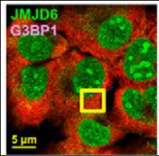
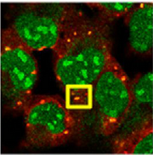
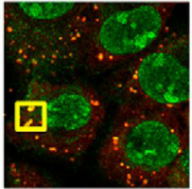
Unbalanced experimental design
Human cells – 3 reps/ experimental condition
name | batch | condition | group |  | name | batch | condition | group
s1 | collA | totRNA_mock | All
s2 | collA | totRNA_mock | All
s3 | collB | totRNA_mock | All
s4 | collA | totRNA_arsenite | treatment1 |  | s16 | collA | sgRNA_arsenite | treatment1
s5 | collB | totRNA_arsenite | treatment1 |  | s17 | collB | sgRNA_arsenite | treatment1
s6 | collB | totRNA_arsenite | treatment1 |  | s18 | collB | sgRNA_arsenite | treatment1
s7 | collB | totRNA_HS | treatment2 |  | s19 | collB | sgRNA_HS | treatment2
s8 | collB | totRNA_HS | treatment2 |  | s20 | collB | sgRNA_HS | treatment2
s9 | collB | totRNA_HS | treatment2 |  | s21 | collB | sgRNA_HS | treatment2
s10 | collA | totRNA_NaCl | treatment3 |  | s22 | collA | sgRNA_NaCl | treatment3
s11 | collB | totRNA_NaCl | treatment3 |  | s23 | collB | sgRNA_NaCl | treatment3
s12 | collB | totRNA_NaCl | treatment3 |  | s24 | collB | sgRNA_NaCl | treatment3
s13 | collA | totRNA_UV | treatment4 |  | s25 | collA | sgRNA_UV | treatment4
s14 | collA | totRNA_UV | treatment4 |  | s26 | collA | sgRNA_UV | treatment4
s15 | collB | totRNA_UV | treatment4 |  | s27 | collB | sgRNA_UV | treatment4
mock other treatments UV
total_RNA
total_RNA
sg_RNA
total_RNA
sg_RNA

Slide 2
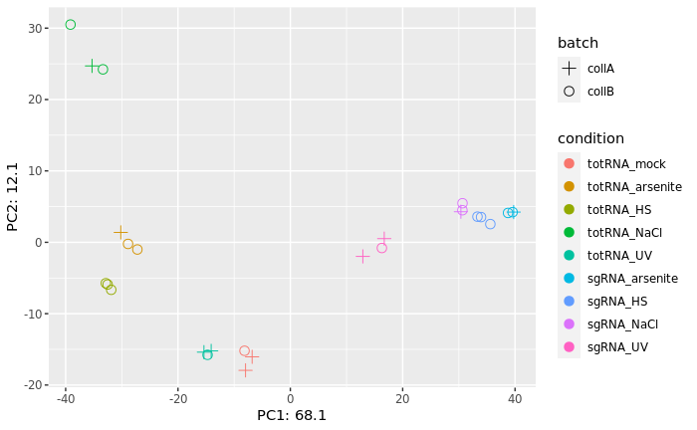
PCA plots

Slide 3
DESeq2_totalRNA – batch vs no_batch
(gene lvl)
Adjp < 0.05
No threshold on lfc
Collection dates | Sample name | No batch in design |  |  | Batch considered in design
 |  | Up DE genes | Down DE genes | total | Up DE genes | Down DE genes | total
AAB vs ABB | totalRNA_ars_vs_mock (treat1) | 1024 | 294 | 1318 | 853 | 179 | 1032
AAB vs BBB | totalRNA_HS_vs_mock (treat2) | 2506 | 1986 | 4492 | 1253 | 984 | 2237
AAB vs ABB | totalRNA_NaCl_vs_mock (treat3) | 2923 | 1935 | 4858 | 2310 | 1675 | 3985
AAB vs AAB | totalRNA_UV_vs_mock (treat4) | 2636 | 2489 | 5125 | 2596 | 2438 | 5034

Slide 4
DESeq2_sgRNA – batch vs no_batch
(gene lvl)
Adjp < 0.05
No threshold on lfc
Collection dates | Sample name | No batch in design |  |  | Batch considered in design
 |  | Up DE genes | Down DE genes | total | Up DE genes | Down DE genes | total
ABB vs BBB | sgRNA_ars_vs_HS | 4240 | 4363 | 8603 | 4135 | 4253 | 8388
ABB vs ABB | sgRNA_ars_vs_NaCl | 3934 | 4102 | 8036 | 3999 | 4261 | 8260
ABB vs AAB | sgRNA_ars_vs_UV | 7524 | 5395 | 12919 | 6850 | 5122 | 11972
BBB vs ABB | sgRNA_HS_vs_NaCl | 5169 | 5188 | 10357 | 4780 | 4905 | 9685
BBB vs AAB | sgRNA_HS_vs_UV | 7252 | 5771 | 13023 | 5119 | 4924 | 10043
ABB vs AAB | sgRNA_NaCl_vs_UV | 6912 | 6094 | 13006 | 6382 | 5837 | 12219

Slide 5
CIRI2 – output
CIRI2
- detect circRNAs from transcriptome
CIRI_AS
- detects circRNAs internal components and alternative splicing events
CIRI_full
- uses both BSJ and reverse overlap (RO) features to reconstruct and quantify full-length circular RNAs
CIRI_VIS
- visualizing alignments of BSJ & RO merged reads and estimating the related abundance of isoforms
CIRIquant
- quantification and DE

Slide 6
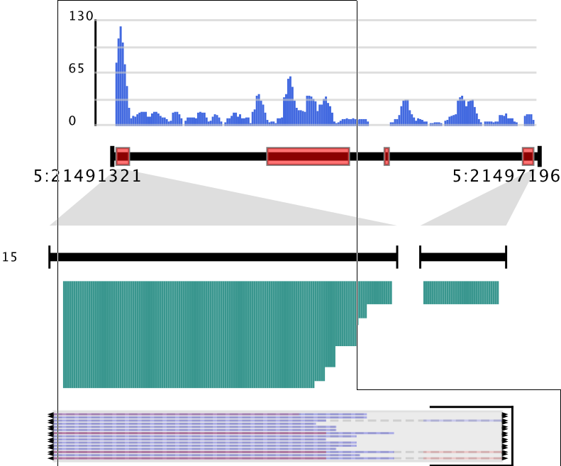
D) CIRI2_VIS – output
- tool for visualizing alignments of BSJ & RO merged reads and estimating the related abundance of isoforms
CIRI2
CIRI_AS
CIRI_full
CIRI_VIS
stout_X.pdf
stout.gtf
stout.list
_circle.fa

Slide 7
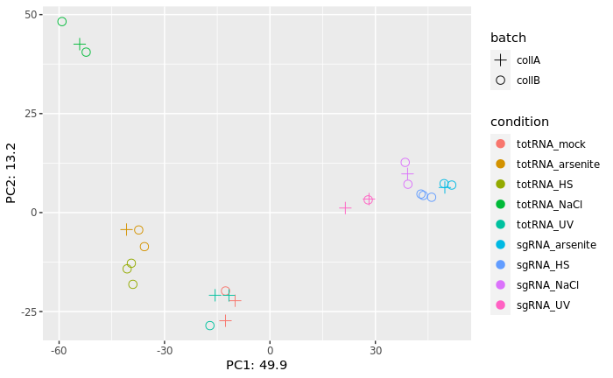
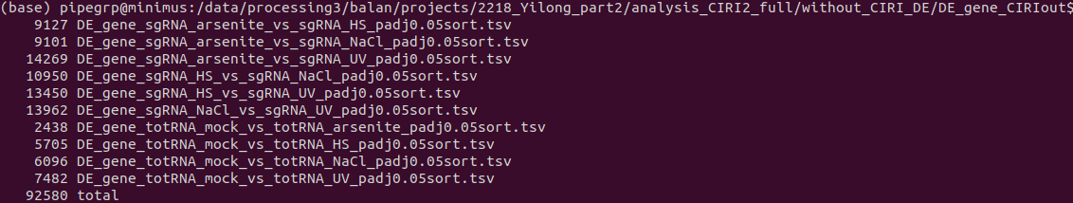
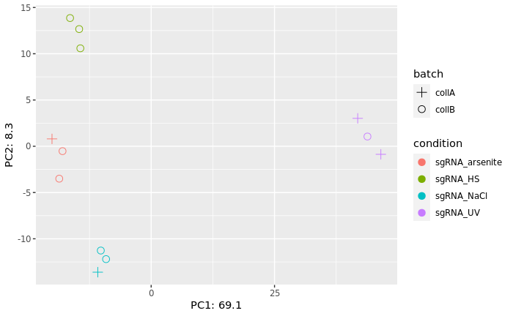
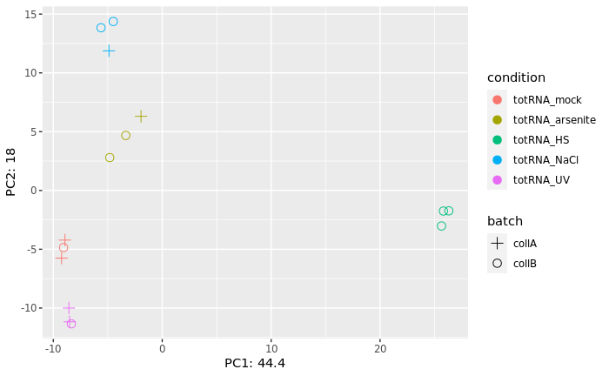
CIRIquant_totalRNA – batch(gene lvl)
padj < 0.05
No threshold on lfc
Arranged by padj values

Slide 8
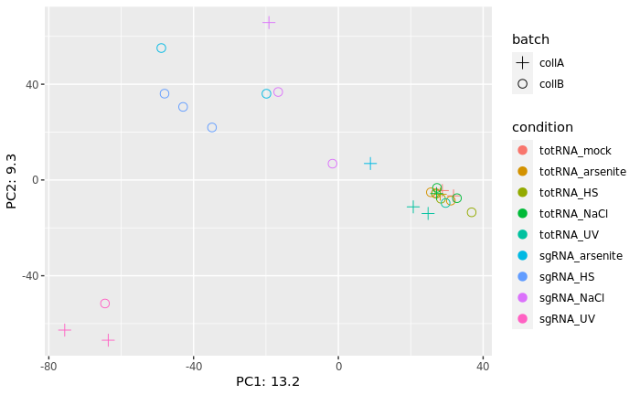
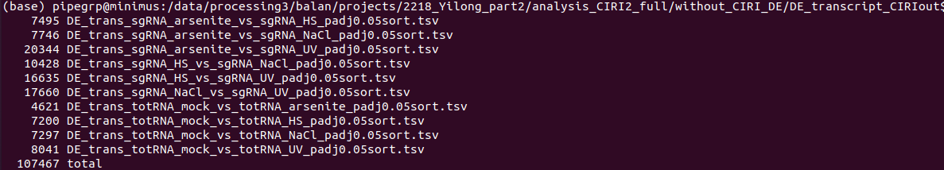
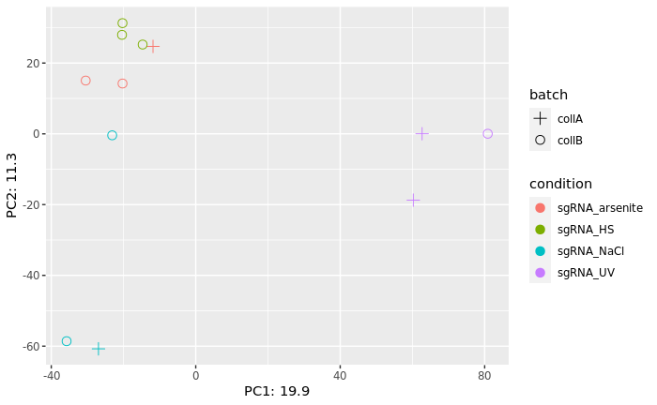
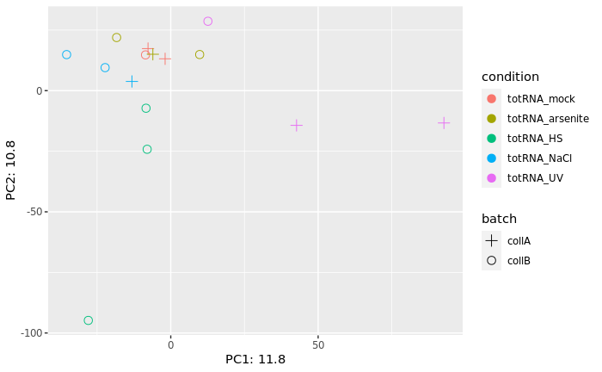
CIRIquant_totalRNA – batch (transcript lvl)
padj < 0.05
No threshold on lfc
Arranged by padj values

