Slide 1
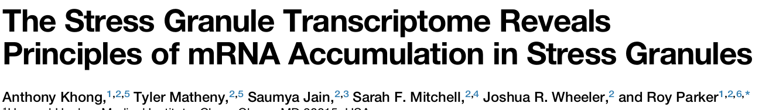
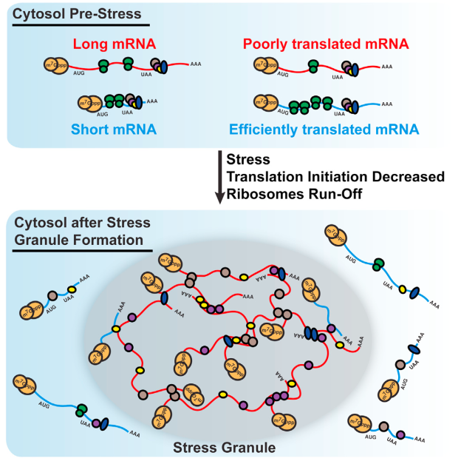
- experimental conditions:
- ars exposure: 60 min
- lyse cells > supernatant
- 5% SN > totalRNA seq
- 95% SN > purif > sgRNA seq

Slide 2
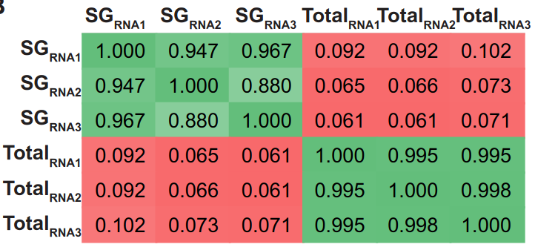
Mammalian SG Cores Are Enriched for Specific mRNAs
QC: Pairwise R^2 correlations between individual replicates of SG
purified RNA and total RNA

Slide 3
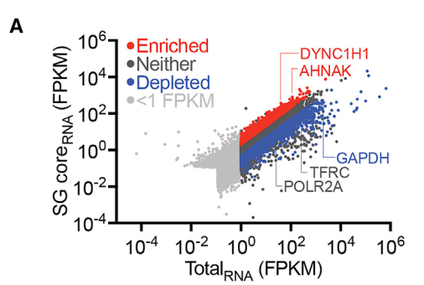
Mammalian SG Cores Are Enriched for Specific mRNAs

Slide 4
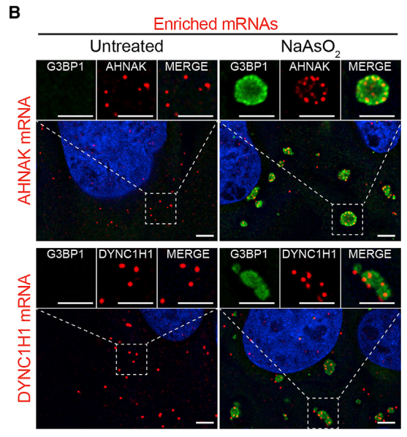
Graphical abstract

Slide 5
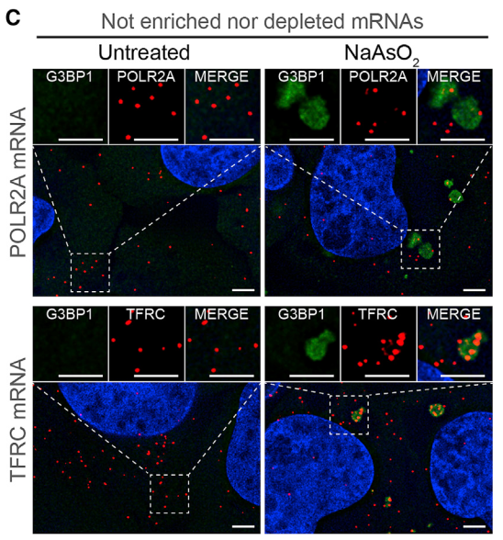
Graphical abstract

Slide 6
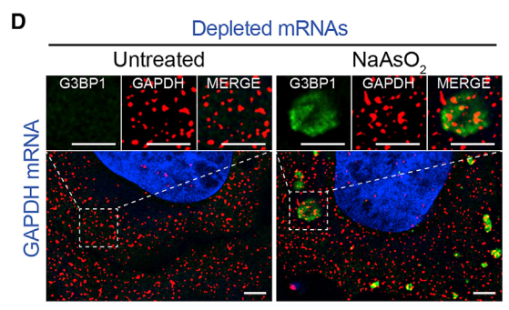
Graphical abstract

Slide 7
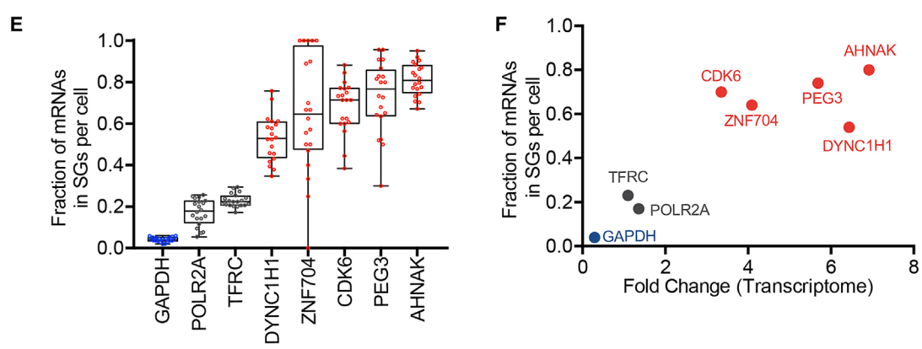
Graphical abstract

Slide 8
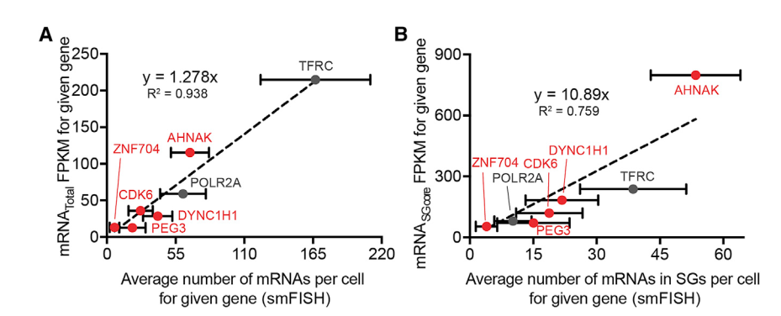
Graphical abstract

Slide 9
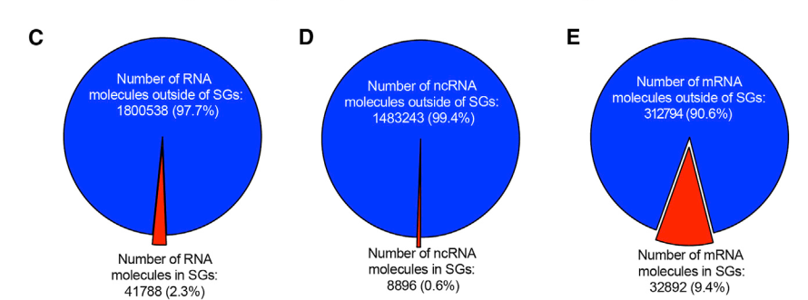
Graphical abstract

Slide 10
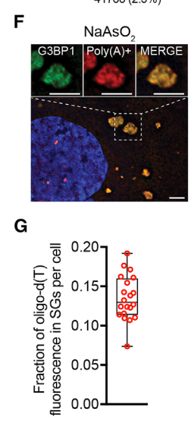
Graphical abstract

Slide 11
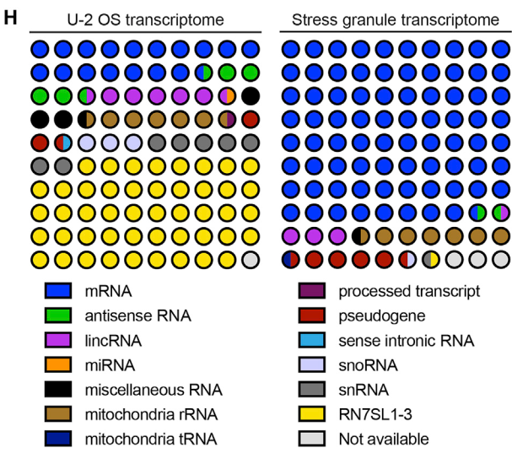
Graphical abstract

Slide 12
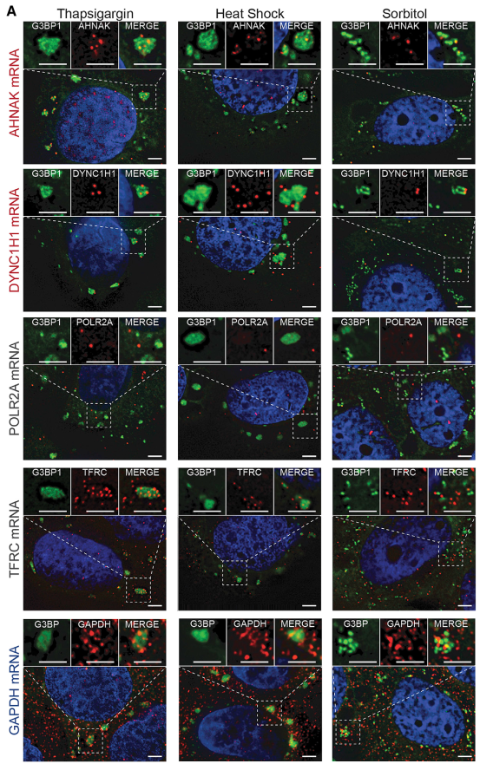
Graphical abstract

Slide 13
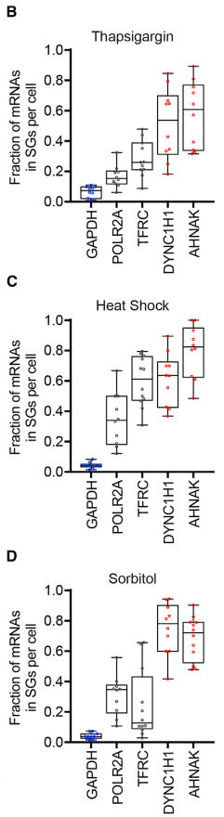
Graphical abstract

Slide 14
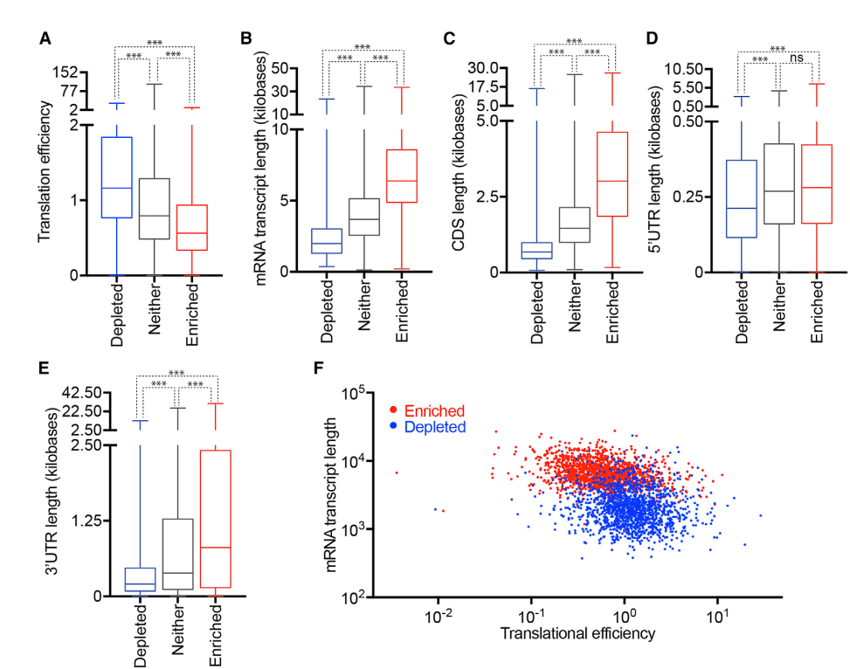
Graphical abstract

Slide 15
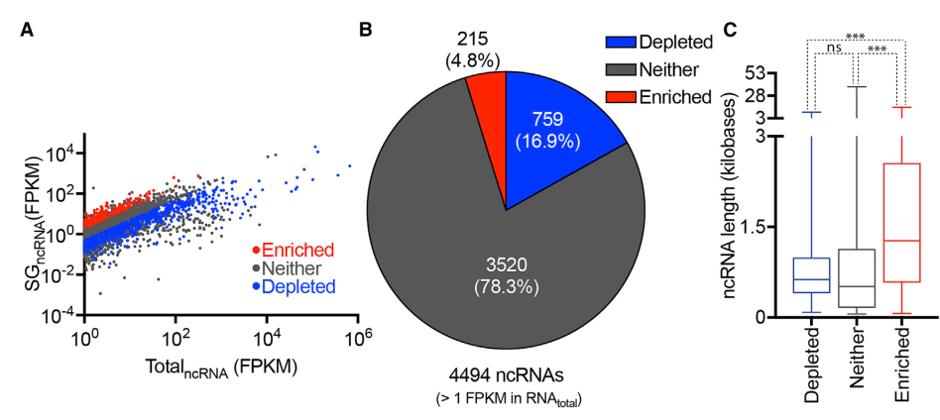
Graphical abstract

Slide 16
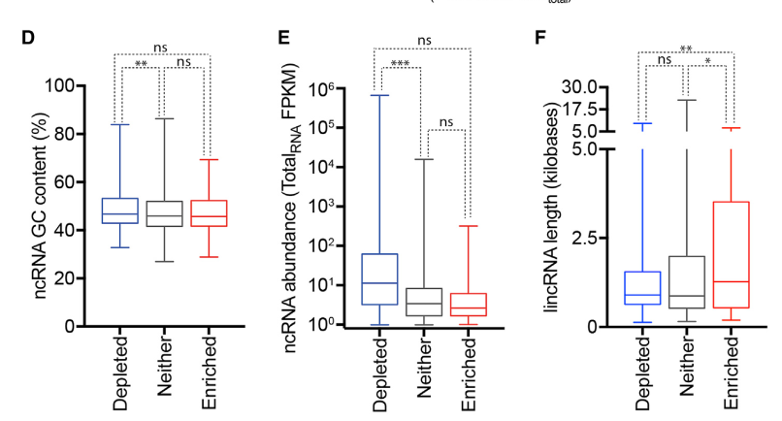
Graphical abstract

Slide 17
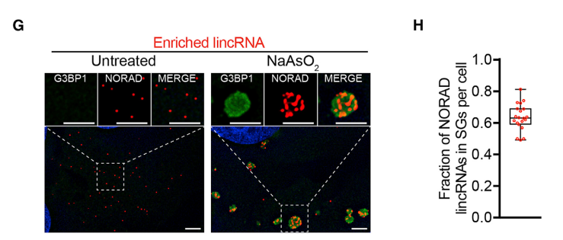
Graphical abstract

Slide 18
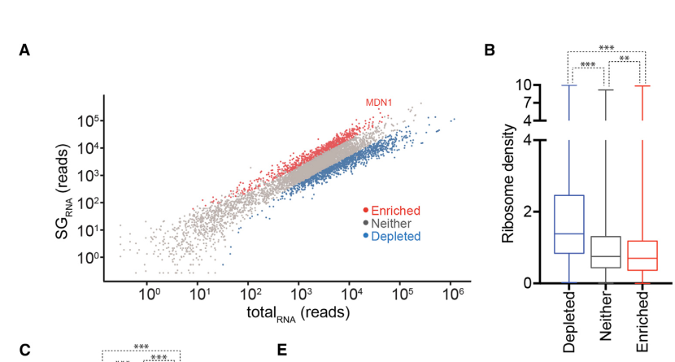
Graphical abstract

Slide 19
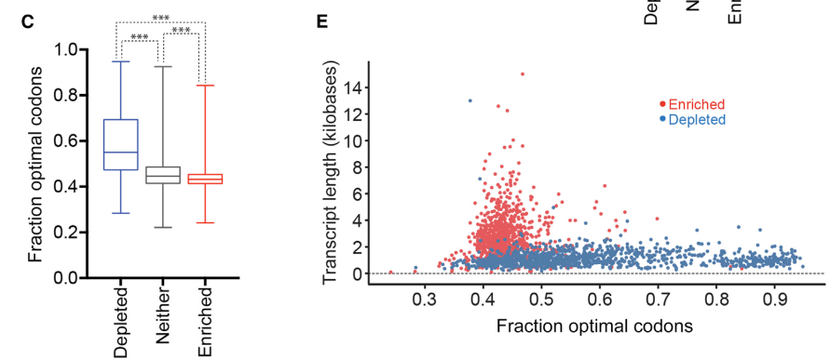
Graphical abstract

Slide 20
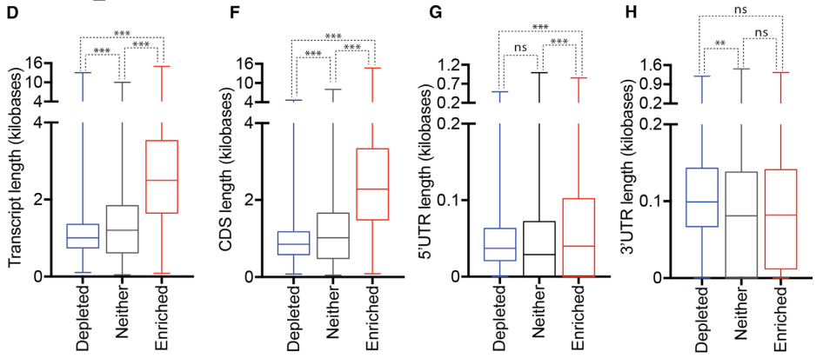
Graphical abstract

Slide 21
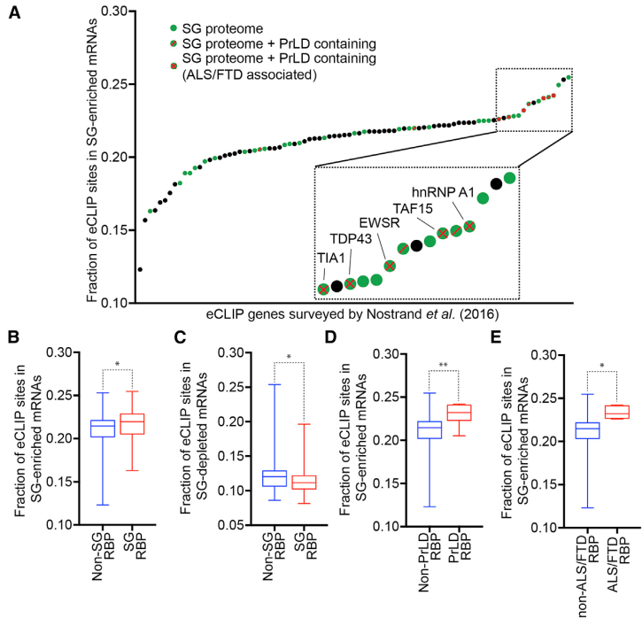
Graphical abstract

Slide 22
Graphical abstract

Slide 23
Graphical abstract

Slide 24
Graphical abstract

Slide 25
Graphical abstract

