Slide 1
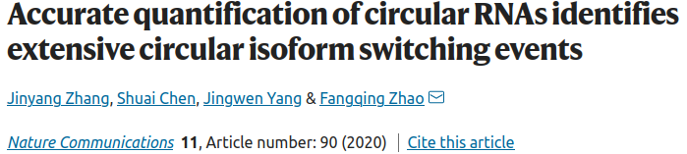

Slide 2
Computational methods for circRNA detection
1) alignment-based strategies (most) – to recognize back-spliced junctions (BSJ) reads from circRNAs
- limited sensitivity
- increased false positive rate of discovery
2) model-based strategies (newer) – uses a quasi-mapping method to get direct estimation of the circ transcripts expression
- e.g. Sailfish-cir
- the statistical model depends on the unique sequence between circular and linear transcripts
- => limits its ability to quantify exonic circular RNA

Slide 3
Differential expression analysis of circRNAs
1) simple statistical tests (e.g. t-test)
2) DE analysis pipelines for linear RNA transcripts (e.g. DESeq2)

Slide 4
Splicing preference in precursor mRNA
- done using the ratio between:
- BSJ reads
- canonical linear reads
At the junction
- so far, only CIRI2 outputs it directly

Slide 5
CIRIquant – accurate quantification of circRNAs and parental transcripts
- filters out false positive BSJ reads
- circRNA identification with any number of softwares:
- CIRI2, CIRCexplorer2, find_circ2, etc
- then generated pseudo-reference sequences for the identified circRNA transcripts to re-align putative BSJ reads.
- Using both alignment results of reads against the reference genome and pseudo circRNA transcripts, CIRIquant not only achieves more accurate and sensitive identification of BSJ reads, but also enables reliable quantification of junction ratio for circRNAs.
- Moreover, CIRIquant provides a convenient function for one-stop circRNA differential expression analysis.
- Additionally, we profile the switching events in circRNA junction ratio and circular transcript usage, and characterize these two groups of circRNAs with potential biological functions.

Slide 6
Mammalian SG Cores Are Enriched for Specific mRNAs

Slide 7
Mammalian SG Cores Are Enriched for Specific mRNAs

Slide 8
Mammalian SG Cores Are Enriched for Specific mRNAs

Slide 9
Mammalian SG Cores Are Enriched for Specific mRNAs

Slide 10
Mammalian SG Cores Are Enriched for Specific mRNAs

Slide 11
Mammalian SG Cores Are Enriched for Specific mRNAs

Slide 12
Mammalian SG Cores Are Enriched for Specific mRNAs

Slide 13
Mammalian SG Cores Are Enriched for Specific mRNAs

