Slide 1
FINAL PRESENTATION
Traffic Violations
Data Analysis
DATA 205 | Feraol Abera | Spring 2026

Slide 2
Introduction
What factors shape the outcome of a traffic stop?
Descriptive
Inferential
Predictive
01
02
03
When, where, and what kind of stops occur
Statistical associations between stop circumstances and outcomes
Random Forest model to predict stop outcome

Slide 3
Data Sources
Primary -- Traffic Violations
Secondary -- Parking Inventory
Source
Montgomery County Open Data Portal
Source
Montgomery County Open Data Portal
Records
150,000 via API (1.4M+ total)
Records
~200 parking facilities
Variables
~35 per stop
Used for
Geographic proximity analysis
Key fields
Date, time, GPS, violation type,
race, gender, search, alcohol

Slide 4
Data Cleaning
Column names
Lowercased, spaces replaced with underscores
Date parsing
date_of_stop as datetime; time_of_stop as time object
Feature engineering
Derived year, month, day_of_week, hour, time_period
Boolean conversion
Yes/No fields converted to 0/1
Categorical cleanup
Title Case applied; invalid values set to NaN
GPS fix
Coordinates of (0.0, 0.0) set to NaN -- ~15% of records
Row filter
Filtered to 2018+; ~212,000 rows in processed file

Slide 5
Descriptive Statistics
212K
67%
29%
Records (cleaned)
Warnings
Citations
4 PM
Tuesday
Peak hour
Busiest day
Warning
67%
Citation
29%
ESERO
4%

Slide 6
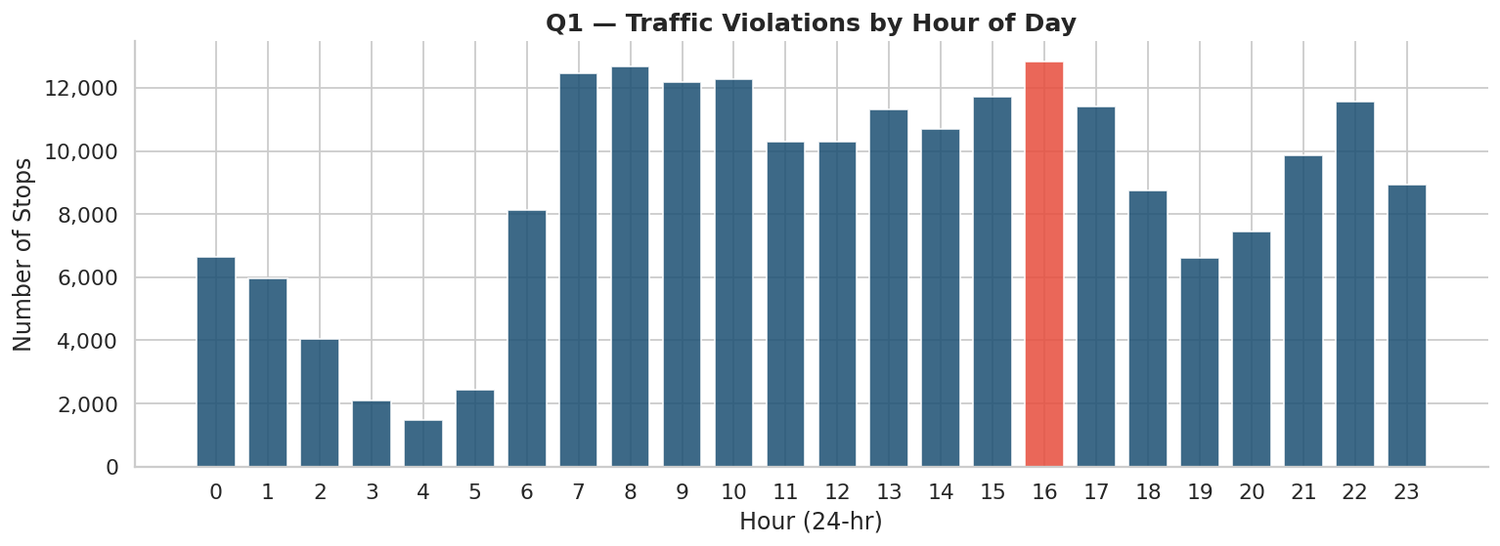
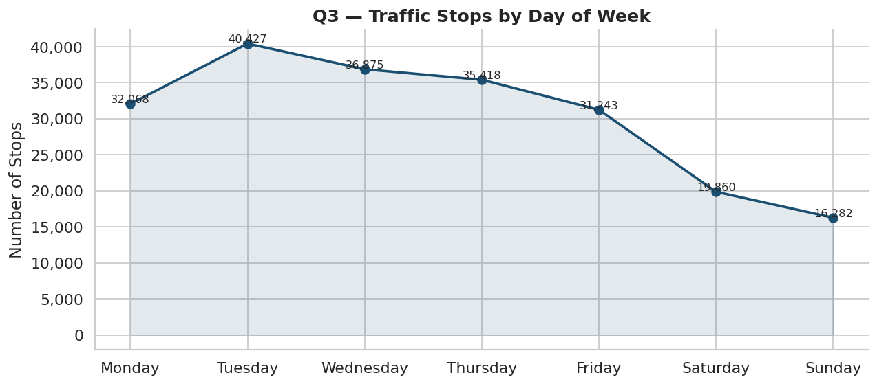
EDA -- Time Patterns (Q1 and Q3)
4 PM
Tuesday
p < 0.0001
Peak Hour
Busiest Day
Chi-square Q3

Slide 7
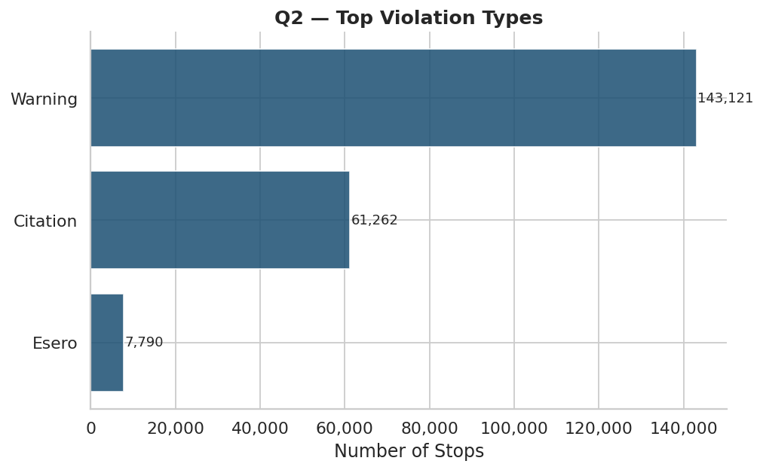
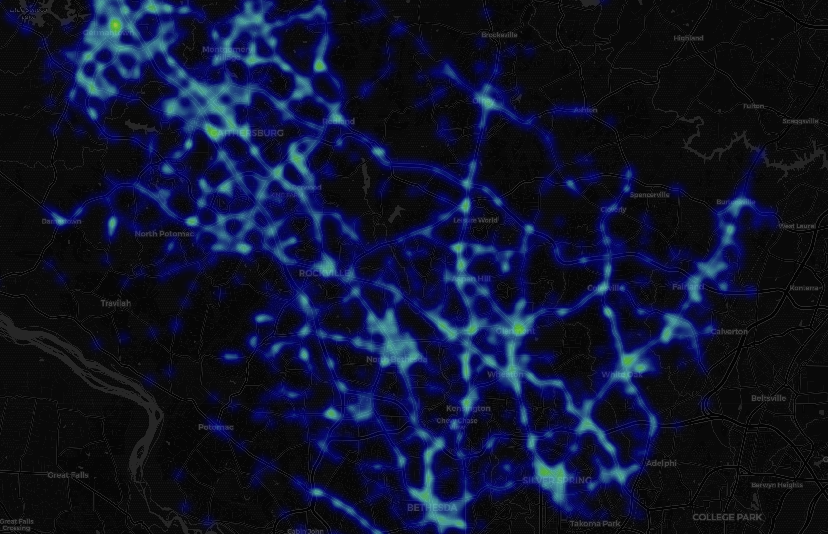
EDA -- Violation Types and Geography (Q2 and Q5)
Warnings = 67% of all stops
Highest density: Rockville, Gaithersburg, Germantown, Wheaton

Slide 8
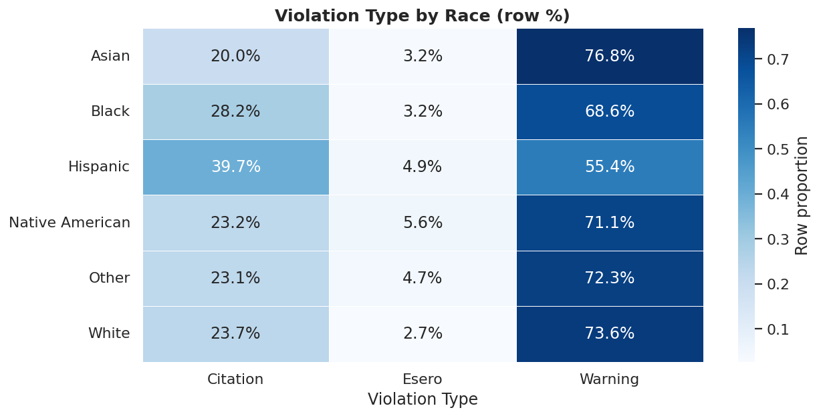
EDA -- Demographics and Violation Type (Q6)
Chi-square result
p < 0.05 | Chi2 = 2,560.74
Highest citation rate
Hispanic drivers: 39.7%
White drivers: 23.7%
Caveat
Geographic deployment likely explains much of the variation.

Slide 9
Parking Dataset -- Geographic Proximity Analysis
Do stops near parking facilities have different outcomes?
Method
Findings
Used ~200 parking facility locations from the parking dataset
Mapped parking locations alongside traffic stop locations
Calculated distance from each stop to the nearest parking facility
Compared stop outcomes within 0.5 mi vs. farther away
Chi-square test to check if outcomes differ by proximity
Citation rate is higher near parking
Stops within 0.5 mi of a parking facility show a higher proportion of citations vs. warnings
Result is statistically significant
Chi-square p < 0.05 -- proximity to parking and stop outcome are not independent
Interpretation
Enforcement near commercial/parking areas tends to be more formal meaning officers may apply stricter standards in high-traffic zones

Slide 10
Analysis -- Logistic Regression (Q4, Q7, Q8)
Q4 -- Warning vs. Citation
Q7 -- Search Conducted
-- alcohol is the strongest predictor
-- alcohol is the strongest predictor
-- search_conducted increases citation likelihood
-- accident involvement increases search likelihood
-- accident involvement also predicts citations
-- violation type contributes significantly
-- hour has a modest effect
Q8 Chi-square: p < 0.05 -- stops with a search have significantly more citations and fewer warnings

Slide 11
Analysis -- Random Forest: Predict Stop Outcome (Q10)
200 trees | max depth 12 | balanced class weights | 40,000 records
Feature Importance
race_enc
22%
hour
18%
Best class
Warning and Citation
gender_enc
15%
search_conducted
13%
Harder class
ESERO (small sample)
alcohol
11%
dow_num
9%
period_num
7%
month
5%

Slide 12
Key Findings
Warnings dominate
Searches are consequential
67% of stops end in a warning meaning officers exercise significant discretion
Stops with a search have far more citations
Time and place matter
Parking proximity matters
Peak at 4 PM; hotspots in Rockville, Gaithersburg, Germantown, Wheaton
Stops within 0.5 mi of parking facilities have higher citation rates (p < 0.05)
Tuesday is busiest
Demographics are significant
2.5x more stops than Sunday; day of week and violation type are linked (p < 0.0001)
Hispanic drivers: 39.7% citation rate vs. 23.7% for White drivers -- likely geographic confounding

Slide 13
Reflections
Challenging
-- Dataset scale -- 1.4M records too large for GitHub; balanced size vs. runtime
-- Interpreting demographic patterns carefully
Rewarding
-- Folium map rendering with real violation and parking data side by side
-- Random Forest confirmed stop circumstances matter more than demographics
What to change
-- Pull full 1.4M records for more reliable rare-class modeling
-- Build a Tableau dashboard for non-technical audiences

Slide 14
Next Steps
01
02
03
Full dataset
Time-series
Dashboard
Pull all 1.4M records and retrain models
Track how enforcement patterns change year over year
Tableau or Plotly Dash for public-facing findings

Slide 15
Acknowledgements
Prof. Alraee
Guidance throughout the semester and project structure
Prof. Saidi
Prof. Perine
Data Professors
Montgomery College DATA 205 class
Feedback and discussion throughout the project

