Slide 1
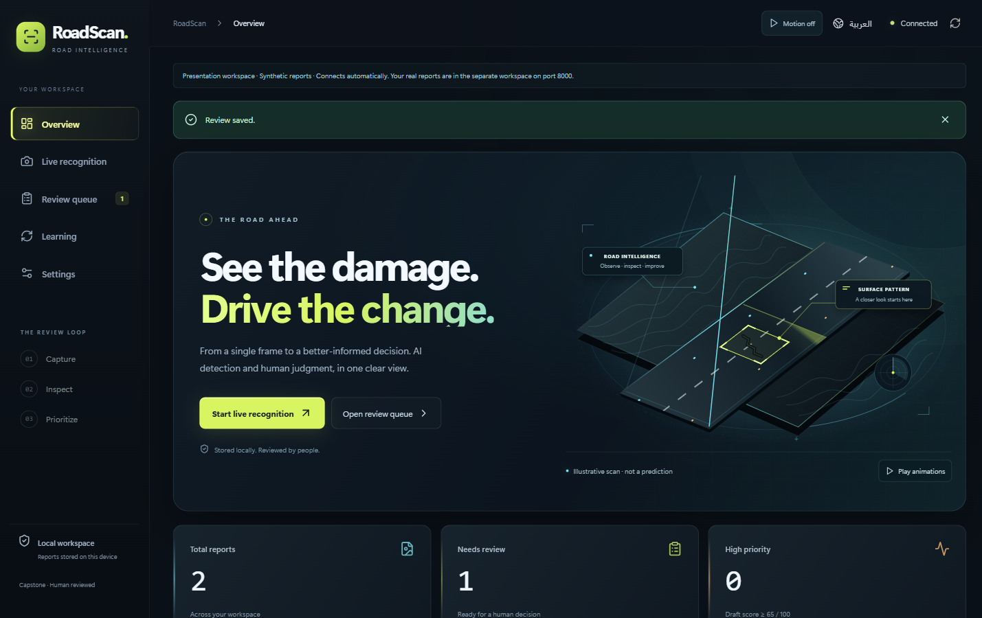
RoadScan
Road damage recognition
with human review
Locate visible damage.
Review the evidence.
Prioritize follow-up.
Feras Alyamani · Ahmed Salamah
Ahmed Alhejaili
AIEP Track A · 27 October 2026 · Five-minute project overview
01
Notes:
0:20 — RoadScan helps turn a road image into a reviewable damage report. Our contribution is the complete inspection workflow: recognition, correction, repair-priority support and controlled preparation of training data. It is a capstone prototype, not structural safety certification.
Sources: RoadScan-Project-Report.pdf sections 1–2; OLO AIEP brief, Track A. Artwork is the current app’s illustrative road scene, not an AI prediction. Team roles are not individually assigned because contribution records have not been verified.

Slide 2
A local inspection workflow
React / TypeScript
FastAPI
Detector
→
→
Photo • camera • video
Validate and infer
Boxes and confidence
↓
Approved export
←
Priority + matches
←
Review + SQLite
Separate training cycle
Score • optional DINOv2
Corrections + audit
FastAPI runs inference locally; SQLite and private files retain reports, model files and review history.
02
Notes:
0:35 — The browser accepts a photo, camera stream or video. FastAPI validates the input and runs the selected local detector. Predictions become saved reports for human review; SQLAlchemy and SQLite retain decisions while images and model files remain in local storage. Priority and optional nearby matching support the reviewer. Only approved examples enter the export workflow.
Sources: RoadScan-Project-Report.pdf architecture section; Code/RoadScan/roadscan/api.py, core.py and frontend/src/App.tsx. The arrows describe the user workflow; matching is optional and training is a separate process.

Slide 3
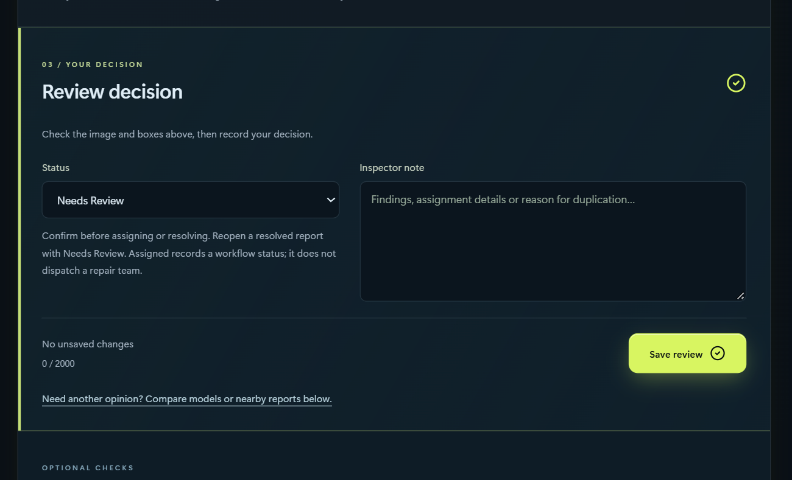
Every prediction stays reviewable
Inspect the boxes
Correct locations or labels.
Save a note and review status.
Keep the human decision
Model voting is advice.
A reviewer can choose a single
model even against a majority.
Public edition: owned review controls replace a road-photo example; workflow illustration, not accuracy evidence.
03
Notes:
0:50 — This public edition substitutes owned demo review controls for an untraced road-photo example; it is not prediction evidence. The reviewer can inspect and correct boxes, record a note and choose a status. An optional vote compares separate model outputs, but a majority is not ground truth: the reviewer can use an individual model’s draft and then save the decision. Demo or synthetic records are demonstrations, not evidence of local-road accuracy.
Sources: Evidence/Design-2026-10-27/deployed-review-desktop.png; Docs/Live-and-Models.md; frontend/src/ModelVote.tsx and review workflow. If showing the app live, keep the original demo report unchanged or use a disposable report.

Slide 4
Model evidence and its limits
YOLO26s · Main · 1024 px
63.04% mAP50
33.01% mAP50–95
Team-reported RDD holdout
Independent reproduction pending
Split leakage may inflate scores
mAP evaluates boxes and labels; 63.04% is not the percentage of road images judged correctly.
AP50 by class: D00 longitudinal · D10 transverse · D20 alligator · D40 pothole.
04
Notes:
0:50 — On the supplied RDD holdout, the main YOLO26s at 1024 pixels reports 63.04 percent mAP50 and 33.01 percent mAP50–95. The native chart shows per-class AP50. mAP evaluates detection across thresholds; it is not ordinary image accuracy. These are teammate-supplied results, not an independent rerun. The supplied audit reports near-duplicate leakage, so the result may be optimistic. The team’s main run reports about 41,000 training images; exact manifests are still needed.
Sources: Docs/Team-Models-and-Results.md; Models/RoadScan-Team-Results-2026-10-24.zip results.csv. D00=longitudinal crack, D10=transverse crack, D20=alligator crack, D40=pothole.

Slide 5
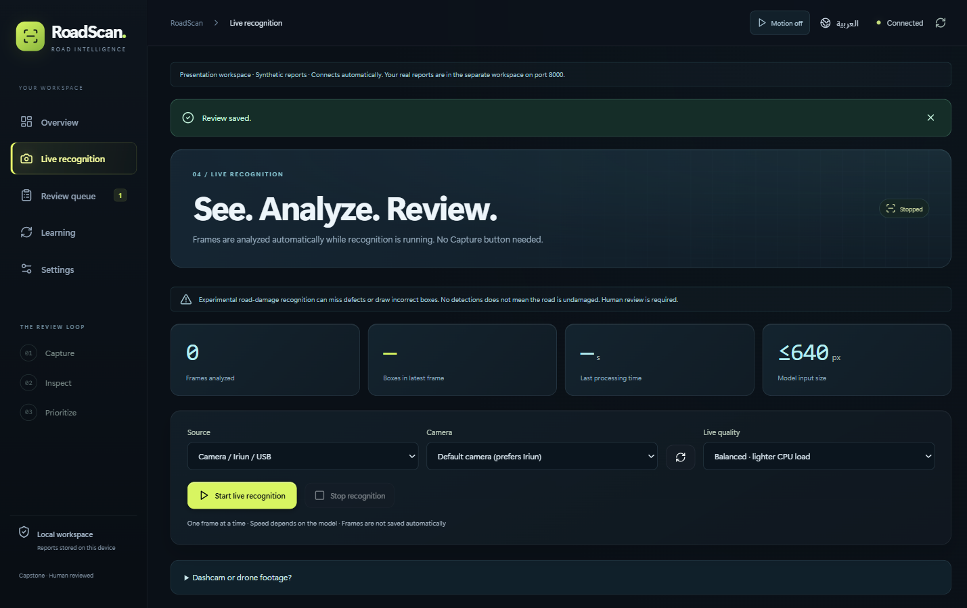
Camera preview and sequential video analysis
Camera / Iriun / USB
Samples frames automatically,
one inference at a time.
Lighter models reduce delay.
Video file
The complete-frame job
processes decoded frames
and may run slower than playback.
Current camera setup screen, 27 Oct · No camera latency or drone-field accuracy is claimed.
05
Notes:
0:40 — Camera mode starts analysis automatically after recognition is started, with one inference in flight at a time. It is responsive sampling rather than a promise to process every arriving camera frame. For stored video, the separate complete-frame job processes decoded frames sequentially and reports progress; it can run slower than the recording. The active model and input size affect speed. Iriun can act as a webcam, as tested by the team, but this deck makes no representative live FPS claim.
Sources: Docs/Live-and-Models.md; frontend/src/LiveRecognition.tsx and FullVideoAnalysis.tsx; current 27 October screenshot. Direct drone telemetry/control is not implemented; compatible footage can be submitted for experimental analysis.

Slide 6
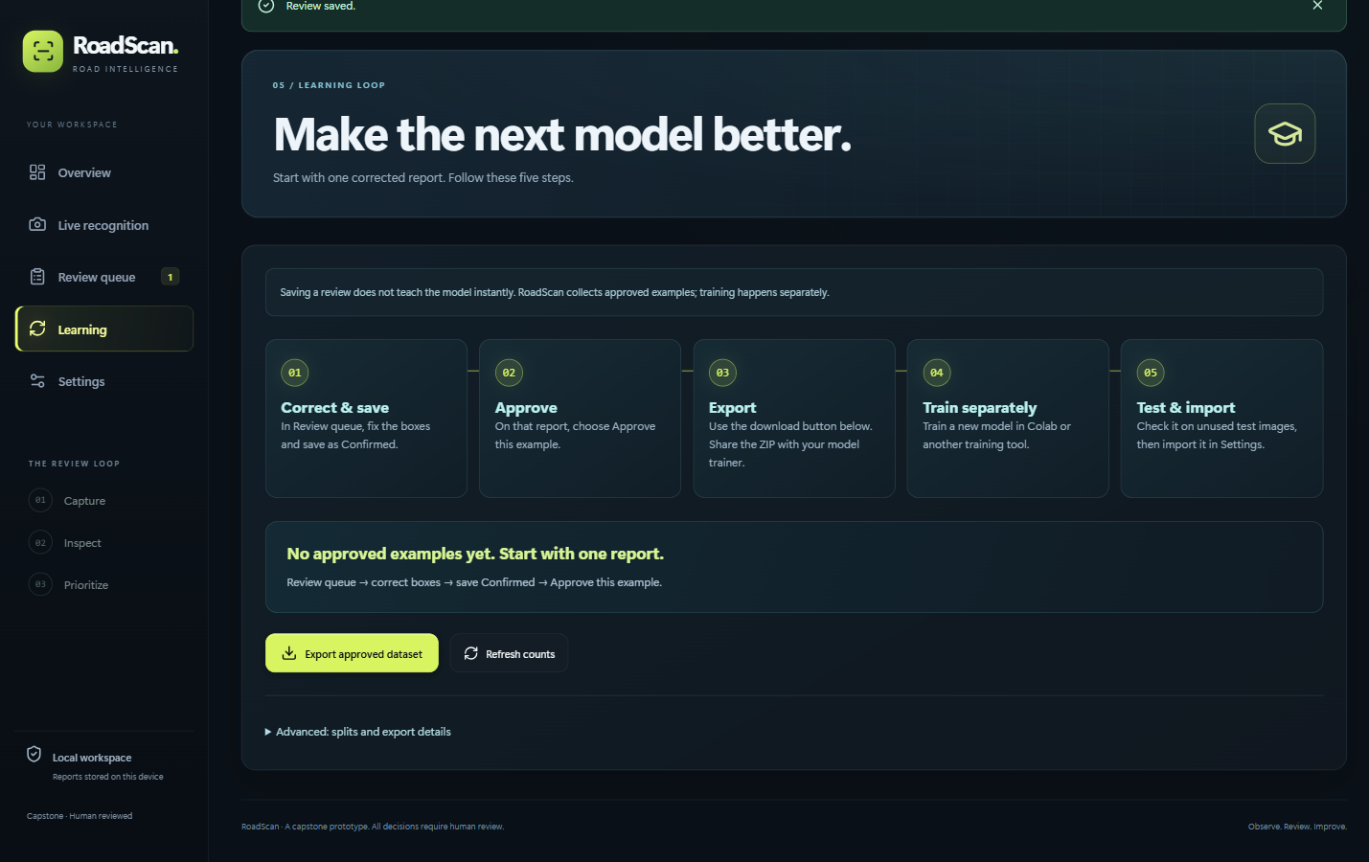
Human review prepares the next training cycle
A saved correction does not update model weights.
Approve → export → train separately → evaluate → import the new model.
The current Learning screen makes the approval boundary visible; the example has no approved training rows yet.
06
Notes:
0:45 — Learning is an explicit workflow. Correct and save the report, approve the example, then export the dataset. A training tool trains a separate checkpoint. Evaluate on protected unused data before importing it and selecting Use model. Review does not silently change the deployed model, and training gains are not guaranteed. This makes each model change deliberate and reversible.
Sources: current Learning UI screenshot, 27 October; START-HERE.md and Live-and-Models; training export/approval code. Keep validation and test data isolated from approved training examples.

Slide 7
Software verified; field validation next
221
24
67
backend tests
frontend tests
browser checks
These checks verify software behaviour, not detection accuracy.
Next evidence
Labeled Saudi road images · real repeat-damage pairs
Repaired data splits · representative camera latency
Local Docker release and setup guide ready · 1 optional backend test skipped · Demo examples remain separate.
07
Notes:
1:00 — The current release passed 221 backend tests, 24 frontend tests and 67 browser checks; one optional backend test was skipped. These results establish software behaviour such as saving, validation and workflow controls, not road-detection accuracy. A clean source-only Docker build also passed model activation, inference and restart persistence checks. The remaining research work is to collect labeled Saudi images and real repeated-damage pairs, repair split leakage, and measure camera performance under representative conditions. Our deliverable is a working, inspectable system with documented limits.
Sources: Docs/For-Examiners.md; current DELIVERY-MANIFEST.json; Evidence/README-Setup-Verification-2026-10-27.json. Closing question: which validation gap should be addressed first?

Slide 8
Appendix · Data and metric definitions
26,869
≈41,000
reported RDD training images
reported main-run pool with extra sources
5,758 validation + 5,758 labeled holdout images
Reported leakage: 2.2% validation / 2.4% holdout.
Raw split manifests and source licenses remain to be checked.
mAP50: box-and-class precision across recall at IoU 0.50.
mAP50–95: averages stricter overlap thresholds; image-presence F1 is a different task.
Team-reported counts, not independently counted; extra sources and ablations do not share one universal training total.
08
Notes:
Appendix — Main training narrative: 26,869 RDD training images plus approximately 14,000 extra images; 5,758 validation and 5,758 holdout. Main training reports 120 epochs, best validation epoch 84 and 1024 px input. Extra sources include Rome potholes, HRP4K, SVRDD Beijing and web data. No original dataset manifest or verified labeled Saudi test set was supplied. Do not call any model’s filename score independent evidence.
Sources: Docs/Team-Models-and-Results.md and supplied split audit in Models/RoadScan-Team-Results-2026-10-24.zip.

Slide 9
Appendix · Baseline and model size
E1 image presence | Any damage F1 | Image accuracy
ResNet18 baseline | 0.893 | 0.869
Main YOLO26s | 0.929 | 0.913
E2 Small: 59.43% mAP50 Nano: 55.99%
Nano was faster in a limited local synthetic diagnostic;
measure end-to-end latency on the real camera.
Supplied labeled-holdout results; independently reproduced road accuracy remains pending
09
Notes:
Appendix — E1 is image-presence classification on 5,758 images: ResNet18 F1 .893 / image accuracy .869; main YOLO26s F1 .929 / image accuracy .913. E2 small versus nano uses 640 px models; supplied mAP50 is 59.43% and 55.99%. These tasks and model settings must not be mixed. A synthetic CPU diagnostic is not real camera FPS.
Sources: e1_classifier_vs_detector.csv and results.csv in the supplied team results; Docs/Team-Models-and-Results.md.

Slide 10
Appendix · Augmentation and domain shift
India holdout
8.86%
mAP50 with India excluded
from comparison training
39.25% when India is
included in comparison training
Teammate-reported experiments; different evaluation domains must remain separate
10
Notes:
Appendix — E3 supplied mAP50: standard 59.43%, no augmentation 46.93%, vertical flip 58.48%. E4 India-only holdout is 8.86% when India is excluded from comparison training, versus 39.25% when included. This motivates local-domain evaluation; it does not establish Saudi performance. The native chart remains editable.
Sources: supplied E3/E4 experiment tables; Docs/Team-Models-and-Results.md.

Slide 11
Appendix · Questions and demo fallback
Is priority a severity measurement?
Can duplicate reports be merged safely?
No: a 0–100 heuristic uses type 40%, visible area 25%, count 20% and confidence/review 15%; it does not measure physical depth.
Optional DINOv2 + FAISS searches nearby candidates within 50 m. The 0.80 threshold is experimental; reports are never merged automatically.
What if the live demonstration fails?
How do we reproduce the project?
Use the PDF screenshots and describe the saved workflow. Restart Docker; check the local URL and active model. Do not claim a failed run succeeded.
Follow README → Docker setup → token → import a trusted model → Use model. Source, weights and private data are distributed separately.
References: Team-Models-and-Results.md · Replacement-Tools.md · README.md · For-Examiners.md
11
Notes:
Appendix / contingency — Rehearse with a disposable demo report. Before presenting: start Docker, open the documented local address, confirm health and the intended active model, and retain this PDF. If a camera or model fails, stop trying after one bounded recovery and use screenshots; state the failure honestly. The README provides exact source-only and bundled-release steps. Optional matching requires coordinates and a DINOv2 backbone. Supplied E5 scores are simulations, not deployed duplicate accuracy. The priority sensitivity tool varies each weight ±20%; no validated engineering severity claim is made.
Sources: Docs/Replacement-Tools.md; Docs/Live-and-Models.md; Code/RoadScan/README.md; current priority and duplicate UI. Repository: https://github.com/Feras-MQ/RoadScan (repository visibility is documented separately).

