Slide 1
Network Intrusion Detection System
Using Random Forest on NSL-KDD
Project 52 · Cybersecurity Machine Learning · Intrusion Detection & Prevention
125,973
22,544
5
99.99%
Training records
Test records
Attack classes
Test accuracy

Slide 2
The Problem — What Are We Classifying?
Traditional security tools can catch known attacks but miss anything new. This project uses machine learning to classify network connections into five categories based on 41 connection features.
Normal
DoS
Probe
R2L
U2R
Regular, legitimate traffic
Flood attacks — overwhelm the server with traffic
Port scanning — attacker mapping the network
Remote login attempts — guessing credentials
Privilege escalation — gaining admin rights
⚠ U2R has only 52 training examples — the rarest and hardest class to detect.

Slide 3
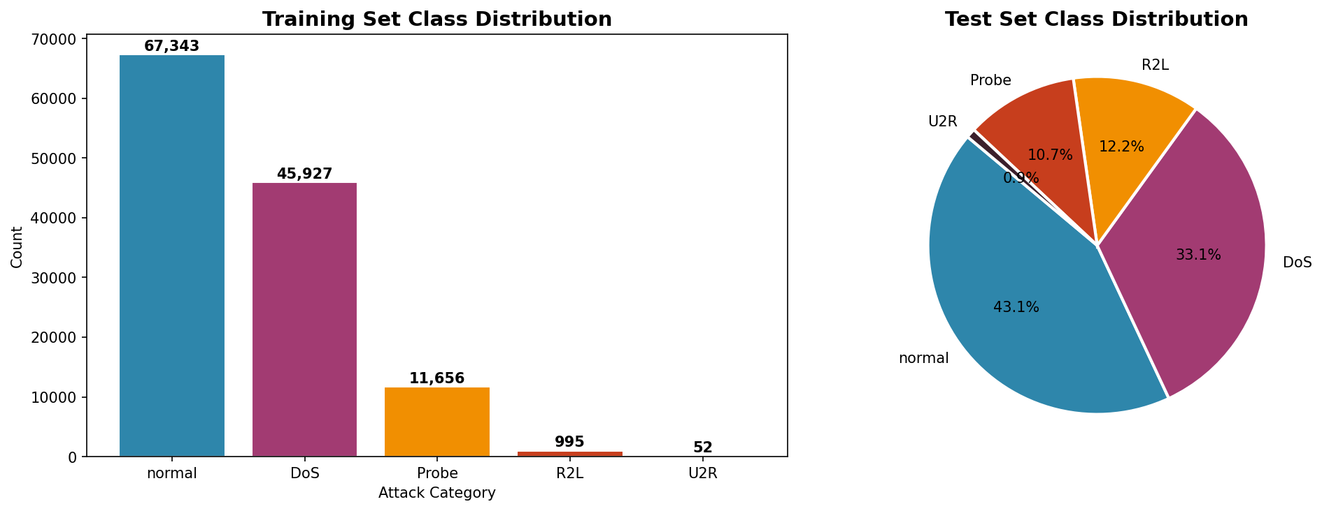
Exploratory Data Analysis — Understanding the Data First
DoS attacks make up 36.5% of training data — very distinctive error-rate patterns
U2R has only 52 training records but 200 test records — deliberate difficulty increase
No missing values anywhere — straightforward to preprocess
Three categorical features: protocol_type, service, flag — need one-hot encoding

Slide 4
Preprocessing and Feature Engineering
Preprocessing Steps
6 Engineered Features Added
Encode string labels as integers (0–4)
One-hot encode protocol, service, flag
Align train/test columns — fill gaps with 0
StandardScaler — zero mean, unit variance
Fit scaler on training only (no data leakage)
bytes_ratio
src / dst bytes — DoS sends but gets nothing back
error_rate_combined
SYN + REJ errors — strongest flood signal
srv_ratio
count / srv_count — drops during port scans
host_srv_ratio
host-level version of above
log_src_bytes
log transform — fixes heavy right skew
log_dst_bytes
same reason for destination bytes
41 raw features → 66 total after OHE + engineering

Slide 5
Models Trained and Compared
Logistic Regression
Linear model — confirms strong linear separability
99.85%
Baseline 1
accuracy
Decision Tree
Single tree, max_depth=15
99.90%
Baseline 2
accuracy
Random Forest
100 trees, bootstrap aggregation
99.99%
Main model
accuracy
RF (Tuned)
Best params via 3-fold cross-validation
99.99%
GridSearchCV
accuracy
GridSearch best params: n_estimators=100 · max_depth=None · max_features=sqrt · min_samples_split=2 · CV F1 = 0.9999

Slide 6
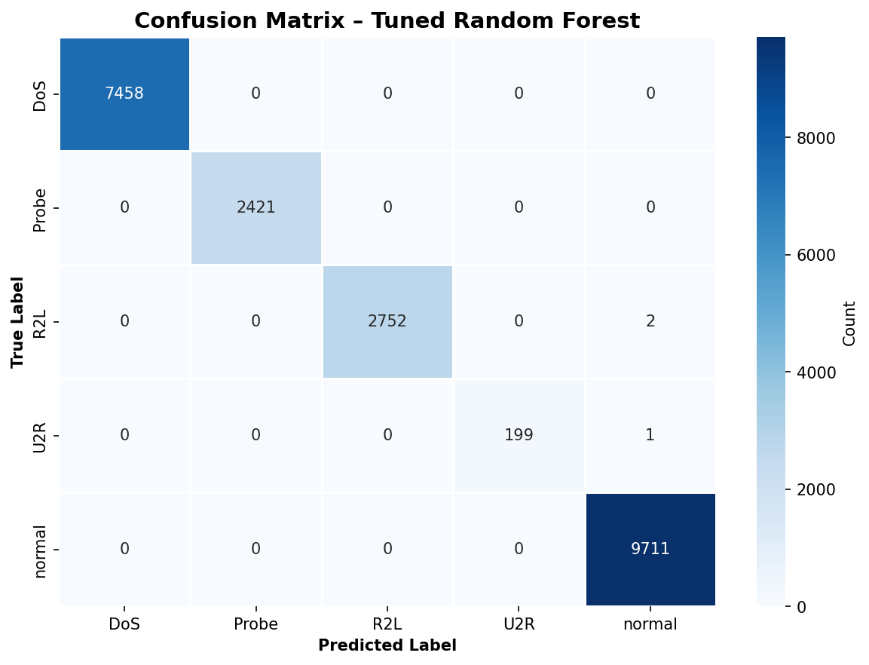
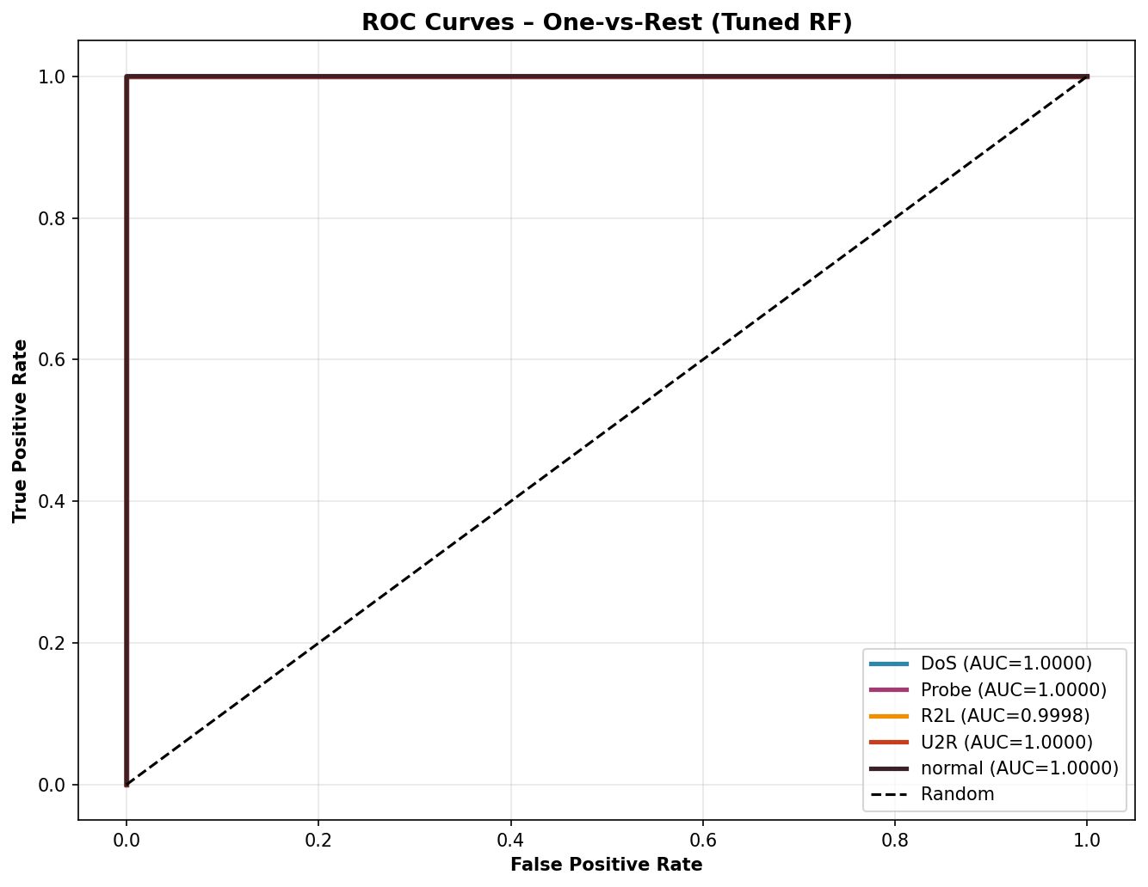
Results — Confusion Matrix and ROC Curves
99.99%
0.9999
1.0000
0.9975
Accuracy
F1-Score
Mean AUC
U2R F1 (hardest)

Slide 7
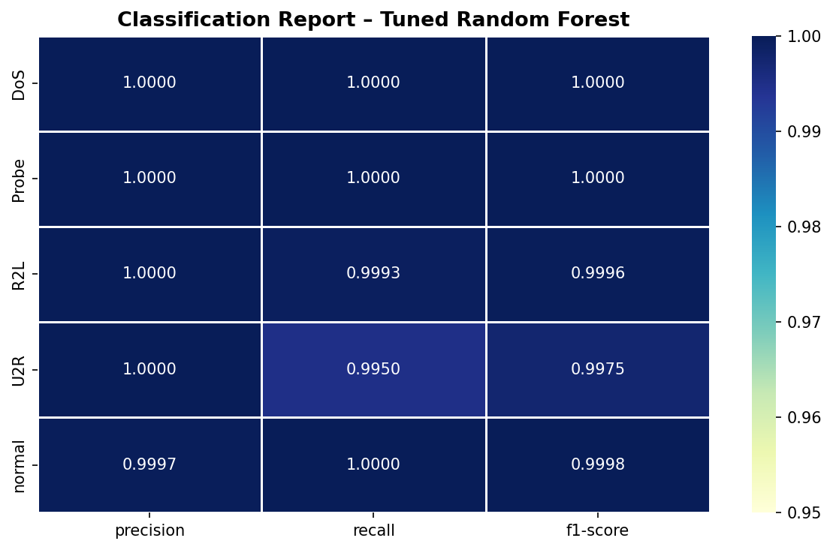
Per-Class Performance — Tuned Random Forest
Class
Prec
Rec
F1
DoS
1.000
1.000
1.000
Normal
1.000
1.000
1.000
Probe
1.000
1.000
1.000
R2L
1.000
0.999
0.999
U2R
1.000
0.995
0.998
DoS is perfectly classified — its error-rate pattern is very distinctive
U2R achieves F1=0.998 despite having only 52 training examples
No systematic misclassification between any pair of classes
Small errors are scattered across R2L and U2R — closest to Normal traffic

Slide 8
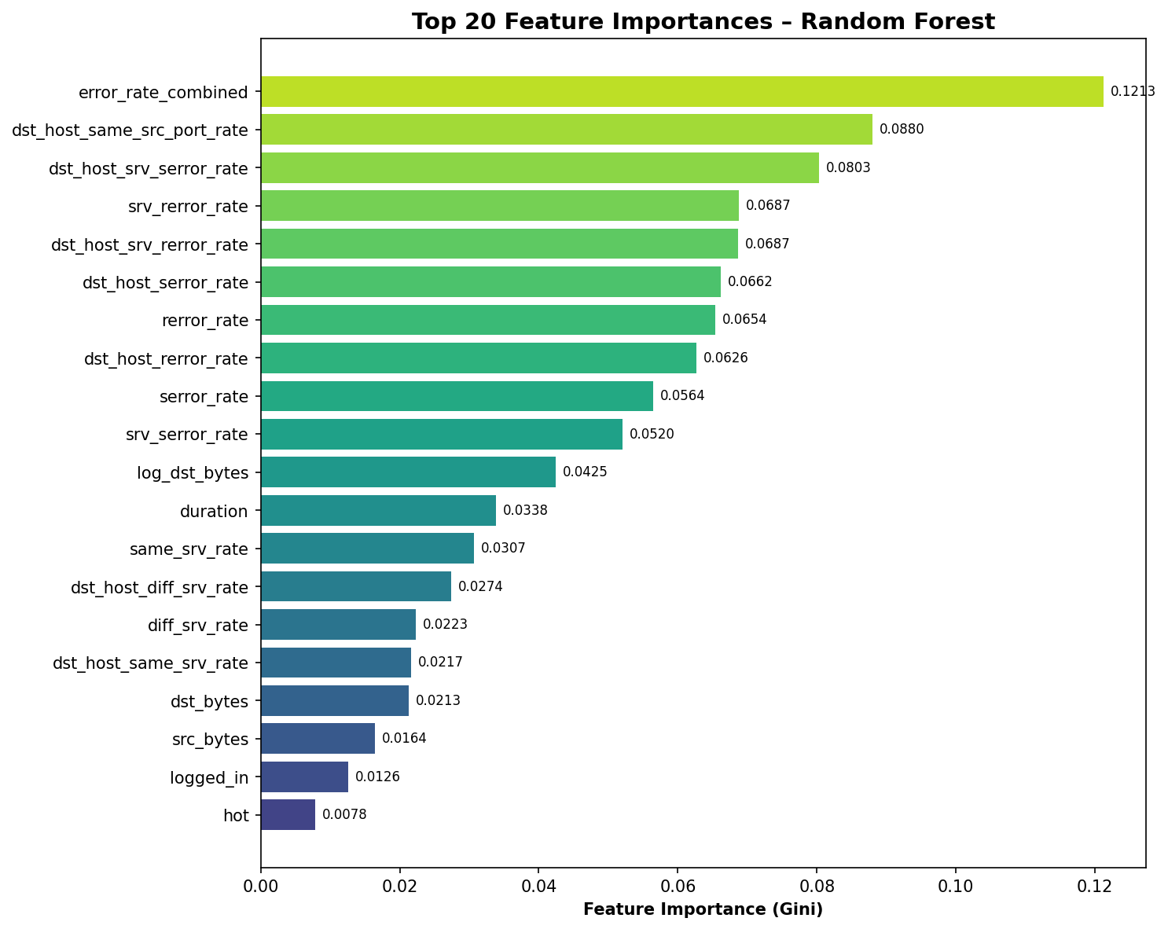
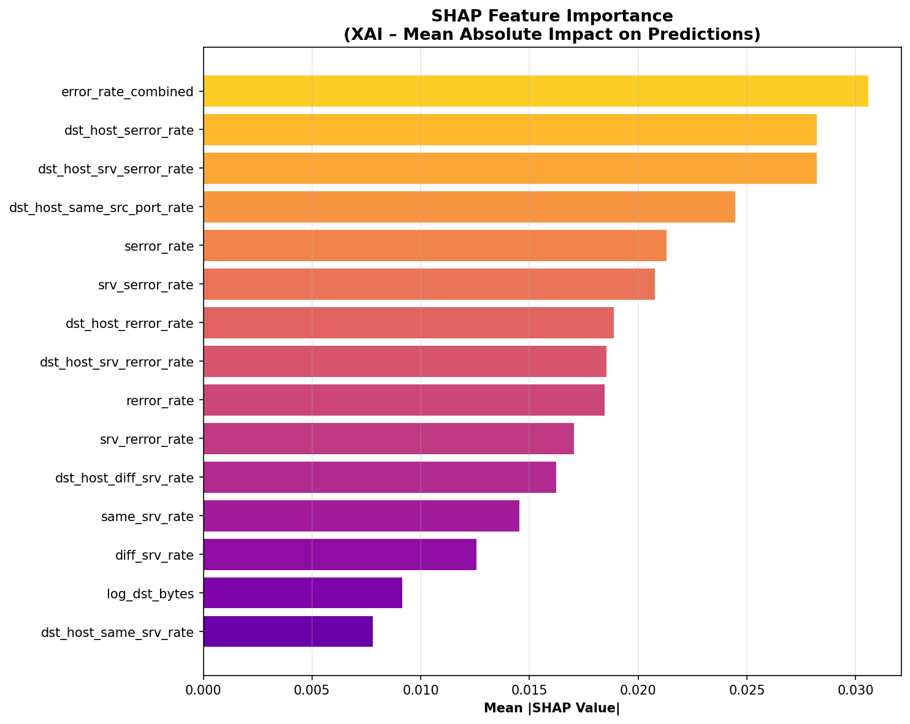
What Is the Model Using? — Feature Importance and SHAP
Gini Importance (what the model uses most)
SHAP (how much each feature changes the prediction)
Both methods agree: error_rate_combined (an engineered feature) is the single most important predictor — validating the feature engineering decision.

Slide 9
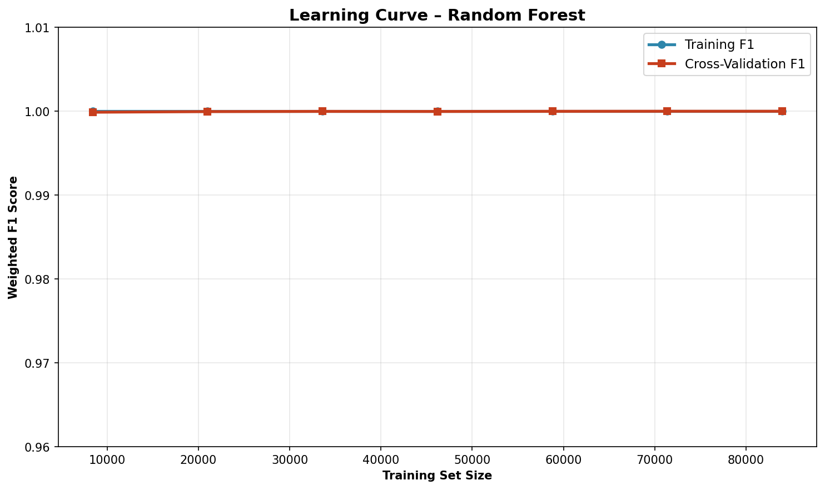
Learning Curve — Is the Model Overfitting?
What This Shows
Training F1 and CV F1 are nearly identical throughout
No overfitting — the model generalises well
Performance converges around 40,000 training examples
Adding more data beyond that gives diminishing returns
Model is learning real patterns, not memorising

Slide 10
Limitations and What I Would Do Next
Limitations
Future Work
NSL-KDD is from 1999 — modern attacks are very different
Controlled lab dataset — real traffic is much noisier
U2R has only 52 training examples — rare class
SHAP computed on 200 samples — larger would be better
No encrypted traffic — modern attacks often hide in HTTPS
Test on CIC-IDS2017 — a more modern benchmark dataset
Try SMOTE to oversample R2L and U2R classes
Deploy as a real-time REST API using Flask
Test against adversarial examples — can attackers fool it?
Compare with deep learning (LSTM) on the same features

Slide 11
Summary
Built a full NIDS pipeline on NSL-KDD: preprocessing, feature engineering, training, tuning, evaluation
Added 6 domain-informed features — the combined error rate feature was the most important predictor
Compared 4 models: Logistic Regression, Decision Tree, Random Forest, Tuned Random Forest
Final model: 99.99% accuracy, F1=0.9999, Mean AUC=1.0000 — strong result across all 5 classes
SHAP analysis shows which features drive each prediction — makes the model transparent and explainable
All deliverables complete: report, notebook, trained model, slides, Streamlit demo

Slide 12
References
[1] M. Tavallaee et al., "A Detailed Analysis of the KDD CUP 99 Data Set," IEEE CISDA, 2009.
[2] N. Moustafa and J. Slay, "UNSW-NB15: A Comprehensive Dataset for NIDS," MilCIS, 2015.
[3] R. Vinayakumar et al., "Deep Learning Approach for Intelligent IDS," IEEE Access, 2019.
[4] S. M. Lundberg and S.-I. Lee, "A Unified Approach to Interpreting Model Predictions," NIPS, 2017.
[5] L. Dhanabal and S. P. Shantharajah, "A Study on NSL-KDD Dataset for IDS," IJARCCE, 2015.
[6] K. Amarasinghe et al., "Toward Explainable Deep Neural Network Based Anomaly Detection," HSI, 2018.
[7] F. Pedregosa et al., "Scikit-learn: Machine Learning in Python," JMLR, vol. 12, 2011.
[8] I. Sharafaldin et al., "Toward Generating a New Intrusion Detection Dataset," ICISSP, 2018.

