Slide 1
Metropolitan Transportation Authority (MTA)
Feras Alyahya

Slide 2
Table of Contents
01
02
03
04
Problem Statement
Data Description
Questions
Conclusion

Slide 3
01
Problem Statement

Slide 4
Data Description
Field Name | Description
C/A | Control Area (A002)
UNIT | Remote Unit for a station (R051)
SCP | Subunit Channel Position represents an specific address for a device (02-00-00)
STATION | Represents the station name the device is located at
LINENAME | Represents all train lines that can be boarded at this station
DIVISION | Represents the Line originally the station belonged to BMT, IRT, or IND
DATE | Represents the date (MM-DD-YY)
TIME | Represents the time (hh:mm:ss) for a scheduled audit event
DESC | Represent the "REGULAR" scheduled audit event (Normally occurs every 4 hours)
ENTRIES | The comulative entry register value for a device
EXITS | The cumulative exit register value for a device

Slide 5
Questions
01
What are the 10 most crowded stations?
02
What is the busiest day? From one of the 10 most crowded stations, such as ST. George.
03
What is the busiest time of the day using 5 stations ? Ex. Before and after midday (AM / PM)

Slide 6
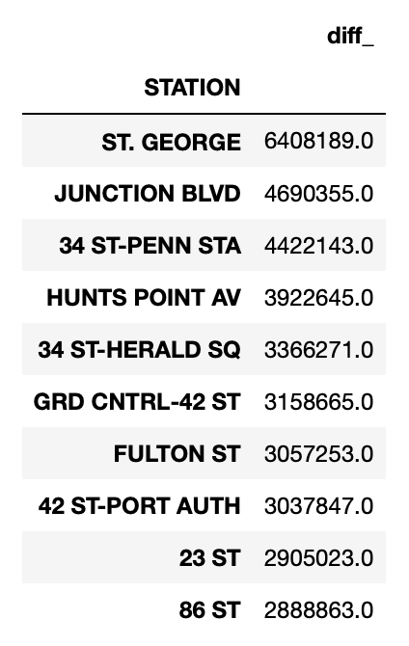
01
What are the 10 most crowded stations?

Slide 7
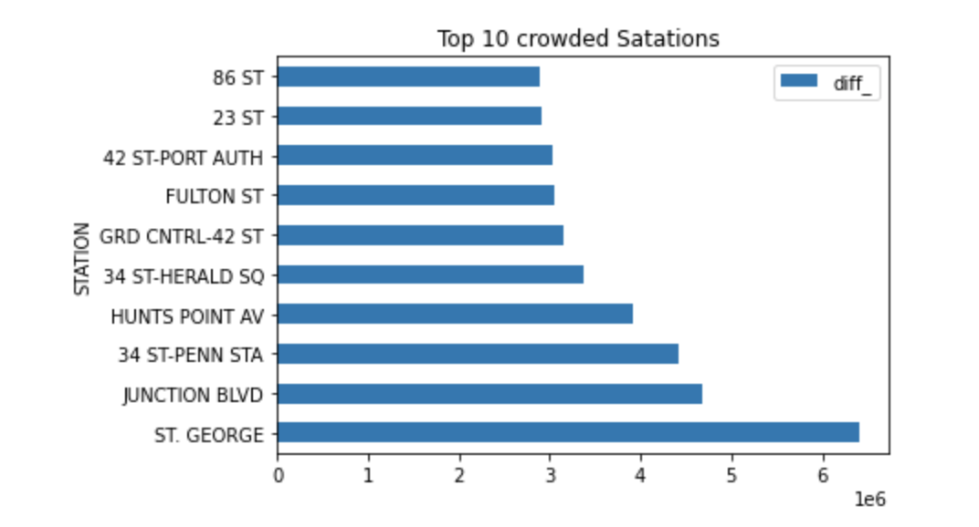
01
What are the 10 most crowded stations?

Slide 8
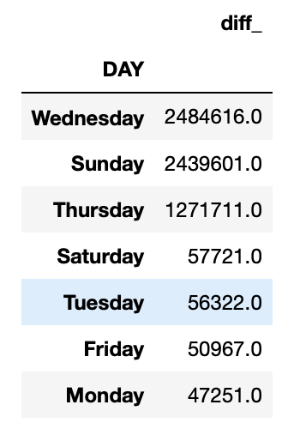
02
What is the busiest day?
Using ST. GEORGE station.

Slide 9
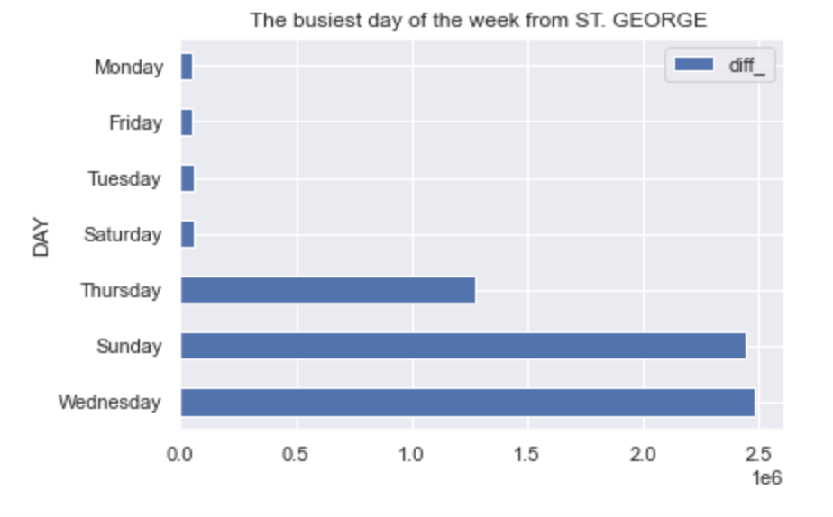
02
What is the busiest day?

Slide 10
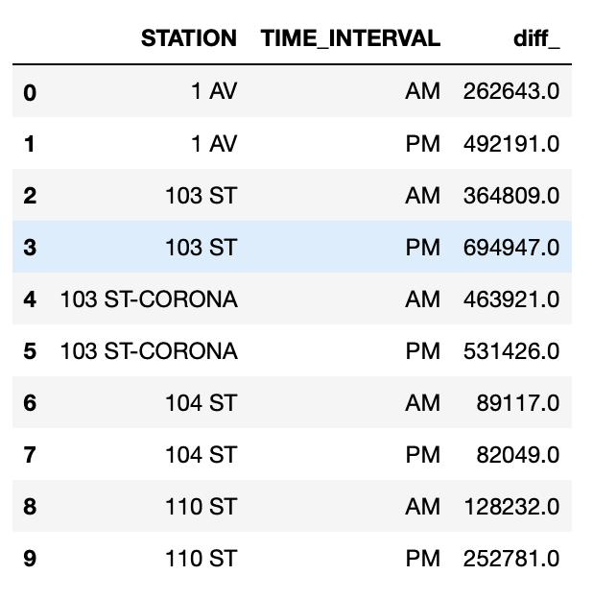
03
What is the busiest time of the day using 5 stations ? Ex. Before and after midday (AM / PM)

Slide 11
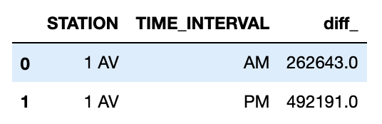
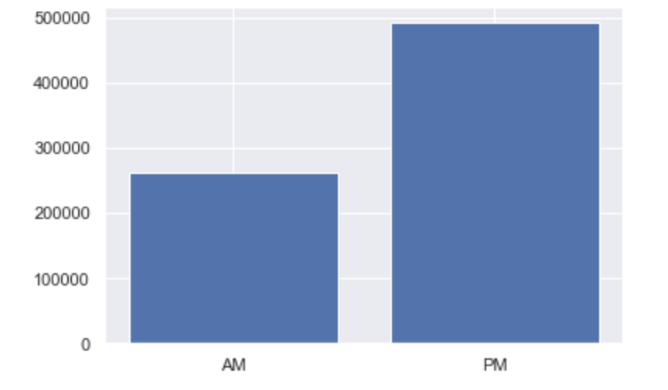
03
What is the busiest time of the day using 5 stations ? Ex. Before and after midday (AM / PM)

Slide 12
Conclusion
Metropolitan Transportation Authority (MTA) needs to
Have more staff assignment in the most crowded stations to ease people entries and exits.
Have more staff assignments in specific days, such as Wedensday.
It is clear that some staions are busier in the after midday. Therefore, we need more staff to help ease and faster the process of entries ana exits.

