Slide 1
Rihla Feras Rabea
Rihla is a programming language I'm developing, drawing on a collection of high-level programming language features I’ve come across. I chose the name “Rihla” because it’s an Arabic word meaning “journey”. Rihla is designed to be both easy to extend and powerful enough to be Turing-complete, making it a versatile tool for learning as well as practical applications.
Rihla5 is focused subset of the language Rihla that supports the main PROGRAM module (without additional submodules) and includes line and block comments, local and global variables and constants (integers and booleans), assertions, console input and output, assignments, conditional statements, and loops (both bounded and unbounded).

Slide 2
Rihla Table Of Operators
Rihla Operators | Precedence | Associativity
LB, UB | 1 (highest) | Non-associative
++, -- | 2 | Non-associative
^, ** | 3 | Non-associative
ABS, +(unary), -(unary), ORD, CHR, INT, FLT, UP, LOW, ISUP, ISLOW, PRED, SUCC | 4 | Non-associative (unary operators)
*, /, % | 5 | Left-to-right
+(binary), -(binary) | 6 | Left-to-right
<, <=, =, >, >=, <>, ||, != | 7 | Non-associative
NOT | 8 | Non-associative
AND, NAND, && | 9 | Left-to-right
OR, NOR, XOR, || | 10 (lowest) | Left-to-right

Slide 3
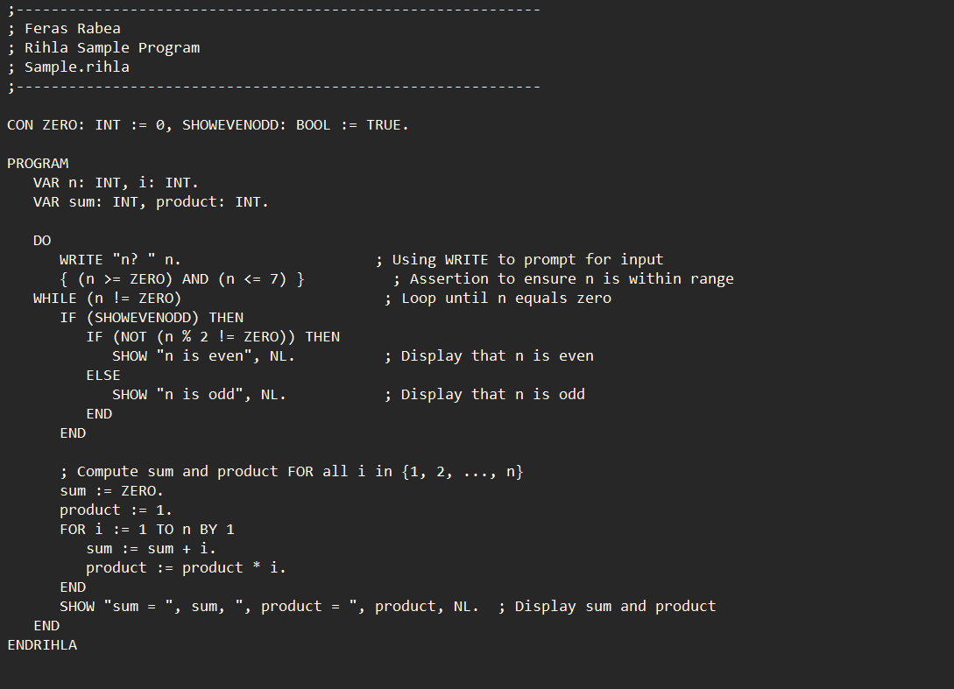
Rihla Program “Sample.rihla”

Slide 4
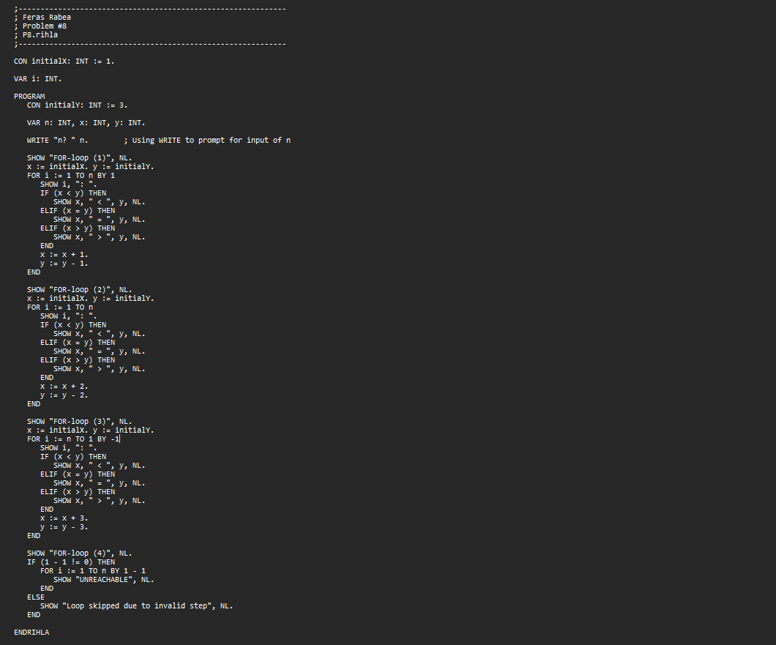
Rihla Program “P8.rihla”

Slide 5
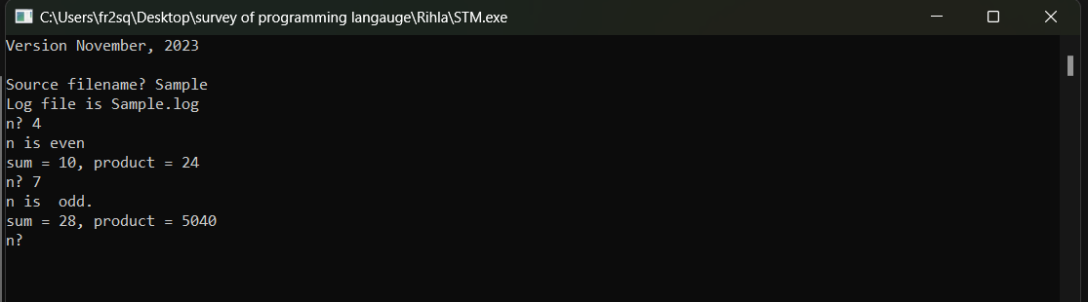
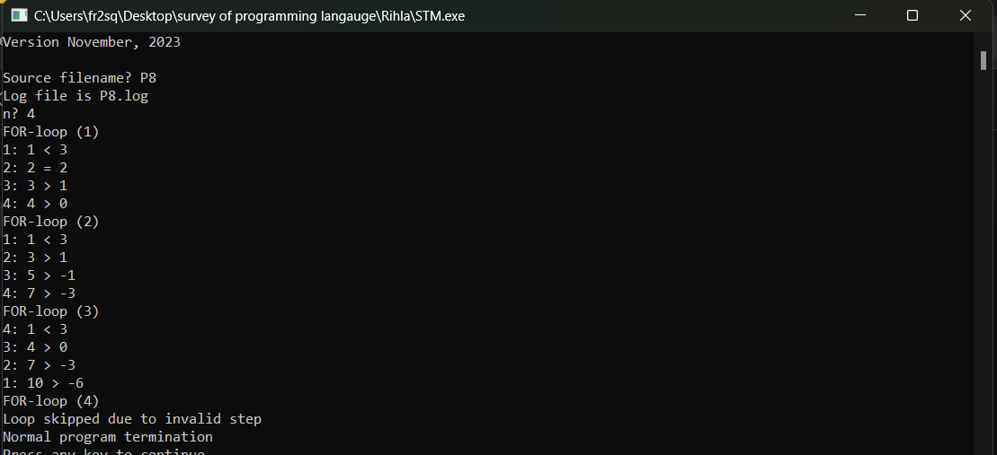
Programs dialog

