Slide 1


Slide 2
COLOR PALETTE
#FFFFFF
#223E5F
#FFFFFF
#7095B6
#D2386C
#EDEEB7
#1F595C
#D0E7DD

Slide 3


Slide 4
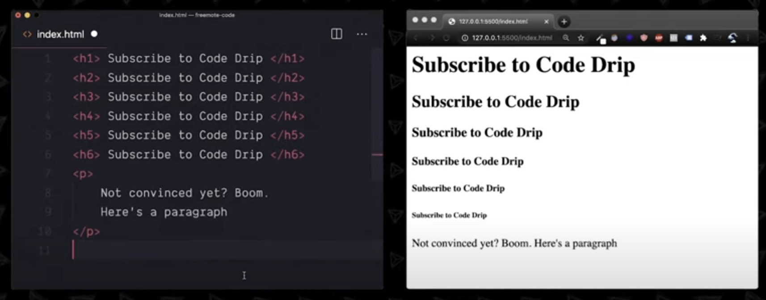

Slide 5
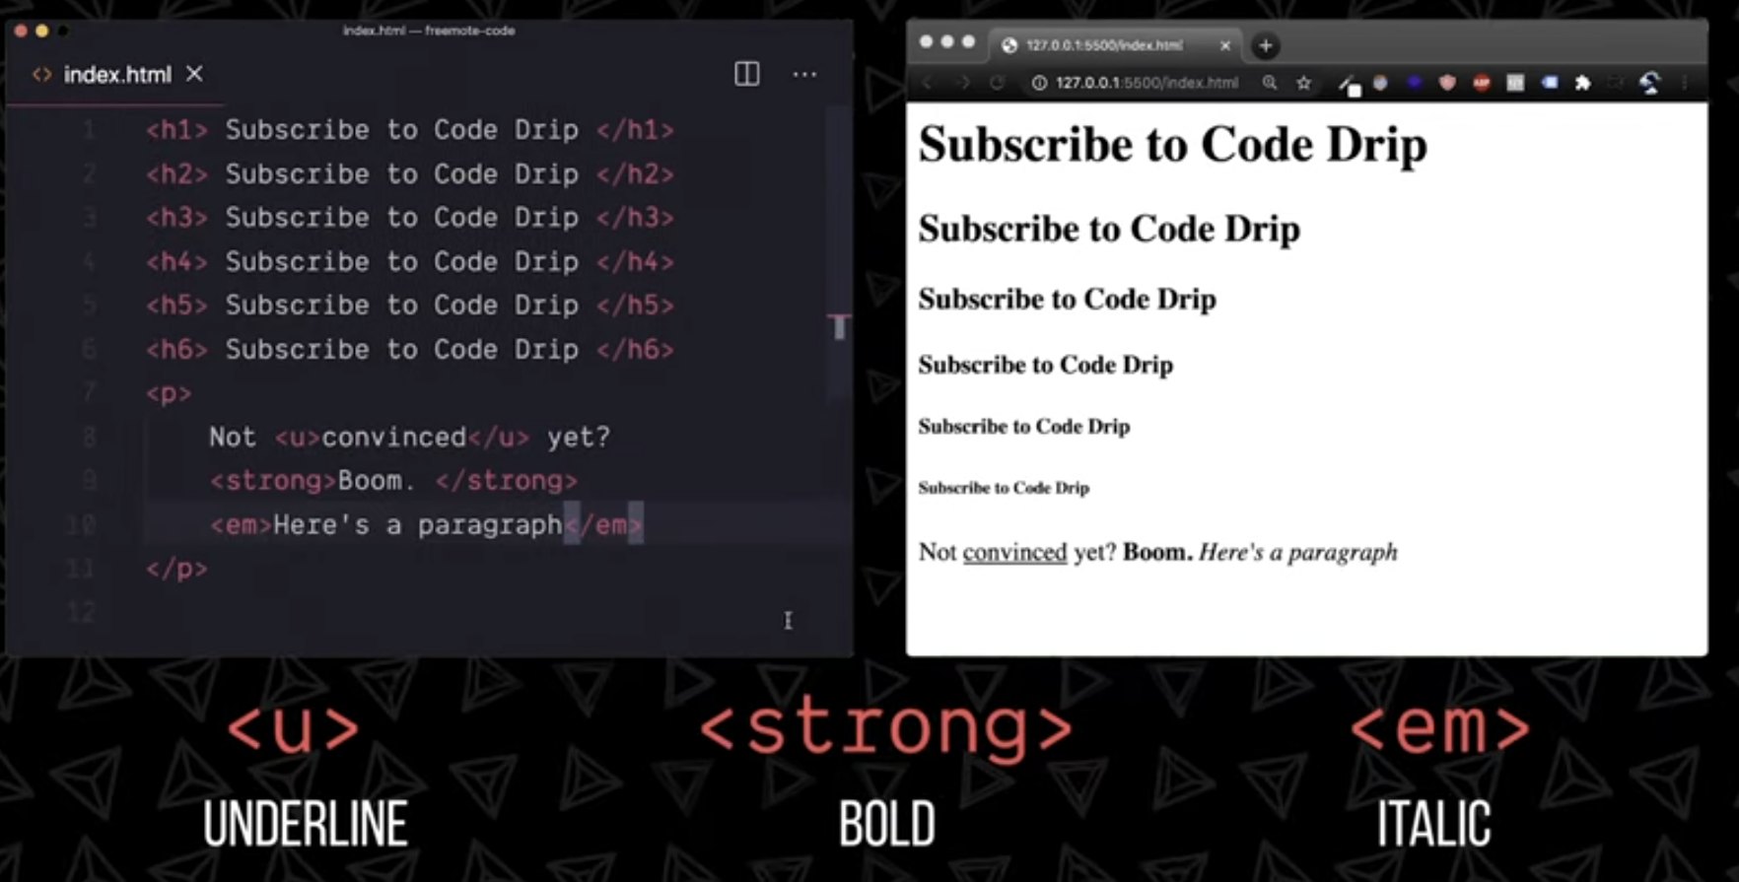

Slide 6











