Slide 1
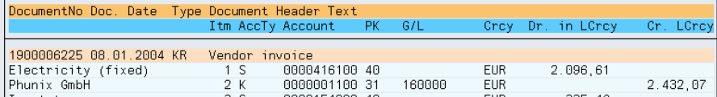
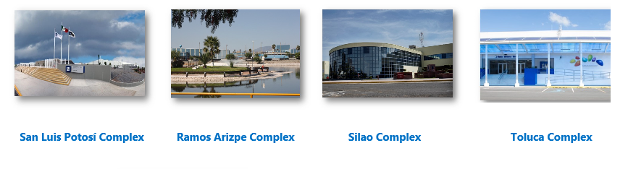

Project #14762: Power Bi - GBS Q&T Management Process Improvement
D
M
A
I
C
D
Project Charter:
DEFINE
Problem / Opportunity Statement:
During 2025 at GBS Silao, the Quality and Transformation area required the management of information for each automated project using a lot of time, 60 hours per year. An area of opportunity was observed in the process for the consolidation of the information of the projects developed and the generation of statistical reports. Also, the team was investing in this process $100K USD annually due to projects loss of information.
Project Objective:
Establish a standard and optimized process for managing team projects and enable project benefits.
Create an automated tool (Power Bi) that consolidates information and generate reports on automated projects.
Time reductions of 80% (48 hours), associated with project upload and reporting.
Enable Cost Avoidance of 100% ($100k USD annually)
Project Benefits:
Time optimization of 80% in this activity (48 annual hours).
Cost avoidance of 100% ($100k USD annually)
Decrease probability of errors
Just 1 Power BI file per report
Formal way of presenting
The Power BI is automatic
Just one revision with the team
Glossary:
JE: Journal Entry, an accountable document posted in ledger.
Cost center: Numerical distinction for a certain engineering group.
Entity: GMM site.
WD: Working day
Q&T: Quality and Transformation
GBS: Global Business Solutions
CICP: Continuous Improvement Culture Program
Project Leader: David Iturriaga Sponsor: Nancy Dominguez
Team Members: Oscar Marquez
OpEx Master: Jennifer Chew / Oscar Tamariz
Financial Approver: Catalina Castillo
Start Date: 10-feb-25 End Date: 25-jul-25
Business Unit Approver:
Jorge Plata
Executive Champion:
Lizbeth Pérez

Slide 2


Intangible Benefits Confirmation
D
M
A
I
C
MEASURE
ACTUAL
Internal request process |  | Consolidate Information |  | Generate Reports |  | Months per year |  | Annual hours worked
 |  |  |  |  | X
3 | + | 1 | + | 1 | x | 12 | = | 60
OPTIMIZED
Internal request process |  | Consolidate Information |  | Generate Reports |  | Months per year |  | Annual hours worked
0.8 | + | 0 | + | 0.2 | x | 12 | = | 12
Waste of time in manual processing
Risk of mistakes
Many platforms used
Not so formal way of presenting
Many revisions with the team
Reduction of 80% of the duration of the activity.
Decrease probability of errors
Just 1 Power BI file per report
More practical to use
Formal way of presenting
The Power BI will be automatic
Just one revision with the team
Annual saving hours of 48 hours (80%)
Benefits confirmed with two pilots completed in May and June 2025. 80% of time improvement achieved. Benefits will keep being monitored during Sustain phase and final benefit will be updated

Slide 3
Tangible BenefitS CONFIRMATION
D
M
A
I
C
MEASURE
Current
$10,000 USD x 10 x = $100,000 USD
Cost per lost project
Lost projects per year
Total Annual Cost
Optimized
$10,000 USD x 0 x = $0.00 USD
Cost per lost project
Lost projects per year
Total Optimized Cost
Annual cost avoidance of $100,000 USD (100%)
First year cost avoidance (from May to December 2025 = ($8,333 USD x 8 months ) = ~$67k USD
Projected cost avoidance is $100K USD year over year ($8,333 USD monthly). Projected 3 years savings is $0.267M USD ($267K USD) starting May 2025 to December 2027

Slide 4
Implementation Plan
D
M
A
I
C
ANALYZE & IMPROVE
Implementation Work Plan
 | Action/Deliverable | Responsible/ Support | Start Date | Completion Date | Status | Phase | Comments
1 | Sharepoint | (Leader) | MM/DD/YYYY | MM/DD/YYYY | 100% | Improve | ...
2 | Consolidated File | (Leader/ Team Member) | MM/DD/YYYY | MM/DD/YYYY | 0% | Improve
3 | Power Bi | (Leader/ Team Member) | MM/DD/YYYY | MM/DD/YYYY | 0% | Improve
4 | Excel Tables | (Leader / Co-Leader) | MM/DD/YYYY | MM/DD/YYYY | 0% | Improve
5 | Future Process Map | (Leader) | MM/DD/YYYY | MM/DD/YYYY | 0% | Improve
6 | Solutions Evidence & Pilots | (Leader) | MM/DD/YYYY | MM/DD/YYYY | 0% | Improve
7 | Benefits Confirmation | (Leader) | MM/DD/YYYY | MM/DD/YYYY | 0% | Improve
8 | Control Plan | (Leader / Co-Leader) | MM/DD/YYYY | MM/DD/YYYY | 0% | Control
9 | Monitoring Plan | (Leader) | MM/DD/YYYY | MM/DD/YYYY | 0% | Control
10 | Standards and Procedures Developed and In Place | (Leader) | MM/DD/YYYY | MM/DD/YYYY | 0% | Control
11 | Replication Opportunities Analysis | (Leader) | MM/DD/YYYY | MM/DD/YYYY | 0% | Control
12 | Process Improvements Monitoring (More Pilots) | (Leader) | MM/DD/YYYY | MM/DD/YYYY | 0% | Sustain
13 |  |  | MM/DD/YYYY | MM/DD/YYYY
1
2
3
4
5
All project activities added to implementation plan in order to get monitored and completed
4

Slide 5

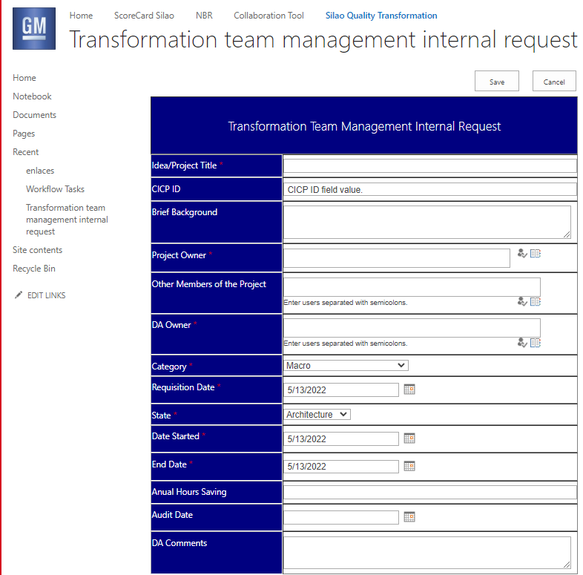
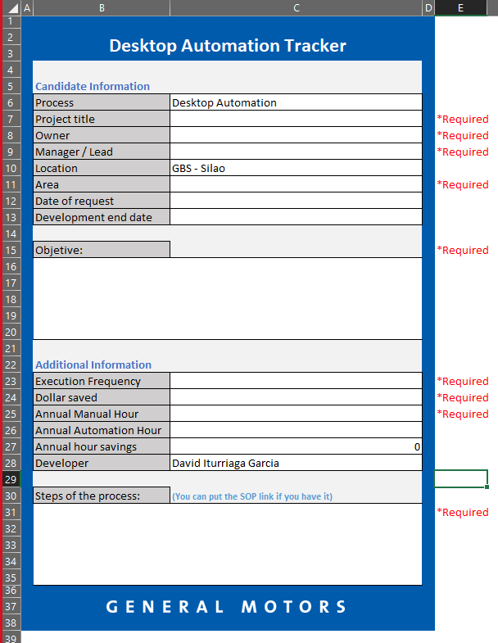

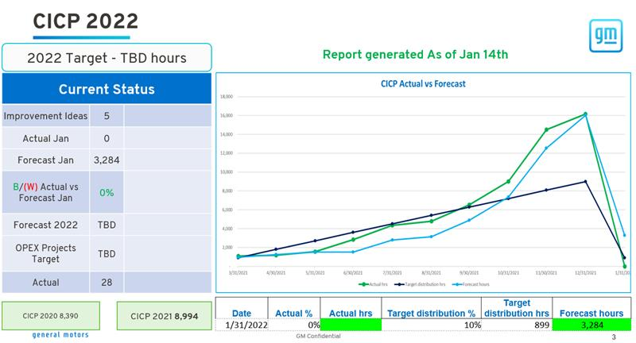
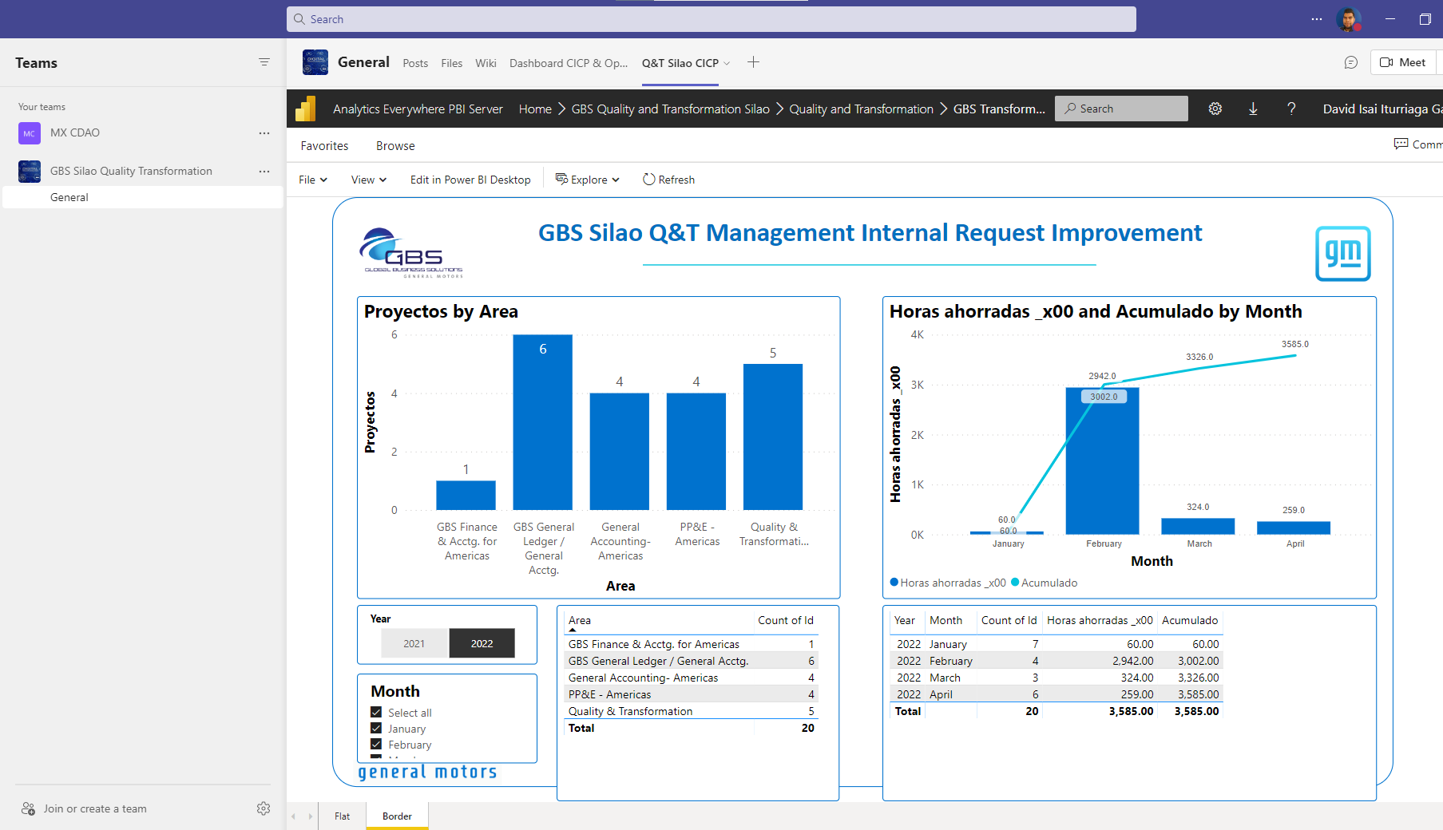
1
SOLUTIONS EVIDENCE & pilots
D
M
A
I
C
3
ANALYZE & IMPROVE
Before
Internal Request Process
After
An Excel form had to be filled out with each project criteria.
A system was created in SharePoint with standard criteria, more friendly and easy to use, eliminating manual errors.
Sharepoint Improvements were validated during May and June 2025. A total of two pilots implemented
Manual graphs are created from the consolidation of the master table, and they were passed to Power Point and then sent to management as a final report.
A Power BI linked directly to system information in SharePoint is created and hosted in Teams for real-time viewing.
Generate Reports
Power Bi Improvements were validated during May and June 2025. A total of two pilots implemented
5

Slide 6
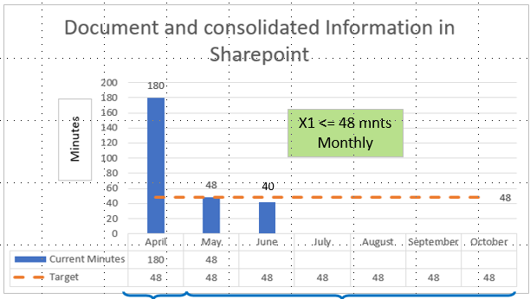
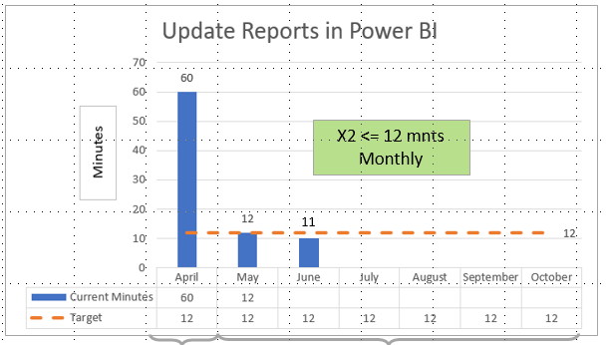
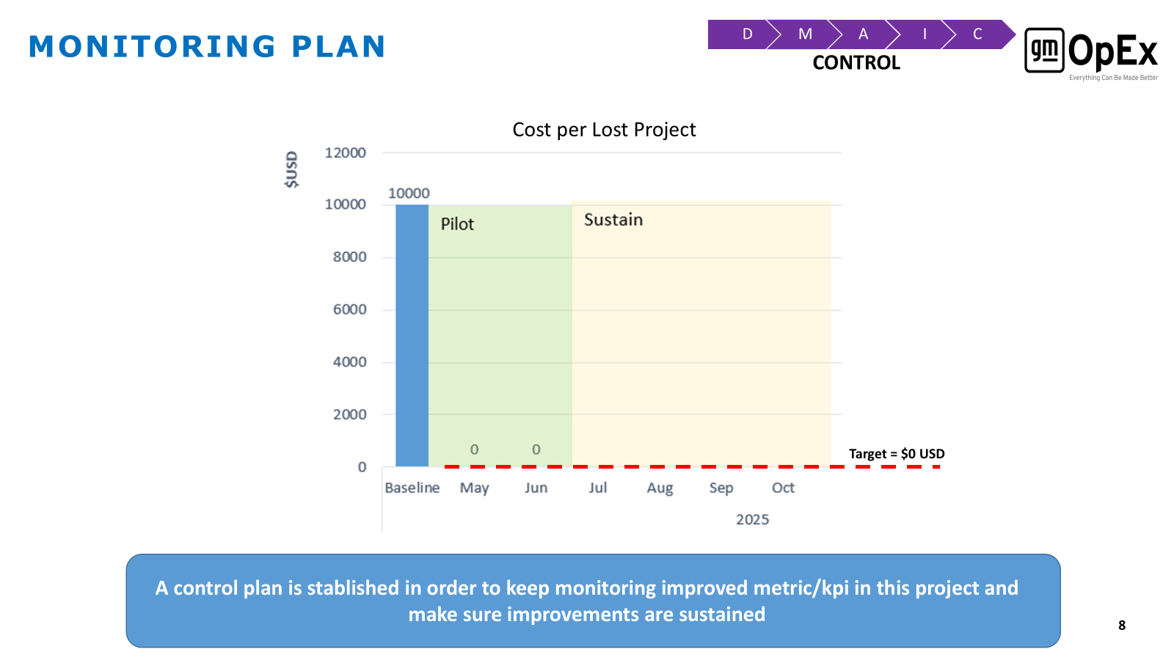
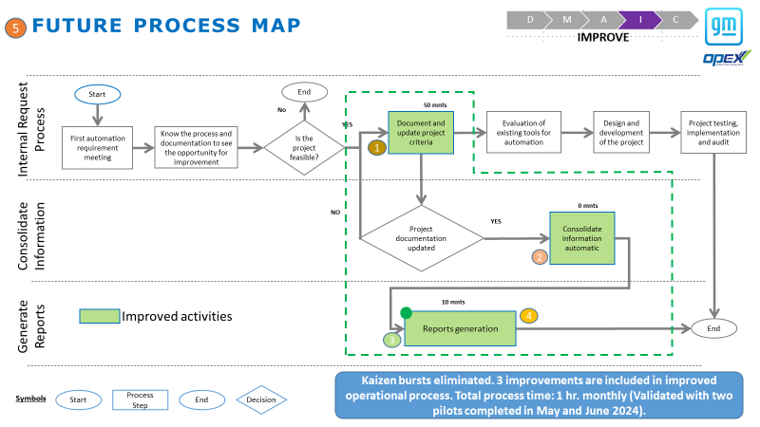
Control Plan
D
M
A
I
C
CONTROL
X´s | Target | Control Method | Action Required | How Often? | Responsible | Start Date | Reaction Plan
X1: Document and consolidate the information in Sharepoint. | X1 <= 48 mnts Monthly | Capture the time that take the process to fill data in SharePoint. | Measure the time that takes to capture, create and visualized the information of project. | Monthly | Saul Marquez / David Garcia | May 2025 | Communicate and provide feedback f X1 > 48 minutes; planned action items: - Verify that the automatic information (area, department, supervisor, analyst) is displayed correctly. - Check that the notification is sent. - Confirm main root causes and implement action plans-
X2: Update reports in Power Bi | X2 <= 12 mnts Monthly | Capture the time that take the process to visualized dashboard at Power BI automation tool. | Measure the time it takes to create the report to verify that it is within the determined range. | Monthly | David Garcia / Saul Marquez | May 2025 | Communicate and provide feedback f X2 > 12 minutes; planned action items: - Verify the connections between SharePoint and Power BI are configured correctly. - Review if the hosting on Teams is working. - Review the scheduled refresh is working. - Confirm main root causes and implement action plans
X3: Cost Optimization Monitoring | X3 = $0 USD | Capture the cost per lost project per month | Measure the cost it takes per lost project | Monthly | David Garcia / Saul Marquez | May 2025 | Communicate and provide feedback f X3 > 0 USD; planned action items: - Confirm action plans are implemented and adopted Confirm process is implemented Make sure finance information is accurate Analyze root cause and implement action plans
X3: Implement Future Process Map | Make sure Future State Map is followed as defined | Follow Future State Map and evaluate it during pilots | Implement Future State Map activities into improved process and validate it during pilot runs | Monthly | David Garcia / Saul Marquez | May 2025 | - Communicate and provide feedback if X3: real process ≠ than Future State Map; planned action items: - Communicate and agree any changes needed in Future process map to the team and explain why updates are needed - Confirm main root causes and implement action plans
A control plan is stablished in order to keep monitoring improved metrics/kpis in this project and make sure improvements are sustained
6

Slide 7

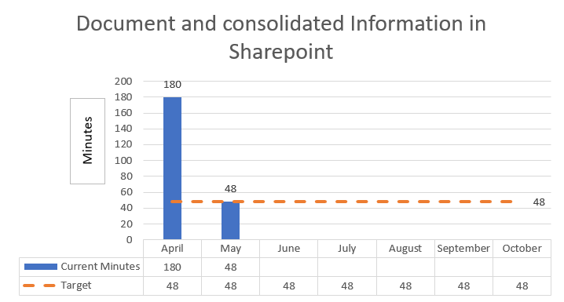
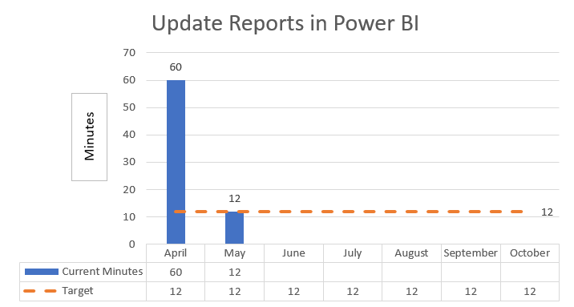
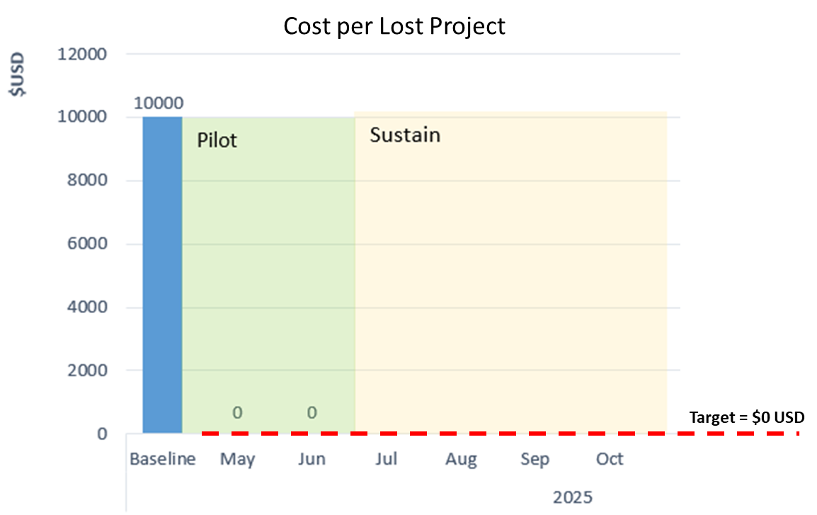
Monitoring Plan
2025
2025
X1 <= 48 mnts
Monthly
X2 <= 12 mnts
Monthly
40
41
44
48
43
11
11
10
12
11
Base Line
Improvements
Base Line
Improvements
2025
Notas: Las gráficas deberán contener Titulo del Métrico y periodo de tiempo mostrado (Ejem: Tiempo dedicado a la actividad de forma mensual Abr-25 a Jun-25), títulos de ejes X y Y, y nombre en periodo eje X (Ejem: Abr-25, May-25… etc).
Improvements
A monitoring plan is stablished in order to keep monitoring improved metric/kpi in this project and make sure improvements are sustained
7

Slide 8
OpEx Tollgate – Current Phase Summary
D
M
A
I
C
CONTROL
CONTROL Date Tollgate Approved:
Take steps to hold the gains, and spread to other parts of the company.
Monitoring and Control Plan/System Defined and Validated.
Standards and Procedures Developed (and Sustained).
Control Chart Established (If Applicable).
Process and Procedures Documented and In-Place.
Transfer Plan Developed, Hand-Off to Process Owner Completed.
Tangible and Intangible Benefits Verified.
Project Documentation Completed.
Replication Opportunities Identified (If Applicable).
Project Closure Confirmed.
Criteria | Y/N | Comments
Standard Tool | Y | Power Bi
Access Control | Y | Data Stage Power BI
Automated Feed* | N | Power Bi linked to sharepoint automatic
User & Back Up // Admin & Tool Maintenance Backup | Y | David Iturriaga & Saul Marquez // Oscar Marquez
Documented SOP | Y | GMM Controllership - New - All Documents (sharepoint.com)
Hosted on Server* | Y | Data Stage Power BI
Training | N | David Iturriaga, Saul Marquez, Oscar Marquez, Nancy Dominguez, Edgar Ramirez & Alejandro Alcantara
Comments/Conclusion: (If any checklist items were not applicable to this project, please briefly explain).
Elimination of manual steps. Processes automation to consolidate data from txt files and create
Power Bi visualizations to monitoring and control customs operation on monthly basis.
Opportunity to increase project scope as per business requirement according to necessities to monitoring.

Slide 9

D
M
A
I
C
Back Up Information
Tool Video
Technical Background
Desk Procedures
Trainings
Communication
etc…
9

Slide 10
D
M
A
I
C
10

