Slide 1
MSc Project
PhD 2nd Year
Are PILs different?
Comparison with emotive texts
Objectively create casual leaflet
Case Study: Pritaporn
Identify PILs phrases that hinder / enhance recruitment / readability
RCT Study
6
1
Are PILs different?
Comparison with news articles
4
Simulated study: Mechanical Turk | Patient Group
Simulated study: stakeholder group assessment
10
Content Analysis: PILs’ words association with recruitment
3
Objectively create emotive leaflet
7
8
Identify the effect of emotive words on recruitment / readability
Create Personas profiles
2
5
9
11
12
Characterise the PILs
Design emotive alternative
Characterize the audience
Understand the stakeholders needs
Assess the performance
Implementation
Assess the tools validity

Slide 2
MSc Project
PhD 2nd Year
PhD 3rd Year
Are PILs different?
Comparison with emotive texts
Identify PILs phrases that hinder / enhance recruitment / readability
RCT Study
1
Are PILs different?
Comparison with news articles
Simulated study: public reviewers’ assessment
10
Content Analysis: PILs’ words association with recruitment
3
Identify the effect of emotive words on recruitment / readability
8
2
11
12
Characterise the PILs
Characterize the audience
9
Assess the tools validity
Understand the stakeholders needs
Assess the performance
Implementation

Slide 3
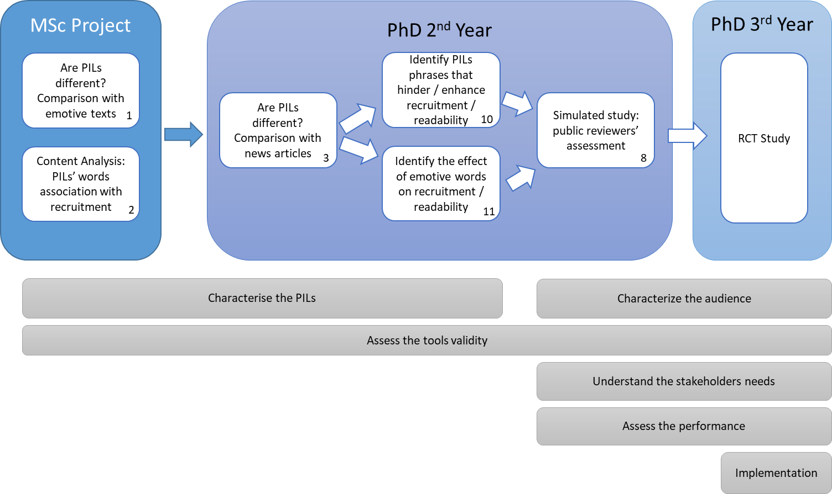

Slide 4
Opportunity to join RCT
Study PIL
Emotion
Motivation to participate in an RCT
Review literature & information
Motivates
Understand & trust PIL
Enables
Experiences during RCT
Join the RCT
Meaningful consent process
Refer back PIL information
Stay in RCT

Slide 5
