Slide 1





Choose an emotion for this comment:
OTHER: ________________
Tell us how to make it better:
Did you mean “elderley"

Slide 2
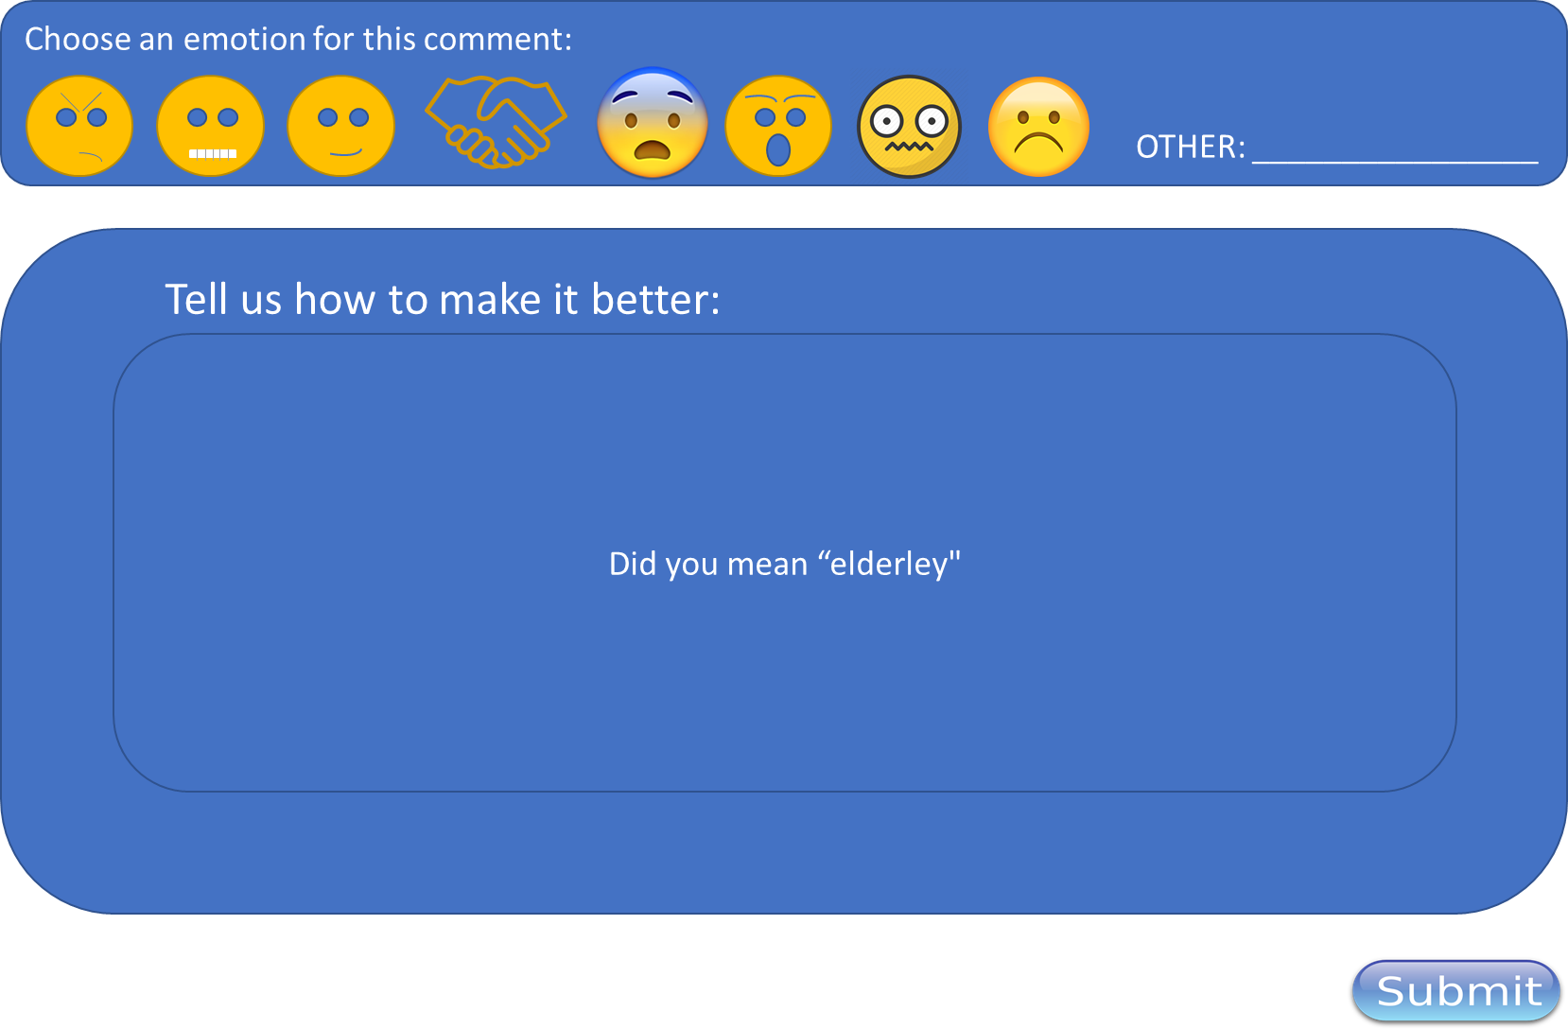

Slide 3

Author
Post
RBM27
Reviewer commented:
– elderly –
-> Did you mean elderley?
3
20
AVATAR IMAGE
RBM27
Reviewer commented:
– a copy may be obtained –
-> How?
15
0
AVATAR IMAGE
RBM27
Reviewer commented :
- It is up to you to decide whether or not to take part. If you decide to take part you will be given this information sheet to keep and be asked to sign a consent form. If you decide to take part you are still free to withdraw at any time without giving a reason. This will not affect the standard of care you receive. –
-> Grammar check for easy reading
10
2
AVATAR IMAGE

Slide 4
