Slide 1

A Web Platform for Public Involvement: Reviewing Patient Information Leaflets for Clinical Trials in the UK
Supervisors: Prof Thanassis Tiropanis
Prof Jeremy Wyatt
By Fernando Santos

Slide 2
The Problem
Current Patient Information Leaflets (PILs) are hard to understand for patients and public audiences.
PILs need to be able to support the patient decision making process, thus it is necessary that they are understandable by all patients.
Employing Patient and Public Involvement group can be too expensive (up-to £20 per hour per person) or time consuming for pragmatic and low-risk trials.
Employing quantitative metrics and text analytics makes easy to identify sentences that may be too hard to understand by the patients, but not to give advice on how to correct the issues.

Slide 3
Our proposal
Assess the effect of different content analysis techniques in revising Patient Information Leaflets (PILs)
Use different quantitative metrics to assess how hard to understand the current PILs are.
Collect public feedback on current PILs information online
Record the comments
Link comments to specific sections of text
Quantitatively assess issues in the sentence
Employ Amazon crowdsourcing to revise the wording of sentences that are too hard to understand.

Slide 4
Current Progress
Invited PIL authors from UK clinical trials to collaborate in the study, received response from FLUPOC, HORIZON and TrueNTH studies.
Four PILs currently in use were selected to test our platform.
Several indexes were used to quantify the readability of the current PILs text.
Sentences that were too hard to understand (required above 10th grade schooling) were identified in each PIL.
Public comments and reviews (EQIP scale) on the PILs’ full text were gathered online.
Currently in process: studying how different techniques (Cloze procedure, sentiment analysis, crowdsourcing) affect the revision quality of sentences that are too difficult to understand.

Slide 5
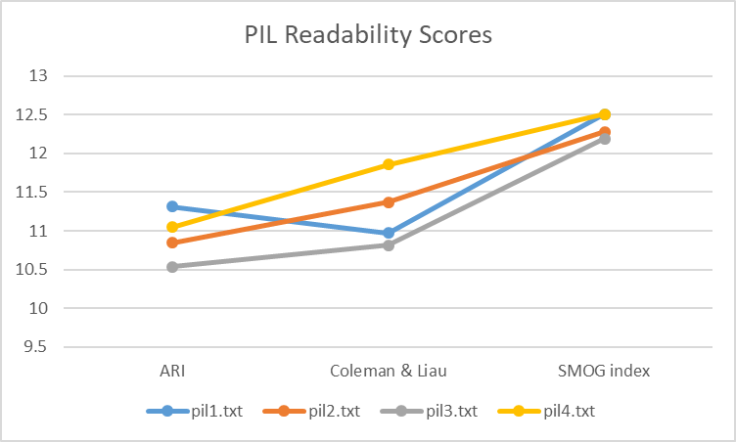
Initial Results
We have obtained some initial results for this study
No meaningful difference was observed in the readability scores for the PILs (ARI, Coleman and SMOG).

Slide 6
Initial Results
The text of the PILs was found to contain similar amount of hard sentences and similar distributions.
In all cases more than 1/3 of the sentences were deem to be too hard to understand. 1/4 of these sentences would require a professor level reading skill to be easily understood.
Professor Level
PIL | Sentences | Sentences Above 10 | Percentage
1 | 78 | 29 | 37%
2 | 133 | 46 | 35%
3 | 60 | 19 | 32%
4 | 136 | 47 | 35%
PIL | Upper | Lower | Q1 | Q2 | Q3
1 | 37.67 | 10.28 | 12.92 | 15.25 | 20.36
2 | 40.93 | 11.27 | 13.83 | 15.95 | 19.19
3 | 25.32 | 11.04 | 14.31 | 16.02 | 20.35
4 | 43.25 | 11.41 | 13.53 | 16.21 | 18.72
College Student

Slide 7
Initial Results
A pilot run was made to assess the viability of employing Amazon crowdsourcing to revise the sentences
Two Groups of 9 revisers each were recruited to revise 4 sentences from PIL 1. One sentence of each quartile was taken at random.
Revisers were asked to fill-in missing words for each sentence (Cloze procedure) before making the revisions to validate quality.
Acceptable level of quality for the revisions:
Revisers | Approved Revisions | Avg Revisions per Reviser | Std Dev
9 | 23 (66%) | 3.8 | 0.4
9 | 22 (62%) | 4 | 0

Slide 8
Initial Results
Sentence | Original Sentence Score | Group | Revisions Avg Score | Percentage of Improvement
if you are in Group A your samples will be Analysed for many different viruses using the rapid test which takes about 1 hour. | 10.5 | Un-aided | 6.7 | 37%
 |  | Tip List | 8.0 | 25%
The clinical team looking after you may wish to test you for respiratory viruses and if they do this will be using standard laboratory testing | 13.3 | Un-aided | 10.9 | 18%
 |  | Tip List | 9.4 | 30%
For both Groups A and B you have the right to decline all or any of these further research samples, should you wish, and this will not affect you being part of this study or the care you receive. | 16.7 | Un-aided | 9.3 | 44%
 |  | Tip List | 9.5 | 43%
The samples collected during the study are stored without any of personal details on them and are only used in further ethically approved research under the direction of the chief investigator of this study. | 19.5 | Un-aided | 13.2 | 32%
 |  | Tip List | 14.4 | 26%

Slide 9
Initial Results
Sentence | G1 | G2
if you are in Group A your samples will be Analysed for many different viruses using the rapid test which takes about 1 hour. | If you are in Group A your test will be conducted within an hour. | If you are in Group A, a 1 hour test will check for viruses in your samples.
The clinical team looking after you may wish to test you for respiratory viruses and if they do this will be using standard laboratory testing | The staff taking care of you may want to examine you for and breathing problems. If they do they will use standard testing. | The team looking after you may want to test you for respiratory viruses. If so, this will use standard laboratory testing.
For both Groups A and B you have the right to decline all or any of these further research samples, should you wish, and this will not affect you being part of this study or the care you receive. | For both groups A and B you can opt out at any time. This will not affect your participation in the study or further care. | If you are in Group A or B, you may choose not to provide further research samples. This will not affect the care you receive now or remove you from this study.
The samples collected during the study are stored without any of personal details on them and are only used in further ethically approved research under the direction of the chief investigator of this study. | The samples will that are taken will only be used for respectful research and they will not contain any information that points to yourself. | Samples are stored confidentially and no personal data will be listed on them. They will only be used in further ethically approved studies as directed by the chief investigator of this trial.

Slide 10


THANK YOU
Fernando Santos
fss1g15@soton.ac.uk
https://www.wppi.soton.ac.uk/authors.html

Slide 11
First Sentence Revisions (ARI 10.5)
if you are in Group A your samples will be Analysed for many different viruses using the rapid test which takes about 1 hour.
Group 1 Revisions | ARI | Group 2 Revisions | ARI
If you are in Group A your test will be conducted within an hour. | 2.7 | If you are in Group A, a 1 hour test will check for viruses in your samples. | 3.3
If you are in Group A, your samples will be analysed during a 1-hour long test. | 4.2 | Samples from those in Group A will be analysed for viruses within an hour using the rapid test | 7.7
Being in group A means you will be tested for different virus which would take about an hour | 7.2 | If you are in Group A your samples will be checked for different viruses using a test which takes about an hour. | 8.8
For group A members, samples will be check for different viruses by rapid 1 hour test. | 7.7 | Samples from Group A will be analysed using rapid tests, this takes approximately an hour. | 9.3
If you are in Group your samples will be tested for a number of viruses using a quick test that will take only an hour. | 8.8 | Group A samples are analysed for viruses using the rapid test which takes approximately 1 hour. | 10.6
Those who are in Group A will be tested for different viruses using the rapid test which will take around one hour. | 9.5

Slide 12
General Statistics
We teste sentences from the FLUPOC study Patient Information Leaflet (PIL) based on the Automated Readability Index (ARI):
The statistics for the PIL sentences with ARI scores above 10:
Percentage of sentences that are too hard to understand: 29/78= 37.2%
Min ARI Score: 10.3
Max ARI Score: 37.7
Avg ARI Score: 16.9
Std Dev: 5.7
Quartiles: 13, 16,19
ARI Score | Grade level
10 | 15-16 years old
11 | 16-17 years old
12 | 17-18 years old
13 | College Student
14 | Professor

Slide 13
The Problem
Current Patient Information Leaflets (PILs) are hard to understand for patients and public audiences.
PILs need to be able to support the patient decision making process, thus it is necessary that they are understandable by all patients.
Employing quantitative metrics and text analytics is easy to identify sentences that may be too hard to understand by the patients but they do not give advice on how to correct the issues.
Employing Patient and Public Involvement group can be too expensive (up-to £20 per hour per person) or time consuming for pragmatic trials.

Slide 14
Methodology
We employed Amazon Mechanical Turk to recruit people to help revise 4 sentences from the FLUPOC PIL.
Four sentences were selected from the FLUPOC PIL based on the ARI values for each of the quartiles for sentences with ARI scores above 10.
Two groups of 9 workers were recruited to revise the 4 sentences via crowdsourcing. The first group will act as a control group, the second group will receive an 11-item list with tips on how to revise the sentences.
Before revising the sentences the revisers were asked to fill-in missing words based on the Cloze procedure to increase the feedback quality.

Slide 15
General Statistics
We teste sentences from the FLUPOC study Patient Information Leaflet (PIL) based on the Automated Readability Index (ARI):
The statistics for the PIL were:
Sentences: 78
Words: 1,644
Characters: 7,751
Complex Words: 235
ARI score: 11.315 (Eleventh grade)
Gunning-Fog index: 14 (College Sophomore)
Flesch-Kincaid grade: 11.17 (Fairly difficult to Read)

Slide 16
General Statistics
We teste sentences from the FLUPOC study Patient Information Leaflet (PIL) based on the Automated Readability Index (ARI):
The statistics for the PIL sentences with ARI scores above 10:
Percentage of sentences that are too hard to understand: 29/78= 37.2%
Min ARI Score: 10.3
Max ARI Score: 37.7
Avg ARI Score: 16.9
Std Dev: 5.7
Quartiles: 13, 16,19
ARI Score | Grade level
10 | 15-16 years old
11 | 16-17 years old
12 | 17-18 years old
13 | College Student
14 | Professor

Slide 17
Results
We received 60 revisions in total. We approved 23 revisions from G1 and 20 from G2. The percentage of revisers who submitted valid revisions was 66% for group 1 and 62% for group 2. In average revisers in groups 1 and 2 submitted 3.8 revisions (std dev 0.4) and 4 revisions respectively.
Sentence | ARI Score | G1 Avg ARI | Percentage | G1 Std Dev | G2 Avg ARI | G2 Std Dev | Percentage
1 | 10.5 | 6.7 | 37% | 2.7 | 8.0 | 2.8 | 25%
2 | 13.3 | 10.9 | 18% | 3.2 | 9.4 | 3.0 | 30%
3 | 16.7 | 9.3 | 44% | 5.0 | 9.5 | 4.2 | 43%
4 | 19.5 | 13.2 | 32% | 1.6 | 14.4 | 4.1 | 26%

Slide 18
First Sentence Revisions (ARI 10.5)
if you are in Group A your samples will be Analysed for many different viruses using the rapid test which takes about 1 hour.
Group 1 Revisions | ARI | Group 2 Revisions | ARI
If you are in Group A your test will be conducted within an hour. | 2.7 | If you are in Group A, a 1 hour test will check for viruses in your samples. | 3.3
If you are in Group A, your samples will be analysed during a 1-hour long test. | 4.2 | Samples from those in Group A will be analysed for viruses within an hour using the rapid test | 7.7
Being in group A means you will be tested for different virus which would take about an hour | 7.2 | If you are in Group A your samples will be checked for different viruses using a test which takes about an hour. | 8.8
For group A members, samples will be check for different viruses by rapid 1 hour test. | 7.7 | Samples from Group A will be analysed using rapid tests, this takes approximately an hour. | 9.3
If you are in Group your samples will be tested for a number of viruses using a quick test that will take only an hour. | 8.8 | Group A samples are analysed for viruses using the rapid test which takes approximately 1 hour. | 10.6
Those who are in Group A will be tested for different viruses using the rapid test which will take around one hour. | 9.5

Slide 19
Second Sentence Revisions (ARI 13.3)
The clinical team looking after you may wish to test you for respiratory viruses and if they do this will be using standard laboratory testing
.
Group 1 Revisions | ARI | Group 2 Revisions | ARI
The staff taking care of you may want to examine you for and breathing problems. If they do they will use standard testing. | 4.6 | The team looking after you may want to test you for respiratory viruses. If so, this will use standard laboratory testing. | 6.0
Your clinical team could check you by laboratory test for respiratory viruses | 10.5 | The clinical team may run lab tests to check if you have respiratory viruses. | 6.8
The team that are looking after you will use standard laboratory testing if they wish to test you to see if you have any respiratory viruses. | 12.4 | Your clinical team may wish to use standard testing to check for respiratory viruses | 9.5
The doctors taking care of you want to conduct respiratory viruses test to you using standard laboratory testing. | 12.4 | The clinical team may wish to test you for respiratory viruses using standard laboratory testing. | 11.8
You might be tested for respiratory viruses by the clinical team using standard laboratory testing | 12.4 | Subjects may be tested for respiratory viruses which is done using standard laboratory testing. | 12.8
The clinical team might check you for respiratory viruses using standard laboratory tests. | 13.0

Slide 20
Third Sentence Revisions (ARI 16.7)
For both Groups A and B you have the right to decline all or any of these further research samples, should you wish, and this will not affect you being part of this study or the care you receive.
Group 1 Revisions | ARI | Group 2 Revisions | ARI
For both groups A and B you can opt out at any time. This will not affect your participation in the study or further care. | 2.9 | If you are in Group A or B, you may choose not to provide further research samples. This will not affect the care you receive now or remove you from this study. | 5.1
Both groups have the right to decline samples being taken from them if they choose. It won't change your participation in the study. | 5.6 | Groups A and B have the right to decline all or any of these further research samples. This will not affect your part in this study or the care you receive. | 5.2
The choice of either rejecting all or some of the research samples will not affect your participation in the study | 10.9 | All participants have a right to decline all samples without affecting care or leaving the study | 10.4
Group A and B have the right to refuse any further research samples, and this will not affect this study or any care they have received. | 11.3 | The treatment you receive and your place in the trial will not be affected by refusing further research samples, should you wish to decline any. | 13.3
Should you wish, you will have the right to not take part in any of the research samples and withdrawing will not affect your part in this study or prevent you from receiving care. | 15.7 | For both groups, you have the right to decline any further research samples if you wish to, and this will not affect your involvement in the study, or your care. | 13.7

Slide 21
Fourth Sentence Revisions (ARI 19.5)
The samples collected during the study are stored without any of personal details on them and are only used in further ethically approved research under the direction of the chief investigator of this study.
.
Group 1 Revisions | ARI | Group 2 Revisions | ARI
The samples collected are stored without any personal information and are only used in this research. | 11.6 | Samples are stored confidentially and no personal data will be listed on them. They will only be used in further ethically approved studies as directed by the chief investigator of this trial. | 10.0
All samples of this study are stored without identity details on it, and also under care and surveyed by chief investigator. | 11.9 | Samples collected during the study are stored with no personal details on them. They are only used further in ethically approved research under the direction of the chief investigator. | 10.8
The chief investigator order the collection of samples without personal details and are used in his direction | 12.8 | Samples will be kept without personal detail and used only at the direction of the chief investigator for ethically approved research | 14.4
The chief investigator order the collection of samples without personal details and are used in his direction | 12.8 | The samples we collect in this study may be used in further ethically approved research, under the chief investigator's direction, but your personal details will not be stored with them. | 17.3

Slide 22
Fourth Sentence Revisions (ARI 19.5)
The samples collected during the study are stored without any of personal details on them and are only used in further ethically approved research under the direction of the chief investigator of this study.
.
Group 1 Revisions | ARI | Group 2 Revisions | ARi
The samples will that are taken will only be used for respectful research and they will not contain any information that points to yourself. | 13.3 | Samples collected during the study are stored without any personal details attached, and are only used in further ethically approved research, under direction of this study's chief investigator. | 19.5
The samples collected are only going to be used in further approved research based on the direction of the leading investigator of this study. | 13.7
Any samples collected will be kept without personal details on them, they will only be used in further ethically approved research by the chief investigator of this study. | 16.5

Slide 23
Conclusions
This was a pilot study to assess the feasibility of employing Amazon Mechanical Turk as a crowdsource platform to revise sentences from PILs for clinical trials.
37% of the sentences from the FLUPOC PIL were determined to be too hard to understand for the general population (ARI scores above 10).
Four sentences with scores above 10 were selected based on the quartiles of the data (ARI scores of 13,16,19).
We assessed if there was an improvement in the ARI scores of the revisions of un-aided revisers and revisers who were given tips.
Both groups show clear improvements in the readability scores for all the sentences.

Slide 24
THANK YOU
Fernando Santos
fss1g15@soton.ac.uk
https://www.wppi.soton.ac.uk/authors.html

Slide 25
Results
We selected 4 sentences from the FLUPOC study PIL based on the quartiles. We presented the sentences to 2 groups of 9 Amazon Mechanical workers each. The first group was asked to

Slide 26
What is our project about?
We seek to use text analysis and Web techniques to enhance the feedback process when PIs engage in PPI activities:
Use Web platform to collect and present the public feedback on an organized and focused manner.
Employ sentiment analysis to highlight sections that produce highly emotive feedback.
Use content analysis to objectively assess the document reading difficulty based on its sentences structure.
Enable public reviewers to assess the information quality
Use EQIP guidelines to assess information quality
Use Cloze procedure to find jargon and misunderstood words.

Slide 27
Why are we doing it?
Current Patient Information resources are commonly found to lack quality, but funding organizations consider them important
Public involvement may be requested before funds are given
–NHS National Institute for Health Research [1]
Interactive questioning of potential participants can highlight areas that are misunderstood
–Medical Research Council (MRC) [2]
Recommended payment £25 per hour per person for public reviewers
–INVOLVE [3]

Slide 28
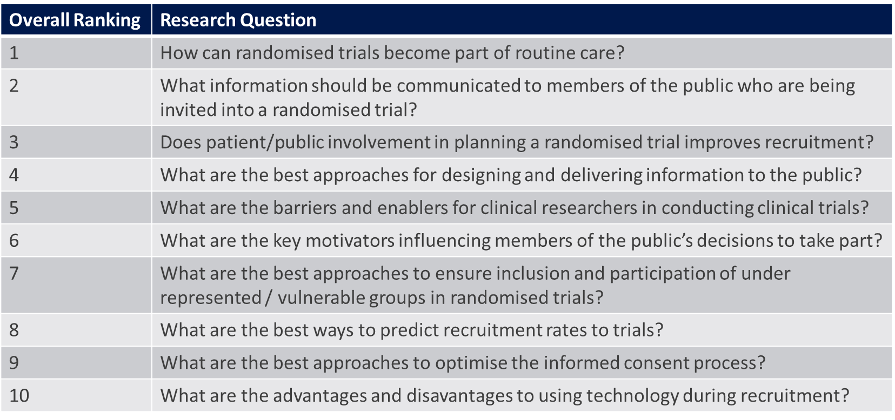
Top 10 Prioritised Research Questions
Health Research Board Trails Methodology Network & James Lind Alliance Final Report 2018 [4]

Slide 29
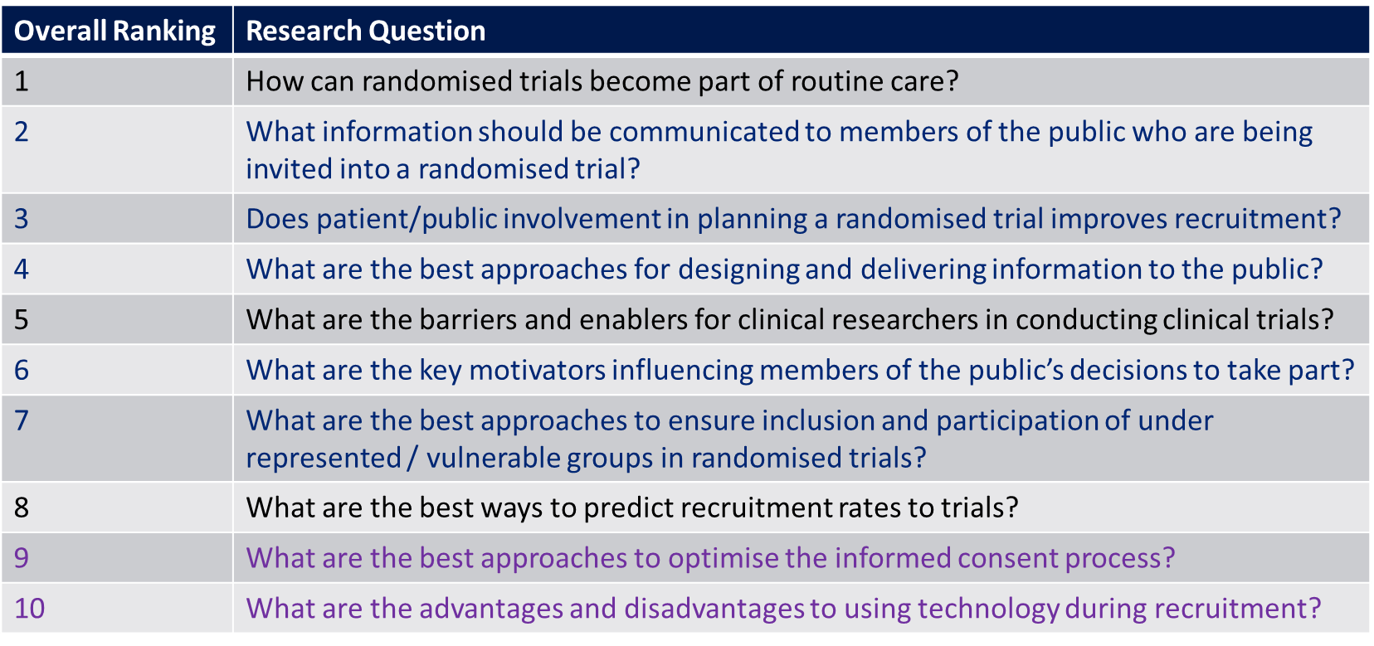
Top 10 Prioritised Research Questions
Health Research Board Trails Methodology Network & James Lind Alliance Final Report 2018 [4]

Slide 30
Research Methodology
We studied the characteristics of the text in the leaflets and the feedback given by the public reviewers:
Compare the PILs with other texts.
Analyse the public feedback to PILs with poor recruitment
Develop a Web platform to collect and present public feedback enhanced by text analytics
Measure the effect of each technique on the quality of the final PIL

Slide 31
Current Advance
We have completed the first 3 items:
No significant difference in emotive text between god and poor PILs
There is a significant correlation between age group and qualitative scores of PIL quality but they do not reflect on reader understanding of the information
There wasn’t found any significant correlation between PILs features and RCT recruitment rates
Sentiment analysis can not be used to directly analyse the PILs
Public reviewers may give a qualitative passing grade to documents they do not fully understand.
PILs show no influence on patients decision, which brings into question if they support informed consent

Slide 32
Our model
We developed a Web model to capture, enhance and present the public reviewers’ feedback:
Suggestions based in PPI Comments
New Leaflet
CARPI
SYTEM
Leaflet Content Analysis report
New Version
PPI Group
Suggestions based in literature insights
New Comments
Quality Eval

Slide 33
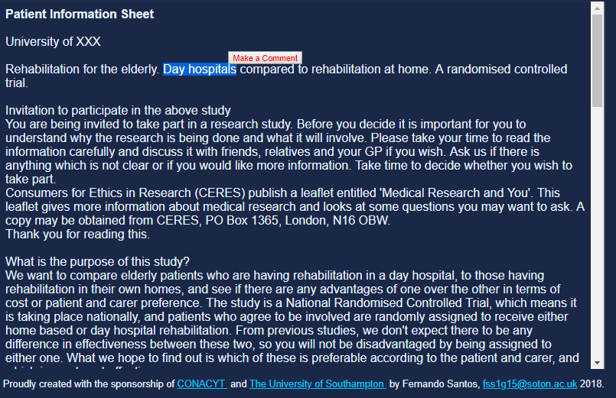
The Web Platform
Use a Web platform to collect and record the public feedback in a structured format:
Each comment will be linked to a specific section of the document.

Slide 34
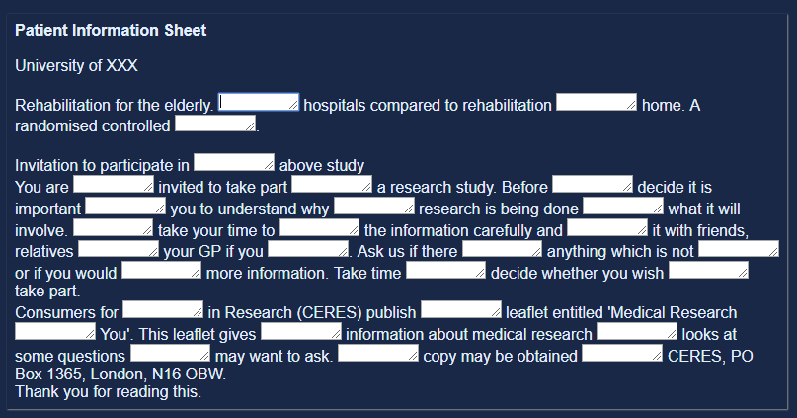
The Web Platform
Employ Cloze procedure to find jargon and unexpected words:
Each reviewer will be given a section of the document in which some words have been replaced with blank spaces and asked to fill them.
Words that are not correctly identified will be reported to the PI.
A list of the words filled by the reviewers will be given to the PI.

Slide 35
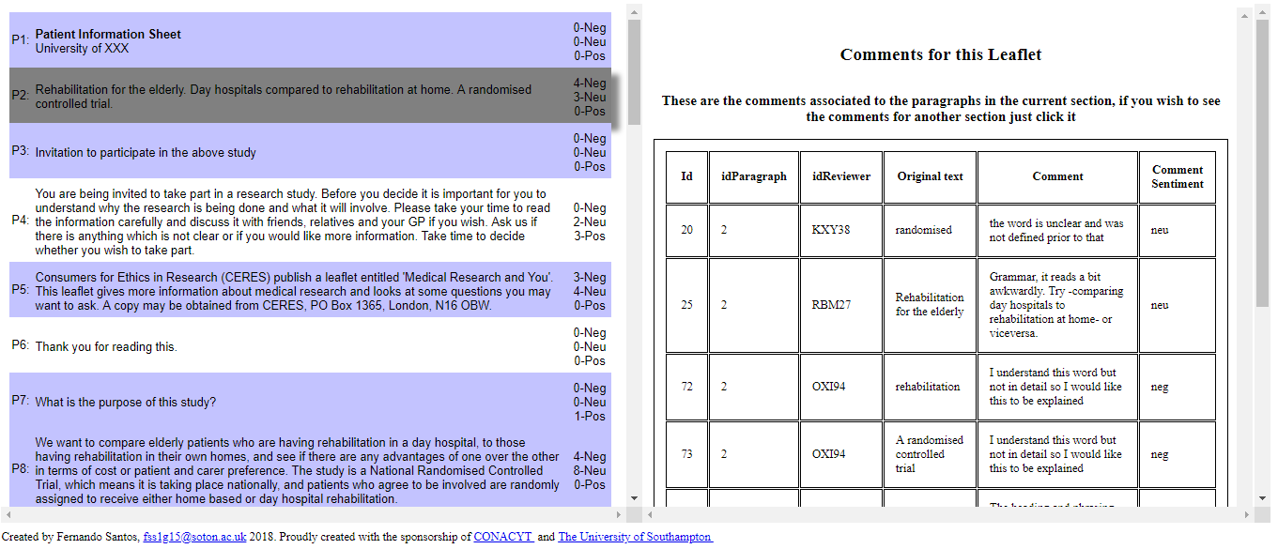
The Web Platform
Employ sentiment analysis on the comments given by the reviewers
The sentiment and emotion of each comment will be analysed.
Sections of the document which are linked to highly emotive responses will be highlighted.
The comments of each highlighted section will be presented as a list.

Slide 36
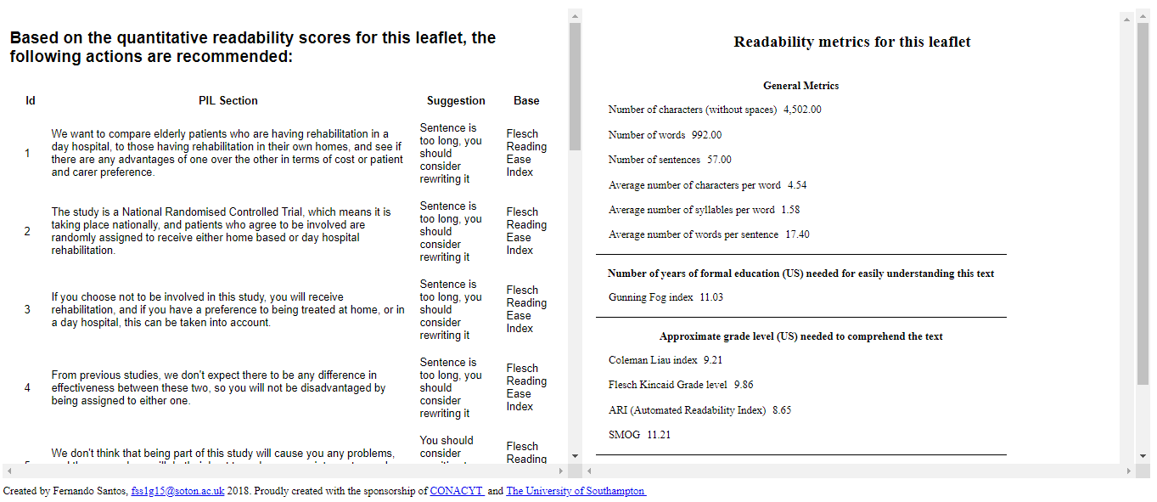
The Web Platform
Employ content analysis on the document to assess readability
The sentences of the document will be assessed by a program based on the SMOG readability score.
Sentences which are deemed to be to difficult to read will be highlighted and presented to the PI as a list.

Slide 37
References
“Patient and public involvement in health and social care research: A handbook for researchers”, NHS National Institute for Health Research (NIHR), 2010.
“Principles of consent: General principles and role of Participant Information Sheets”, Medical Research Council (MRC), accessed 2017, [http://www.hra-decisiontools.org.uk/consent/principles-general.html]
“Budgeting for involvement: Practical advice on budgeting for actively involving the public in research studies” p.12, INVOLVE and NHS NIHR, 2013.
“Prioritising recruitment in randomised trials: the priority study-an Ireland and UK priority setting partnership”, Health Research Board Trials Methodology Research Network and James Lind Alliance, 2017.

Slide 38
THANK YOU
Fernando Santos
fss1g15@soton.ac.uk
https://www.wppi.soton.ac.uk/authors.html

