Slide 1

A Web Platform for Public Involvement: Reviewing Patient Information Leaflets for Clinical Trials in the UK
Supervisors: Prof Thanassis Tiropanis
Prof Jeremy Wyatt
By Fernando Santos

Slide 2
The Problem
Current Patient Information Leaflets (PILs) are hard to understand for patients and public audiences.
PILs need to be able to support the patient decision making process, thus it is necessary that they are understandable by all patients.
Employing Patient and Public Involvement group can be too expensive (up-to £20 per hour per person) or time consuming for pragmatic and low-risk trials.
Employing quantitative metrics and text analytics makes easy to identify sentences that may be too hard to understand by the patients, but not to give advice on how to correct the issues.

Slide 3
Our proposal
Assess the effect of different content analysis techniques in revising Patient Information Leaflets (PILs)
Use different quantitative metrics to assess how hard to understand the current PILs are.
Collect public feedback on current PILs information online
Record the comments
Link comments to specific sections of text
Quantitatively assess issues in the sentence
Employ Amazon crowdsourcing to revise the wording of sentences that are too hard to understand.

Slide 4
Current Progress
Invited PIL authors from UK clinical trials to collaborate in the study, received response from FLUPOC, HORIZON and TrueNTH studies.
Four PILs currently in use were selected to test our platform.
Several indexes were used to quantify the readability of the current PILs text.
Sentences that were too hard to understand (required above 10th grade schooling) were identified in each PIL.
Public comments and reviews (EQIP scale) on the PILs’ full text were gathered online.
Currently in process: studying how different techniques (Cloze procedure, sentiment analysis, crowdsourcing) affect the revision quality of sentences that are too difficult to understand.

Slide 5
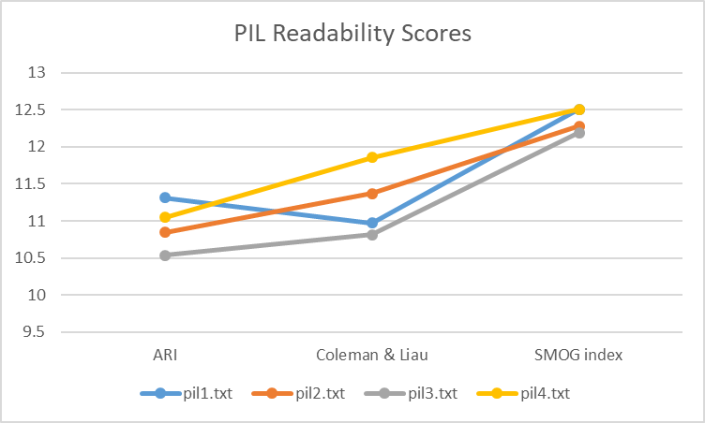
Initial Results
We have obtained some initial results for this study
No meaningful difference was observed in the readability scores for the PILs (ARI, Coleman and SMOG).

Slide 6
Initial Results
The text of the PILs was found to contain similar amount of hard sentences and similar distributions.
In all cases more than 1/3 of the sentences were deem to be too hard to understand. 1/4 of these sentences would require a professor level reading skill to be easily understood.
Professor Level
PIL | Sentences | Sentences Above 10 | Percentage
1 | 78 | 29 | 37%
2 | 133 | 46 | 35%
3 | 60 | 19 | 32%
4 | 136 | 47 | 35%
PIL | Upper | Lower | Q1 | Q2 | Q3
1 | 37.67 | 10.28 | 12.92 | 15.25 | 20.36
2 | 40.93 | 11.27 | 13.83 | 15.95 | 19.19
3 | 25.32 | 11.04 | 14.31 | 16.02 | 20.35
4 | 43.25 | 11.41 | 13.53 | 16.21 | 18.72
College Student

Slide 7
Initial Results
A pilot run was made to assess the viability of employing Amazon crowdsourcing to revise the sentences
Two Groups of 9 revisers each were recruited to revise 4 sentences from PIL 1. One sentence of each quartile was taken at random.
Revisers were asked to fill-in missing words for each sentence (Cloze procedure) before making the revisions to validate quality.
Acceptable level of quality for the revisions:
Revisers | Approved Revisions | Avg Revisions per Reviser | Std Dev
9 | 23 (66%) | 3.8 | 0.4
9 | 22 (62%) | 4 | 0

Slide 8
Initial Results
Sentence | Original Sentence Score | Group | Revisions Avg Score | Percentage of Improvement
if you are in Group A your samples will be Analysed for many different viruses using the rapid test which takes about 1 hour. | 10.5 | Un-aided | 6.7 | 37%
 |  | Tip List | 8.0 | 25%
The clinical team looking after you may wish to test you for respiratory viruses and if they do this will be using standard laboratory testing | 13.3 | Un-aided | 10.9 | 18%
 |  | Tip List | 9.4 | 30%
For both Groups A and B you have the right to decline all or any of these further research samples, should you wish, and this will not affect you being part of this study or the care you receive. | 16.7 | Un-aided | 9.3 | 44%
 |  | Tip List | 9.5 | 43%
The samples collected during the study are stored without any of personal details on them and are only used in further ethically approved research under the direction of the chief investigator of this study. | 19.5 | Un-aided | 13.2 | 32%
 |  | Tip List | 14.4 | 26%

Slide 9
Initial Results
Sentence | G1 | G2
if you are in Group A your samples will be Analysed for many different viruses using the rapid test which takes about 1 hour. | If you are in Group A your test will be conducted within an hour. | If you are in Group A, a 1 hour test will check for viruses in your samples.
The clinical team looking after you may wish to test you for respiratory viruses and if they do this will be using standard laboratory testing | The staff taking care of you may want to examine you for and breathing problems. If they do they will use standard testing. | The team looking after you may want to test you for respiratory viruses. If so, this will use standard laboratory testing.
For both Groups A and B you have the right to decline all or any of these further research samples, should you wish, and this will not affect you being part of this study or the care you receive. | For both groups A and B you can opt out at any time. This will not affect your participation in the study or further care. | If you are in Group A or B, you may choose not to provide further research samples. This will not affect the care you receive now or remove you from this study.
The samples collected during the study are stored without any of personal details on them and are only used in further ethically approved research under the direction of the chief investigator of this study. | The samples will that are taken will only be used for respectful research and they will not contain any information that points to yourself. | Samples are stored confidentially and no personal data will be listed on them. They will only be used in further ethically approved studies as directed by the chief investigator of this trial.

Slide 10


THANK YOU
Fernando Santos
fss1g15@soton.ac.uk
https://www.wppi.soton.ac.uk/authors.html

