Slide 1
A Computer Assisted Reviewer-Platform for Patient & Public Involvement
Student: Fernando Santos
Supervisors: Prof Jeremy Wyatt, Prof Thanasis Tiropanis

Slide 2
Why are we doing it?
To develop an objective assessment of Patient Information Leaflets (PILs) quality.
To assess the effect of PILs on the patients informed decision.
To measure the association between PIL quality and patients’ interest in and understanding of Randomized Controlled Trials (RCTs).

Slide 3
How are we doing it?
First Phase
Create a web system that captures & links the following information:
Text in the leaflet
Specific comments on leaflet sections
Global comments on the leaflet
Reviewer quality grade
Reviewer understanding
Reviewer demographics
RCT recruitment details
Second Phase
Employ Web analysis techniques to discover associations:
Employ clustering analysis to find patterns that correlate with recruitment or understanding.
Employ content analysis to obtain objective assessment of the comments

Slide 4
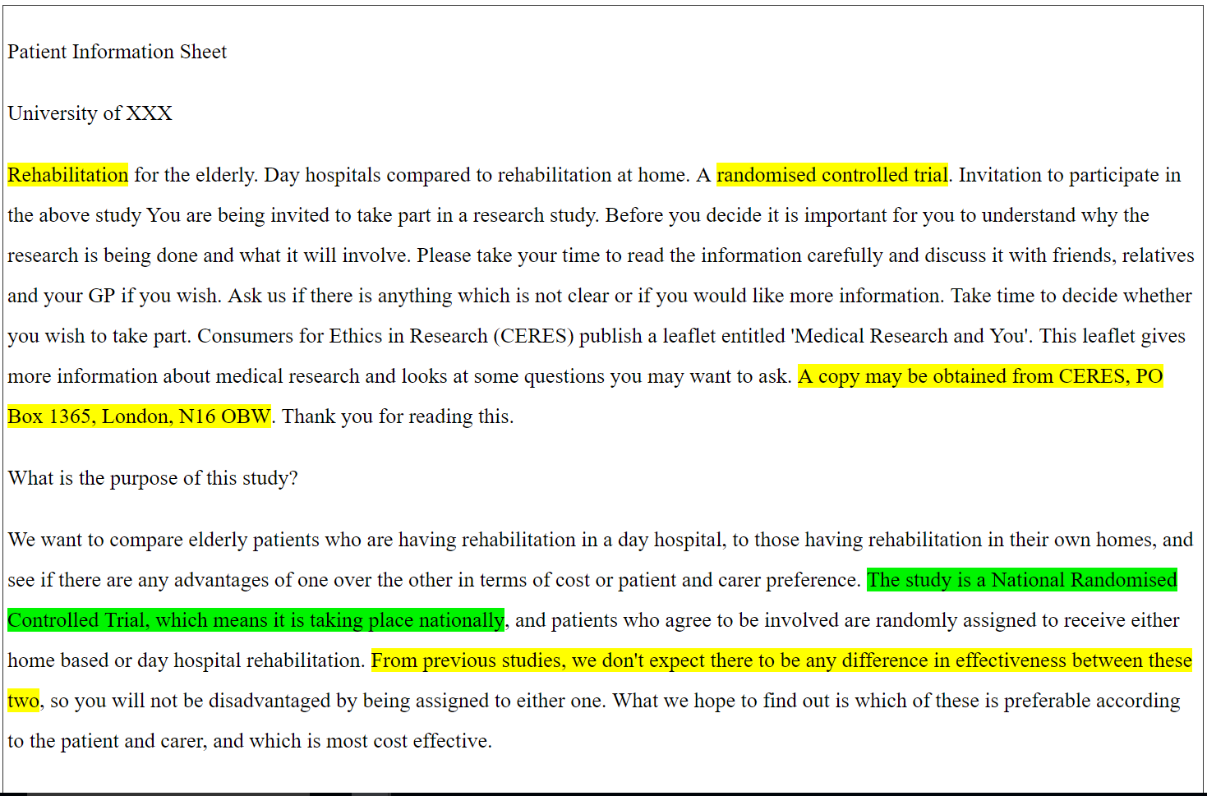
The CARPI System
Computer Assisted Reviewer for PPI (CARPI) - the platform for our analysis.

Slide 5
WHAT IS IN THE SYSTEM
4 leaflets from poor recruiting interventions of low-risk trials:
Rehabilitation at home or in hospital
Knee surgery for treating osteoarthritis
Treatment of varicose veins
Treatment of constipation
Input from 25 participants:
Reviewed each leaflet
Gave specific or general comments on each leaflet
Graded the quality of the leaflet
Answered a quiz about the information in the leaflet (EQIP scale)

Slide 6
Results: WHO WAS OUR SAMPLE?

Slide 7
RESULTS
Obtained:
85 Global comments
159 Specific comments
Significant correlation between age group and quality grades
Significant correlation between the education level and the percentage of correct answers

Slide 8
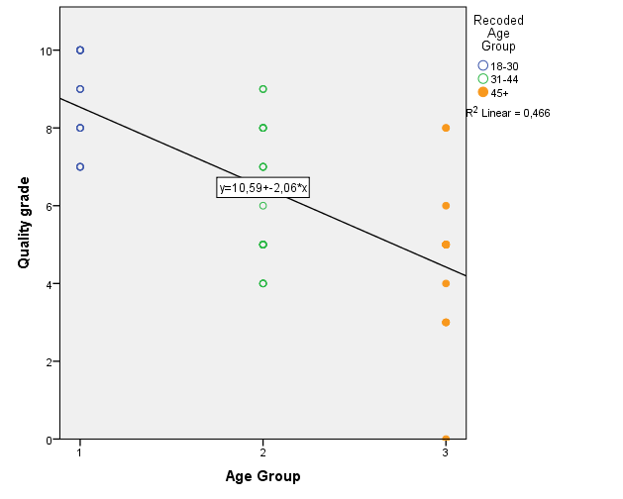
RELATION BETWEEN AGE GROUP AND QUALITY GRADES

Slide 9
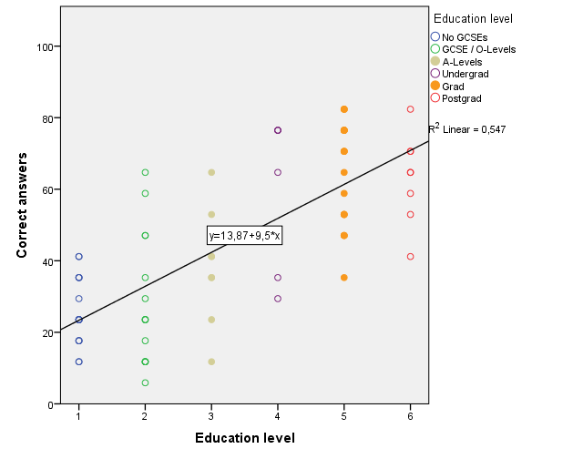
RELATION BETWEEN EDUCATION LEVEL AND CORRECT ANSWERS

Slide 10
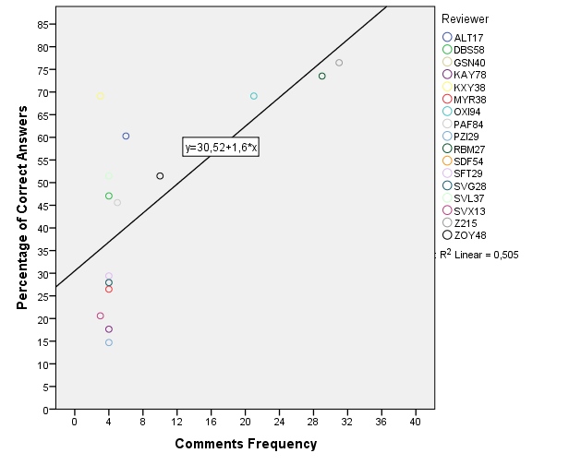
RELATION BETWEEN the total number of COMMENTS & PERCENTAGE OF CORRECT ANSWERS

Slide 11
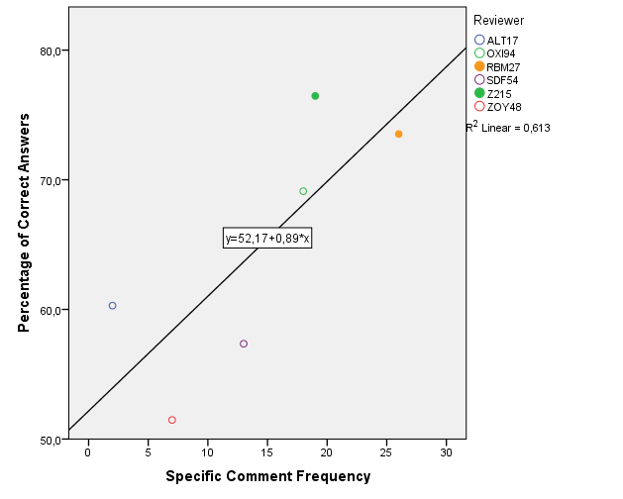
SPECIFIC COMMENTS AND CORRECT ANSWERS

Slide 12
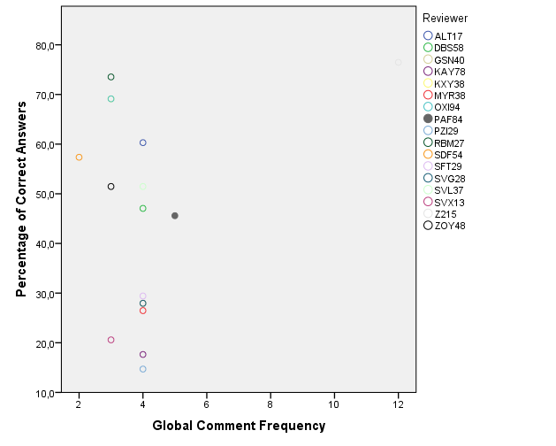
NON-SIGNIFICANT CORRELATIONS

Slide 13
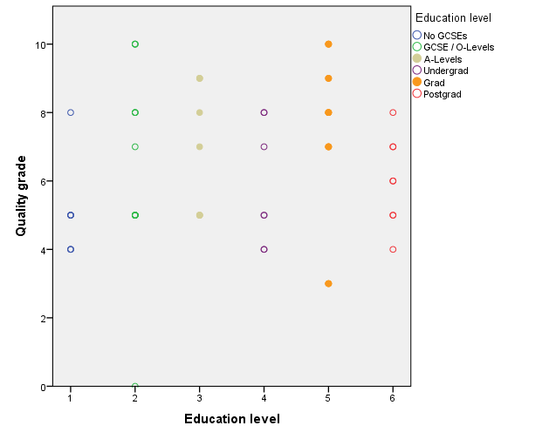
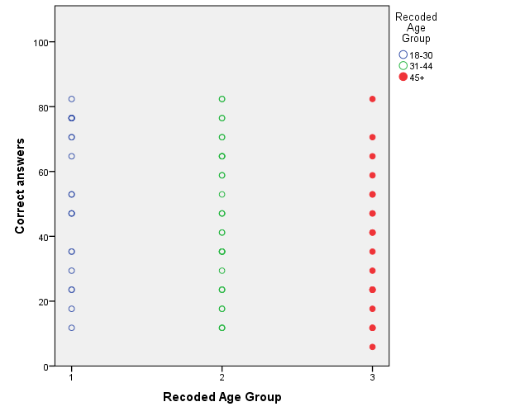
NON-SIGNIFICANT CORRELATIONS

Slide 14
Conclusions
Only 40% of participants gave specific comments about the leaflets
The number of global comments doesn’t correlate with the assigned grades or the correct answers.
The leaflet capacity to inform cannot be determined by only taking into account general comments or qualitative quality measures.
My contact details: Fernando Santos Sanchez, fss1g15@soton.ac.uk

