Slide 1
A Computer Assisted Reviewer-Platform for Public Involvement
Student: Fernando Santos
Supervisors: Prof Jeremy Wyatt, Prof Thanasis Tiropanis

Slide 2
What are we doing it?
Researching the effects of comments on PIL quality by assessing public reviewers perception and understanding of PILs.

Slide 3
Why are we doing it?
To develop an objective assessment of Patient Information Leaflets (PILs) quality.
To assess the effect of PILs on the patients informed decision.
To measure the association between PIL quality and patients’ interest in, and understanding of, Randomized Controlled Trials (RCTs).

Slide 4
How are we doing it?
First Phase
Create a web system that captures & links the following information:
Text in the leaflet
Comments on specific leaflet sections
General comments on the leaflet
Reviewer quality grade
Reviewer percentage of correct answers
Reviewer demographics
RCT recruitment rates

Slide 5
How are we doing it?
Second Phase
Employ Web analysis techniques to discover associations:
Employ clustering analysis to find patterns that correlate with recruitment or understanding.
Employ content analysis to obtain objective assessment of the comments

Slide 6
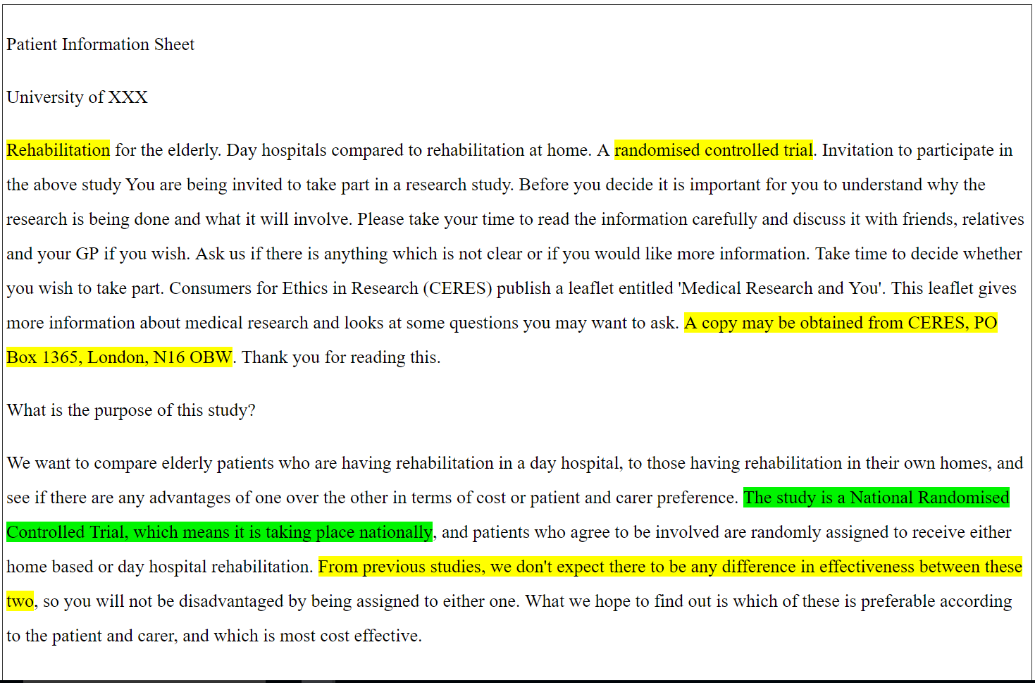
The CARPI System
Computer Assisted Reviewer for PPI (CARPI) - the platform for our analysis.
Notes:
Explain what Global & Specific Comments are.

Slide 7
What is in the system?
4 leaflets from poor recruiting interventions of low-risk trials:
Rehabilitation at home or in hospital
Knee surgery for treating osteoarthritis
Treatment of varicose veins
Treatment of constipation
Input from 25 participants:
Reviewed each leaflet
Gave specific or general comments on each leaflet
Graded the quality of the leaflet 0 (poor) to 10 (excellent)
Answered a quiz about the information in the leaflet based on the EQIP scale topics

Slide 8
EQIP scale
The Ensuring quality information for patients (EQIP) scale was developed at Genova University Hospitals (Switzerland) to assess three aspects of patient information documents:
Content
Structure
Identification of data
Criteria for evaluation of PIL quality:
Sample definition
Definition of purpose
Treatment alternatives
Description of medical procedure
Qualitative/Quantitative benefits, risks & side-effects
Addressing potential complications
Precautions
Other relevant info.

Slide 9
Results: Who was our sample?

Slide 10
Results
Obtained:
85 Global comments
159 Specific comments
Significant correlation between age group and quality grade
Significant correlation between the education level and EQIP scale

Slide 11
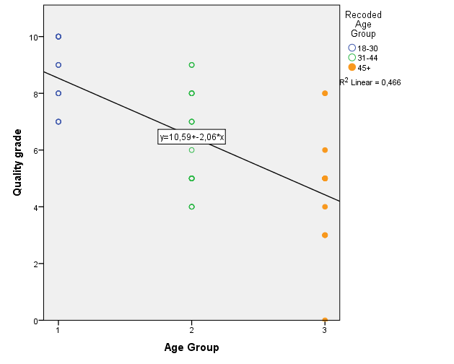
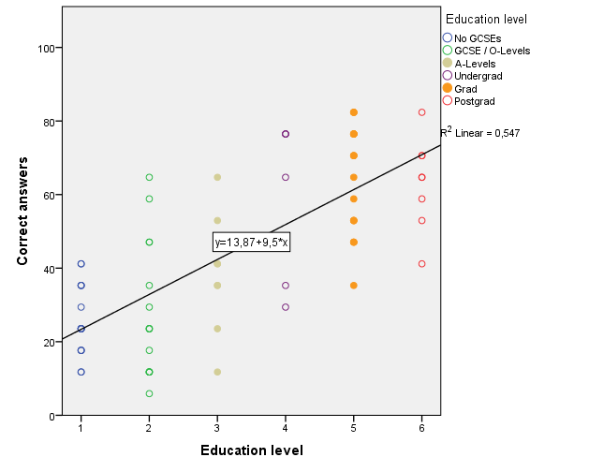
Relation between age group, education level and quality grade

Slide 12
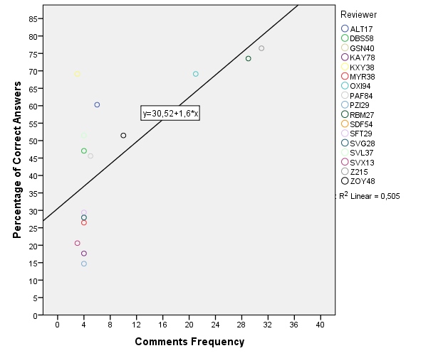
Relation between the total number of comments & EQIP scale

Slide 13
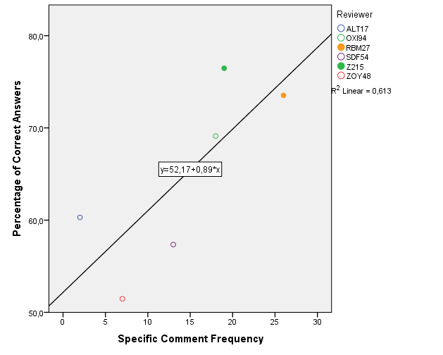
Specific comments and correct answers

Slide 14
Conclusions
Only 40% of participants gave comments about specific sections of the leaflets
There was no significant association between the general comments and the assigned grades or the percentage of correct answers.
The leaflet capacity to inform cannot be determined by purely taking into account general comments or qualitative quality grades.
Fernando Santos Sanchez, fss1g15@soton.ac.uk

Slide 15
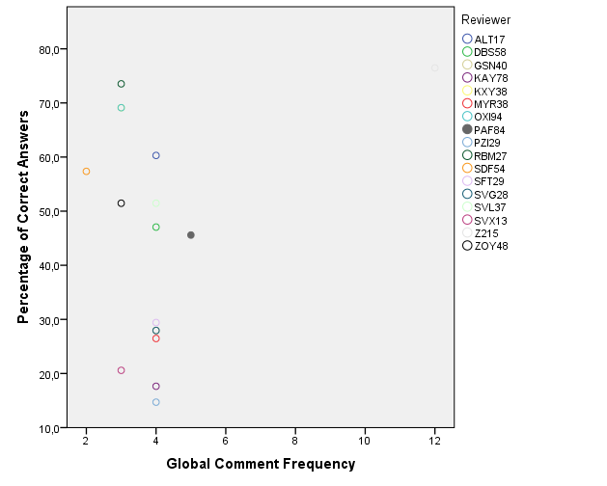
Non-significant correlations

Slide 16
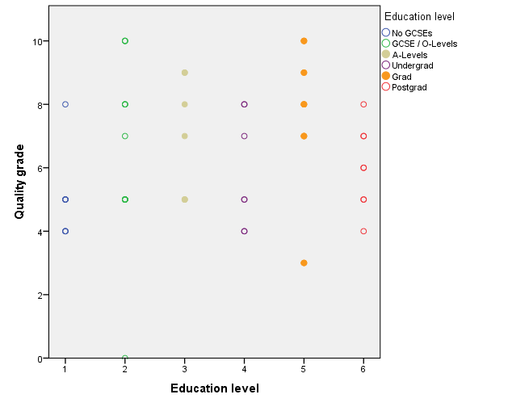
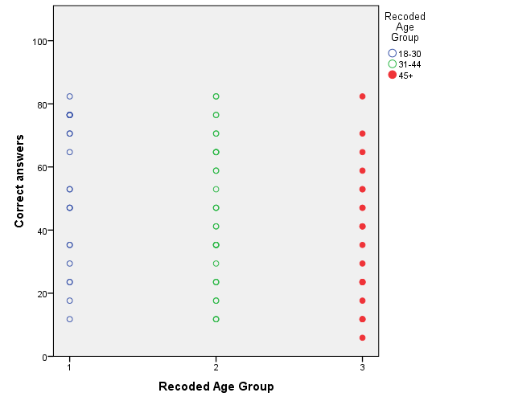
Non-significant correlations

