Slide 1


A Computer Assisted Reviewer-Platform for Public Involvement
Student: Fernando Santos
Supervisors: Prof Jeremy Wyatt, Prof Thanasis Tiropanis

Slide 2
What are we doing?
Researching the effects of public review comments on PIL quality by assessing public perception and understanding of trial PILs.

Slide 3
Why are we doing it?
To improve trial recruitment through improving the quality of PILs, by:
Capturing public comments on PILs and classifying them into general and specific comments
measuring the associations between subjective PIL quality, education level, age and understanding of the Randomized Controlled Trial
[using these insights to produce an automated comment system for PILS]

Slide 4
How are we doing it?
First Phase
Create a web system with 4 sample RCT leaflets that captures the following information from participants:
Participant demographics
Comments on specific leaflet sections
General comments on the leaflet
Subjective overall leaflet quality grade from 0 (poor) to 10 (excellent)
Percentage of correct answers about the RCT described in the PIL using topics from the EQIP scale (Charvet-Berard 2008)

Slide 5
EQIP scale
The Ensuring quality information for patients (EQIP) scale was developed at Geneva University Hospitals (Switzerland) to assess three aspects of patient information documents:
Content
Structure
Identification of data
Criteria for evaluation of PIL quality:
Sample definition
Definition of purpose
Treatment alternatives
Description of medical procedure
Qualitative/Quantitative benefits, risks & side-effects
Addressing potential complications
Precautions
Other relevant info.

Slide 6
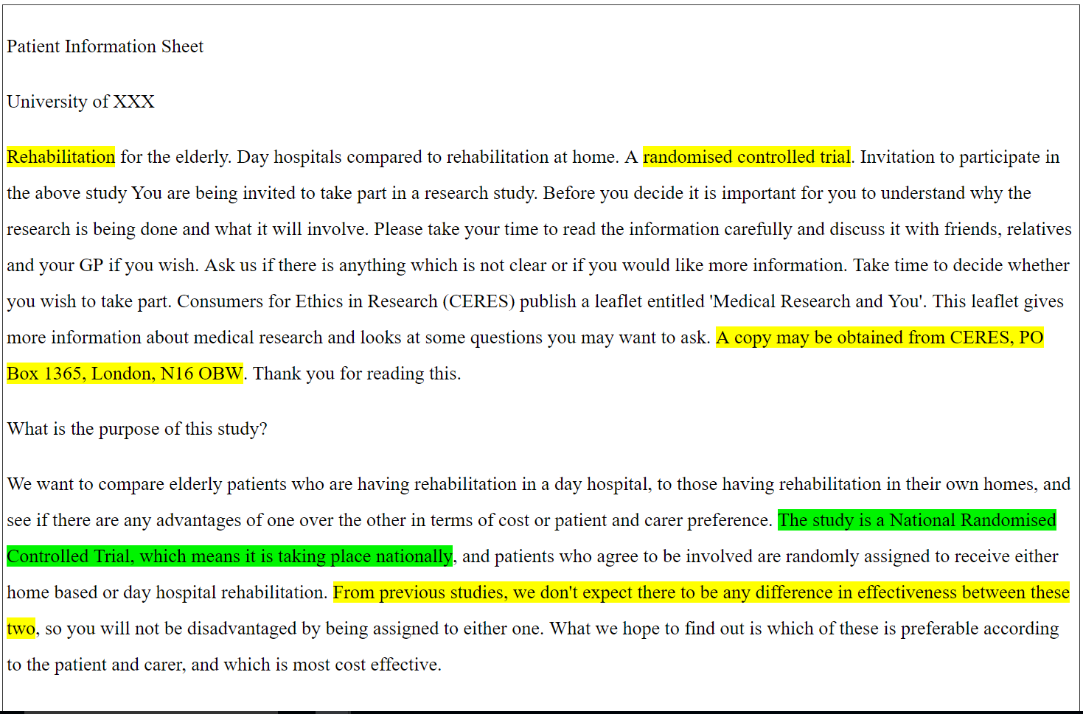
The CARPI System
Computer Assisted Reviewer for PPI (CARPI) - the platform for our analysis.
Notes:
Explain what Global & Specific Comments are.

Slide 7
Participants: 25 volunteers from 3rd Millennium Age Centre

Slide 8
Results
Number of comments captured:
85 Global comments (c. 20 per leaflet)
159 Specific comments (c. 40 per leaflet)
Distribution of comments by participant

Slide 9
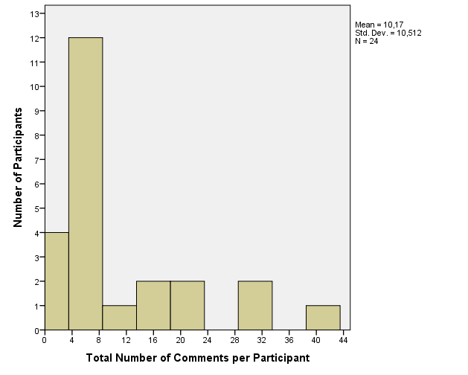
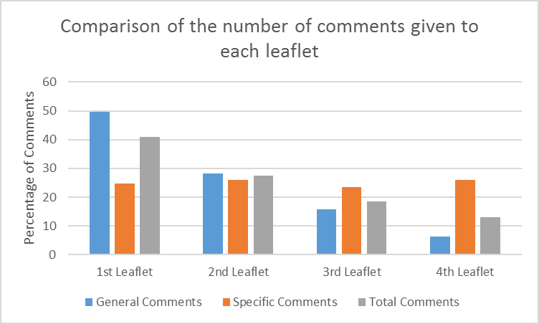
Histogram of comments by participant

Slide 10
Correlation analysis:
Significant correlation between age group and quality grade
Significant correlation between the education level and EQIP score

Slide 11
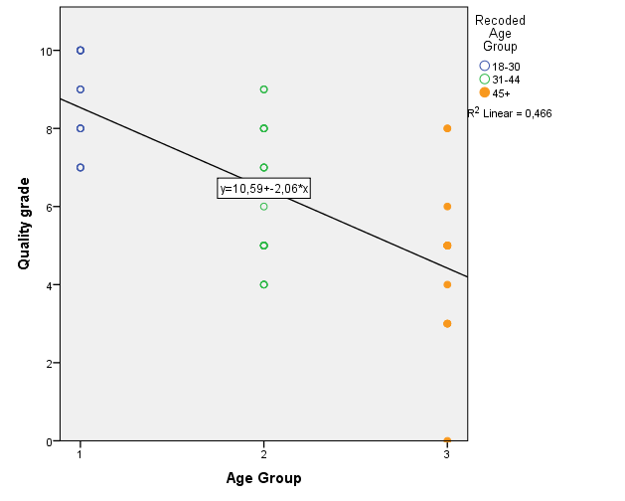
Relation between age group and quality grade

Slide 12
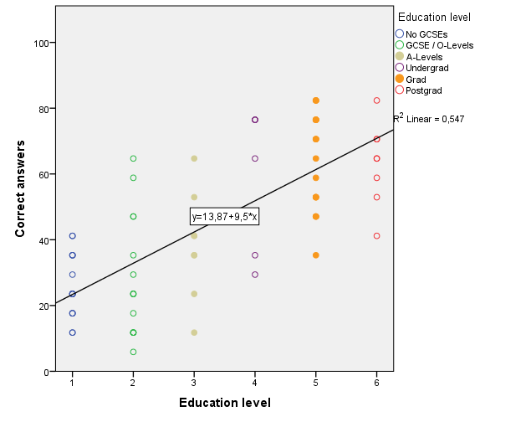
Relation between education level and percentage of correct answers

Slide 13
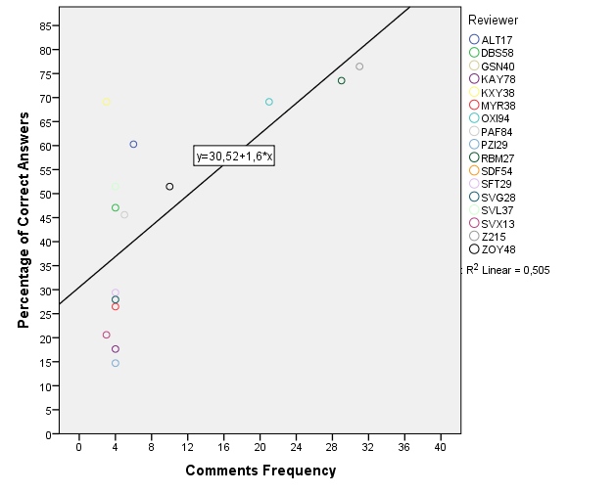
Relation between the number of comments & correct answers

Slide 14
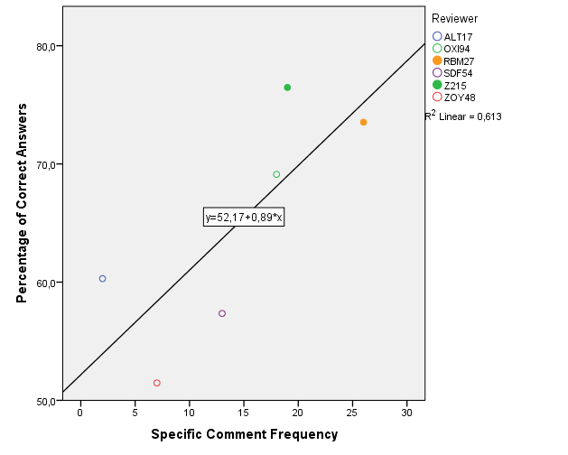
Specific comments and correct answers

Slide 15
Conclusions
Only 40% of participants gave comments about specific sections of the leaflets
There was no significant association between the number of general comments and the subjective quality grades or the percentage of correct answers (EQIP score).
The leaflet capacity to inform cannot be determined by purely taking into account general comments or subjective quality grade – use specific comments and EQIP score
Fernando Santos Sanchez, fss1g15@soton.ac.uk

Slide 16
Future work
Second Phase
Employ Web analysis techniques to discover associations:
Employ clustering analysis to find patterns that correlate with recruitment or understanding.
Employ content analysis to obtain objective assessment of the comments

Slide 17
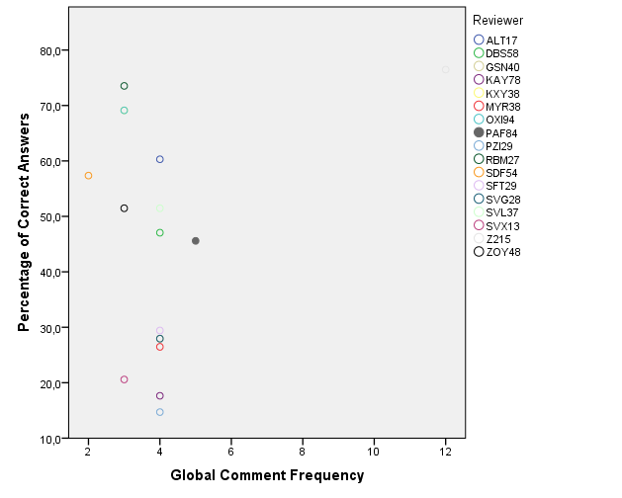
Non-significant correlations

Slide 18
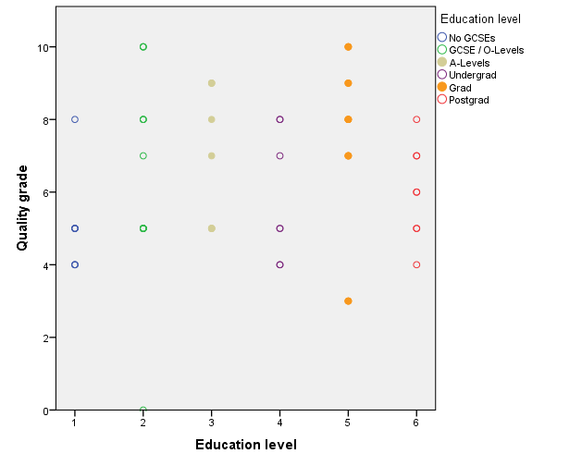
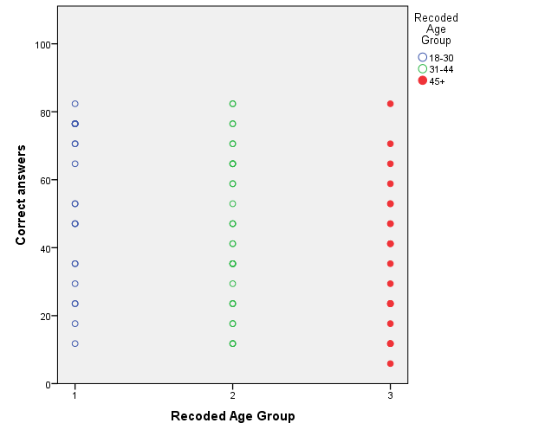
Non-significant correlations

Slide 19
What is in the system?
4 leaflets from poorly recruiting trials of low-risk interventions:
Rehabilitation at home or in hospital
Knee surgery for treating osteoarthritis
Treatment of varicose veins
Treatment of constipation
Input from 25 participants:
Reviewed each leaflet
Gave specific or general comments on each leaflet
Graded the quality of the leaflet 0 (poor) to 10 (excellent)
Answered a quiz about the information in the leaflet based on the EQIP scale topics

