Slide 1


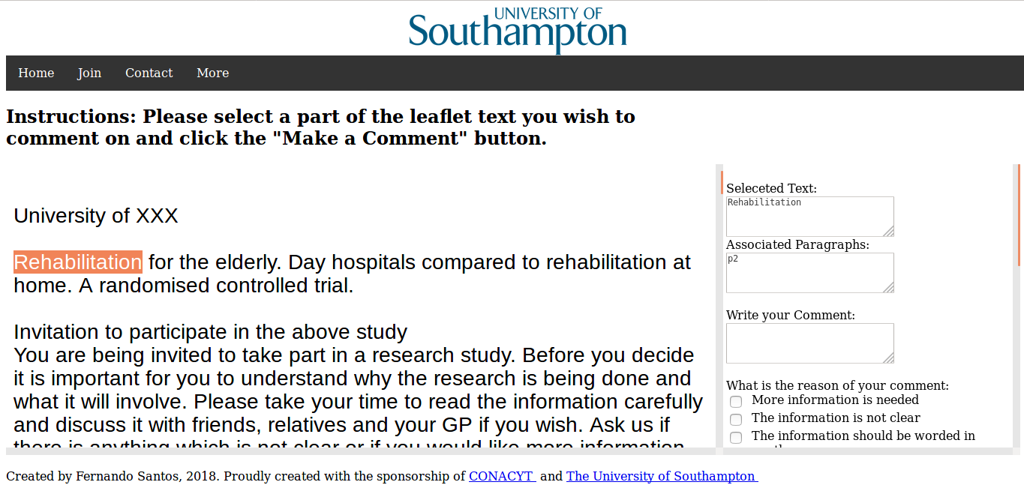
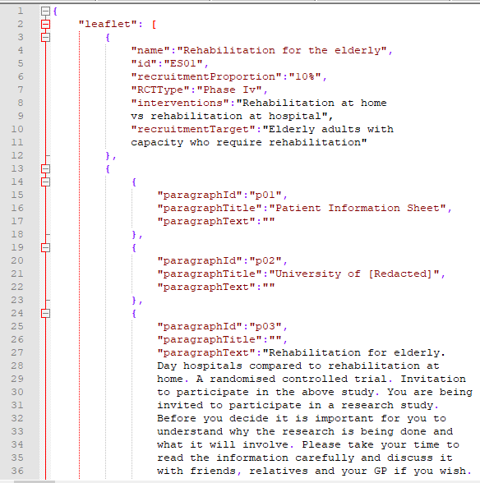

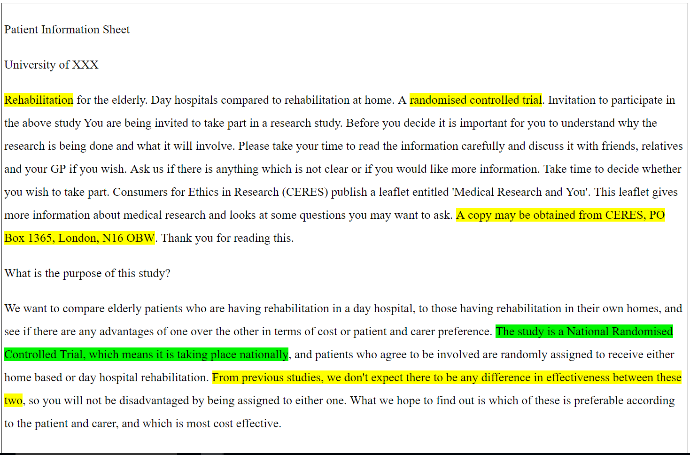



Fernando Santos | Prof Jeremy Wyatt | Prof Thanassis Tiropanis
FSS1g15@soton.ac.uk J.C.Wyatt@soton.ac.uk T.Tiropanis@southampton.ac.uk
Web Text Analytics: Enhancing Public Feedback on Patient Information
The problem
The documents used to inform patients about clinical trials have been found lacking. They are badly written, hard to understand and are not read. The role of these documents is essential in enabling informed consent for patients.
Research Question
Can text analytics enhance the public feedback on Patient Information?
Web Platform to Collect Public Feedback
Original Document
Sentiment analysis: identifying sections that produced highly emotive responses.
Adding:
Sentiment analysis
Content analysis
Similarity analysis
Json Representation
Adding comments on from similar PILs
Enhanced Feedback for the clinical researcher
Short Biography
Analysis of the text’s sentence structure with quantitative metrics
I’m a Mexican student doing a PhD in Web Science at the University of Southampton.
I have a BS in computer science and an MSc in
Current Results
Public feedback relates to issues in writing and information presentation
The use of subjective grading for PIL quality only accounts for 8% of the variance in patient understanding scores (trial quiz based on EQIP/Knapp topics).
Web Science. I like reading, gothic rock and extra spicy food.

Slide 2
A COMPUTER ASSISTED REVIEWER
FOR PUBLIC FEEDBACK ON PATIENT INFORMATION
Fernando Santos [fss1g15@soton.ac.uk] | Prof Jeremy Wyatt | University of Southampton
Introduction
Currently, PILs are deficient, employ scientific language and are not readOur research preposition is that employing Web analytics to collect, analyse, and present the public feedback to clinical researchers (CRs) who are developing a Patient Information Leaflet (PIL) for a pragmatic trial can enhance the final quality (readability & understandability) of the document..
Prototype v1.0
Initial Results
Public feedback relates to issues in writing and information presentation
The use of subjective grading for PIL quality only accounts for 8% of the variance in patient understanding scores (trial quiz based on EQIP/Knapp topics).
When comments on specific PIL sections are analysed independently, general comments and subjective grades are deemed non-significant
Research Questions
Can Web analytics enhance the public feedback given to CRs who are developing new PILs?
Can sentiment analysis help by identifying sections that produced highly emotive responses?
Can the objective analysis of the text’s sentence structure help by identifying text that is too hard to read?
Does adding comments on from similar PILs help the CR?
Identified Issues
PPI groups are small (3-7 people).
Public involvement is expensive, £25 per hour and £200 - £400 per session.
PPI comments are not currently stored.
The final leaflet quality is not commonly assessed.
PPI officers believe PPI members should not be treated as participants.
Many researchers have found that the language is too hard to enable meaningful consent.
Proposal
My proposal is to create a Web platform that permits the collection, analysis, and presentation of public feedback for PILs in an structured model. This would enable us to measure the effect Web analytics has in improving PIL quality.

