Slide 1

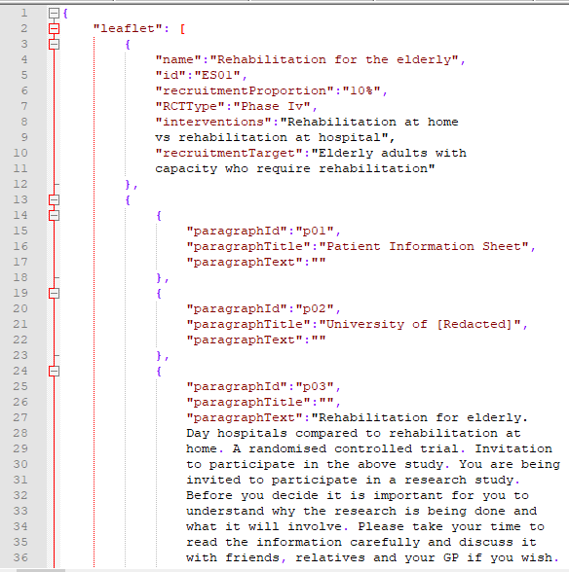
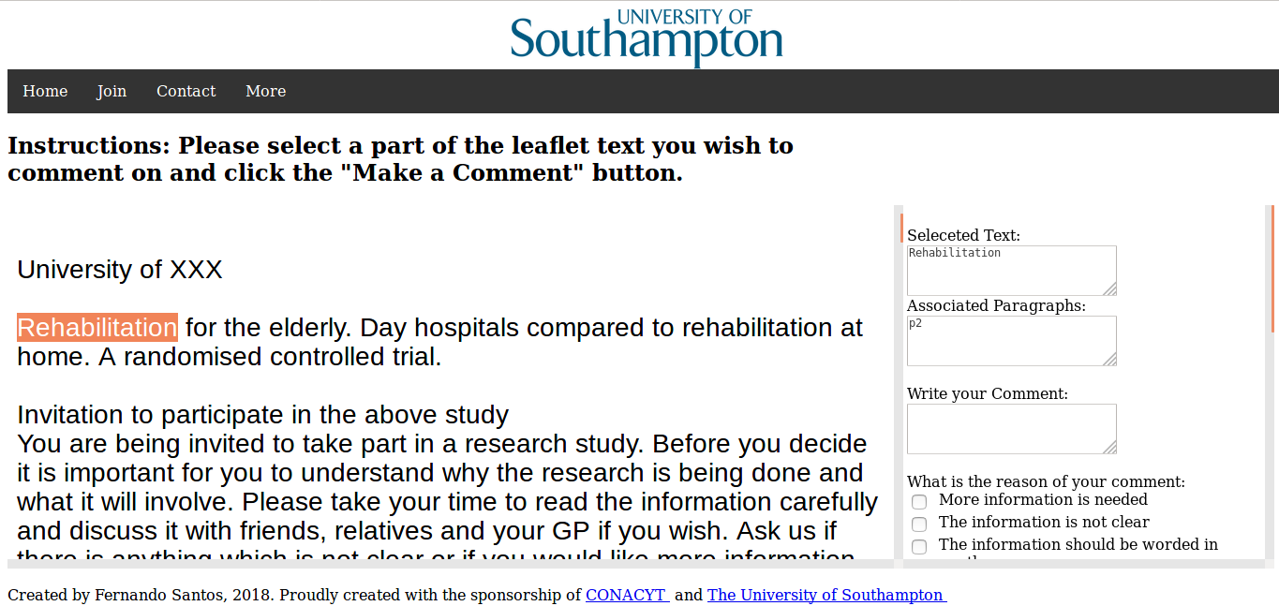
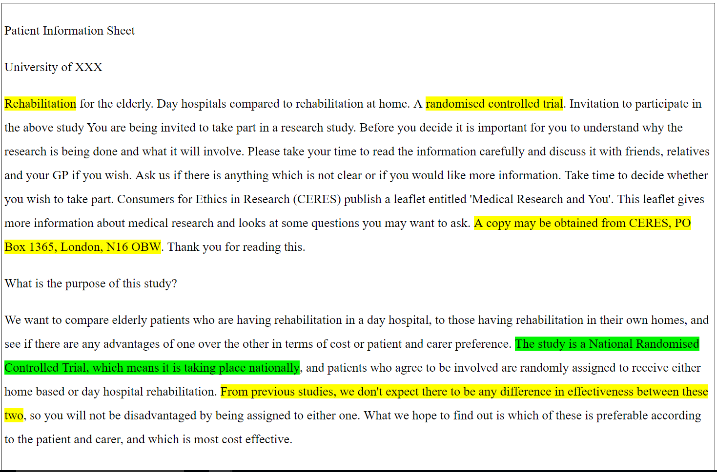






Web Text Analytics: Enhancing Public Feedback on Patient Information
Fernando Santos | Prof Jeremy Wyatt | Prof Thanassis Tiropanis
FSS1g15@soton.ac.uk J.C.Wyatt@soton.ac.uk T.Tiropanis@southampton.ac.uk
Issues with Patient Information Quality
The documents used to inform patients about clinical trials have been found lacking. They are badly written, hard to understand and are not read. The role of these documents is essential in enabling informed consent for patients.
Challenge
We want to answer if text analytics can enhance the public feedback on Patient Information?
Identifying sections that produced highly emotive comments.
Employing quantitative content analysis metrics to identify sentences that are too hard to understand.
Employ comment from similar leaflets to enhance the feedback to the clinical researcher.
Original Document
Json Representation
Web Platform to Collect Public Feedback
Adding:
Sentiment Analysis
Content Analysis
Similarity Analysis
Enhanced feedback for the clinical researcher
Current Results
Public feedback relates to issues in writing and information presentation
The use of subjective grading for PIL quality only accounts for 8% of the variance in patient understanding scores (trial quiz based on EQIP/Knapp topics).
When comments on specific PIL sections are analysed independently, general comments and subjective grades are deemed non-significant
About Me!
I’m a Mexican student doing a PhD in Web Science at the University of Southampton. I have a BS in computer science
and an MSc in Web Science. I like reading, gothic rock and extra spicy food.

