Slide 1

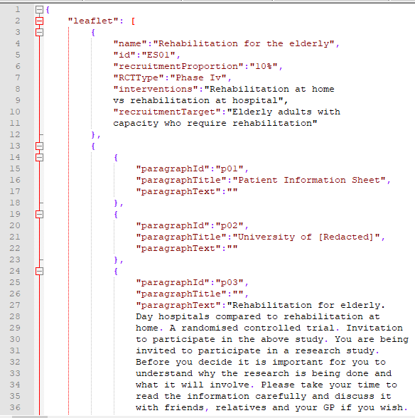
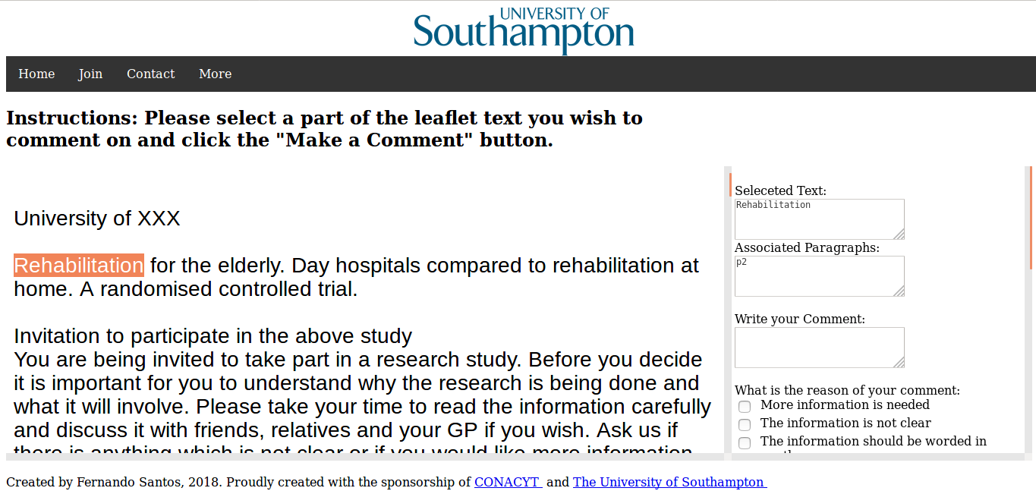
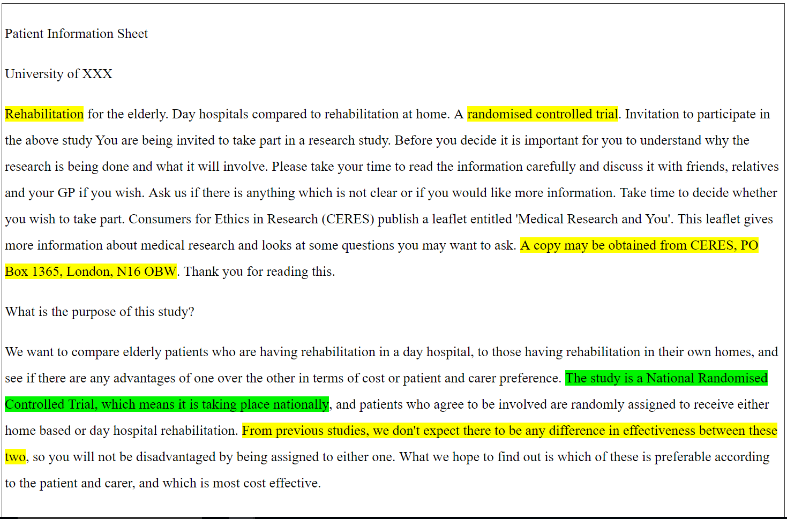






Web & Text Analytics to Enhance Public Feedback on Patient Information Leaflets
Fernando Santos | Prof Jeremy Wyatt | Dr Thanassis Tiropanis
FSS1g15@soton.ac.uk J.C.Wyatt@soton.ac.uk T.Tiropanis@southampton.ac.uk
Issues with Patient Information Quality
Patient information leaflets (PILs, documents used to inform patients about clinical trials) have been found lacking. They are badly written, hard to understand and are not read. However, these documents are essential to enable informed consent.
Challenge
Can text analytics enhance the public feedback on Patient Information, by:
Identifying sections that produce highly emotive comments that compromise quality.
Employing quantitative content analysis metrics to identify sentences that are too hard to understand.
Employ comments from similar leaflets to enhance the feedback to the leaflet author.
Original PIL Document
Json Representation
Web Platform to Collect Public Feedback
Adding:
Sentiment Analysis
Content Analysis
Clustering Analysis
Enhanced feedback for the leaflet author
Results so far
Public feedback captured on PILs relates to issues in writing and information presentation
The use of subjective grading for PIL quality only accounts for 8% of the variance in patient understanding scores (study based on EQIP score & Knapp topics).
When comments on specific PIL sections are analysed independently, general comments and subjective leaflet quality grades do not contribute significantly to EQIP score
About Me !
I’m a Mexican student doing a PhD in Web Science at University of Southampton. I have a BSc in computer science and an MSc
in Web Science. I like reading, gothic rock and extra spicy food.

