Slide 1
Web Analysis Techniques in Clinical text
By Fernando Santos
PhD student in web Sciences supported by EPSRC & CONACYT

Slide 2
Study description
We employed two of the most common techniques in Web Analysis, sentiment analysis and k-mean clustering, to discover the associations between the text in Patient Information Leaflets and recruitment rates achieved by Clinical Studies.

Slide 3
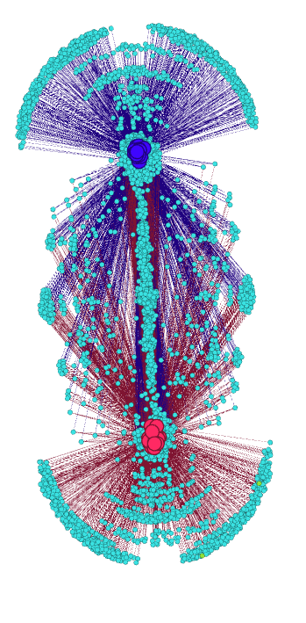
What CAN clustering analysis tell us?
Clustering techniques are commonly employed in Web analysis to identify patterns, communities and subgroups of interest. Here we employed a k-means classifier to identify the 353 words which had an apparent correlation with the final recruitment rates achieved by the 58 studies.

Slide 4
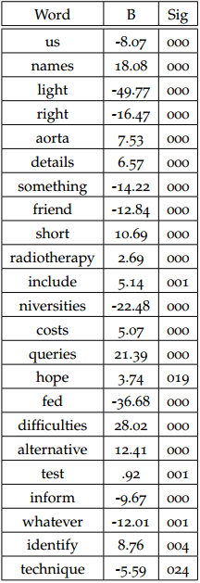
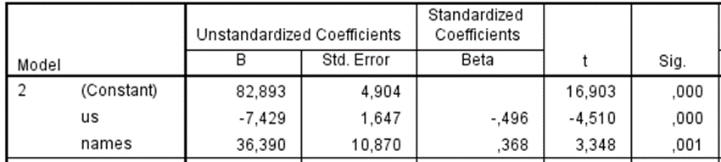
Then we employed a linear regression model to further refine this word set into 23 words correlated significantly with the final recruitment rate. This model predicted the recruited proportion with F(23,40)=44,109 p<.0005, adjusted R²=0.94
With only 58 cases a regression model with more than 2 variables could induce co-linearity bias. A reduced model employing only the 2 most significant variables predicted F(2,61)=13.049 p<.0005, adjusted R²=0.28

Slide 5
What can Sentiment Analysis tell US?
Sentiment analysis has been used in many diverse areas, from analysing opinions about political parties, finding terrorist associations through hate mail and identifying trends in Tweets.
Here, we employed the NRC Emotional Lexicon which contains emotional associations for 6520 English words to quantify the level of emotion in the Patient Information Leaflets.

Slide 6
What we found?
We found that there were no statistical significant difference in the emotive content of leaflets from studies with good recruitment (80% of intended) and those which failed to recruit adequately
However, we found that the same tools identified a significant difference in the measured level of emotive content in other studies which employed the NRC Lexicon to analyse novels, fairy tales and e-mails.

Slide 7
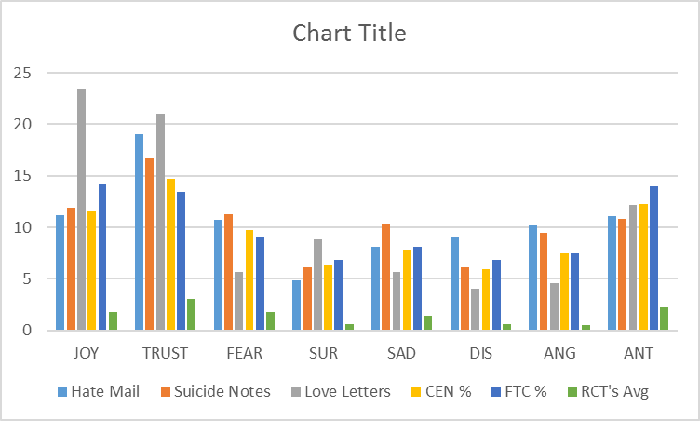

Slide 8
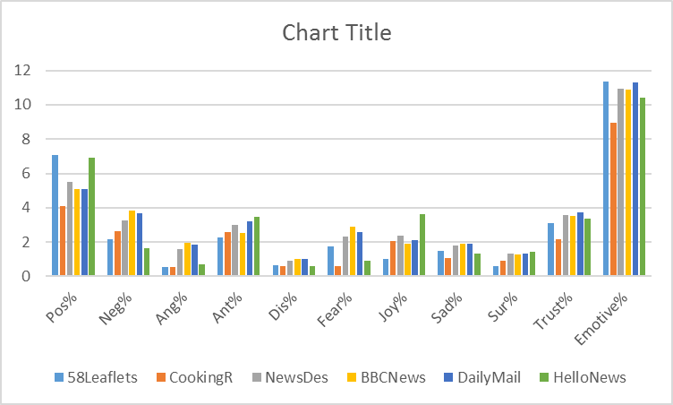

Slide 9
Conclusions & Future Work
There is a statistically significant lower level of emotion-related text present in Patient Leaflets compared to other common texts
There is not enough distinction in the level of emotion between Leaflets to measure a significant association with recruitment rates
It is necessary to measure the effect that the use of formal language has in the recruitment rates

Slide 10
References
[1] Béla Bollobás. Modern graph theory, volume 184 of graduatetexts in mathematics, 1998.
[2] John Adrian Bondy and Uppaluri Siva Ramachandra Murty. Graph theory with applications, volume 290. Citeseer, 1976.
[3] Bonka Boneva, Robert Kraut, and David Frohlich. Using e-mail for personal relationships the difference gender makes. American behavioral scientist, 45(3):530–549, 2001.
[4] Samuel B Green. How many subjects does it take to do a regression analysis. Multivariate behavioral research, 26(3):499–510, 1991.
[5] Saif M Mohammad and Peter D Turney. Emotions evoked by common words and phrases: Using mechanical turk to create an emotion lexicon. In Proceedings of the NAACL HLT 2010 workshop on computational approaches to analysis and generation of emotion in text, pages 26–34. Association for Computational Linguistics, 2010.
[6] Saif M Mohammad and Peter D Turney. Nrc emotion lexicon. Technical report, NRC Technical Report, 2013.
[7] Saif M Mohammad and Tony Wenda Yang. Tracking sentiment in mail: how genders differ on emotional axes. In Proceedings of the 2nd workshop on computational approaches to subjectivity and sentiment analysis (acl-hlt 2011, pages 70–79, 2011.

