Slide 1
Web Analysis Techniques in Clinical text
By Fernando Santos

Slide 2
Study description
We employed two of the most common techniques in Web Analysis, sentiment analysis and k-mean clustering, to discover the associations between the text in Patient Information Leaflets and recruitment rates achieved by Clinical Studies.

Slide 3
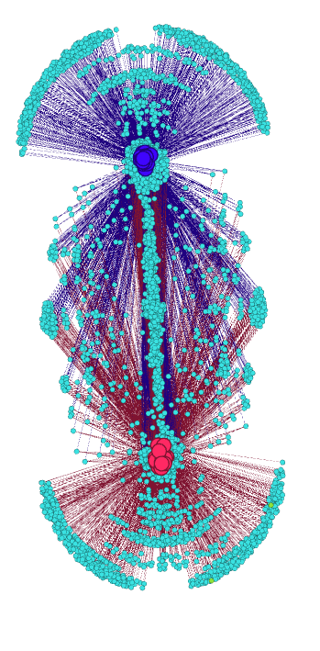
What clustering analysis can tell us?
Clustering techniques are commonly employed in Web analysis to identify patterns, communities and subgroups of interest. Here we employed a k-means classifier to find a selection of 353 words which had an apparent correlation with the final recruitment achieved by the studies.

Slide 4
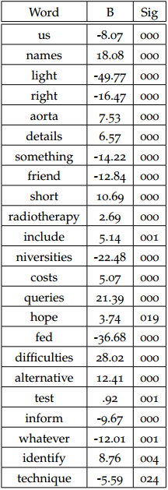

Then we employed a linear regression model to further refine this word set into 23 words which appearance held a high correlation with the final recruitment achieved. This model predicted the recruited proportion with F(23,40)=44,109 p<.0005, adj. R2=.940.
With only 58 cases a regression model with more than 2 variables could induce co-linearity bias. The model employing only the 2 most significant variables predicted F(2,61)=13.049 p<.0005, adj. R2=.277.

Slide 5
What can Sentiment Analysis tell?
Sentiment analysis has been used in many diverse areas, from analysing the opinion of political parties, finding terrorist associations trough hate mail and identifying trends in Tweeter. Here, we employed the NRC Emotional Lexicon which contains emotional associations for 6520 English words to quantify the level of emotion in the Patient Information Leaflets.
We found that there were no statistical significant difference in the emotive content of leaflets from studies with good recruitment and those which failed to recruit.
We found that there were a significant difference in the expected level of emotive content with other studies which employed the NRC Lexicon to analyse novels, fairy tales and e-mails.

Slide 6
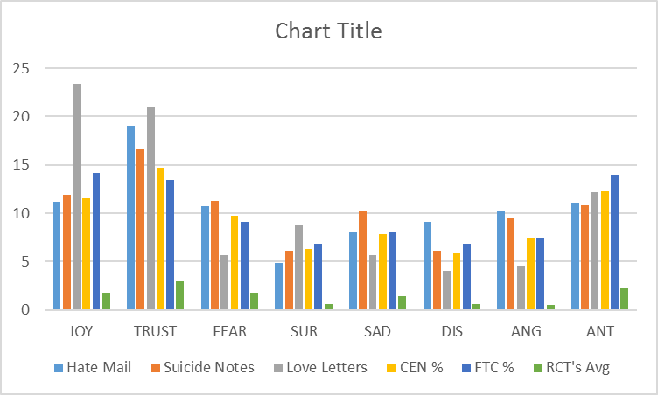

Slide 7
References
[1] Béla Bollobás. Modern graph theory, volume 184 of graduatetexts in mathematics, 1998.
[2] John Adrian Bondy and Uppaluri Siva Ramachandra Murty. Graph theory with applications, volume 290. Citeseer, 1976.
[3] Bonka Boneva, Robert Kraut, and David Frohlich. Using e-mail for personal relationships the difference gender makes. American behavioral scientist, 45(3):530–549, 2001.
[4] Samuel B Green. How many subjects does it take to do a regression analysis. Multivariate behavioral research, 26(3):499–510, 1991.
[5] Saif M Mohammad and Peter D Turney. Emotions evoked by common words and phrases: Using mechanical turk to create an emotion lexicon. In Proceedings of the NAACL HLT 2010 workshop on computational approaches to analysis and generation of emotion in text, pages 26–34. Association for Computational Linguistics, 2010.
[6] Saif M Mohammad and Peter D Turney. Nrc emotion lexicon. Technical report, NRC Technical Report, 2013.
[7] Saif M Mohammad and Tony Wenda Yang. Tracking sentiment in mail: how genders differ on emotional axes. In Proceedings of the 2nd workshop on computational approaches to subjectivity and sentiment analysis (acl-hlt 2011, pages 70–79, 2011.

