Slide 1
Employing sentiment analysis & clustering techniques in clinical text
By Fernando Santos
University of Southampton
Supervisors: Prof Jeremy Wyatt, Prof Thanasis Tiropanis
With support from EPSCR & CONACYT

Slide 2
The Problem
There is little research in evaluating the Quality of Patient Information Resources (PIR).
There is general doubt on the true impact Patient Information Leaflets (PIL) have on the patients informed decision.
There is evidence badly designed PIRs can hinder understanding, interest and recruitment rates to Randomized Controlled Trials (RCT).

Slide 3
The Approach
Employ Clustering techniques to explore PIRs datasets and find patterns of interest that correlate PIRs with the recruitment rates of RCTs.
Selected recruitment rates as a strong predictor of influence in patient decision.
Employ Content Analysis on the PIRs to obtain significant predictors.
Employ Sentiment Analysis to quantify the effect of emotive content on recruitment rates.

Slide 4
Why Emotion
“How we communicate is as
important as what we tell” –Jacob Nielssen
“People store material in memory
on the basis of its affective tone” – Richard Lazarus
Mood affects perception and prosocial
behavior – (Fergas & bower 19987)

Slide 5
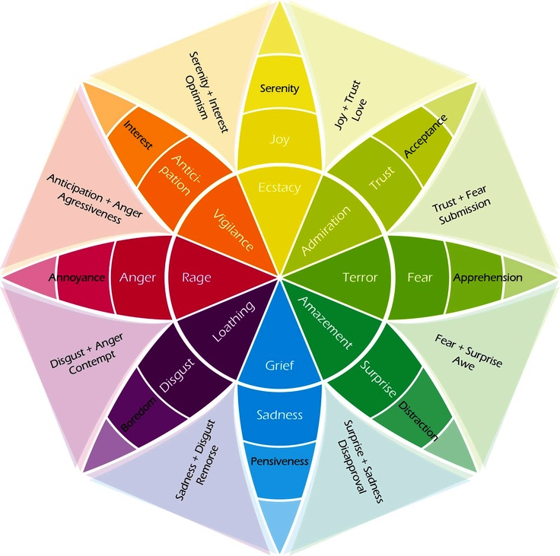
What is Emotion
Definitions of Basic Emotions:
Biological: Information coded in genes
Social: rules and cultural artefacts
Psychological: schemas and knowledge structures
Functions of Basic Emotions: something is basic, fundamental or primary if it fulfils an important function
Survival of the species
Benefit of the society
Help the self
Criteria of Basic Emotions:
Be universal
Be observable in other primates
Be heritable

Slide 6
What is Emotion
Definitions of Basic Emotions:
Biological: Information coded in genes
Social: rules and cultural artefacts
Psychological: schemas and knowledge structures
Functions of Basic Emotions: something is basic, fundamental or primary if it fulfils an important function
Survival of the species
Benefit of the society
Help the self
Criteria of Basic Emotions:
Be universal
Be observable in other primates
Be heritable

Slide 7
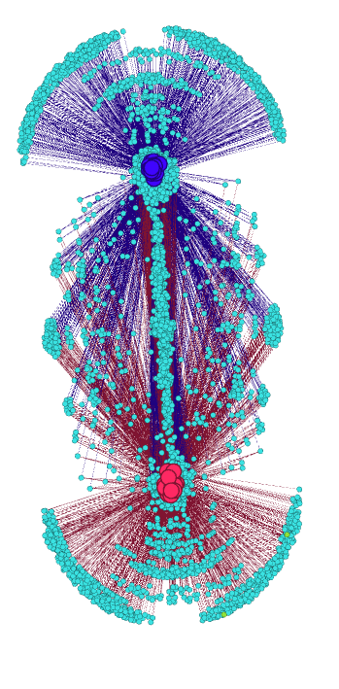
Clustering
Employ the K-means clustering technique to visualize and find patterns in the appearance of words and the recruited proportion of the planed sample.

Slide 8
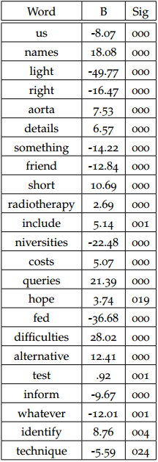
What Clustering tell us?
353 words which had an apparent correlation with the final recruitment rates achieved by the 58 studies.
A linear regression model further refined this word-set into a list of 23 words. This model predicted the recruited proportion with F(23,40)=44,109 p<.0005, adjusted R2=0.94
A reduced model employing only the 2 most significant variables predicted F(2,61)=13.049 p<.0005, adjusted R²=0.28

Slide 9
Sentiment Analysis?
Sentiment analysis is a commonly employed technique used in the Web to explore big sources of text.
At its basic level it employs lexicons (dictionaries which stores the word relationships of interest instead of their meaning) to explore the content of a document and quantify its character.
Pos
Tru
Ang
Sad
Ant
Difficulty
Sur
Joy
Fear
Dis
Neg
id | ProjRef | Pos | Neg | Ang | Ant | Dis | Fear | Joy | Sad | Sur | Tru
6 | 01/13/03 | 84 | 22 | 6 | 18 | 3 | 12 | 3 | 16 | 9 | 34

Slide 10
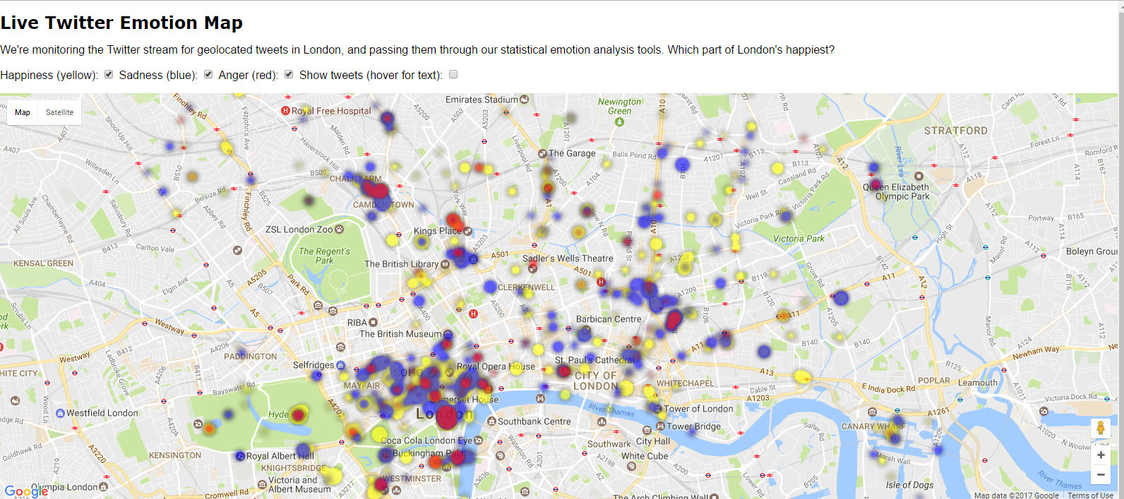
What Sentiment Analysis Does?
http://www.eecs.qmul.ac.uk/~mpurver/emomap/

Slide 11
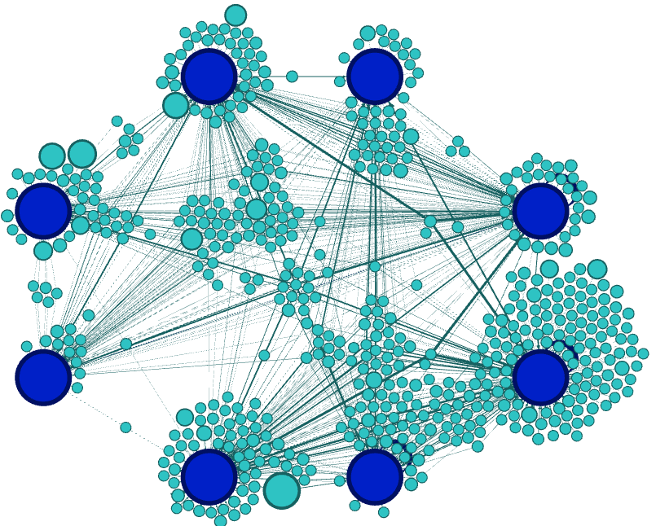
The Results: Leaflets
Sadness
Surprise
In the 64 leaflets only 572 word-instances were recognized as emotive from a total of 26,632 word-instances.
Disgust
Fear
Anger
Trust
Joy
Anticipation

Slide 12
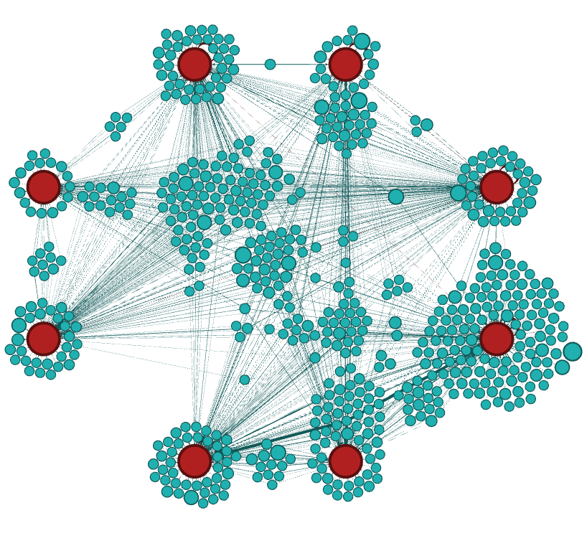
The Results: Leaflets
Sadness
Surprise
In the 31 BBC News analyzed 624 word-instances were recognized as emotive from a total of 8,842 word instances analyzed.
Disgust
Fear
Anger
Trust
Joy
Anticipation

Slide 13
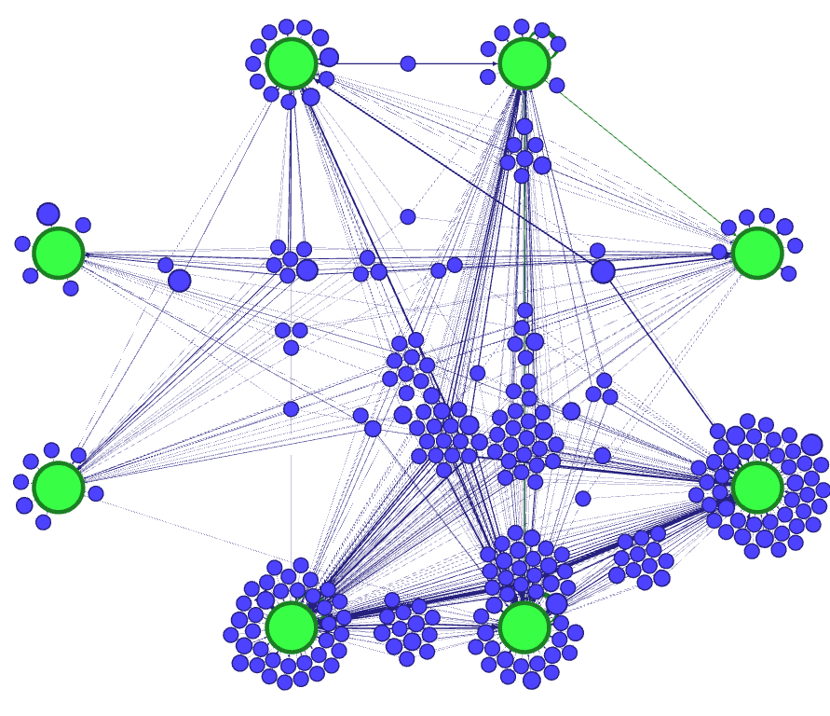
The Results: Leaflets
Sadness
Surprise
In the 20 Hello Magazine! articles analyzed 285 word-instances were recognized as emotive from a total of 4,479 word instances analyzed.
Disgust
Fear
Anger
Trust
Anticipation
Joy

Slide 14
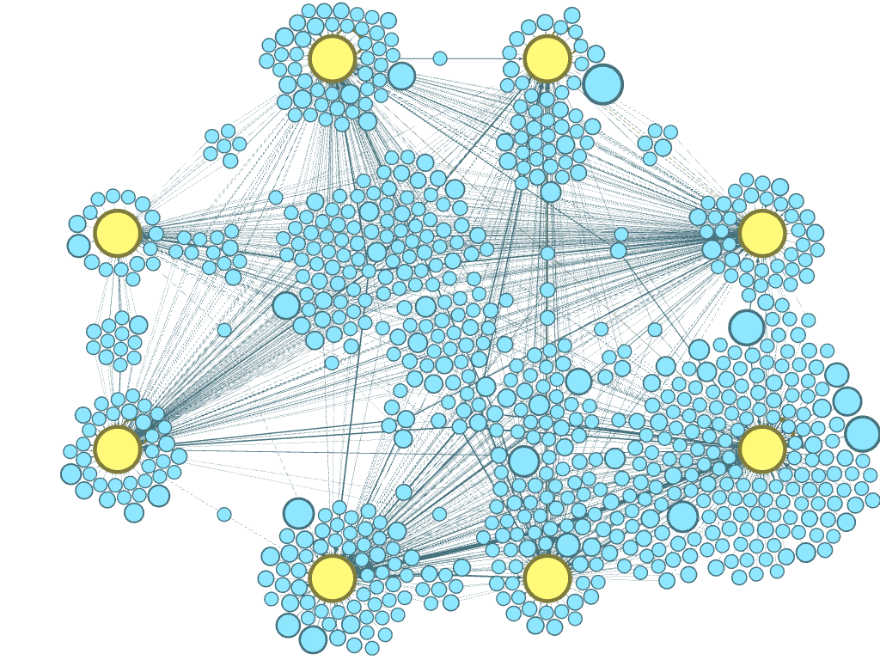
The Results: Leaflets
Sadness
Surprise
In the 31 Daily Mail News analyzed 735 word-instances were recognized as emotive from a total of 11,600 word instances analyzed.
Disgust
Fear
Anger
Trust
Anticipation
Joy

Slide 15
The Caveats
First time Sentiment Analysis is employed in clinical text, the lexicons may not be appropriate to the study
There appears to be differences in the ability to recognize emotions depending on the individual sense of power
Other aspects of leaflet design may have important influences:
Structure
Images
Length
Tone of Voice

Slide 16
Conclusions
The Leaflets appear to have a low emotive content level. This may be due because the researchers procure to employ objective & specific language.
There is evidence patients find the leaflets boring and hard to understand. This could be an effect of a lower than expected emotive level.
The Leaflets appear to have no significant correlation with the recruitment rates in trials
This could imply that the leaflets do not have a significant influence in the patient decision which brings into question the patient informed consent.

Slide 17
References
[1] Béla Bollobás. Modern graph theory, volume 184 of graduatetexts in mathematics, 1998.
[2] John Adrian Bondy and Uppaluri Siva Ramachandra Murty. Graph theory with applications, volume 290. Citeseer, 1976.
[3] Bonka Boneva, Robert Kraut, and David Frohlich. Using e-mail for personal relationships the difference gender makes. American behavioral scientist, 45(3):530–549, 2001.
[4] Samuel B Green. How many subjects does it take to do a regression analysis. Multivariate behavioral research, 26(3):499–510, 1991.
[5] Saif M Mohammad and Peter D Turney. Emotions evoked by common words and phrases: Using mechanical turk to create an emotion lexicon. In Proceedings of the NAACL HLT 2010 workshop on computational approaches to analysis and generation of emotion in text, pages 26–34. Association for Computational Linguistics, 2010.
[6] Saif M Mohammad and Peter D Turney. Nrc emotion lexicon. Technical report, NRC Technical Report, 2013.
[7] Saif M Mohammad and Tony Wenda Yang. Tracking sentiment in mail: how genders differ on emotional axes. In Proceedings of the 2nd workshop on computational approaches to subjectivity and sentiment analysis (acl-hlt 2011, pages 70–79, 2011.

