Slide 1
Employing sentiment analysis & clustering techniques in PILs
By Fernando Santos
University of Southampton
Supervisors: Prof Jeremy Wyatt, Prof Thanasis Tiropanis
With support from EPSRC & CONACYT

Slide 2
Background: The Problem
Randomised trials (RCTs) are one of the core methods used in health technology assessment
RCTs are expensive and take time & expertise to design and execute
Poor recruitment delays, and undermines the validity of, the results
However, poor recruitment is common, despite careful attention by PIs and the NETSCC Monitoring team
One of the most common issues in RCT is difficulty to recruit.
Several research have outlined that only around 1/3 of the trials recruit they planned sample in the estimated timeframe (Lovato et al, 1997).
Around 60% fail to recruit 80%. (Raftery et al, 2015)

Slide 3
Background: What has been done?
Several works have tried to find the principal factors in RCT recruitment:
Organizational difficulties
Strong preference for treatments
Bias against randomization
Conflict between clinical and researcher roles
And recommendations to improve it:
Dedicated trial manager
Training in recruiting/RCT/Interventions
Telephone reminders
Opt-out approach
Incentives
Account for patient feelings

Slide 4
Background: Why do we need to do more?
“The effects of many recruitment strategies remain unclear”
-Treweek, 2010
“no trial was found to display particularly
marked changes in recruitment”
-Raftery, 2015
“Despite the recent focus on improving the quality of
patient information, there is no rigorous method of
assessing quality of written patient information”
-Moult, 2004

Slide 5
Our Problem: PILs?
There is little research in evaluating the Quality of Patient Information Leaflets (PIL).
There is general doubt on the true impact Patient Information Leaflets (PIL) have on the patients informed decision to participate in RCTs.
There is evidence badly designed PILs can hinder understanding, interest and recruitment rates to Randomized Controlled Trials (RCT).

Slide 6
Our Problem: Why PILs
They are commonly required by REC committees for RCTs
According to HRA guidelines on PILS mention that:
Their objective is “To ensure that those who are invited to take part in a research study have been adequately informed”
“Potential participants must be able to understand the information given to them and consider this information in light of their own circumstances.”

Slide 7
The Approach
Employ Clustering techniques to explore PIRs datasets and find patterns of interest that correlate PIRs with the recruitment rates of RCTs.
Selected recruitment rates as a strong predictor of influence in patient decision.
Employ Content Analysis on the PIRs to obtain significant predictors.
Employ Sentiment Analysis to quantify the effect of emotive content on recruitment rates.

Slide 8
Why Emotion
“How we communicate is as
important as what we tell” –Jacob Nielssen
“People store material in memory
on the basis of its affective tone” – Richard Lazarus
Mood affects perception and prosocial
behavior – (Fergas & bower 19987)

Slide 9
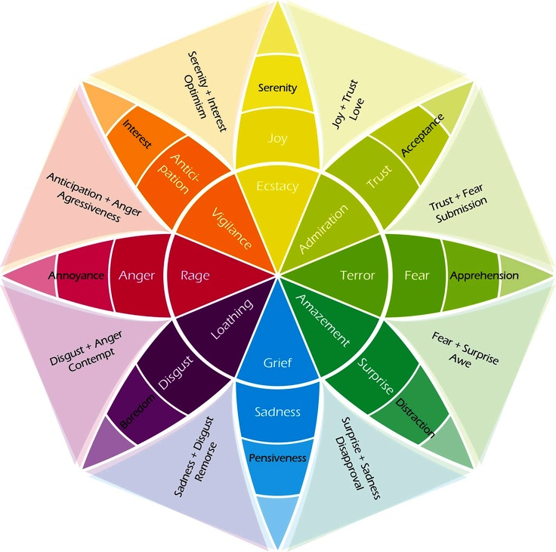
What is Emotion
Definitions of Basic Emotions:
Biological: Information coded in genes
Social: rules and cultural artefacts
Psychological: schemas and knowledge structures
Functions of Basic Emotions: something is basic, fundamental or primary if it fulfils an important function
Survival of the species
Benefit of the society
Help the self
Criteria of Basic Emotions:
Be universal
Be observable in other primates
Be heritable

Slide 10
What is Emotion
Definitions of Basic Emotions:
Biological: Information coded in genes
Social: rules and cultural artefacts
Psychological: schemas and knowledge structures
Functions of Basic Emotions: something is basic, fundamental or primary if it fulfils an important function
Survival of the species
Benefit of the society
Help the self
Criteria of Basic Emotions:
Be universal
Be observable in other primates
Be heritable

Slide 11
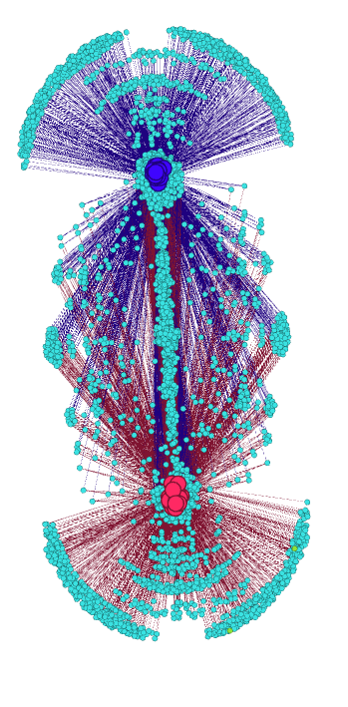
Clustering
Employ the K-means clustering technique to visualize and find patterns in the appearance of words and the recruited proportion of the planed sample.

Slide 12
Sentiment Analysis?
Sentiment analysis is a commonly employed technique used in the Web to explore big sources of text.
At its basic level it employs lexicons (dictionaries which stores the word relationships of interest instead of their meaning) to explore the content of a document and quantify its character.
Pos
Tru
Ang
Sad
Ant
Difficulty
Sur
Joy
Fear
Dis
Neg
id | ProjRef | Pos | Neg | Ang | Ant | Dis | Fear | Joy | Sad | Sur | Tru
6 | 01/13/03 | 84 | 22 | 6 | 18 | 3 | 12 | 3 | 16 | 9 | 34

Slide 13
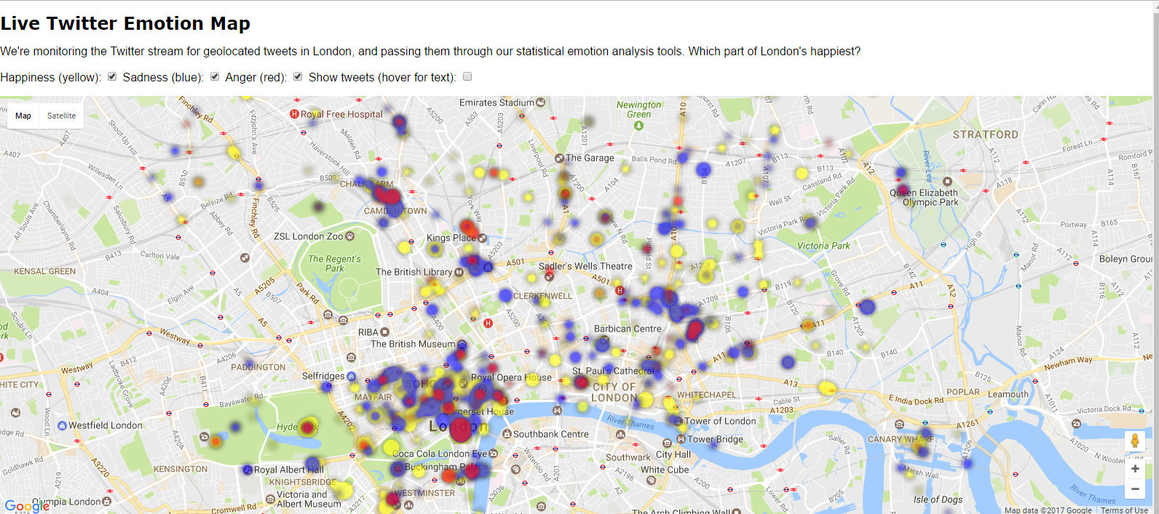
What Sentiment Analysis Does?
http://www.eecs.qmul.ac.uk/~mpurver/emomap/

Slide 14
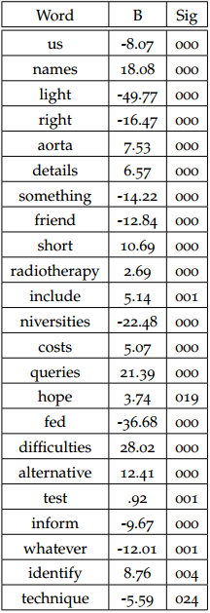
What they tell us?
353 words which had an apparent correlation with the final recruitment rates achieved by the 58 studies.
A linear regression model further refined this word-set into a list of 23 words. This model predicted the recruited proportion with F(23,40)=44,109 p<.0005, adjusted R2=0.94
A reduced model employing only the 2 most significant variables predicted F(2,61)=13.049 p<.0005, adjusted R²=0.28

Slide 15
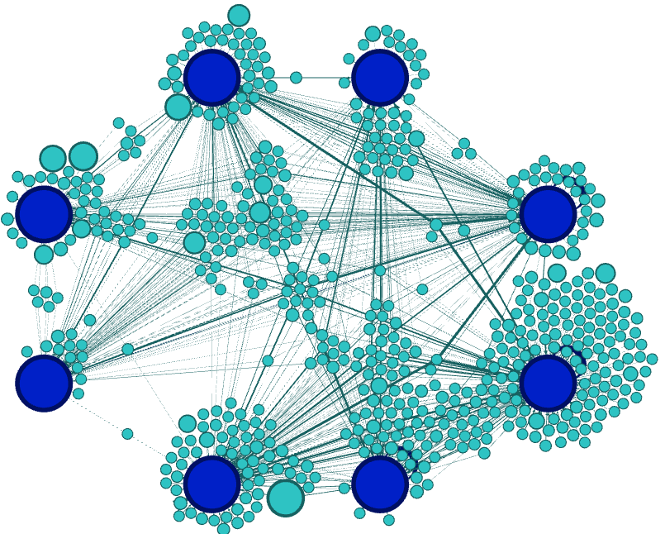
My Results: Leaflets
Sadness
Surprise
Around 25% of the words were recognized by the Lexicon. 11% were associated with an emotion or sentiment.
There was a strong appearance of Positive words (7%)
There were extreme low appearance of words associated with Angry, Joy, Sadness and Surprise
Disgust
Fear
Anger
Trust
Joy
Anticipation

Slide 16
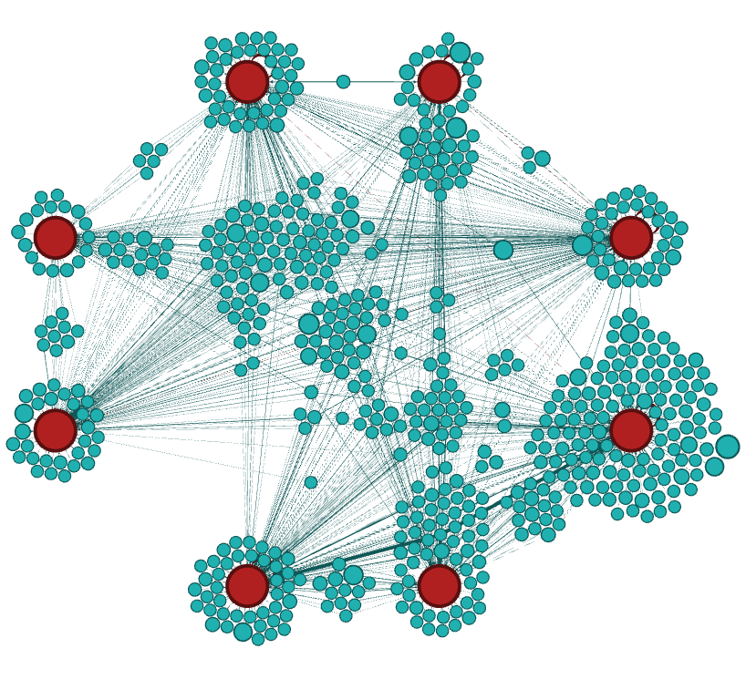
My Results: BBC News
Sadness
Surprise
Around 26% of the words were recognized by the Lexicon. 11% were associated with an emotion or sentiment.
There was a strong appearance of Positive words (5.42%)
There were low appearance of words associated with Disgust (0.8%)
Disgust
Fear
Anger
Trust
Joy
Anticipation

Slide 17
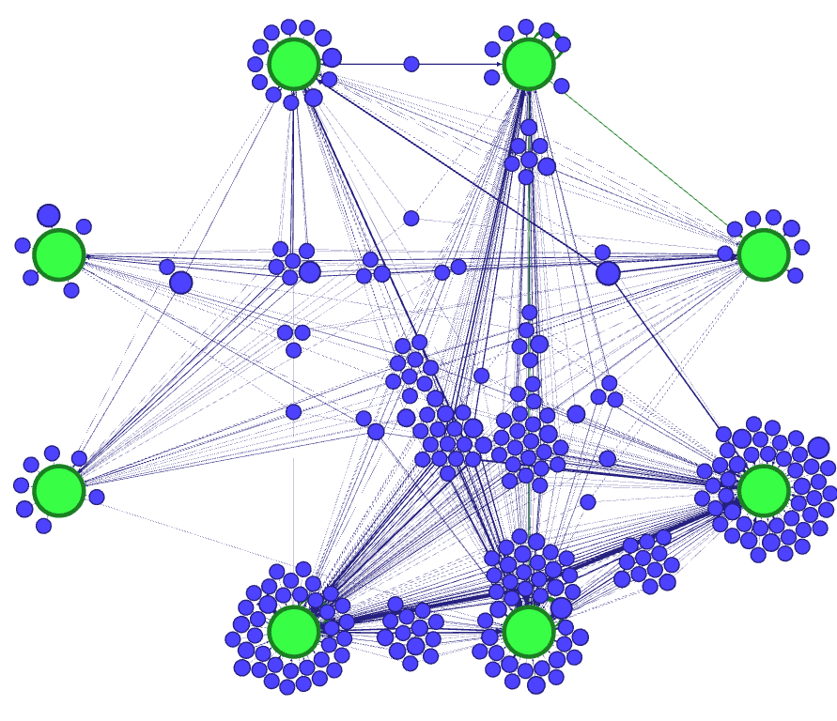
My Results: Hello Magazine!
Sadness
Surprise
Around 26% of the words were recognized by the Lexicon. 11% were associated with an emotion or sentiment.
There was a strong appearance of Positive words (6.62%)
There were low appearance of words associated with Disgust and Fear (less than 1%)
Disgust
Fear
Anger
Trust
Anticipation
Joy

Slide 18
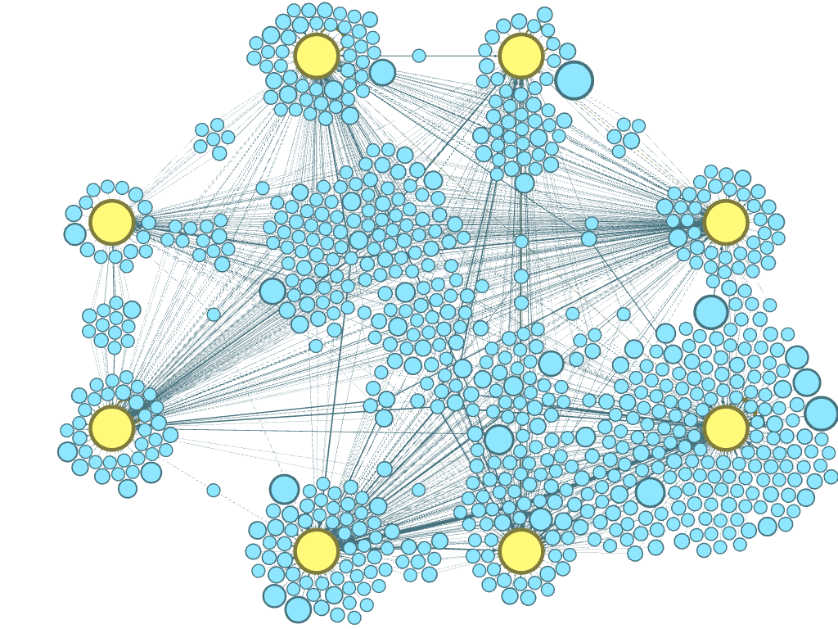
My Results: Daily Mail
Sadness
Surprise
Around 26% of the words were recognized by the Lexicon. 11% were associated with an emotion or sentiment.
There was a strong appearance of Positive words (5.23%)
Every category had at least 1% of the words associated with it.
Disgust
Fear
Anger
Trust
Anticipation
Joy

Slide 19
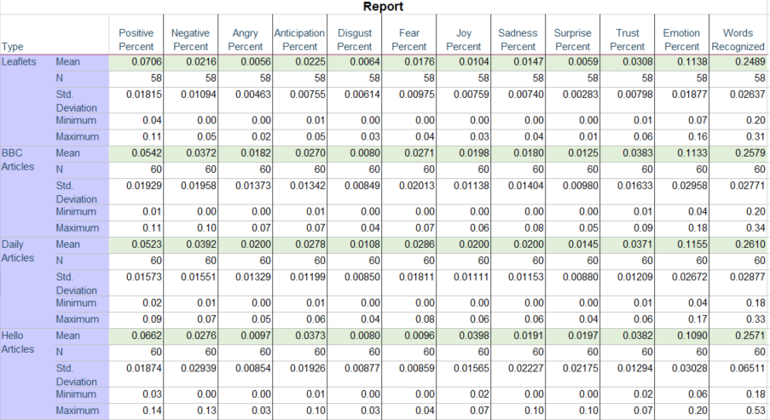
My results

Slide 20
My Results: Resume
A similar amount of words is recognized by the lexicon on the PILs and in the articles.
The leaflets have a higher amount of words related to Positive sentiment; a similar amount of Trust; a low amount of Negative, Anticipation, Disgust, Fear; and quite low levels of Angry, Joy, Sadness and Surprise..
There is no significant difference between the emotive content on PILs with good recruitment and those with bad recruitment rates.

Slide 21
The Caveats
First time Sentiment Analysis is employed in clinical text, the lexicons may not be appropriate to the study
There appears to be differences in the ability to recognize emotions depending on the individual sense of power
Other aspects of leaflet design may have important influences:
Structure
Images
Length
Tone of Voice

Slide 22
Conclusions
The Leaflets appear to have a low emotive content level. This may be due because the researchers procure to employ objective & specific language.
There is evidence patients find the leaflets boring and hard to understand. This could be an effect of a lower than expected emotive level.
The Leaflets appear to have no significant correlation with the recruitment rates in trials
This could imply that the leaflets do not have a significant influence in the patient decision which brings into question the patient informed consent.

Slide 23
References
[1] Béla Bollobás. Modern graph theory, volume 184 of graduatetexts in mathematics, 1998.
[2] John Adrian Bondy and Uppaluri Siva Ramachandra Murty. Graph theory with applications, volume 290. Citeseer, 1976.
[3] Bonka Boneva, Robert Kraut, and David Frohlich. Using e-mail for personal relationships the difference gender makes. American behavioral scientist, 45(3):530–549, 2001.
[4] Samuel B Green. How many subjects does it take to do a regression analysis. Multivariate behavioral research, 26(3):499–510, 1991.
[5] Saif M Mohammad and Peter D Turney. Emotions evoked by common words and phrases: Using mechanical turk to create an emotion lexicon. In Proceedings of the NAACL HLT 2010 workshop on computational approaches to analysis and generation of emotion in text, pages 26–34. Association for Computational Linguistics, 2010.
[6] Saif M Mohammad and Peter D Turney. Nrc emotion lexicon. Technical report, NRC Technical Report, 2013.
[7] Saif M Mohammad and Tony Wenda Yang. Tracking sentiment in mail: how genders differ on emotional axes. In Proceedings of the 2nd workshop on computational approaches to subjectivity and sentiment analysis (acl-hlt 2011, pages 70–79, 2011.

Slide 24
Questions?

