Slide 1
Employing sentiment analysis & clustering techniques in PILs
By Fernando Santos, University of Southampton
Supervisors: Prof Jeremy Wyatt, Prof Thanasis Tiropanis
With support from EPSRC & CONACYT

Slide 2
Background: The Problem
Randomised trials (RCTs) are one of the core methods used in health technology assessment
RCTs are expensive and take time & expertise to design and execute
Poor recruitment delays and undermines the validity of the results
However, poor recruitment is common, despite careful attention by PIs and the NETSCC Monitoring team
One of the most common issues in RCT is difficulty to recruit.
Several studies have outlined that only around 1/3 of the trials recruit the planned sample in the intended timeframe (Lovato et al, 1997).
Around 60% fail to recruit 80% of particpants (Raftery et al, 2015)

Slide 3
Background: What has been done?
Several studies have tried to find the principal factors in RCT recruitment:
Organizational difficulties
Strong preference for treatments
Bias against randomization
Conflict between clinical and researcher roles
And recommendations to improve it:
Dedicated trial manager
Training in recruiting/RCT/Interventions
Telephone reminders
Opt-out approach
Incentives
Account for patient feelings

Slide 4
Background: Why do we need to do more?
“The effects of many recruitment strategies remain unclear”
-Treweek, 2010
“no trial was found to display particularly
marked changes in recruitment”
-Raftery, 2015
“Despite the recent focus on improving the quality of
patient information, there is no rigorous method of
assessing quality of written patient information”
-Moult, 2004

Slide 5
Our Focus: PILs
There is little research in evaluating the quality of Patient Information Leaflets (PIL).
There is general doubt on the true impact of patient Information Leaflets (PIL) on patients informed decision to participate in RCTs.
There is evidence that badly designed PILs can hinder understanding, interest and recruitment rates to Randomized Controlled Trials (RCT).

Slide 6
Methods
Use Clustering techniques to explore PIRs datasets and find patterns of interest that correlate PIRs with the recruitment rates of RCTs.
Selected recruitment rates as a strong predictor of influence in patient decision.
Use Content Analysis on the PIRs to obtain significant predictors.
Use Sentiment Analysis to quantify the effect of emotive content on recruitment rates.

Slide 7
Why Emotion
“How we communicate is as
important as what we tell” –Jacob Nielssen
“People store material in memory
on the basis of its affective tone” – Richard Lazarus
Mood affects perception and prosocial
behavior – (Fergas & bower 19987)

Slide 8
What is Emotion
Definitions of Basic Emotions:
Biological: Information coded in genes
Social: rules and cultural artefacts
Psychological: schemas and knowledge structures
Functions of Basic Emotions: something is basic, fundamental or primary if it fulfils an important function
Survival of the species
Benefit of the society
Help the self
Criteria of Basic Emotions:
Be universal
Be observable in other primates
Be heritable

Slide 9
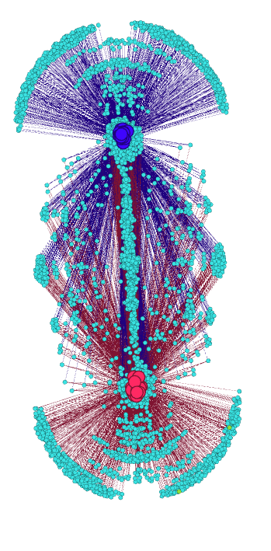
Clustering
Employ the K-means clustering technique to visualize and find patterns in the appearance of words and the recruited proportion of the planed sample.

Slide 10
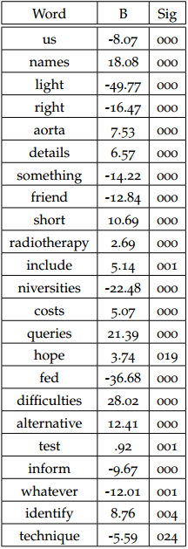
What content analysis tell us?
353 words which had an apparent correlation with the final recruitment rates achieved by the 58 studies.
A linear regression model further refined this word-set into a list of 23 words. This model predicted the recruited proportion with F(23,40)=44,109 p<.0005, adjusted R2=0.94
A reduced model employing only the 2 most significant variables predicted F(2,61)=13.049 p<.0005, adjusted R²=0.28

Slide 11
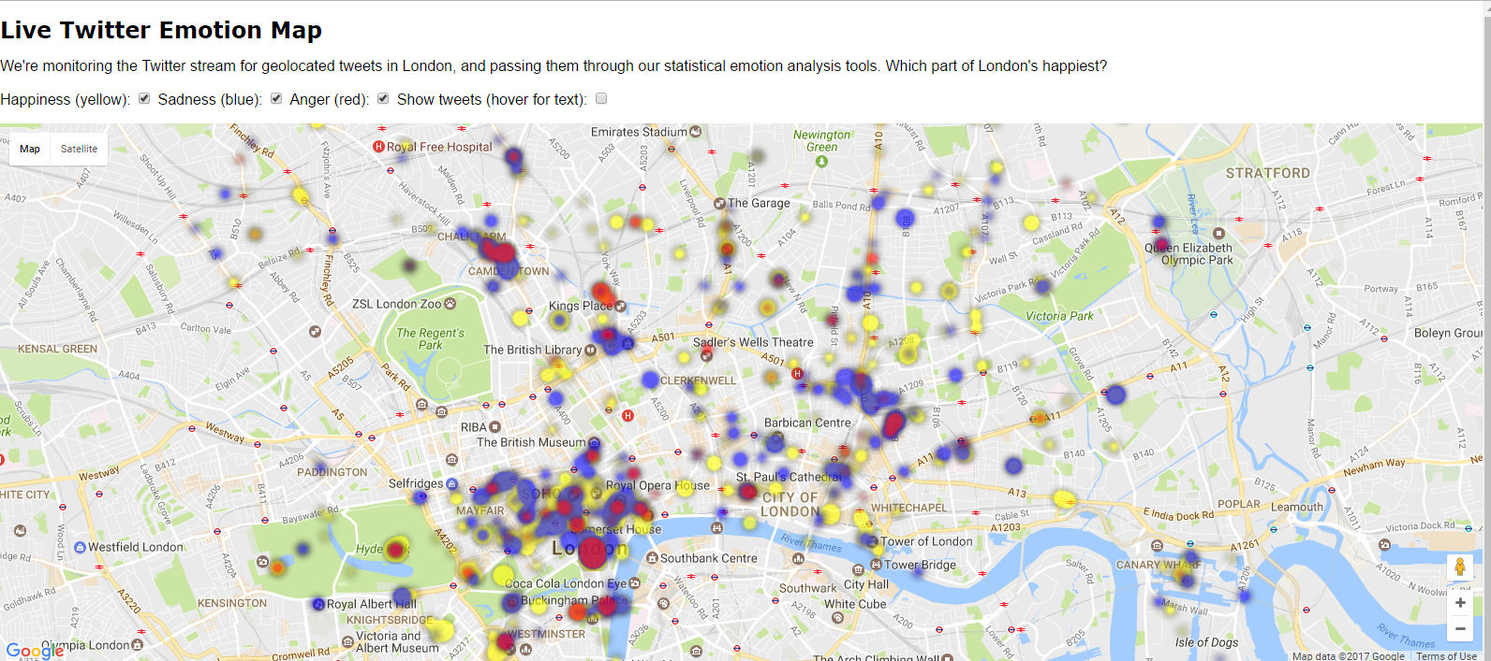
What Sentiment Analysis Does?
http://www.eecs.qmul.ac.uk/~mpurver/emomap/

Slide 12
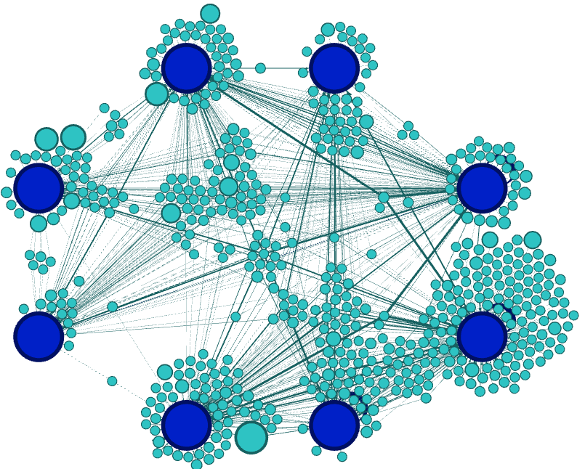
Clustering & content results for 58 PILs
Sadness
Surprise
Around 25% of the words were recognized by the Lexicon. 11% were associated with an emotion or sentiment.
There was a strong appearance of Positive words (7%)
There were extremely low appearance of words associated with Angry, Joy, Sadness and Surprise
Disgust
Fear
Anger
Trust
Joy
Anticipation

Slide 13
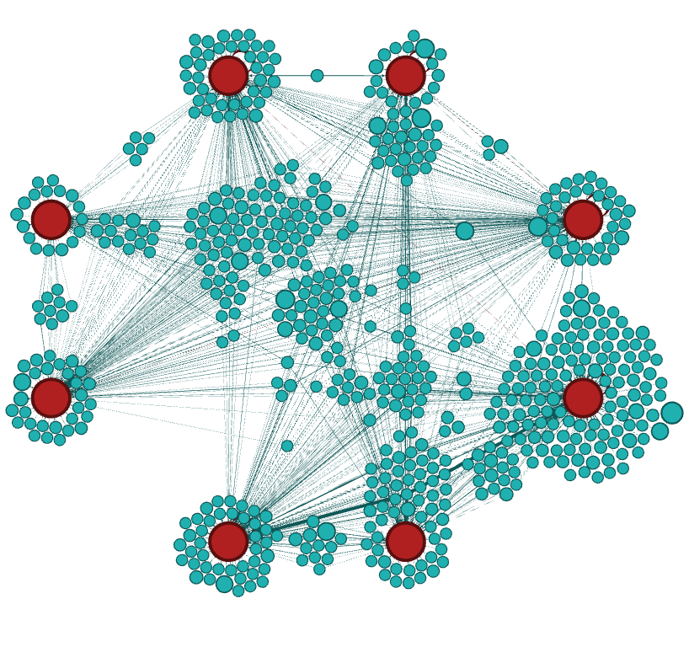
Clustering & content results for 60 BBC News stories
Sadness
Surprise
Around 26% of the words were recognized by the Lexicon. 11% were associated with an emotion or sentiment.
There was a strong appearance of Positive words (5.42%)
There were low appearance of words associated with Disgust (0.8%)
Disgust
Fear
Anger
Trust
Joy
Anticipation

Slide 14
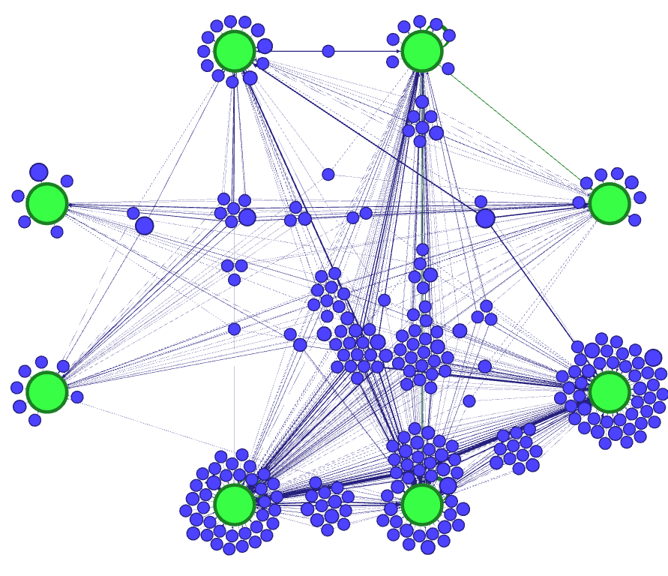
Clustering & content results for 60 Hello Magazine! stories
Sadness
Surprise
Around 26% of the words were recognized by the Lexicon. 11% were associated with an emotion or sentiment.
There was a strong appearance of Positive words (6.62%)
There were low appearance of words associated with Disgust and Fear (less than 1%)
Disgust
Fear
Anger
Trust
Anticipation
Joy

Slide 15
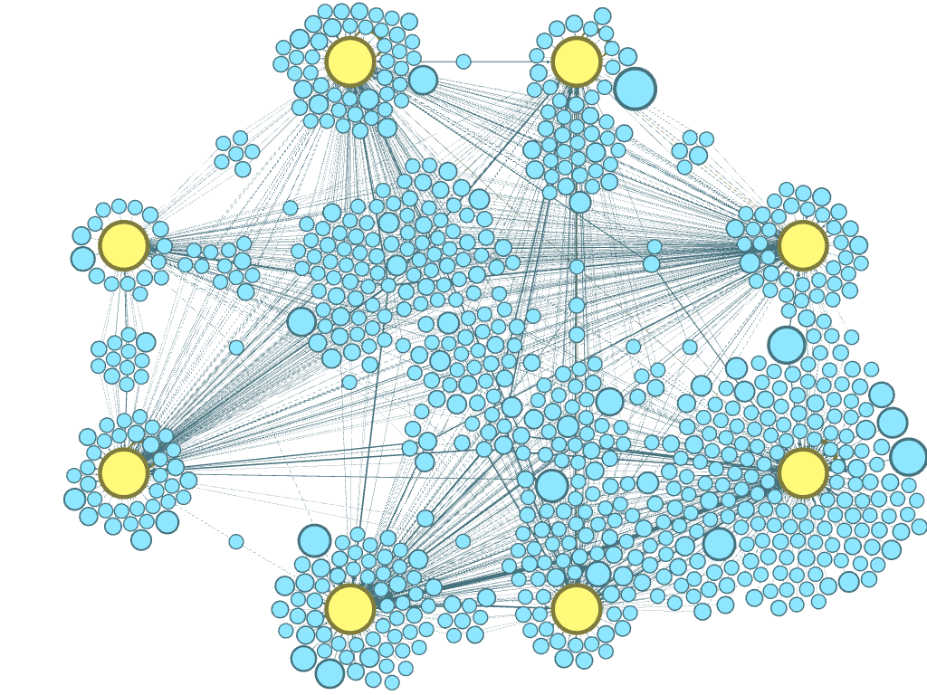
Clustering & content results for 60 Daily Mail stories
Sadness
Surprise
Around 26% of the words were recognized by the Lexicon. 11% were associated with an emotion or sentiment.
There was a strong appearance of Positive words (5.23%)
Every category had at least 1% of the words associated with it.
Disgust
Fear
Anger
Trust
Anticipation
Joy

Slide 16
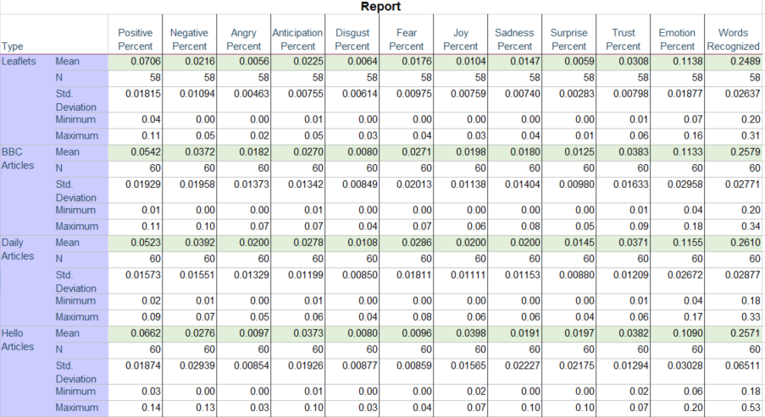
Content analysis for all data sources

Slide 17
Summary of my results
A similar proportion of words are recognized by the lexicon in the PILs and in the articles.
The leaflets have a higher number of words related to Positive sentiment; a similar amount of Trust; a lower amount of Negative, Anticipation, Disgust, Fear; and very low levels of words related to Anger, Joy, Sadness and Surprise..
There is no significant difference between the emotive content of PILs with high recruitment rates and those with lower recruitment rates.

Slide 18
Comments
This is the first time Sentiment Analysis has been employed in clinical text, but the lexicons may not be appropriate to the study
Other studies have shown differences in our ability to recognize emotions depending on the individual sense of power
Other aspects of leaflet design may have important influences:
Structure
Images
Length
Tone of Voice

Slide 19
Conclusions
The Leaflets appear to have a low emotive content. This may be because the researchers attempt to employ objective & specific language.
There is evidence patients find the leaflets boring and hard to understand. This could be an effect of a lower than expected emotive level.
The features examined so far in the Leaflets appear to have no significant correlation with recruitment rates to trials
This could imply that the leaflets do not have a significant influence in the patient decision, which brings into question whether they really contribute to informed consent.

Slide 20
References
[1] Béla Bollobás. Modern graph theory, volume 184 of graduatetexts in mathematics, 1998.
[2] John Adrian Bondy and Uppaluri Siva Ramachandra Murty. Graph theory with applications, volume 290. Citeseer, 1976.
[3] Bonka Boneva, Robert Kraut, and David Frohlich. Using e-mail for personal relationships the difference gender makes. American behavioral scientist, 45(3):530–549, 2001.
[4] Samuel B Green. How many subjects does it take to do a regression analysis. Multivariate behavioral research, 26(3):499–510, 1991.
[5] Saif M Mohammad and Peter D Turney. Emotions evoked by common words and phrases: Using mechanical turk to create an emotion lexicon. In Proceedings of the NAACL HLT 2010 workshop on computational approaches to analysis and generation of emotion in text, pages 26–34. Association for Computational Linguistics, 2010.
[6] Saif M Mohammad and Peter D Turney. Nrc emotion lexicon. Technical report, NRC Technical Report, 2013.
[7] Saif M Mohammad and Tony Wenda Yang. Tracking sentiment in mail: how genders differ on emotional axes. In Proceedings of the 2nd workshop on computational approaches to subjectivity and sentiment analysis (acl-hlt 2011, pages 70–79, 2011.

Slide 21
Questions?

Slide 22
Our Problem: Why PILs
According to the HRA guidelines, PILS mention that:
Their objective is “To ensure that those who are invited to take part in a research study have been adequately informed”
“Potential participants must be able to understand the information given to them and consider this information in light of their own circumstances.”

