Slide 1

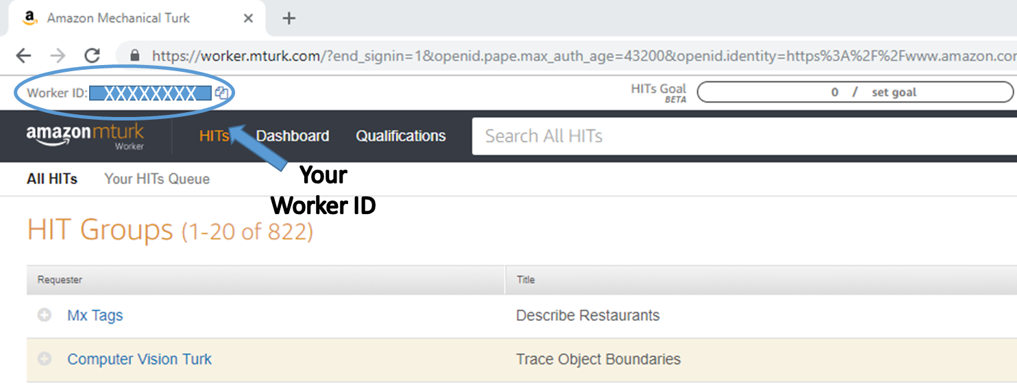
XXXXXXXX
Your Worker ID

