Slide 1
Project On an Agro E-commerce Application Using Jsp & Servlets
The project explains the development of an agro e-commerce web application that simulates an e-commerce front end operations using Jsp & Servlets.

Slide 2
PROJECT TOUR
ADMIN DASHBOARD
USER PLATFORM
Admin Portal
User Section
LogIn
Window
Notes:
This is the login screen

Slide 3
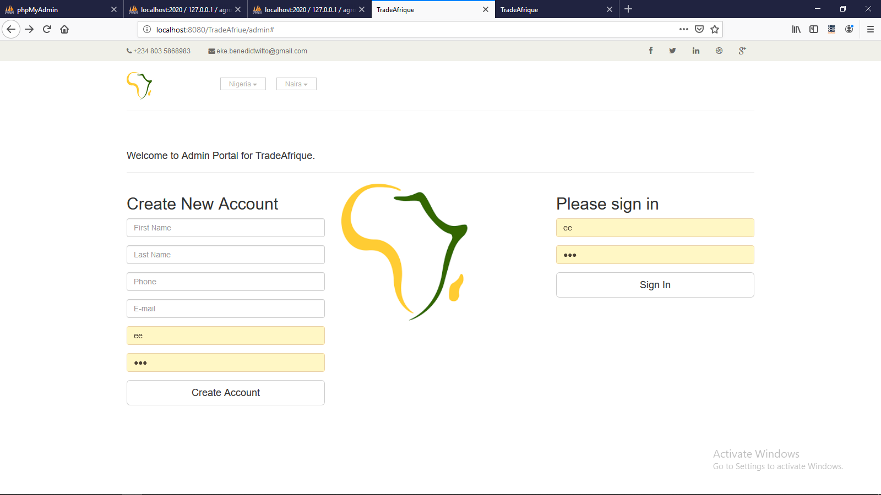
THE LANDING PAGE OF THE ADMIN PORTAL
USERS CAN LOGIN
THE DASHBOARD PAGE OF THE ADMIN PORTAL
ADMIN CAN ADD,VIEW, UPDATE AND DELETE PRODUCT

Slide 4
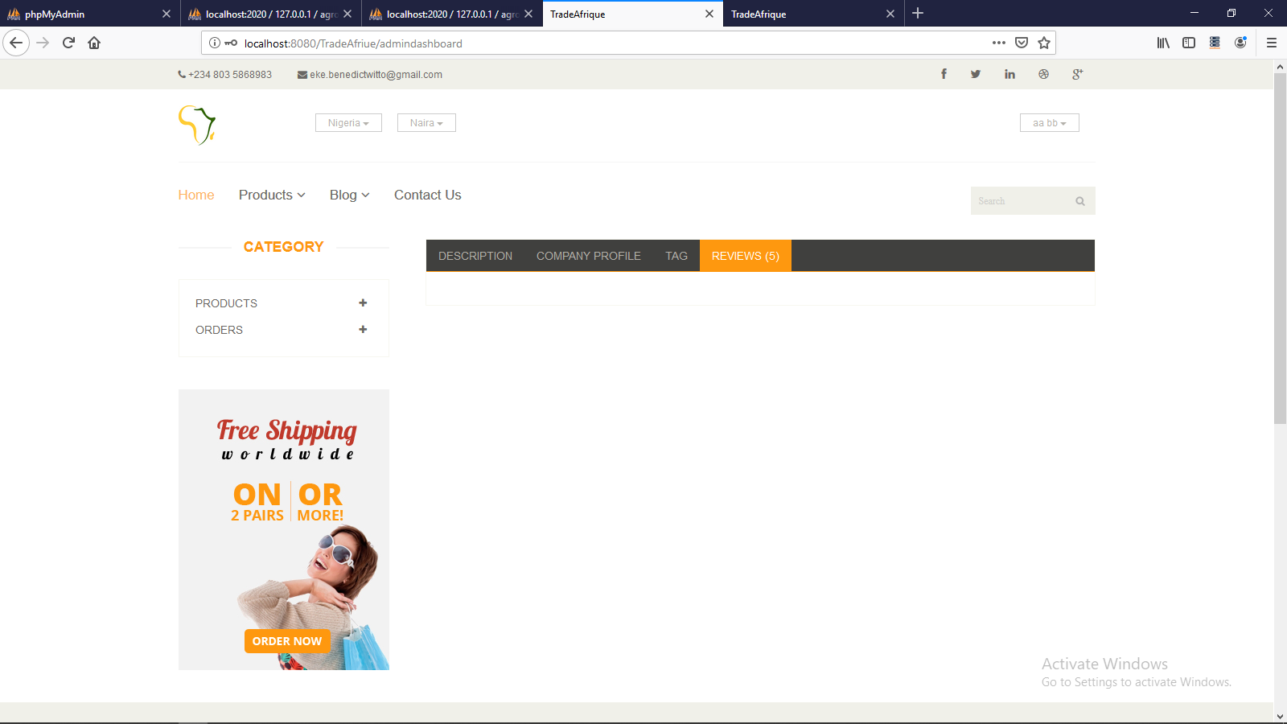
THE DASHBOARD PAGE OF THE ADMIN PORTAL
ADMIN CAN ADD,VIEW, UPDATE AND DELETE PRODUCT

Slide 5
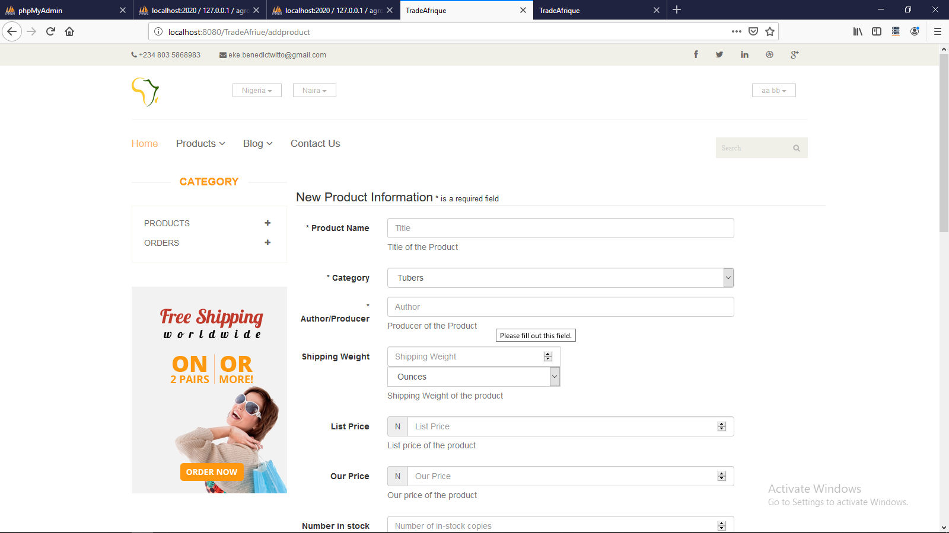
THE DASHBOARD PAGE OF THE ADMIN PORTAL
ADMIN CAN ADD,VIEW, UPDATE AND DELETE PRODUCT

Slide 6
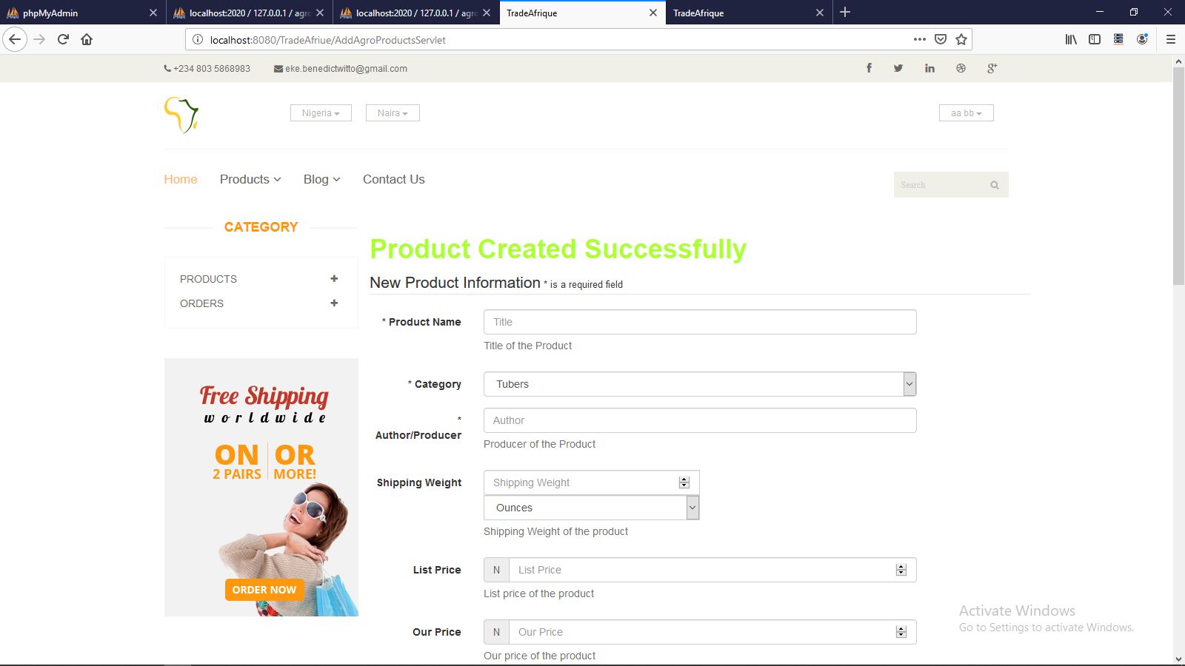
THE DASHBOARD PAGE OF THE ADMIN PORTAL
ADMIN CAN ADD,VIEW, UPDATE AND DELETE PRODUCT

Slide 7
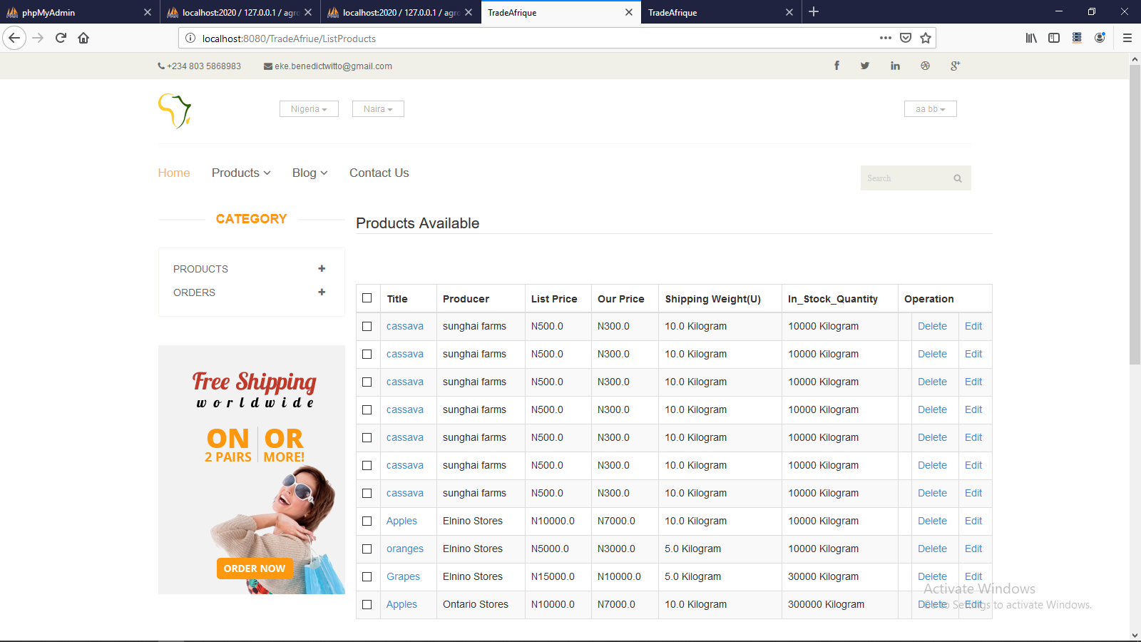
THE DASHBOARD PAGE OF THE ADMIN PORTAL
ADMIN CAN ADD,VIEW, UPDATE AND DELETE PRODUCT

Slide 8
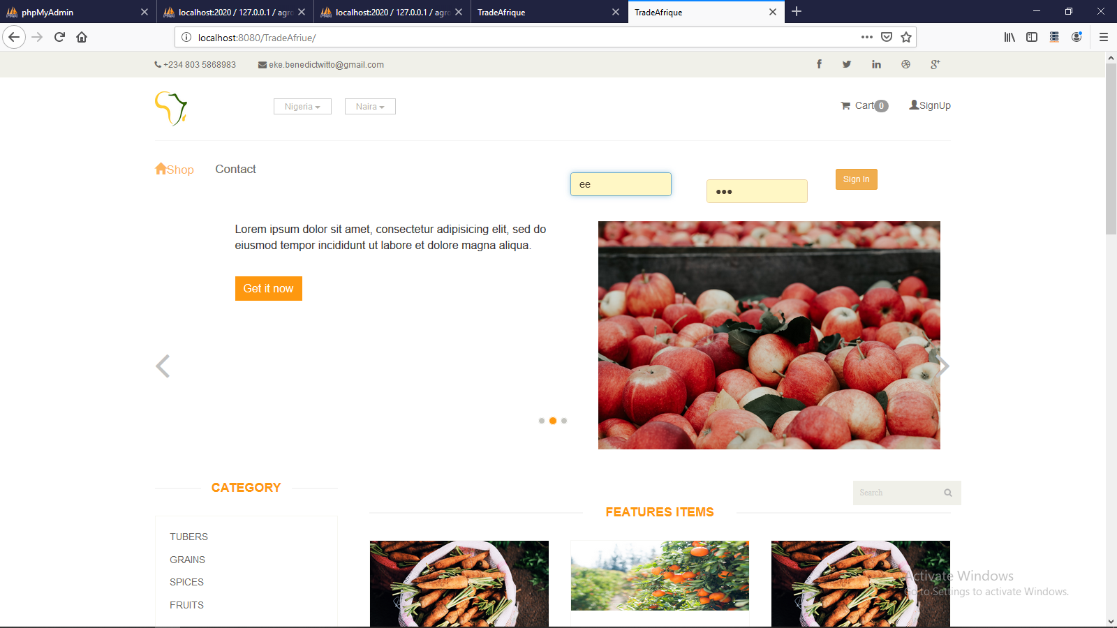
THE USERS PAGE:
USERS CAN VIEW AND BUY PRODUCT

Slide 9
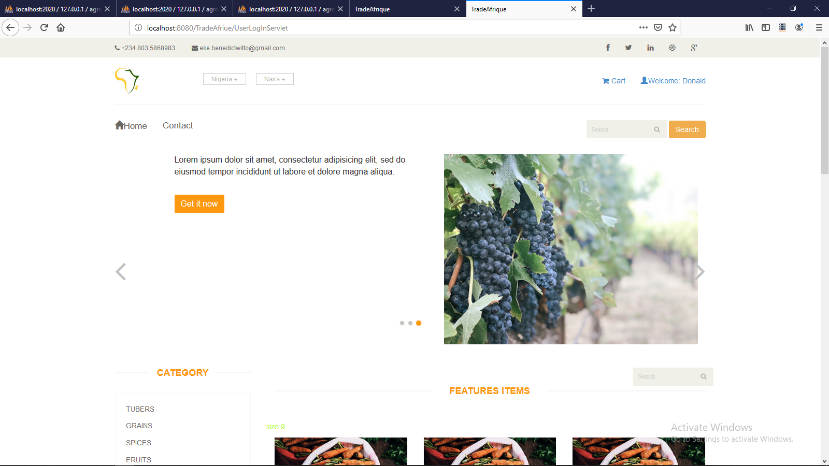
THE USERS PAGE:
On login
USERS CAN VIEW AND BUY PRODUCT

Slide 10
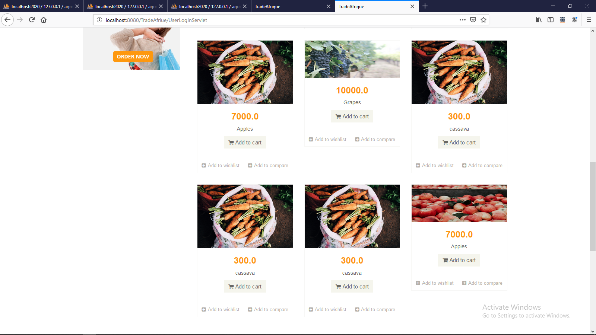
THE USERS PAGE:
On login
USERS CAN VIEW AND BUY PRODUCT

Slide 11
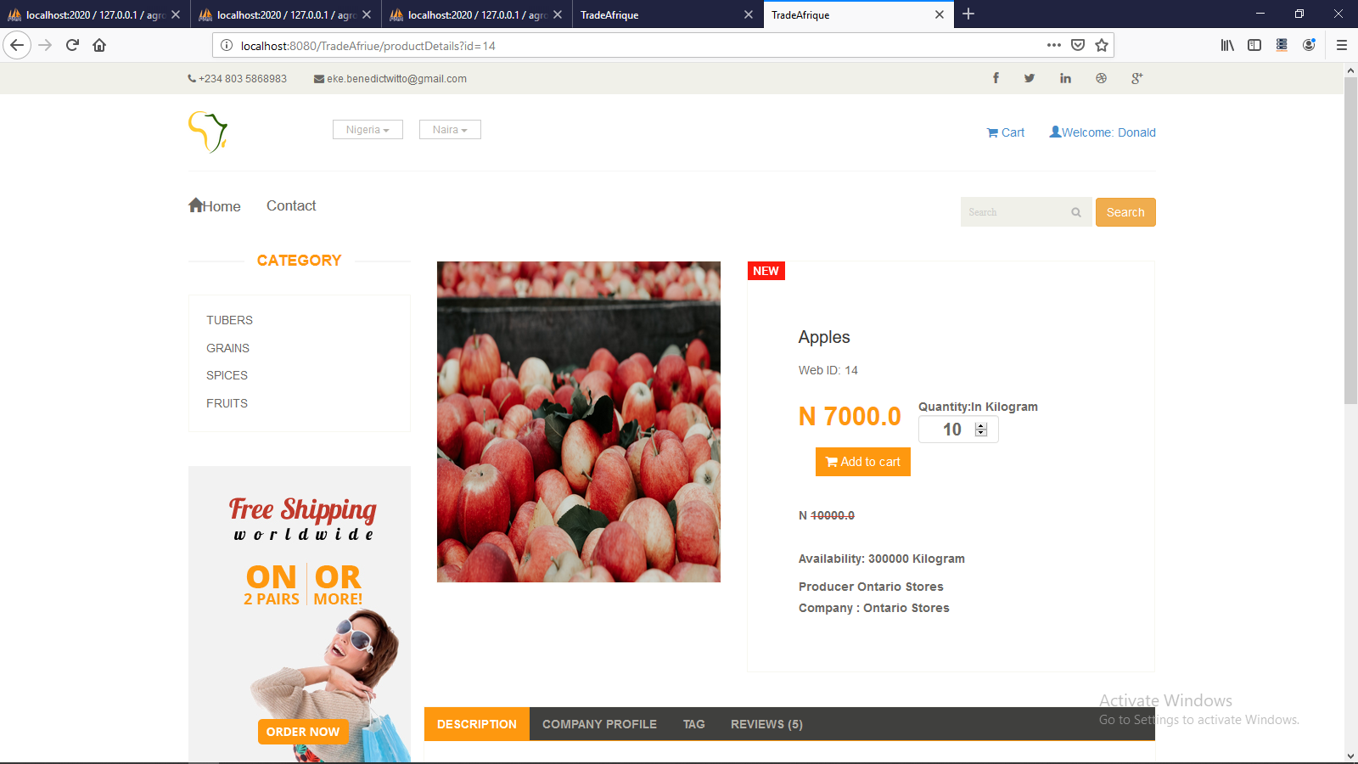
THE USERS PAGE:
On login
USERS CAN VIEW AND BUY PRODUCT

Slide 12
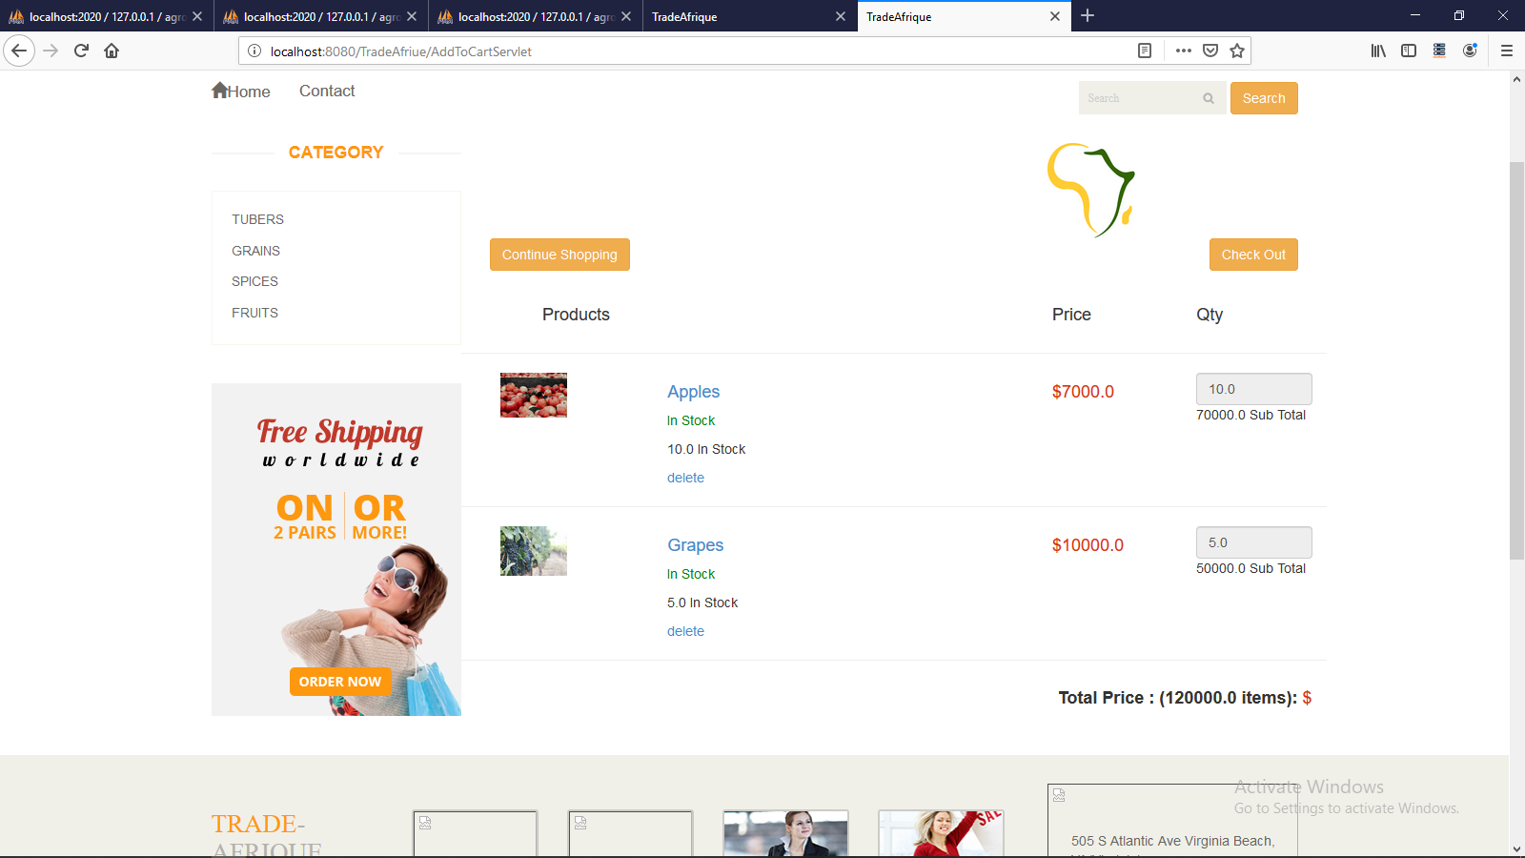
THE USERS PAGE:
On adding to cart
USERS CAN VIEW AND BUY PRODUCT

Slide 13
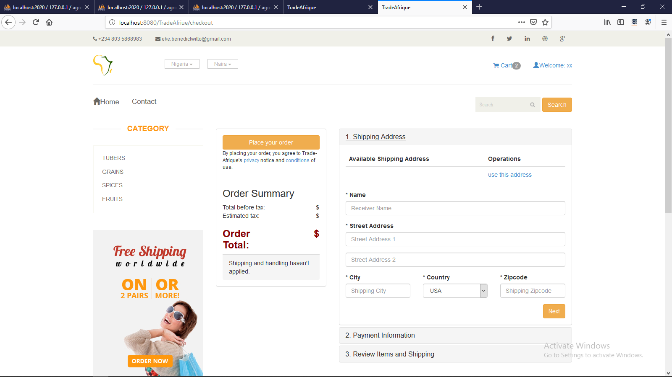
THE USERS PAGE:
On checking out
USERS CAN VIEW AND BUY PRODUCT

Slide 14
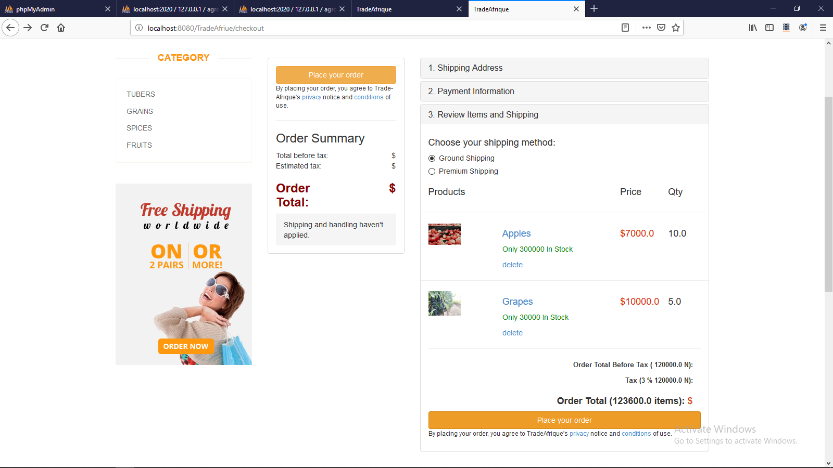
THE USERS PAGE:
On checking page
USERS CAN VIEW AND BUY PRODUCT

Slide 15
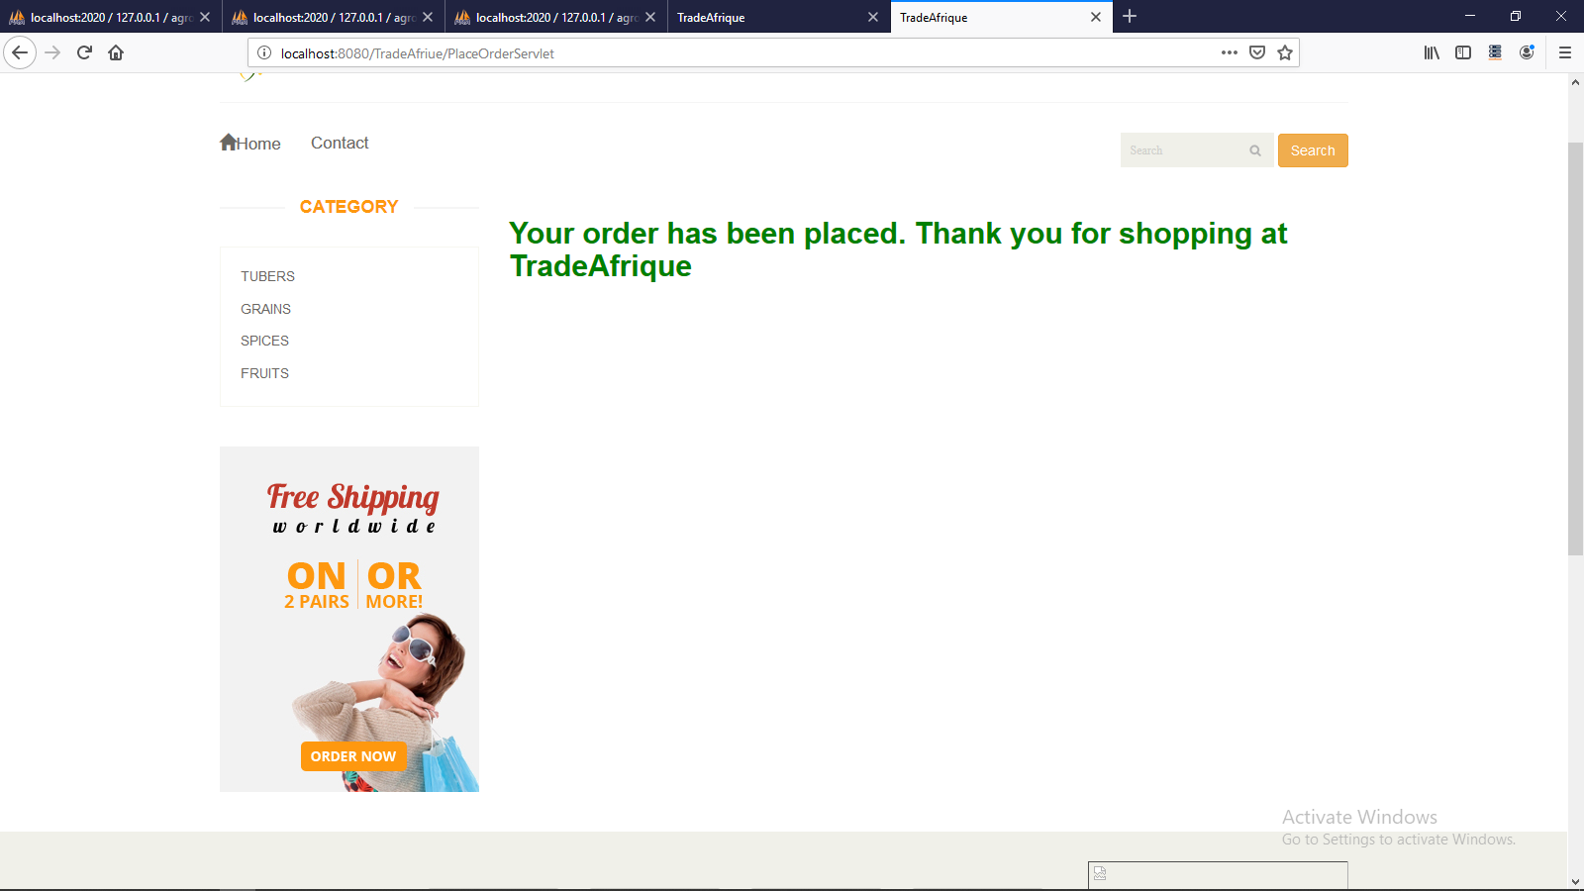
THE USERS PAGE:
On complete checking out
USERS CAN VIEW AND BUY PRODUCT

