Slide 1
Oct-10-2026
PROJECT PRESENTATION
AI Interview Coach
A hybrid multi-agent mock interview system that personalizes practice
from a candidate resume and target job description.
Prepared by:
Devendra Yadav
Ferdinand Dinga
Agentic AI Engineering · Live demo + architecture walkthrough

Slide 2
AI INTERVIEW COACH
The Problem
Why generic interview practice falls short
Today's reality
Impact
• Practice questions are often generic
• They ignore the candidate's real experience
• They ignore the target job requirements
• Feedback is vague or delayed
• Candidates prepare for the wrong conversation
• Weak transfer to real interviews
• Hard to track improvement over time
• No reusable prep artifacts after practice

Slide 3
AI INTERVIEW COACH
The Solution
Personalized practice powered by cooperating agents
AI Interview Coach turns a resume + job description into a voice-based mock interview,
then evaluates the full session and produces downloadable coaching materials.
1
2
3
4
Analyze
Interview
Evaluate
Prepare
Compare resume and JD
Find matches and gaps
Ask tailored questions
with speech in/out
Score the full session
and give practical feedback
Export study pack with
answers + concepts

Slide 4
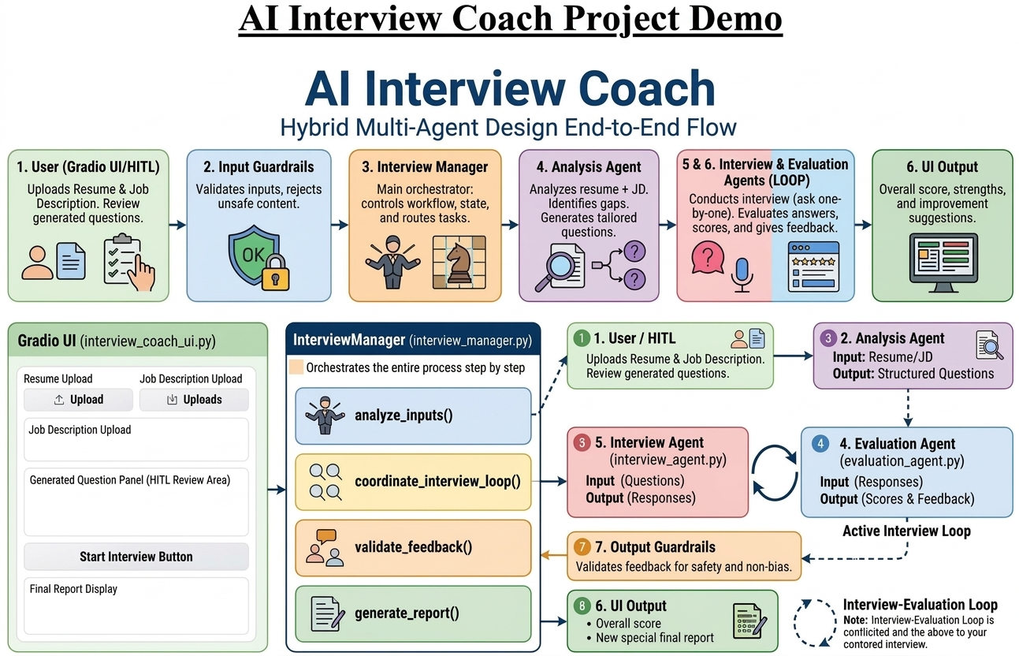

Slide 5
AI INTERVIEW COACH
Multi-Agent Architecture
Clear roles. Predictable orchestration.
Job Analysis Agent
Interview Agent
Extracts skills, matches, gaps
Generates tailored questions
Runs question sequence
Opening → tailored → close
Interview Manager
Evaluation Agent
Owns session state & turn order
Coordinates the workflow
Reviews all Q&A together
Produces final coaching feedback

Slide 6
AI INTERVIEW COACH
Product Layer Around the Agents
From model calls to a usable practice product
Auth
Document library
Conversation history
Email/password accounts with hashed credentials
Save and reuse resumes & job descriptions
Reopen past interviews; replay audio clips
Downloads
Voice loop
Modular codebase
Feedback report + study pack (PDF / DOCX)
Speech-to-text answers and text-to-speech questions
agents / auth / library / reports / ui

Slide 7
AI INTERVIEW COACH
Live Demo Flow
What you will see next
1
Login or register
2
Upload / select resume + JD from library
3
Start interview — hear question audio
4
Record → Transcribe → Save & continue
5
Review final feedback
6
Download feedback + study pack
7
Open a past interview and replay audio

Slide 8
AI INTERVIEW COACH
Tech Stack
Practical tools for an agentic product demo
Python
Gradio
OpenAI API
Application logic & orchestration
Interactive interview UI
Analysis, interview, STT, TTS, evaluation
Multi-agent design
python-docx / fpdf2 / pypdf
Local user_data store
Specialized roles + manager workflow
Document read & report export
Resumes, JDs, conversations, audio

Slide 9
AI INTERVIEW COACH
Engineering Highlights
What makes this more than a chatbot wrapper
• Separation of concerns: analysis, interviewing, evaluation, and orchestration are distinct agents
• Deterministic interview pipeline in code for a reliable 6-question flow
• Session state tracks questions, answers, and audio for history + reporting
• Per-user persistence: document library and past conversations under user_data/
• Downloadable coaching artifacts: feedback report and study pack with model answers + concepts
• Modular project layout: agents/, auth/, library/, reports/, ui/

Slide 10
AI INTERVIEW COACH
Scope, Limits & Next Steps
Honest about today — clear about tomorrow
Current scope
Next steps
• Opening/closing questions are fixed
• Four middle questions are tailored
• Evaluation after the full interview
• Local auth + local file storage
• Adaptive follow-up questions
• Richer scoring rubric per answer
• Cloud storage / stronger production auth
• Progress analytics across sessions

Slide 11
CLOSING
Agentic patterns become a real product:
personalized practice, measurable feedback,
and prep materials candidates can take away.
Questions?
AI Interview Coach · Thank you

