Slide 1
BLUE HARVEST
Mortgage Pricing
Exception Requests
Agentic SDLC Engineering Assignment
Presented by Ferdinand Dinga
8 November 2026
Notes:
Introduce yourself and state the purpose: walk the Capgemini developers through the assignment, the implemented solution, how to run it, and the evidence behind it. The requested presentation date is 8 November 2026. Validation results are from previously recorded local runs; this is not a claim that tests were run on that future date.

Slide 2
BLUE HARVEST / CAPGEMINI ASSIGNMENT
What this presentation covers
From the client problem to a runnable solution and an engineering handoff.
01 Understand the assignment
02 Explain the implementation
03 Run and validate it
Client needs, the approval problem, and the proposed solution.
Main workflow, architecture, technology choices, and design decisions.
Docker setup, test commands, delivered artefacts, and live demonstration.
Goal for the walkthrough
Show how the solution meets the brief and how another developer can run, verify, and continue it.
PRESENTATION OVERVIEW
2 / 24
Notes:
Allow about 10–12 minutes for the slides, then 5–7 minutes for the live demo and questions. Introduce the outline before discussing implementation detail. Assignment source: Documentation/Blue Harvest Agentic SDLC Engineering Assignment.pdf. Current implementation and commands: DOCKER.md, compose.yaml, Program.cs, services and test sources. Earlier copied reports may describe superseded InMemory-only implementation stages.

Slide 3
BLUE HARVEST / CAPGEMINI ASSIGNMENT
A discount must be reviewed before it can be used
Relationship managers need flexibility; the mortgage process needs an unambiguous, auditable approval.
Required business behaviour
Required operational behaviour
Create a request using an application ID, discount in basis points, and reason.
Record approval or decline, reviewer identity, and decision time.
Expose the current approved discount and request history.
Handle retries after timeouts without duplicates; run locally without private infrastructure.
The key tension in the brief
Managers may change submitted terms, but an approval must always belong to the exact terms reviewed.
PROBLEM STATEMENT
3 / 24
Notes:
These requirements come directly from the Scenario and What the client needs sections. Explain basis points: 100 bps equals one percentage point. An approved discount is a reduction from the standard rate. The assignment allows useful representations for mortgage applications and users. The API accepts a non-empty external application GUID; validating its existence in a real mortgage system remains outside this implementation. Assignment source: Documentation/Blue Harvest Agentic SDLC Engineering Assignment.pdf. Current implementation and commands: DOCKER.md, compose.yaml, Program.cs, services and test sources. Earlier copied reports may describe superseded InMemory-only implementation stages.

Slide 4
BLUE HARVEST / CAPGEMINI ASSIGNMENT
A small API, a usable UI, and durable workflow records
An internal React application backed by ASP.NET Core and PostgreSQL.
Relationship manager
Assigned reviewer
Mortgage process
Creates and revises requests.
Selects an independent reviewer.
Sees current status and history.
Reviews the current terms.
Approves or declines with a note.
Decision records actor and time.
Retrieves the effective discount.
Only a current approval applies.
Revised terms require reapproval.
Local demonstration identities
3 managers + 5 reviewers + Mortgage Process; existing development header authentication, with no registration.
PROPOSED SOLUTION
4 / 24
Notes:
The proposed solution is implemented in this repository. The HTTP API meets the core deliverable; the React UI implements the optional UI bonus. Development user switching uses stable seeded database identities and X-User-Id. It is not production authentication and is disabled in normal production frontend builds; the backend also refuses demo identity headers outside Development. All known internal users retain existing read access; only the assigned reviewer may decide. Assignment source: Documentation/Blue Harvest Agentic SDLC Engineering Assignment.pdf. Current implementation and commands: DOCKER.md, compose.yaml, Program.cs, services and test sources. Earlier copied reports may describe superseded InMemory-only implementation stages.

Slide 5
BLUE HARVEST / CAPGEMINI ASSIGNMENT
Why store an application ID instead of a full mortgage?
This service owns pricing exceptions; the mortgage application is assumed to belong to an external system.
Why this scope was chosen
What the ID gives us
What is not verified yet
The brief asks for an application identifier and allows us to choose its representation.
No upstream mortgage API or application data contract is supplied.
Links a request to its mortgage application without duplicating customer or loan records.
Keeps the exception workflow small and independently runnable.
The API checks for a non-empty GUID; it does not prove the application exists or is eligible.
Production must validate it through the owning mortgage system.
Explicit assumption—not a completed integration
Demo IDs are references only. Do not interpret a successful exception request as proof of a valid mortgage application.
ASSUMPTIONS · MORTGAGE APPLICATION BOUNDARY
5 / 24
Notes:
This answers why we did not fetch or store a complete mortgage application. The brief explicitly requires an application identifier and says applications and users can be represented as useful for the exercise. It supplies no upstream API, credentials, schema, or application lifecycle contract. Therefore the chosen boundary treats the mortgage system as the owner of customer, loan and application records. This service stores MortgageApplicationId to correlate the pricing exception. That avoids inventing a second application system and unnecessary duplicated data; it does not remove the need to validate references in production. Current behaviour validates a non-empty GUID, not actual existence, ownership, state, credit eligibility or allowed discount. A future integration must agree the authoritative source, application status/eligibility rules, reference format, access controls, timeout/unavailability behaviour, and how an approved discount is consumed or revoked. Consider a local stub or contract tests if an upstream environment is unavailable. Source: assignment PDF, What the client needs; Assumptions.md, Mortgage application ownership; PricingExceptionService.CreatePricingExceptionRequestAsync.

Slide 6
BLUE HARVEST / CAPGEMINI ASSIGNMENT
Separate assignment requirements from chosen policies
These exercise choices need stakeholder confirmation before production use.
One request per application
Use revisions for later proposals, including after decline.
Keeps one decision history; confirm whether parallel requests are needed.
Discount: integer 1–500 bps
Use a simple bounded range with no fractional basis points.
A demo validation policy, not a banking limit specified by the brief.
Independent assigned reviewer
Only the selected reviewer decides; creator cannot self-review.
Provides clear accountability; confirm delegation and approval limits.
Reasons and read visibility
Request reason required; review note optional; known users can read.
Supports the demo; confirm mandatory decline reasons and privacy rules.
Approval lifetime
Approval stays effective until a new revision; no expiry or consumption.
No lifecycle contract was supplied; agree expiry and downstream use.
ASSUMPTIONS · WORKFLOW POLICIES AND RATIONALE
6 / 24
Notes:
Use this slide to distinguish chosen policies from explicit assignment requirements. One request per application is enforced by the existing create workflow; revisions represent subsequent proposals. The 1–500 integer-bps range and 2,000-character reason limits are exercise assumptions. Request/revision reasons must be non-blank; review notes are currently optional, including decline. Each stored user has one role; delegation, reviewer limits and multiple roles are outside the current model. Any known internal user can read request/history data; the MortgageProcess role is required for effective-discount lookup. Approval has no implemented expiry, consumption or external revocation; a new revision withdraws it from current lookup, but cannot undo a discount already applied externally. Only the creator may revise, and assignment is retained across revisions. Future developers should obtain business-owner sign-off and add tests for agreed changes. Current development identities are also an exercise scope choice, not production authentication. Source: Backend/BlueHarvest.PricingExceptions/docs/Architecture/Assumptions.md and current service implementation.

Slide 7
BLUE HARVEST / CAPGEMINI ASSIGNMENT
Create → assign → review → retrieve
A clear decision path, with revisions that preserve the earlier terms and decisions.
1
2
3
4
Create
Assign
Decide
Retrieve
Application ID
Discount + reason
Select one of
five reviewers
Approve or decline
Actor + UTC time
Effective discount
for current terms
If the manager changes the terms
Create a new revision → return to Pending → withdraw the effective approval → obtain a fresh decision.
MAJOR WORKFLOW
7 / 24
Notes:
Demo: James creates three requests with distinct application GUIDs and assigns David, Emily, and Robert. Switch to each reviewer for two approvals and one decline. Show that another reviewer has no decision action and that the API enforces the same rule. Use Mortgage Process to look up an approved discount; then revise it as James and show the effective discount is unavailable until reapproved. History preserves the old revision and decision. Source: workflow services and the James assigns three requests Playwright test.

Slide 8
BLUE HARVEST / CAPGEMINI ASSIGNMENT
Separate HTTP handling, workflow rules, and persistence
One backend application with clear logical boundaries, deployed alongside the frontend and database.
React + Nginx
ASP.NET Core
Services
EF Core
PostgreSQL
UI and API proxy
Controllers + DTOs
Workflow rules
DbContext + migrations
Durable records
Service responsibilities
Compose deployment
PricingExceptionService handles requests and decisions.
UserService checks identities and roles.
ApprovedDiscountService exposes effective discounts.
Frontend + backend + PostgreSQL.
A named volume persists database data.
EF migrations run at API startup.
ARCHITECTURE
8 / 24
Notes:
Follow a request through the diagram. In Docker, Nginx serves compiled React assets and proxies /api to backend:8080. Controllers bind DTOs, obtain actor identity, invoke services and map results to response DTOs. EF Core uses Npgsql for PostgreSQL. SaveChanges uses a relational transaction. The database volume survives ordinary compose down/up. Services retain their existing in-process semaphore; it does not coordinate multiple backend instances. Assignment source: Documentation/Blue Harvest Agentic SDLC Engineering Assignment.pdf. Current implementation and commands: DOCKER.md, compose.yaml, Program.cs, services and test sources. Earlier copied reports may describe superseded InMemory-only implementation stages.

Slide 9
BLUE HARVEST / CAPGEMINI ASSIGNMENT
Why these technologies fit this assignment
Rationale and trade-offs for a small, testable local solution.
React + TypeScript
Reusable forms, typed API contracts, and responsive user interactions.
Adds a frontend build; the API remains usable through Swagger.
ASP.NET Core / C#
Built-in DI, validation, HTTP APIs, and a language familiar to the team.
Keep the application small rather than adding unnecessary services.
EF Core + PostgreSQL
Explicit migrations, durable data, and transactional saves.
Needs a database container; relational checks need live validation.
Docker Compose
Repeatable local startup for the UI, API, and database.
Requires Docker Desktop and available host ports.
TECHNOLOGY CHOICES
9 / 24
Notes:
The assignment permits any language and storage and says Java or C# are familiar to the team. These are project-specific rationale statements, not performance benchmark claims. React supports the UI bonus; TypeScript helps keep DTO usage consistent. ASP.NET Core supplies DI, validation and TestServer support. PostgreSQL replaces the earlier temporary InMemory application store so request and retry data survive restart. Docker Compose packages local dependencies. Isolated tests still use InMemory for speed, complemented by PostgreSQL smoke and persistence checks.

Slide 10
BLUE HARVEST / CAPGEMINI ASSIGNMENT
Resolve changed terms without rewriting an approval
Explicit rules protect review integrity, request history, and retry behaviour.
Immutable revisions
Idempotent writes
New terms create a new revision. The old decision stays in history but stops authorising the new terms.
A retry with the same key and input replays the original result; conflicting reuse returns 409.
Version checks + audit trail
Dependency injection
Stale edits are rejected. Actor IDs, name snapshots, reasons, and UTC times retain attribution.
Scoped services and DbContext separate responsibilities. Interfaces and TimeProvider support testing.
KEY DESIGN DECISIONS
10 / 24
Notes:
The revision policy directly resolves the conflicting stakeholder input in the brief. Explain a lost-response timeout: the manager retries with the same key so ExecuteIdempotentWriteAsync returns the persisted response. Keys are scoped by actor and operation, with request IDs for updates. A different key still encounters the one-request-per-application policy. Version increments on every mutation, revision number on new terms. Existing historical names remain unchanged when current users are renamed. Multi-instance concurrency needs stronger database constraints and transaction design before production.

Slide 11
BLUE HARVEST / CAPGEMINI ASSIGNMENT
From repository files to a running application
Run these commands from the repository root—the folder containing compose.yaml.
1 Install prerequisites
2 Get the source
3 Build and start
Install and start Docker Desktop
using Linux containers.
Git is optional if downloading a ZIP.
No host Node.js is needed for Compose.
Clone the shared Git repository,
or download and extract its ZIP.
Open a terminal in the extracted root.
Keep the full folder structure.
Compose builds the frontend and API, starts PostgreSQL, applies migrations, and seeds demo users.
docker compose up --build -d
docker compose ps
Frontend http://localhost:5173
Swagger http://localhost:5267/swagger
RUN LOCALLY · SETUP AND STARTUP
11 / 24
Notes:
Exact source: DOCKER.md and compose.yaml. Obtain the actual shared repository URL from Ferdinand; do not invent one. For a ZIP, extract all files rather than downloading only compose.yaml. With Git, run git clone using that shared URL, then cd into the checkout. The root must include compose.yaml, Dockerfile, FrontEnd, and Backend. Docker Desktop must be running with Linux containers. The first build needs internet access to fetch public images and packages, but no paid service or private infrastructure. Compose publishes localhost ports 5173, 5267 and 5432; stop conflicting processes or use documented .env overrides. The default password and demo identities are local-development settings. A .NET SDK is needed only for host-side test/EF commands, not to run the application with Compose.

Slide 12
BLUE HARVEST / CAPGEMINI ASSIGNMENT
Verify the workflow and preserve the database
Install the .NET 10 SDK to run host-side backend tests; keep Docker running for the live demo.
Backend tests (from repository root)
Verify in the browser
cd Backend/BlueHarvest.PricingExceptions
dotnet test
Open the frontend and select James.
Create a request and assign a reviewer.
Switch users, decide, and inspect history.
From the repository root
docker compose logs --tail 50 backend postgres frontend
docker compose restart
docker compose stop
Use docker compose up -d to start again. The named volume keeps data; down -v deletes it.
RUN LOCALLY · VERIFICATION AND LIFECYCLE
12 / 24
Notes:
The user-requested backend test command is dotnet test from Backend/BlueHarvest.PricingExceptions. To return to the root from that solution directory, use cd ../.. before the lifecycle commands. The .NET suite creates isolated InMemory stores and does not need the running API. For live PostgreSQL checks, run the PowerShell smoke script from the root: powershell.exe -NoProfile -ExecutionPolicy Bypass -File Backend/BlueHarvest.PricingExceptions/tests/Invoke-ApiSmokeTests.ps1 -BaseUrl http://localhost:5173. The Test-DockerPersistence.ps1 script checks container recreation while retaining the volume. Frontend browser commands are in DOCKER.md: npm.cmd run test:e2e from FrontEnd. Do not execute docker compose down -v unless deliberately deleting database data. Rebuild with docker compose up --build -d after source changes.

Slide 13
BLUE HARVEST / CAPGEMINI ASSIGNMENT
Test evidence supports the implementation choices
Recorded local results: isolated automated tests plus real Docker/PostgreSQL workflow checks.
184 .NET tests passed
20 browser tests passed
Live deployment checks
56 unit + 118 HTTP + 10 PostgreSQL cases.
All manager/reviewer combinations, permissions, revisions, history, retries, and discount retrieval.
UI forms, user switching, decision attribution, and responsive layout.
The three-request flow also passed against Compose/PostgreSQL.
The API smoke test exercises the real PostgreSQL-backed workflow.
Persistence and reseeding checks verify retained records and stable users.
Additional live checks
API smoke tests, persistence across recreation, and restart reseeding without duplicate users or record loss.
VALIDATION EVIDENCE
13 / 24
Notes:
Do not equate passing tests with production readiness or claim a coverage percentage. Isolated .NET and browser tests use InMemory; live smoke checks and the deployment browser scenario exercise actual PostgreSQL. Prior checks validated full compose down/up persistence, including original retry responses. The final multi-user restart left nine users and unchanged request, decision and history counts. Codex drafted code and tests, ran commands and helped diagnose failures under developer-directed staged work. The developer remains responsible for reviewing outputs and confirming assumptions. There is no AI mortgage-decision agent and no autonomous sub-agent work to claim. Source: local test results, DOCKER.md, HttpWorkflowTests.cs, workspace.spec.ts, AiDevelopmentLog.md.

Slide 14
BLUE HARVEST / CAPGEMINI ASSIGNMENT
How Codex contributed—and how output was checked
AI supported the engineering workflow; the developer directed scope and remains accountable for the result.
Implementation assistance
Validation + handoff
Developer controls
Drafted and refined API and UI code, DTOs, service rules, seed data, and explanatory comments.
Helped diagnose proxy ports, package conflicts, and Docker DNS issues.
Generated and executed unit, HTTP, and browser tests; used failures to guide corrections.
Prepared Docker configuration, runbooks, diagrams, and presentation material.
Work used developer-directed steps and checkpoints.
Review generated changes, check requirements independently, and rerun tests.
Limits and remaining risk
AI can miss requirements or generate matching code/test defects. Humans make mortgage decisions; no AI approval agent is implemented.
AI-ASSISTED DEVELOPMENT
14 / 24
Notes:
Explain your actual process rather than attributing every engineering decision to AI. Ferdinand provided requirements, corrected scope, selected PostgreSQL and requested staged work and commit messages. Codex proposed and edited code and tests, ran builds and test commands, investigated failures, and helped document the solution. Examples: backend/Vite port mismatch, idempotent timeout retry tests, immutable history tests, manager/reviewer access matrix, persistent PostgreSQL setup, and Docker DNS refresh. Automated validation is recorded: 69 .NET cases, 13 browser tests, deployment smoke tests, and persistence checks. Tests generated alongside code can share the same mistaken assumption; manual requirement tracing and independent human review remain necessary. Do not claim an independent human review is complete unless you have performed it. Do not infer actual development time from tool durations. Future SDLC agent ideas, not implemented: a CI assistant could summarise test failures or draft review comments, restricted to read-only evidence with human approval before changes; never give it autonomous mortgage-decision authority or real customer data. See AiDevelopmentLog.md and DOCKER.md.

Slide 15
BLUE HARVEST / CAPGEMINI ASSIGNMENT
Priorities for the developers who take this forward
Complete these controls before moving beyond the local demonstration.
1 Identity + external integration
2 Database + concurrency
Integrate enterprise SSO; validate JWTs and roles.
Remove demo switching from production.
Validate IDs and eligibility with the mortgage service.
Confirm discount and approval policies.
Add database uniqueness and retry constraints.
Design transactions for multi-instance races.
Test against PostgreSQL in CI.
Plan and verify safe schema upgrades.
3 Deployment + recovery
4 Operations + governance
Move credentials to managed secrets.
Configure HTTPS and secure ingress.
Automate builds, checks, and deployment.
Test backup restoration and rollback.
Export OpenTelemetry traces to AWS X-Ray.
Use CloudWatch or Prometheus/Grafana for monitoring.
Run load, security, and recovery tests.
Assign support ownership and runbooks.
PRODUCTION ROADMAP
15 / 24
Notes:
This is proposed future work, not a list of completed features. Priority 1: replace DevelopmentAuthenticationHandler with the organisation-approved identity system and enforce permissions from trusted claims and stored user/assignment rules. Keep demo headers disabled. Confirm stakeholder assumptions such as one request per application, valid discounts, re-review, and approval expiry/consumption; integrate real mortgage application checks. Priority 2: the existing singleton semaphore only coordinates one process. Design database-level uniqueness, idempotency conflict handling, isolation and concurrency behaviour for simultaneous writers across replicas. Add real PostgreSQL integration tests and failure tests; keep existing EF migrations but use a controlled rollout strategy in production instead of relying on each replica migrating itself. Priority 3: no hard-coded demo credentials; use secret injection, TLS, scanned/pinned images, CI/CD approvals, migration rollback or forward-fix plans, tested backups and restore. Priority 4: define readiness/liveness checks, telemetry exporters, dashboards and alerts, audit access/retention and privacy handling, performance and security testing, and incident ownership. Observability hooks and basic Compose restart policies already exist but do not constitute production operations.

Slide 16
Assumptions and production improvements
Current assumption
Proposed production improvement
Mortgage applications are external; only IDs are stored.
Integrate the mortgage service and validate application existence and eligibility.
Users are selected from a demo dropdown.
Use enterprise SSO such as Cognito, validate JWTs and enforce roles.
OpenTelemetry is present without production observability infrastructure.
Export traces to AWS X-Ray; use CloudWatch or Prometheus and Grafana for metrics, dashboards and alerts.
Future improvements, not completed integrations.

Slide 17
BLUE HARVEST / CAPGEMINI ASSIGNMENT
A clear handoff for the next engineer
The delivered artefacts address the brief; remaining production work is explicitly scoped.
Delivered in the repository
Before production
Source code + Docker setup + run instructions.
README, assumptions, diagrams, and EF migrations.
Automated tests and operational test scripts.
React UI bonus and AI contribution record.
Trusted identity and authorisation integration.
Real mortgage-application existence checks.
Multi-instance concurrency guarantees.
Backups, observability, and operational ownership.
Before submission
Confirm the reviewer can access the Git repository and include the actual time spent, as requested in the brief.
ASSIGNMENT DELIVERABLES AND NEXT STEPS
17 / 24
Notes:
Assignment Deliverable section asks for a runnable solution, seed/setup instructions, source in Git with run/test/explore instructions, a concise README of problem and assumptions, behaviour validation, and engineering diagrams/notes/operations. Constraints require easy local execution and explicit production trade-offs. Bonus items are a simple UI and a grounded demonstration of AI support for the solution or SDLC. The React UI and documented Codex workflow address these as implemented scope; do not claim an AI approval product. Submission requires repository access and actual development time: do not invent either. Some historical copied documents are earlier snapshots; use DOCKER.md for current PostgreSQL setup. Assignment source: Documentation/Blue Harvest Agentic SDLC Engineering Assignment.pdf. Current implementation and commands: DOCKER.md, compose.yaml, Program.cs, services and test sources. Earlier copied reports may describe superseded InMemory-only implementation stages.

Slide 18
BLUE HARVEST / CURRENT METHOD REFERENCE
Request actions and their service calls
Current names for creation, review and revision; the routes remain unchanged.
Create a request — POST /pricing-exceptions
Controller: CreatePricingExceptionRequestAsync
Service: CreatePricingExceptionRequestAsync
Record a decision — POST /{id}/decisions
Controller: RecordPricingExceptionDecisionAsync
Service: ReviewPricingExceptionRequestAsync
Submit a revision — POST /{id}/revisions
Controller: SubmitPricingExceptionRevisionAsync
Service: SubmitRequestRevisionAsync
Code snapshot: 7 November 2026 | Naming refactor; HTTP contracts and database schema unchanged

Slide 19
BLUE HARVEST / CURRENT METHOD REFERENCE
Reads, identities and approved discounts
Action → service method. Every call retains its existing cancellation token and access checks.
CONTROLLER ACTION
SERVICE METHOD
GetPricingExceptionRequestsAsync
ListPricingExceptionRequestsAsync
GetPricingExceptionRequestByIdAsync
GetPricingExceptionRequestAsync
GetPricingExceptionHistoryAsync
GetRequestHistorySnapshotAsync
GetCurrentUserProfileAsync
GetUserOrThrowAsync
GetReviewersAsync
GetReviewersAsync
GetApprovedDiscountForMortgageApplicationAsync
ApprovedDiscountService.GetAsync
Code snapshot: 7 November 2026 | Naming refactor; HTTP contracts and database schema unchanged

Slide 20
BLUE HARVEST / CURRENT METHOD REFERENCE
Helpers make the workflow responsibilities explicit
Private helpers remain below public methods. UserService preserves stored identity and role validation.
PricingExceptionService
UserService
ExecuteAuthorizedRequestReadAsync
FindRequestOrThrowAsync
ExecuteIdempotentWriteAsync
ValidateDiscountTerms
ValidateRequestVersionAndRevision
CreateRequestRevision
AppendRequestHistoryEntry
MapToPricingExceptionResult
GetUserOrThrowAsync
GetUserWithRequiredRoleAsync
GetReviewersAsync
Code snapshot: 7 November 2026 | Naming refactor; HTTP contracts and database schema unchanged

Slide 21
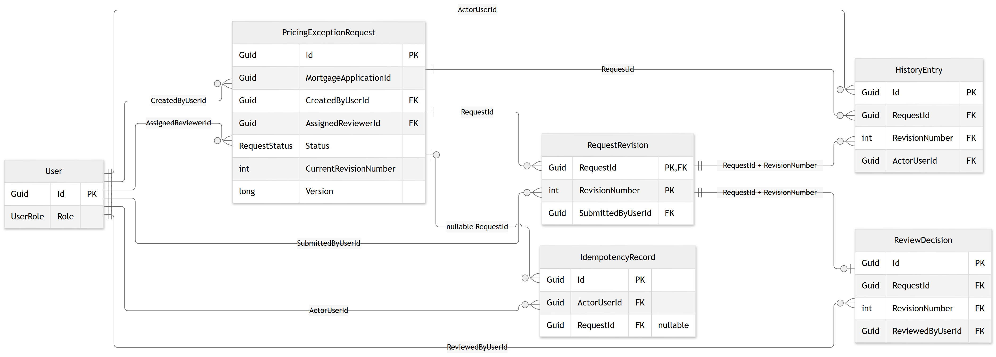
BLUE HARVEST / CURRENT METHOD REFERENCE
Entity relationships remain unchanged
Six persisted entities. The naming refactor changes methods, not tables, properties or constraints.
Code snapshot: 7 November 2026 | Naming refactor; HTTP contracts and database schema unchanged

Slide 22
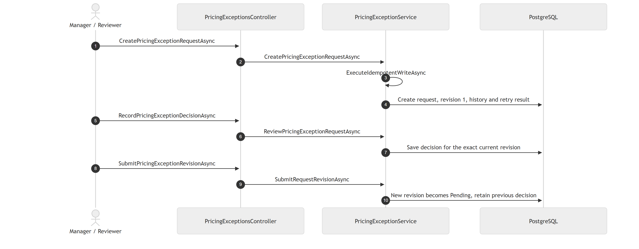
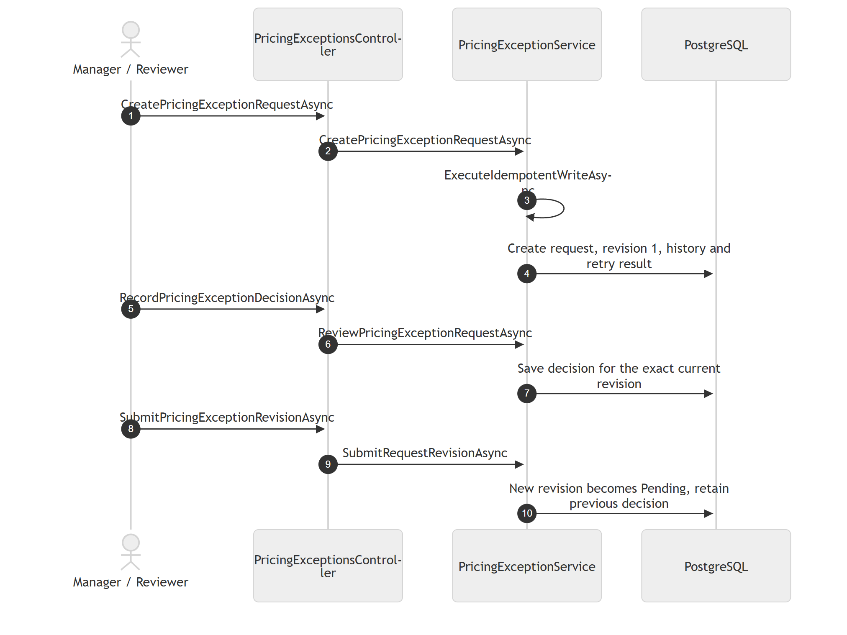
BLUE HARVEST / CURRENT METHOD REFERENCE
Sequence: submit, decide and revise
Current controller actions and service messages; each new revision requires a fresh decision.
Code snapshot: 7 November 2026 | Naming refactor; HTTP contracts and database schema unchanged

Slide 23
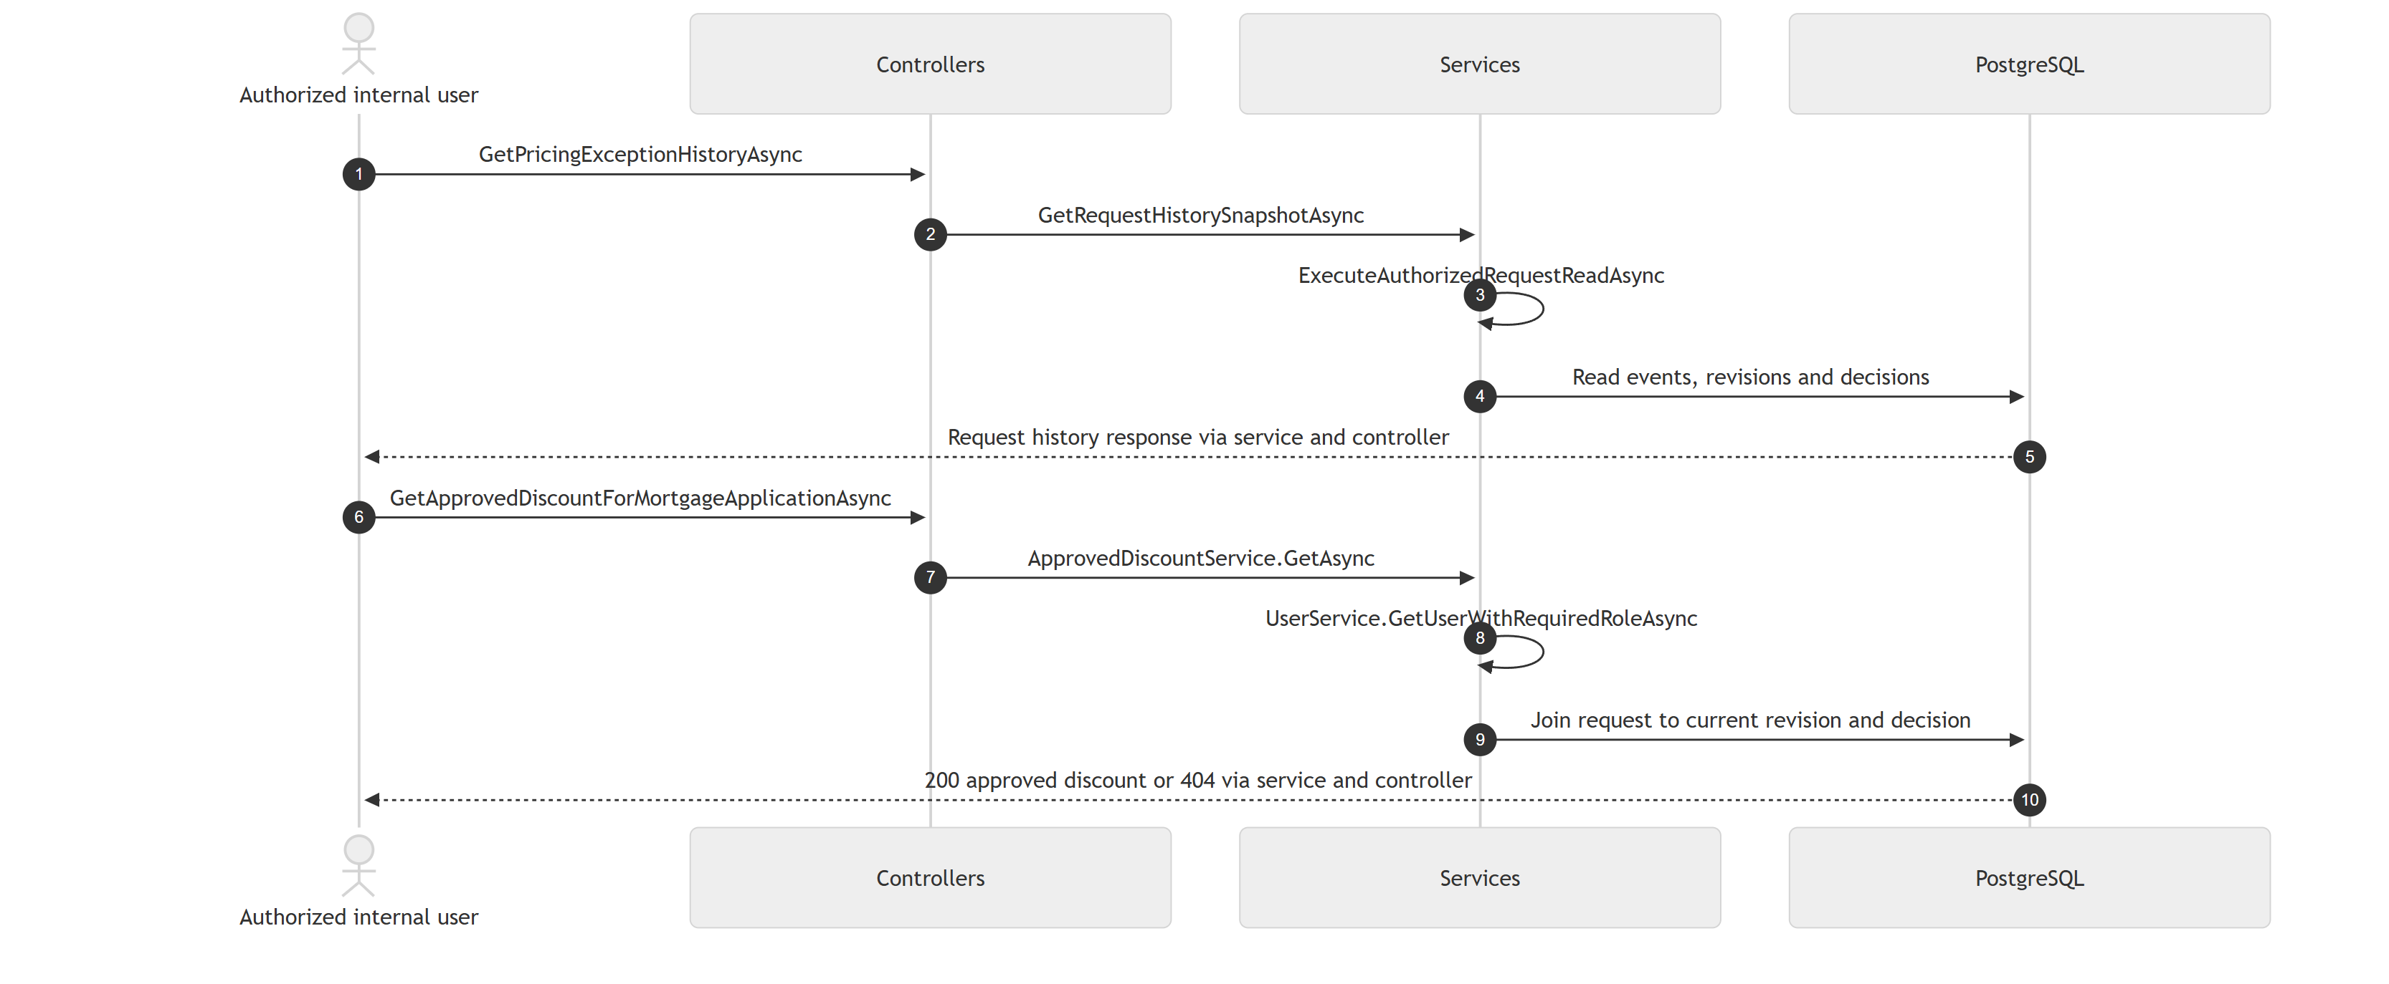
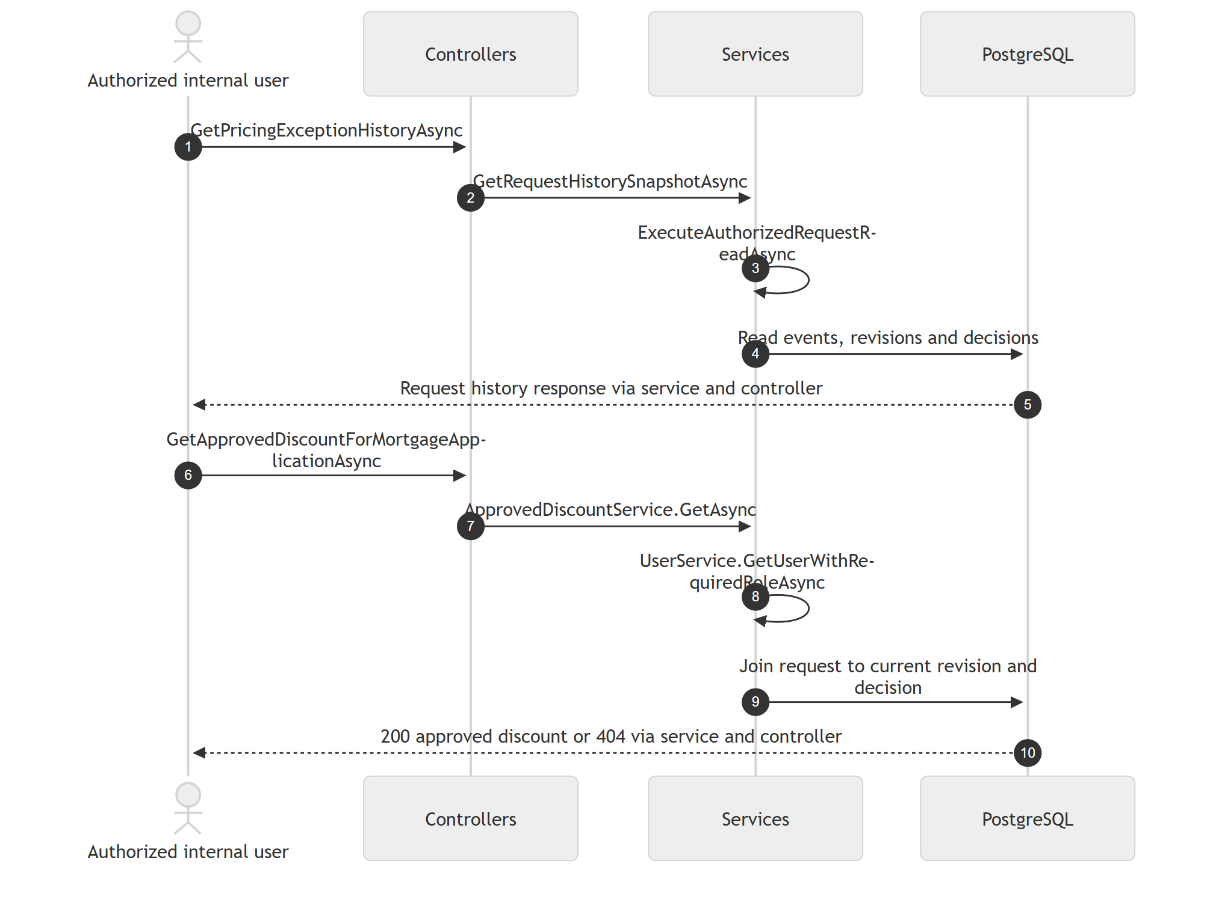
BLUE HARVEST / CURRENT METHOD REFERENCE
Sequence: history and approved-discount lookup
Current read methods retain identity checks, history snapshots and effective-approval rules.
Code snapshot: 7 November 2026 | Naming refactor; HTTP contracts and database schema unchanged

Slide 24
BLUE HARVEST / CAPGEMINI ASSIGNMENT
Thank you
Any questions?
Ferdinand Dinga | 8 November 2026
Live demo: create → assign → decide → inspect history
Notes:
Invite questions and transition to the live demonstration if it has not already been shown. Suggested demo: James creates three requests assigned to David, Emily, and Robert; record two approvals and one decline; inspect actor names, notes and timestamps; retrieve an approved discount; revise it and show that a new approval is required. Use fresh application GUIDs. Be prepared to explain retry keys, version checks, PostgreSQL persistence, development-only identities, and what would change before production.

