Slide 1
SaTScan performance analysis - Executive summary
SaTScan detects ~8 space-time clusters on October 2011 data
Main limit is that reported clusters cannot overlap geographically, whatever the time of the event → Small number of clusters
When parameters vary, only the most significant results are very consistent
  May be different without the non-overlapping constraint
Adding a cluster size bound allows detection of more clusters with more even significance
Ellipse scan performs better than circular but is more expensive
  Computation: Ellipse ~ Circles x 100 on data
  Ellipses fit events better than circles – elongated events on road network
  Results are more significant when ellipse can elongate more – no constraint

Slide 2
0. Experiment design
SaTScan experiment parameters
Time analysis
Time bounds: October
Year / Month / Day / Generic: Day
Aggregation period: 1 Day (minimum)
Cluster
max/min bounds: all time clusters
Adjust day-of-week: No
Spatial analysis
Window shape
Circular
Ellipse
Compactness constraint: none / mid / strong
Cluster size bound / cluster count bound: none / 1km / 0.5km for circular – none / 25k cart.units / 10k for ellipses
Type of analysis
Retrospective/Prospective: Retrospective
Proba model: Space-Time permutation – only one that fits the data
High/Low rates: Low rates
Cluster selection: No geographical overlap whatever the time
Coord system
Lat/Long or Cartesian:
# Replications: 0
Output
Temporal graph for clusters
kml file

Slide 3
SaTScan experiments summary
Name of experiment | Run time PC | Clusters detected | Bound cluster radius (radius km/semi-minor axis units) | Ellipse constraint | Max/Med/Min cluster size rad km / semi-minor k cart. units | Max/med/min semi-major (k cart.units) | Stat score: max/nedian/min | Replicas
graph | 1’09’’ | 6 | NA |  | 2.4/0.8k/0.2 |  | 7500/1200/500 | 0
graph05 | 24’’ | 10 | 0.5 |  | 0.5/0.48/0.2 |  | 4700/2300/1100 | 0
graph1 | 19’’ | 10 | 1.0 |  | 0.94/0.6/0.08 |  | 6700/1500/750 | 0
graph_elp | 2h10’ | 3 | NA | mid | 50/24/10 | 78/71/20 | 9300/7600/600 | 0
graph_elp_10k | 7’ | 10 | 10k | mid | 10/9.5/6 | 50/45/8 | 6300/1400/800 | 0
graph_elp_25k | 25’ | 6 | 25k | Mid | 25/23/10 | 98/72/20 | 9400/900/75 | 0
graph_elp_10k_none | 3’ | 10 | 10k | none | 10/9.7/6 | 50/49/30 | 8500/1950/750 | 0
graph_elp_10k_strong | 7’ | 10 | 10k | strong | 10/9.7/6.5 | 50/20/8 | 5000/1300/750 | 0

Slide 4
Main limit of executable SaTScan: small number of reported clusters
Small number of reported clusters
→ Maximum = 10, down to 3 sometimes
→ Important parts of Manhattan where no event is detected over the whole month
→ Due to “Non-geographical overlap” option only?
→ Actually, test statistic are computed for every point of the grid. It would be possible to report all of them and choose a significance threshold
→ Makes the results difficult to interpret since for each area
Currently, impossible to use SaTScan as an exploratory tool
This version is better to detect the most significant event on a given period

Slide 5
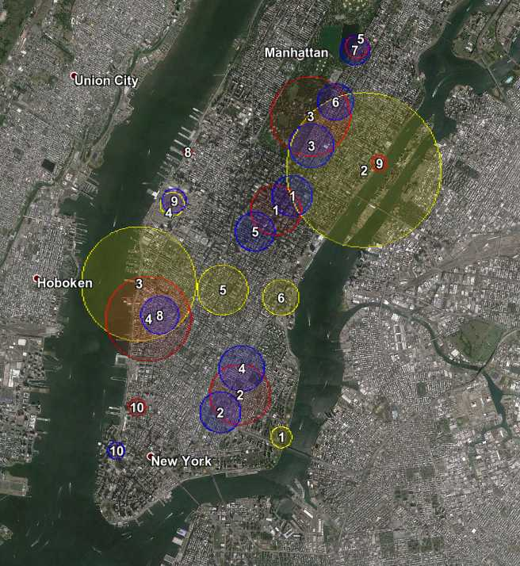
1.1. Cluster size bound - Circular
Significance
→ Increases with cluster size
Max test statistic: 7500 / 6700 / 4500
→ More equally distributed with small size bound
Median test statistic: 1200 / 1500 / 2300
Number of clusters
→ High when small bound (overlap option)
Consistency
→ Overlapping clusters always have same dates
→ Strong consistency 1km / 0.5km
Event Analysis
→ Halloween parade
None 1km 0.5km

Slide 6
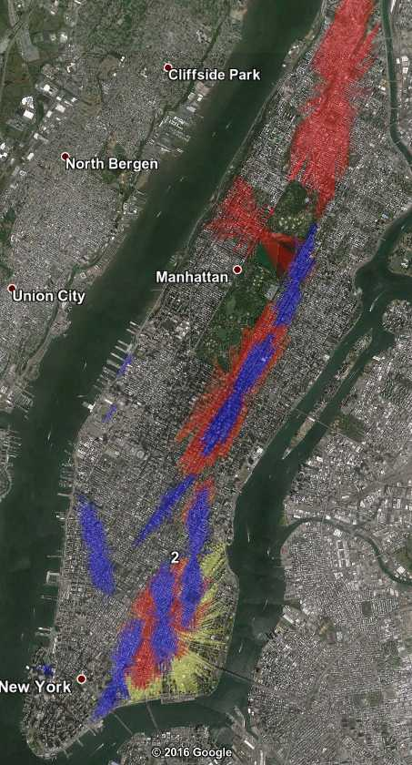
1.2. Cluster size bound - Ellipses
Significance → same as circular
→ Increases with cluster size
→ More equally distributed with small size bound
Number of clusters → same as circular
→ High when small bound (overlap option)
Consistency
→ Overlapping clusters always have same dates
→ Strong consistency for high test significances
Small bound allows to detect a
greater number of clusters of
more even significance
Bound in cartesian units, arbitrary unit
None 25k 10k

Slide 7
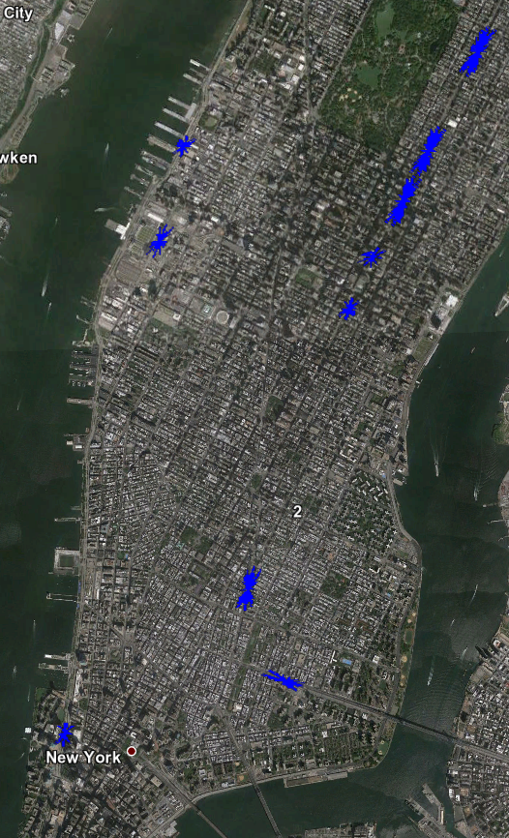
1.2. Cluster size bound - Ellipses
Events are focused on main lowspots
→ Consistent events compared to bigger size bounds
2k units size bound

Slide 8
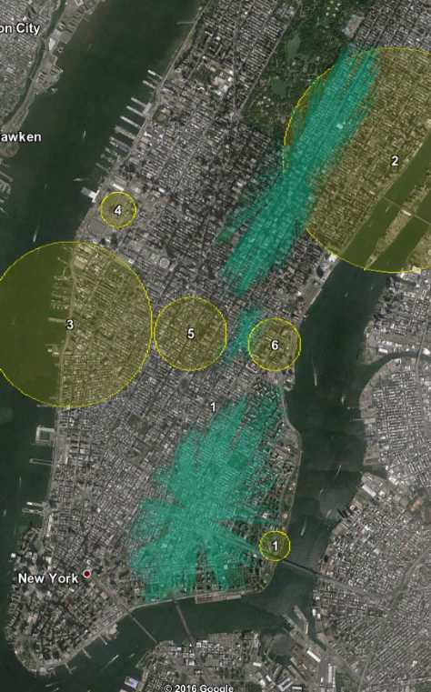
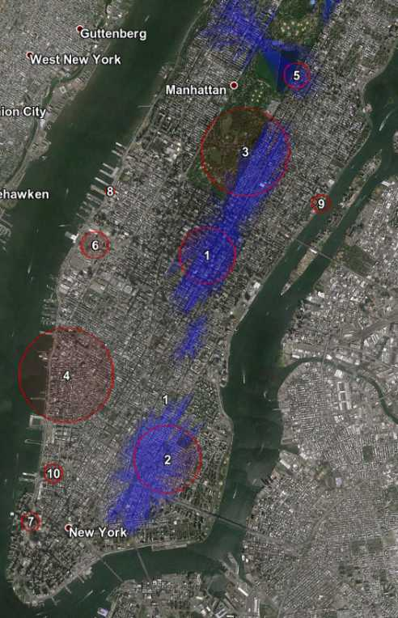
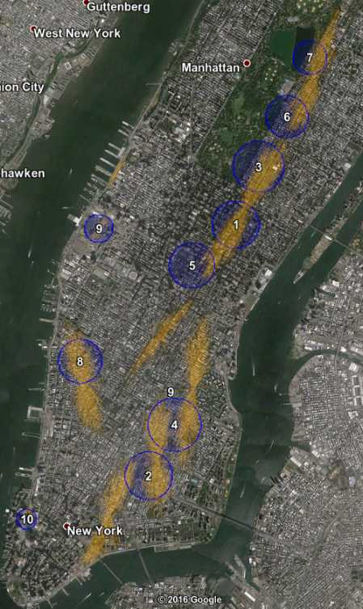
2. Circles vs Ellipses

Slide 9
2. Circles vs Ellipses
Significance
→ Ellipse clusters have ~25% better test statistic
→ More equally distributed with small size bound
Median test statistic: 1200 / 1500 / 2300
Number of clusters
→ Similar
Shape of clusters
→ Flat ellipses are favored, possibly because they fit better the road network
Consistency
→ Quite bad for none or large size bounds
→ Very strong with small size bounds
→ Most overlapping events have same dates
Computation for circles is much cheaper
→ No bound: x120
→ Mid bound: x50
→ Small bound: x30

Slide 10
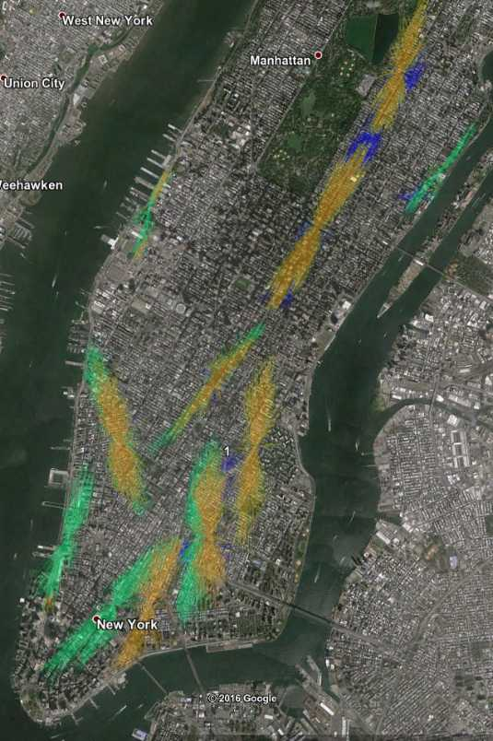
3. Ellipse constraints
Significance
→ No constraint => Most significant
Max test stat 8500 / 6300 / 5000
Number of clusters
→ Similar
Consistency
→ On most significant
→ Two geographical neighbors may have different dates
None Medium Strong

Slide 11
Possible improvements
Increase # reported cluster with overlap options
→ Report clusters which are non overlapping in geography OR time
→ Select manually clusters
Search for more ellipses
→ Add ellipse shapes (flatter)
→ Add ellipse angles
Adjust for day-of-week effect
→ TBD: check if many events are if the week-end
Possible next steps:
1) Get SaTScan source code and adapt it to the problem
2) Look for other techniques → Seem more reasonable at first

Slide 12
No easy event interpretability
None of the detected clusters match a real-life easy to find
event - Parade, demonstration...
Scan | # Cluster | Main st 1 | Main st 2 | Time | Significance | Zone | Event research on the cluster’s dates | Day-of-Week
Elp | 1 | 34th → 75th st | Lexington / Park / Madison | 29 → 30 | 9000 | E.Mid / UES | Not relevant – Central Park Pumpkin Festival | Sat29
 | 2 | E.Bway → 14th st | Bowery → Pitt st | 3 → 6 | 7500 | LES | Not found | Mon3
 | (3) |  |  |  | 500
Elp25k | 1 | 34th → 75th st | Lexington – Park - Madison | 29 → 30 | 9300 | E.Mid / UES | Not found
 | 2 | Canal St → 14th st | Bowery – Allen – Essex | 3 –> 6 | 7300 | LES | Not found | Mon3
 | 3 | 90th → 100th | Madison - 5th – Central Park - Columbus | 8 → 9 | 1100 | UWS |  | Sat8
Elp10k | 1 | 40th → 70th | Lexington – Park - Madison | 29 → 30 | 6300 | E.Mid / UES | Not found | Sat29
 | 2 | Grand – Houston – Delancey - 10th | Essex – Allen - 2nd Ave | 24 → 27 | 3500 | LES/ EV | 24: Grub Street Food - not significant | Mon24
 | 3 | 79th → 96th | Park - Madison | 1 → 2 | 2600 | E.Mid / UES | Not found | Sat1
 | 4 | Bleeker – Christopher – W 14th | 6th → 8th | 24 → 27 | 1800 | Greenwhich/West Village | Not found | Mon24

Slide 13
No cluster match October 2011 NY events
Idea: look for events and then see if they were detected
10: Columbus parade, 5thAve&44th st → 5thAve&79th
31: Halloween Parade, Greenwich village
29: snow storm → OUT, a priori not localized in particular neighborhood
  3 inches of snow in 1 day
  Urgency state in New Jersey, two rail service closed in NY area
Occupy Wall Street
  Sat 8 & Sat 1 in Union Square
  5: 15k demonstrators from Foley Square to Zuccotti Park Wikipedia → NO, different location
  15: thousands protestors from downtown Manhattan to Times Square Armed Forces recruiting station, Broadway? → NO, different location
      http://abcnews.go.com/Business/occupy-wall-street-movement-worldwide/story?id=14743648
No cluster match either of those events

Slide 14
Event research protocol & possible reasons for non-interpretability
Research from detected clusters
  “october DD” “2011” nyc lower east side on Google
  “october DD” “2011” nyc park avenue, etc
  Check 1st page of results
  Nothing found
Research from events
  Occupy Wall Street
  Columbus Parade
  Halloween Parade
    → No match found
Possible reasons for inability to interpret events
  Need to double check the dates: shift?
      Raw file: taxi1110.csv → format dates → Urbane aggregation → Writecounts python = hourly + daily → SaTScan Wizard = import file + aggregation window
      Error in reading dates
      Error in aggregation
        Urbane code
        Python hourly to daily aggregation
        SaTScan count file importation Wizard
        SaTScan hourly to daily aggregation
  Too big spatial window? → New experiments with smaller window
      With smaller window, clusters detected at the centers of previously detected clusters → changes nothing

