Slide 1
Heart Disease Indicator Using Logistic Regression (DS-160 Final Project Presentation)
By: Ferdinand Yeke
DS-160-01 Intro Into Data Science
12/9/2025

Slide 2
Dataset Summary
This a 2020-2022 dataset that gathers information of the respondent’s health conditions, history, and symptoms.
This dataset also came from a CDC (Centers for Disease Control and Prevention) annual telephone survey. This survey took place in the United States of America from 2020 to 2022 in all 50 states.
In this Dataset there are 246,022 adults surveyed (or 246,022 rows) with 40 questions (columns) regarding their health.
These columns to name some of them are about their General health, Physical Health days (days where they don’t feel good), Mental Health Days (days where they don’t mentally feel well), Sleep Hours, Smoker Status, Alcohol Status, Having a Heart Attack, and more.

Slide 3
Research Question
“Can my model predict the potential of heart disease based on HadHartAttack and other important variables like GeneralHealth?”
“Can my model accurately classify the potential of heart disease based on numerical and categorical columns like SmokerStatus, BMI, SleepHours, and the like?”
Classification problems like these are meaningful since it can assist doctors and medical professionals on various factors on what can have an individual being suspectable to heart disease or not, while also doing predictions as well.

Slide 4
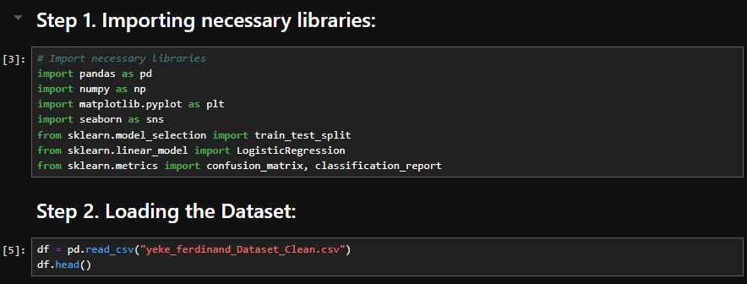
Python EDA (basic overview)
First things first, I had to implement the data in Python with Jupyter Notebook.

Slide 5
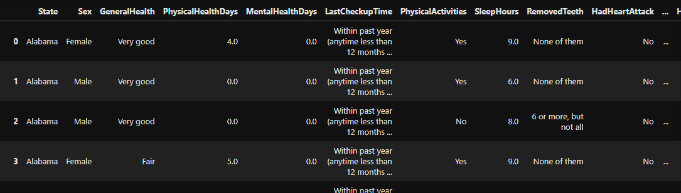
Python EDA (basic overview)
When loading the dataset and seeing the output, the data looks clean. I also did not need to rename ANY of the columns since the columns name looks appropriate enough.

Slide 6
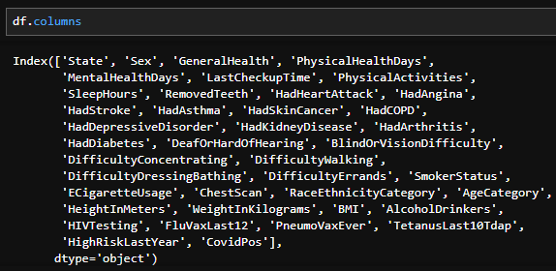
Python EDA (basic overview)
When loading the dataset and seeing the output, the data looks clean. I also did not need to rename ANY of the columns since the columns name looks appropriate enough.

Slide 7
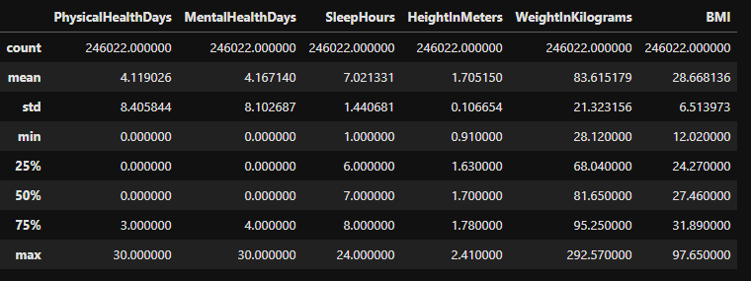
Python EDA (statistics)
So, then I tried to get the statistics of the dataset with .describe()
In these statistics, things that I noticed here is that the mean amount of physical health days (days in which the respondents did not feel good) is at 4 days, same with the mental health days.
The Average for Sleep is 7 hours.
The Max Weight in kilograms is 292.57 (645 lbs.)
The Minimum Weight in kilograms is 83.61 (184.32 lbs.)
The Standard Deviation of BMI is 6.51.

Slide 8
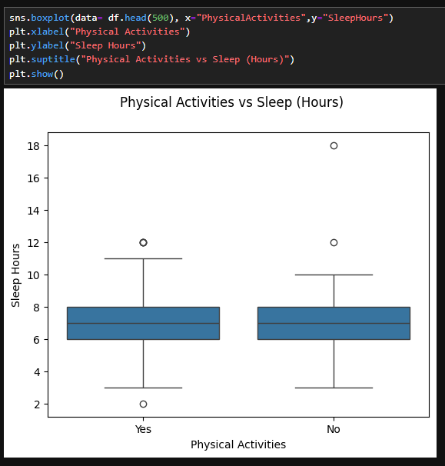
Python EDA (Plots)
In the first EDA Visualization, this will be comparing Physical Activities with Sleep Hours. I decided to use a Boxplot to better see outliers
This is also just using the first 500 rows of the dataset for a brief glimpse of some outliers.
What is interesting in this plot is that with all of the respondents that said No with Physical activities, they seem to have 7 hours of sleep or lower, while respondents with Yes have more than 7 hours of sleep.

Slide 9
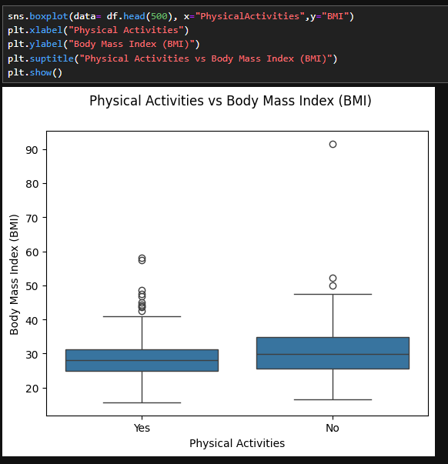
Python EDA (Plots)
Like with the first, this is also a boxplot visualization with a dataset row limit of 500.
This plot is comparing the Physical Activities by Body Mas Index (BMI).
The respondents that said Yes for Physical activities had an average BMI at around the high 20s.
The respondents that said No for Physical Activities had an average BMI at the low 30s.
Outliers?

Slide 10
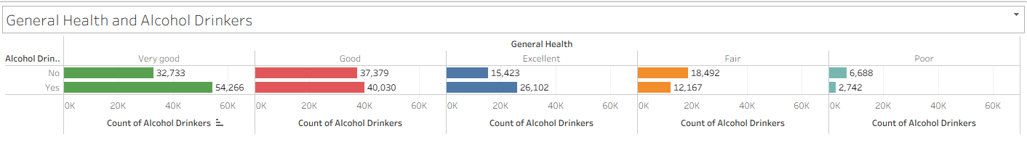
Tableau Graph Visualizations
This first Tableau graph visualization compares General Health by Alcohol Drinkers.
In the “Very Good Sector”, there is a lower count of people that did not drink compared to the ones that do (No= 32,733; Yes= 54,266).
In the “Good” Sector, there is a very close count of people that did not drink compared to the ones that do (No= 37,379; Yes= 40,030)
In the “Excellent” Sector, there is an extremely low count of people that did not drink compared to the ones that do (No= 15,423; Yes= 26,102)
In the “Fair” Sector, there is a very high count of people that did not drink alcohol compared to the ones that do. (No= 18,492; Yes= 12,167)

Slide 11
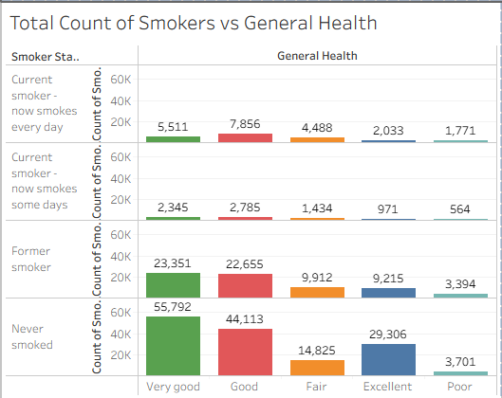
Tableau Graph Visualizations
The second Tableau visualization compares the Total Count of Smokers by General Health.
In the “Never Smoked” Sector:
  55,792 respondents reported having “Very good” heath.
  44,113 respondents reported having “Good” health.
  14,825 respondents reported having “Fair” heath.
  29,306 respondents reported having “Excellent” health.
  3,701 respondents reported having “Poor” health.
There is more respondents with poor health in the “Never Smoked” Sector than the Current Smoker sectors.

Slide 12
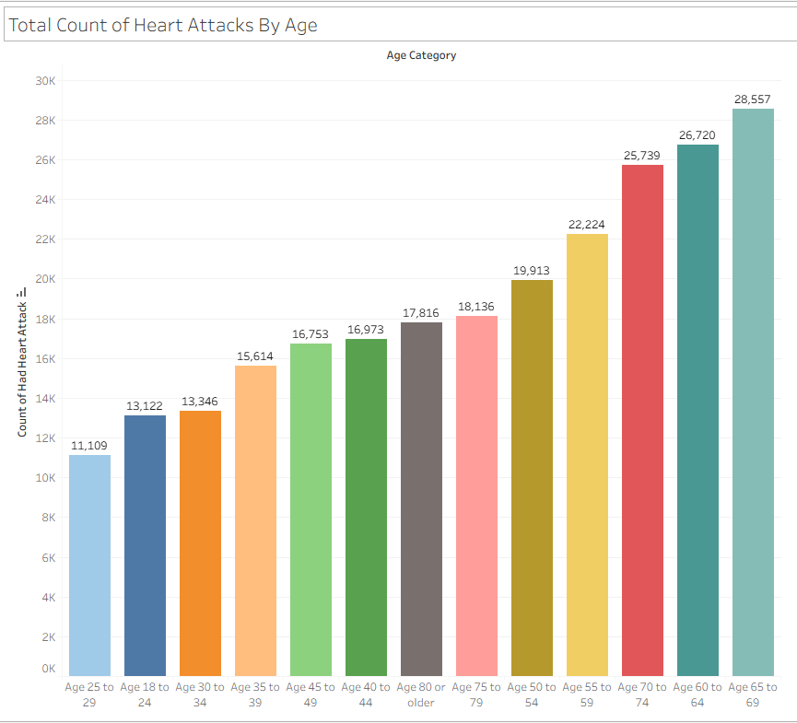
Tableau Graph Visualizations
In the Third Tableau Visualization, this is the Total Count of Heart Attacks By Age.
The Ages between 65 to 69 seems to have the most amount of heart attacks in the entire dataset. (Age 70 to 74 & 60 to 64 are also following suit).
The concerning thing seen in this dataset is seeing younger adults suffer for heart attacks at all. Even when that age demographic has the lowest count here, it is still concerning.

Slide 13
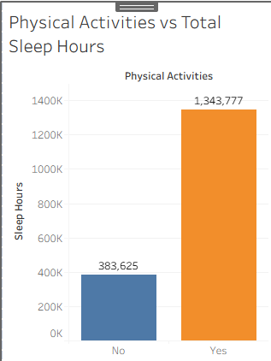
Tableau Graph Visualizations
In the Fourth Tableau Visualization, it compares Physical Activities by Total Sleep Hours.
In this, respondents that responded doing regular activities in total had more sleep time compared to those who don’t.
This shows that most of the respondents also have a good sleep schedule.

Slide 14
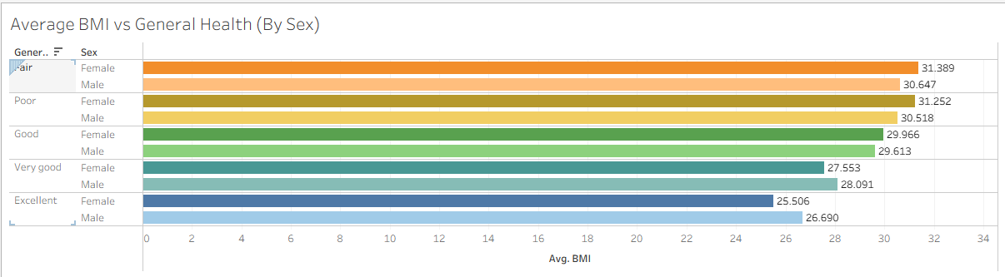
Tableau Graph Visualizations
In this Fifth and final Tableau Visualization, this compared the Average BMI by the General Heath (By Sex).
In the “Excellent” Sector, the average BMI is 26.690 from Male respondents, and 25.506 for Female respondents.
In the “Very Good” Sector, the average BMI is 28.091 from the Male respondents, and 27.553 from the Female respondents.
In the “Good” Sector, the average BMI is 29.613 from the Male respondents, and 29.966 from the Female respondents.
In the “Fair” Sector, the average BMI is 31.389 from the Female respondents, and 30.647 from the Male respondents.
In the “Poor” Sector, the average BMI is 31.252 BMI from the Female respondents, and 30.518 from the Male respondents.

Slide 15
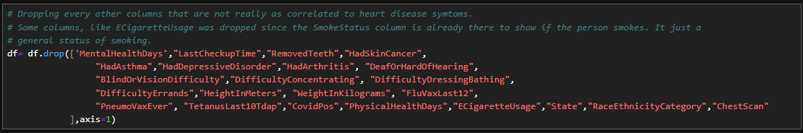
Model Training Summary
Columns that I decided to drop:

Slide 16
Model Training Summary
Columns that are converted into dummy columns:

Slide 17
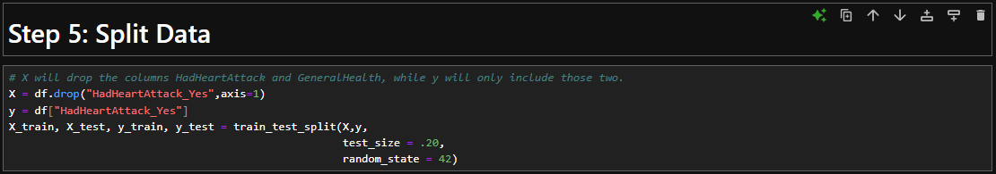
Model Training Summary
After making the dummy columns and dropping some columns, I then split the data and done a train/test split on it.
Also, the parameters for the test_size is set to .20, while random_state is set to 42.

Slide 18
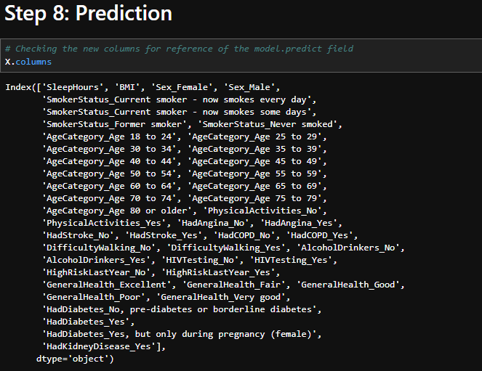
Model Training Summary
Results of columns (for X):

Slide 19
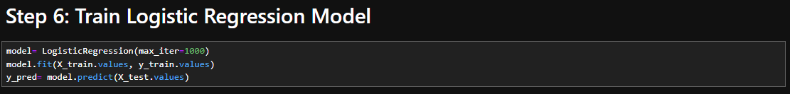
Model Training Summary
After that, I then trained the model on that split:

Slide 20
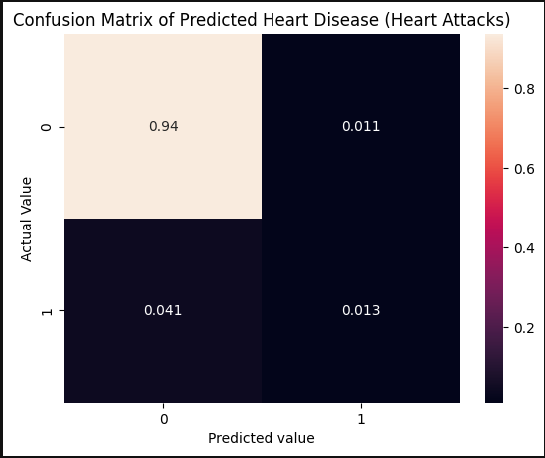
Confusion Matrix
This is the normalized confusion matrix.
In the true negatives, it predicted that 94% haven’t had heart disease, and it was right.
In the False Positives, it predicted that 0.01% had heart disease, and it is wrong.
In the False Negatives, it predicted that 0.04% haven’t had heart disease, which it is wrong. In the True Positives, it predicted that 0.013% had heart disease, and it is right.

Slide 21
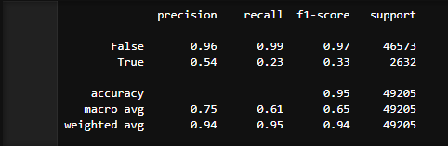
Accuracy Metrics
The Precision, Recall, and F1 Score of the Model
The precision score of this model is at 0.96 for false, and 0.54 for true.
The Recall score of this model is at 0.99 false, and 0.23 for true.
The F1-Score of this model is at 0.97 false, and 0.33 true.
The total accuracy from all of this is 0.95.
  Based on this, this might seem good for people in the medical field, and for a model on medical data, this seems good.

Slide 22
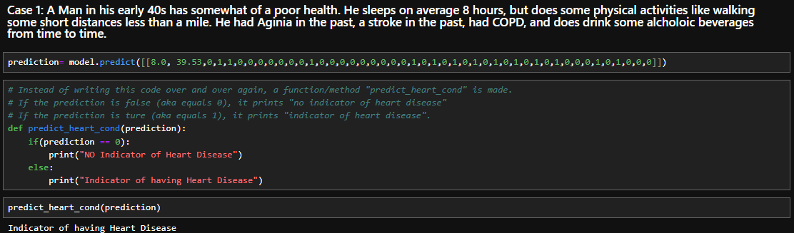
Key Insights
When doing predictions like with example cases of a person of poor health, it seems that factors such as high BMI, lack of physical activities, having Angina, a Stroke, COPD, smoking and drinking can raise the indication of a person having heart disease.

Slide 23
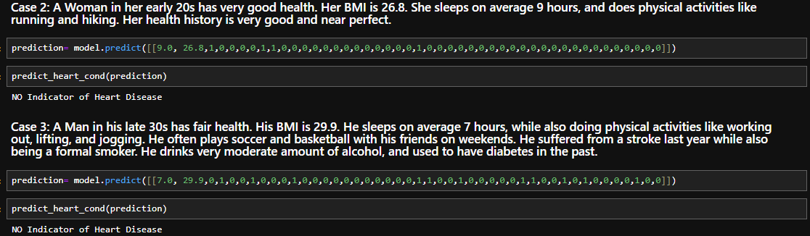
Key Insights
Also, if a person has lack of problematic heath problems, or health problems that can be worked on while not being too severe, it decreases the indication of heart disease.

Slide 24
Conclusion
The model performed very well with predictions and accuracy score.
What could be improved more with this dataset is just having slightly more data for respondents that do have cases of health background that may be a higher indicator of heart disease
Even with the suggested improvement, to me it seems enough with 246,022 respondents. But more information, the better figuring out the many causes that can lead to heart disease and helping not just the individual, but everyone.

Slide 25
Sources
Dataset: Indicators of Heart Disease (2022 UPDATE)
Medical Sources: Centers for Disease Control and Prevention | CDC
The world's best hospital - Mayo Clinic

