Slide 1
AI on Your Existing BI Backend
Natural-language answers, reports and recommendations for business users, on the data assets you already own
Generic playbook · Cloudera · 2026
Notes:
开场。客户看了demo后有尽快推进的意向(方向已定)。今天讲PH1(AI基座)提案+三阶段路径。

Slide 2
Shared Needs and Pain Points (Same Across Domains)
Typical scenarios
Common pain points
Expected interaction & output
Marketing
Revenue Q&A and insights, extensible to orders and opportunities
Too many dashboards and metrics; the numbers you need are hard to find
Natural-language Q&A · PC + mobile · charts / reports
Finance · Service
Revenue Q&A and forecasting, ticket Q&A and failure prediction
Traditional BI delivery is slow and rigid, cannot respond quickly
Guided dimension / metric filtering · conversation history
Quality · Ops
Chart generation, insight reports, root-cause analysis, forecasting
No anomaly insight or root-cause analysis; recommendations stay manual
Domain analysis reports · charts / PPT
Every domain converges on the same ask: drive existing data assets with natural language, start with accurate answers, then grow into insight and recommendations.
Notes:
三入口一架构。

Slide 3
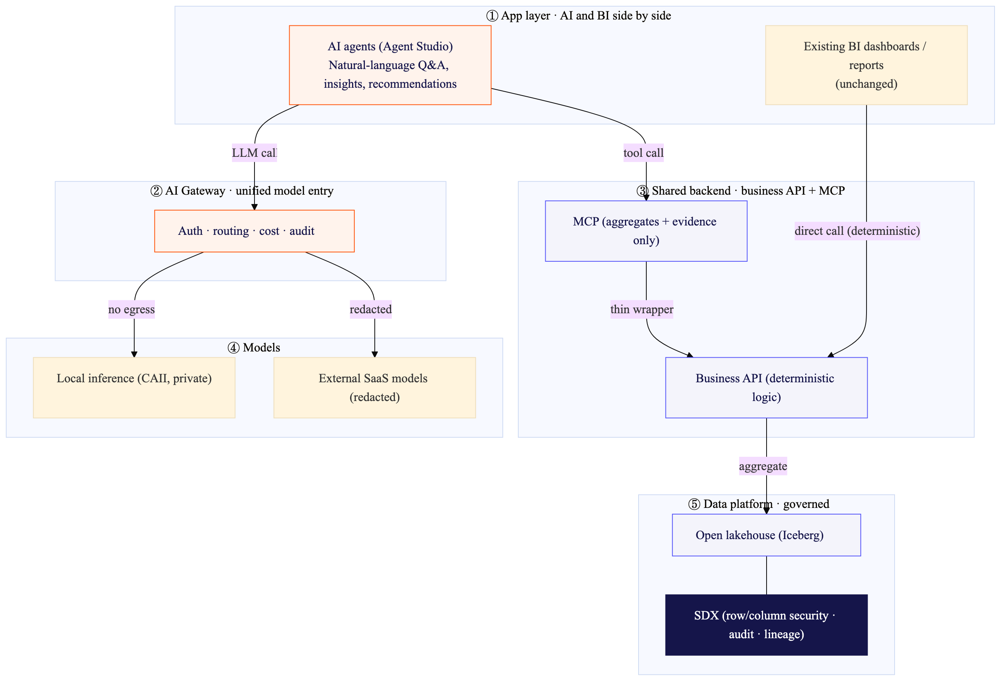
Target Architecture: AI and BI Share One Backend
BI calls business APIs directly (deterministic); AI calls the same APIs via MCP, on the same governed data platform
Notes:
图2 在图1上叠 BI 前端(App Service)。

Slide 4
Three Paths to Reuse Existing Assets (3 Entries, 1 Architecture)
Starting point
How it works
Correctness / notes
P1
Existing BI reports (PowerBI etc.)
Extract metric logic (DAX / SQL), reproduce on the platform, wrap with MCP
Reconcile against production reports (100% machine-verified)
P2
Existing backend APIs
Thin MCP wrapper over existing backends, returns JSON directly
Production is ground truth; correctness guaranteed
P3
New development
Define metric semantics, build the API, wrap with MCP
Defined from scratch; needs business alignment
All three converge on a business API plus a thin MCP wrapper, only how the API is obtained differs.

Slide 5
Governed and Trusted: Accurate, Secure, Auditable
Existing BI keeps running; AI adds a natural-language layer on the same governed data
Trusted answers and compliant data access, guaranteed by design and platform capabilities.
① MCP returns aggregates only (data egress): row-level raw data never leaves the platform, PII never gets out (strongest)
② Execute as the user (doAs + Ranger): row and column permissions enforced per person, management-tiered access works out of the box
③ Reconciled with production reports (accuracy): reproduced logic is machine-verified, production is the ground truth for answer accuracy
④ Evaluation and audit (traceable): every question is logged and replayable, evaluate before you trust, audit-ready
Notes:
治理=PII三道防线。

