Slide 1
Cloudera AI
Building Your Centralized Private-AI Platform
Zhong Qishuai

Slide 2
AI-ready Platform

Slide 3
The AI Landscape is Broad — Private AI is Your Stronghold
2023
2024
2025
2026
FOUNDATION
EXPANSION
MATURITY
THE FRONTIER
First LLM deployments
Basic cluster setup
System integration
RAG at scale
Multimodal (VLM)
First agents
Reasoning agents
Deep data & API integration
Fine-tuning at scale
Self-evolving agents
Ontology-grounded reasoning
Centralized AI infra & governance
INCREASING AUTONOMY
→
Notes:
If you zoom out, the last four years tell a very clean story — a story of increasing autonomy. In 2023, it was all about foundations: standing up your first LLM, getting a cluster running, basic integration. In 2024, we expanded — RAG went mainstream, models became multimodal, and we saw the first real agents. In 2025, complexity arrived: reasoning agents, deep integration into data and APIs, fine-tuning at scale. And now, in 2026, we're in the autonomy phase — self-correcting loops, MCP and 'computer use,' and a new discipline called context and harness engineering. The key insight: every single year, we've handed the system more autonomy. 2026 is the tipping point where the agent stops being a helper and starts being an operator.

Slide 4
The Agentic Shift — and the Inference Bill
Agents don't just change what AI does — they change what AI costs. Three numbers every platform owner should know.
56%
CIOs put run-cost first
Enterprise CIOs cite raw run-time cost as primary LLM criterion
Today's token prices are heavily VC-subsidized
Bubble bursts as vendors face IPO margin pressure
30×
Agents multiply compute
39%
Racing to capacity control
Testing local, on-prem open-weight model hosting
Securing capacity and cost control early
Taking proactive steps before token pricing flips
Cost per run jumps from ~$0.04 (chat) to ~$1.20 (agentic)
Over 75% of run cost is driven by input tokens
Tool calls re-send the entire growing context window
Agentic AI is an economics game — whoever controls inference cost and capacity, controls AI scale.

Slide 5
Anatomy of an Enterprise Agent Harness
Every advanced pattern — deep research, computer-use, self-evolving loops — is assembled from the same blocks.
THE AGENT LOOP
PLAN
REASON
ACT
OBSERVE
ITERATE
Reasoning Core — the LLM
System Prompt & Persona
Tools & MCP Servers
Private-hosted open-weight or frontier API. Swappable without rewriting the agent.
Role, goal, backstory and policy instructions per agent — versioned like code.
The agent's hands: data queries, APIs, actions — governed tools via MCP.
Memory & Context
Guardrails & Policy
Deploy & Marketplace
Session state, retrieval, enterprise knowledge — what the agent remembers.
Input/output safety enforced inside the loop, not bolted on per app.
Publish agents as endpoints — reusable lego blocks other teams assemble.
The platform question is not “which model” — it is which of these blocks you get out of the box, governed.

Slide 6
Models Are Commoditized: Your Data Isn't
If your AI strategy relies entirely on public model capabilities, your competitive differentiation is effectively zero.
“We've built a super AI system locally because I'm just not confident to share that conversation. It turns out the most valuable IP to me are my questions. The answers are a commodity.”
— Jensen Huang, Cisco AI Summit 2026
Commoditized: model capability
Unique: your data & your platform
Everyone can rent the same frontier models with the same APIs, benchmarks, and answers.
Model choice alone differentiates no one.
Proprietary, longitudinal data and its governance provide the only sustainable advantage.
High-fidelity, well-governed data wins.
So the strategic question for IT: where does AI meet your data: in someone else's cloud, or on a platform you own?

Slide 7
Three walls stand between you and agents at scale
Agents don't just change what AI does. They expose three problems that compound each other.
30×
Cost: out of your hands
Cost jumps 30x (~$0.04 to ~$1.20 per run)
75% of cost is input tokens re-sent each call
Dependent on temporary subsidized vendor pricing
1
Shadow AI
Governance breaks at scale
BUs build agents without IT visibility or audit
IT cannot approve unmonitored AI activity
Leads to systemic platform failure, not innovation
2
Your data
The real moat: unreachable
Proprietary data is your only real differentiator
Without safe data access, agents remain generic
Security barriers block connection to models
3
Fix one wall and the other two still block you. You need one answer to all three.

Slide 8
From adding pieces to building the platform
The platform absorbs what you already built: your tools, RAG apps, MCPs, data. It doesn't replace them. It connects them.
INPUT
PLATFORM
OUTPUT
What you bring
Cloudera AI
What you get
Your proprietary data
Existing tools, RAG apps & MCPs
Business teams who want to build
Private inference
Unified tools catalog
Connected data
Platform-enforced guardrails
Governed agents in production
Shared reusable blocks
Full cost & capacity control
IT runs the platform. The business builds on it.

Slide 9
Chapter 1: Own your cost & capacity
When agents multiply your compute 30×, the difference between renting inference and owning it determines whether you can actually scale.
Private
Host models inside your perimeter
Frontier or open-weight models
Hosted in your infrastructure
No data leaves your perimeter
No external pricing controls
Swappable
Change models without rewriting agents
Models as swappable components
Upgrade as benchmarks shift
Zero application rewrites
Efficient
Autoscaling inference, no idle waste
Scales up on load, down at rest
Pay only for what you run
Complete ownership of your runs
Agentic AI is an economics game. Whoever controls inference cost and capacity, controls AI scale.

Slide 10
Chapter 2: Unify what you already own
Your tools, RAG apps, MCPs, and data, unified on one platform.
“We've built a super AI system locally because I'm just not confident to share that conversation. It turns out the most valuable IP to me are my questions. The answers are a commodity.”
Jensen Huang, Cisco AI Summit 2026
Your tools, RAG apps & MCPs
Your data → connected knowledge
Transform tools, RAG apps, and MCPs into governed, reusable blocks.
Enable secure, standardized access for all authorized agents.
Eliminate duplicate development and isolated experiments across teams.
Unify proprietary data into an active, connected knowledge layer.
Enable agents to reason with deep semantic context and relationships.
Ground agent actions with trusted facts instead of basic document retrieval.
Your scattered experiments stop being dead ends. The platform makes them reachable, not replaceable.

Slide 11
Chapter 3: Govern it, and prove it
IT can't say yes to what it can't see. Three questions, each answered at the platform level, not per-app.
1
2
3
Who can use AI, and how?
What can AI say?
Can you prove what it did?
Role-based access & project isolation
Every AI asset strictly governed
Shadow AI blocked at platform level
Platform-level agent guardrails
Content filters & PII masking
Automated LLM safety judges
Full trace of steps & tool calls
Agent evaluation before trust
Post-shipment monitoring
Built into the floor. Not a policy PDF.

Slide 12
The hard 20%: Applied AI builds it with you
Forward Deployed Engineers work alongside your centralized AI team: on your data, in your environment, on two fronts.
Solutions on your data
Platform frontier co-build
· Example: Financial crime detection: graph + agents on the lakehouse
· Domain-specific agentic workflows on proprietary data
· High-ROI solutions built directly on your data, in weeks
High-ROI problems → deployed Private AI solutions.
· Knowledge & ontology layer
· Centralized vector DB & agent memory
· MCP gateway & new MCP servers
· Agent self-evolvement tooling
The frontier pieces an Enterprise IT / Data Department wants to own.
Cloudera gives you the platform. Applied AI makes it yours.
Notes:
Divider. Everything after this is optional; pick based on the request form's audience/industry.

Slide 13
Key Evolvement: Data → Knowledge → Action
Data together is not knowledge connected. Knowledge without write-back is not automation.
DATA
the platform holds it
Structured, unstructured & multimodal, unified on one open lakehouse (Iceberg)
One governed copy, no egress — solves “where is my data”
KNOWLEDGE
the semantic layer
Taxonomy (clean hierarchy) · Ontology (objects, relationships & actions, defined once)
Entity resolution across systems: equipment → component → spare part → vendor
VALUE · AUTONOMY
ACTION
the differentiator
Write-back to SAP, ticketing & plant systems — not read-only
Every action carries a chain of evidence for audit
How Applied AI builds it: use-case-first, model only the schemas one use case needs · validation quality follows knowledge quality · autonomy earned in grades
The moat is not the model. It is your data connected into knowledge the agent can act on, safely.

Slide 14
Autonomous Fault Diagnosis on Your Data
Example: From one alarm to a root-cause decision, evidence attached. All on your data, no egress.
01 · INGEST
Alarm
“Power amplifier overheating” arrives on a Kafka topic and triggers the agent pipeline
02 · SOP AGENT
Hypotheses
Retrieves the version-correct equipment manual and lists five candidate causes
03 · CORRELATION AGENT
Context
Temporal + spatial: past alarms on similar models; is the connected fan also alarming?
AGENT FLOW
04 · DIAGNOSIS AGENT
Verify & eliminate
Image via MCP looks normal — rules a cause out
Fan alarmed yesterday at reduced speed; temperature rising since — fan confirmed
RESULT
Root cause + evidence
The fan is the root cause. Recommendation written back to ticketing, every data point compiled into a chain of evidence.
Multimodal data plus a connected knowledge layer turns a raw alarm into a trusted, auditable decision, on your data.

Slide 15
Autonomous Gate Review on Your Data (R&D Example)
Example: From a program at release gate to an auditable PASS / CONDITIONAL / FAIL decision—all on your data, with no egress.
01 · INGEST
Program enters gate
The PACK-ATLAS-01 battery-pack program enters the release gate, triggering a five-agent review
02 · ENGINEERING AGENT
Coverage & test verdicts
Builds the traceability matrix—one requirement lacks a test plan; thermal test is MARGINAL at +3% margin
03 · RISK & COMPLIANCE
Scores & standards
The design-risk model flags thermal as HIGH; checks coverage for UN 38.3 · GB 38031 · IEC 62660
GATE REVIEWFLOW
04 · KNOWLEDGE REUSE
Historical validation
Retrieves PACK-ORION-00 thermal design image + test report (historical FAIL)
That failure corroborates HIGH risk + MARGINAL testing—confirming the concern
RESULT
Recommendation + evidence
CONDITIONAL—computed by traceability.decide(); findings form an evidence chain for human review.
A deterministic core plus a connected knowledge layer turns raw program data into a trusted, auditable gate decision—on your data.

Slide 16


Can the New Battery Design Pass the Gate Review?
A vehicle NPI prototype built and running in Cloudera AI Workbench, turning engineering data, ML risk and historical knowledge into auditable materials for human review.
BUSINESS QUESTION
Can PACK-ATLAS-01 be released?
01 INPUT
02 ANALYSIS
03 OUTPUT
Program facts
ML + Agentic AI
Auditable review package
• Design requirements & parameters
• BOM & supplier data
• Current & historical DVP&R results
• Historical design images & reports
• Deterministic test bench & traceability
• GBM design-risk scoring
• 5 specialist agents gather evidence in parallel
• Lance multimodal knowledge retrieval
• PASS / CONDITIONAL / FAIL
• Risks, gaps & standards coverage
• Cited evidence & narrative summary
• Human approve / condition / reject
Code decides. The LLM narrates.

Slide 17
End-to-End Architecture | Two Paths, One Decision
Engineering apps and agents call the same governed data and APIs; every score, test verdict and recommendation is reproducible.
ENGINEERING DATA
DETERMINISTIC ANALYTICS + ML
AGENTIC AI ORCHESTRATION
REVIEW OUTPUT
PACK-ATLAS-01
Test bench + traceability matrix
5 specialist agents
80% coverage · Thermal test MARGINAL
Requirements
Design parameters
BOM / suppliers
Test plans & results
Coverage
LLM writes the review narrative
Text only
Test Verdict
GBM design-risk model
Compliance
Human final decision
Approve / condition / reject
Predictive risk · explainable feature contributions
Design Risk
Knowledge Reuse
Iceberg / SDX
Lance: text + images + reports + metadata
Query · evidence · synthesis
Two independent signals corroborate: ML predicts HIGH + test measures MARGINAL → code returns CONDITIONAL.

Slide 18
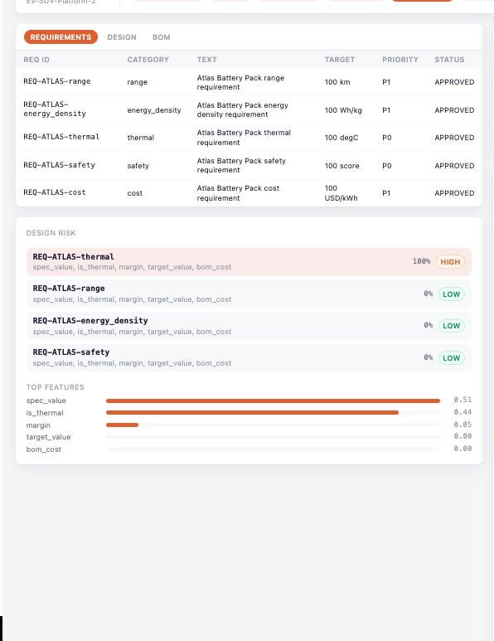
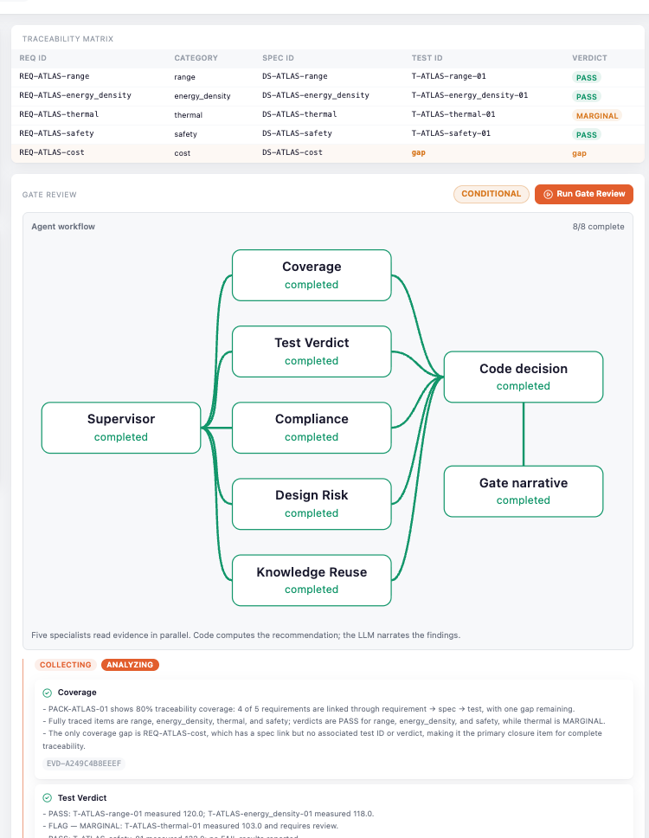
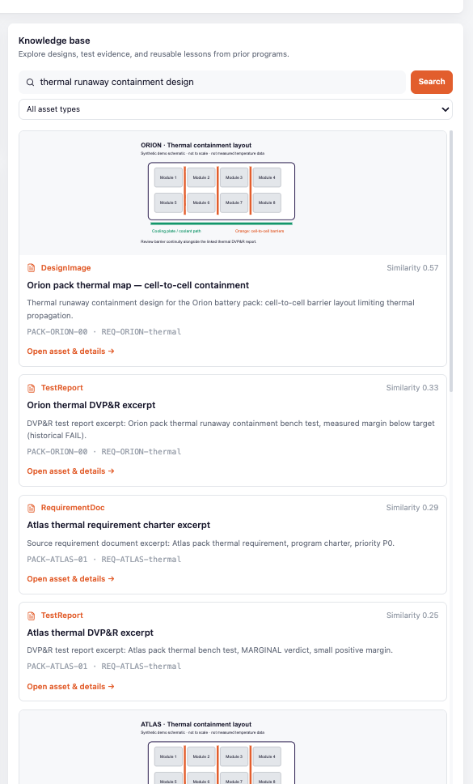
Risk, Evidence and Decision—Aligned on One Screen
Move left to right: start with ML risk, verify independent test evidence, then reuse historical multimodal knowledge.
01
ML PREDICTIVE RISK
02
ENGINEERING EVIDENCE
03
KNOWLEDGE REUSE
Thermal requirement scored HIGH
Thermal test MARGINAL · 80% coverage
Lance retrieves historical images and test reports
Talk track: ① ML surfaces predictive risk → ② tests and traceability provide independent facts → ③ the knowledge base adds historical context → click Run Gate Review

Slide 19
Gate Review | Five Agents Gather Evidence; Code Decides
Agents query, explain and cite evidence; the decision function reads deterministic results only. The LLM never scores or controls the flow.
Coverage
Coverage & gaps
traceability.decide()
Evidence package
Test Verdict
DVP&R verdicts
CONDITIONAL
Run Gate Review
Structured findings
Source IDs
Parameters & thresholds
Evidence hashes
SSE live updates
Compliance
Standards coverage
LLM
HUMAN
Design Risk
ML risk explanation
Writes narrative
Final decision
Knowledge Reuse
Historical multimodal evidence
Same input = Same result
Every recommendation can be replayed to its source data, thresholds, model version and cited assets.

Slide 20
One Prototype, Four Reusable Capabilities
From engineering data to a human gate decision: traditional ML, Agentic AI and multimodal knowledge indexing work together in one Cloudera AI application.
01
02
03
04
DATA & ENGINEERING KNOWLEDGE
TRADITIONAL ML + GEN AI
MULTIMODAL KNOWLEDGE INDEX
AGENTIC COLLABORATION & GOVERNANCE
Requirements · design parameters · BOM · tests
End-to-end traceability & gap detection
One API for real PLM / MES / ERP
GBM scores risk per requirement
Agents explain model and engineering evidence
The LLM is swappable and never changes decisions
Lance indexes text, images and reports
Ontology links programs, requirements, tests and assets
Past experience is searchable, citable and reusable
5 specialist agents gather evidence in parallel
SSE live flow + hashed evidence records
Template fallback + human final decision
Production path: replace synthetic data with enterprise sources and the production model registry; retain the API, agent workflow and frontend experience.

Slide 21
IT runs it. The business builds on it.
GA today
In progress / roadmap
Applied AI co-build
Three chapters, one platform: own your cost, unify what you have, govern & prove everything.
CH 1 · OWN YOUR COST
Private Model Hosting & Serving
in your perimeter, GPU-efficient
CH 2 · UNIFY WHAT YOU OWN
CH 3 · GOVERN & PROVE
Governance & Audit
access · lineage · evidence
01
Seamless Upgrade & Switch
registry · CICD integration
12
02
Guardrails & Safety
enforced, not goodwill
Hybrid Deployment
cloud · on-prem · air-gapped
11
03
Evaluation & Proof
eval before you trust
Agent-Ready
Enterprise AI
the platform IT runs
Cost & Quota Management
private AI· token budgets
10
04
Usage Monitoring & Tracing
full traces, no sampling
Low-Code Agent Builder
BUs assemble agents visually
09
05
Data Ready for Agents
knowledge + memory agents query
08
06
Tools & MCP Catalog
governed tools, one MCP gateway
07
For Business Units · build & self-serve
Agent Marketplace
lego blocks: publish once, reuse everywhere
On Open Data Lakehouse · Iceberg · your private data
©2026 Cloudera, Inc. All Rights Reserved.

Slide 22
Journey of Adoption of AI with Cloudera AI

Slide 23
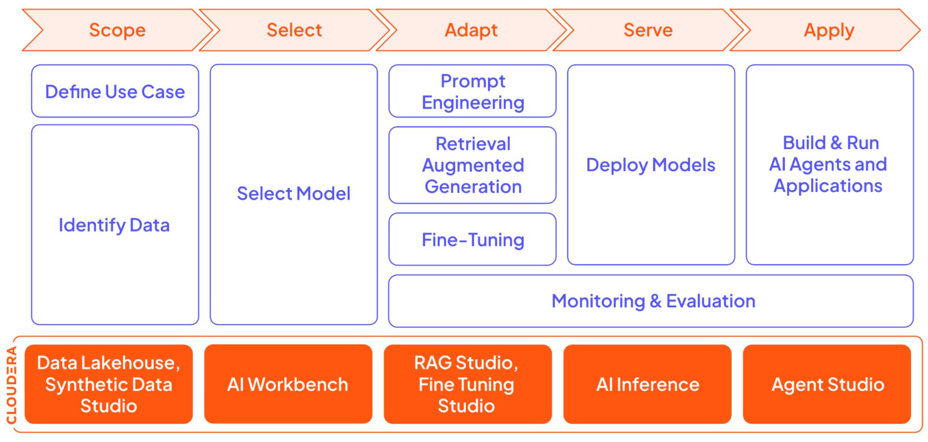
One Lifecycle for Adopting AI
Scope → Select → Adapt → Serve → Apply — one spine behind every GA capability on the map

Slide 24
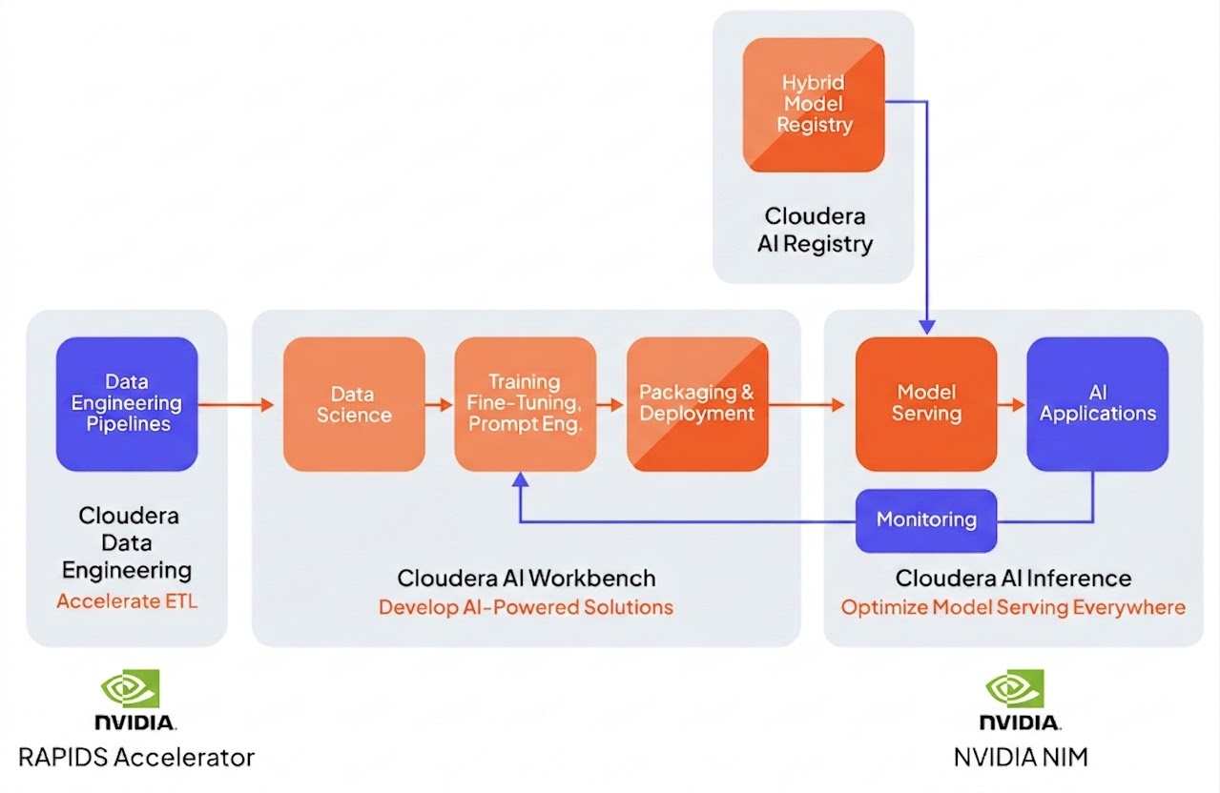

Private AI Inferencing — Enterprise Model Serving
Private model hosting · low-latency serving · NIM / Triton / vLLM — a few clicks for SOTA Open-source models
Huggingface
Make the Decision
Containerization
Copilot
Evaluation
AI Solutions
Security First
Agentic Workflows
CI/CD Integration
Cloudera
AI Assistants
Observability

Slide 25
AI Registry → CICD: Seamless Model Upgrade & Switch
Push weights to Registry; deploy to CAII / Workbench PROD via CICD with env segmentation and human sign-off
Development Env
CI/CD Orchestration
Production Env
MLOps Engineer & DS
Github Action Webhook /
GitLab CICD Runner /
Jenkins CICD Pipeline
Through API
CAI Instances
Implementation
GitOps
Trigger
Repository
Human Sign-off
Interface & Monitoring
Notes:
Production AI has to ship like software, not like a science project. This is our recommended flow, with environment segmentation. Your ML engineers and data scientists commit to a repository; a CI/CD orchestrator — GitHub Actions, GitLab, or Jenkins — picks it up; there's a human sign-off gate; and a GitOps trigger promotes it into the production environment on your CAI instances, with monitoring on the other side. Dev and prod stay cleanly separated. This is how you move from notebook experiments to something auditable and repeatable.

Slide 26
Cloudera Agent Studio 3.0 (GA)
Low-code to high-code: business units build agents visually; IT keeps governance, observability and control.
Agentic workflow builder
Tools Catalog
Multi-LLM support
Test & debug
Agents with tasks, tools & roles; AI-assisted authoring
Built-in + custom Python + MCP tools — reusable across workflows
CAII · Azure OpenAI · Gemini · Anthropic · any OpenAI-compatible
Logs, playback and visual debugger in the Test panel
Deploy as endpoint
Built-in observability
Guardrails
Proved Samples
One click → governed API — the marketplace foundation
Phoenix (Arize) tracing on every agent run
Content filters · LLM judges · custom guardrails — built in, hosted centrally
Source of Wealth: 10 days → under 1 hour (banking sector)
Fault Detection: based on knowledge (manufacturing sector)
The agent harness, productized — business units assemble lego blocks; IT monitors every run.
Notes:
And this is where it stops being theory. Everything I just described — the harness — Cloudera has productized as Agent Studio. It's a flexible low-code-to-high-code platform to build agents, tools, and multi-agent workflows through a UI. You get an agentic workflow builder with AI-assisted authoring; a Tools Catalog of built-in, custom Python, and MCP tools that are reusable across workflows; multi-LLM support — CAII, Azure OpenAI, Gemini, Anthropic, any OpenAI-compatible endpoint; a test-and-debug panel with logs and playback; one-click deployment as an API endpoint with an auto-generated UI; built-in observability via Phoenix; and configurable guardrails. In other words, the harness, ready to use.

Slide 27
Agent Marketplace Requirements — Agent Studio Coverage
The harness anatomy, mapped to Agent Studio — green = GA today, amber = co-build to enterprise scale
Agent Harness Anatomy
Agent Studio Coverage
✅ LLM (Reasoning Core)
Multi-LLM: CAII on-prem · Azure OpenAI · Gemini · Anthropic · any OpenAI-compatible
System Prompt
✅ System Prompt
Per-agent role / goal / backstory; AI-assisted authoring in Studio
LLM
Agent Loop
Tools
✅ Tools — key strength
Built-in + custom Python + MCP tools; reusable across workflows
reasoning core
built-in + MCP
✅ Agent Loop
Sequential + hierarchical (manager-routed) multi-agent workflows
Session / Context
🟡 Session / Context Memory
LightMem/Qdrant per-workflow; centralized enterprise memory = co-build
■ GA ■ Co-build Dashed outline = co-build scope
🟡 Enterprise / Web Retrieval
RAG Studio · Iceberg MCP; centralized shared vector index = co-build
✅ Guardrails
Built-in: content filters + LLM judges (input · output · tool-call) + custom — hosted centrally
Green = GA in Agent Studio today · Amber = exists per-workflow or needs Applied AI co-build to reach enterprise scale
🟡 Marketplace Layer
One-click deploy-as-endpoint; catalog + governance UX = Applied AI co-build

Slide 28

Eval & Monitoring: Built In, Not Bolted On
Eval before you trust. CAI Eval Platform scores every candidate; Phoenix / OTEL traces every production run.
Dataset & Ground Truth
Candidate
Evaluators
Scores & Report
Human Gate → Promote
Versioned eval datasets · golden Q&A sets
→
Model or agent workflow under test
→
Ragas metrics · LLM-as-judge · task checks
→
Repeatable, comparable, per version
→
Sign-off, then CICD to production
IN PRODUCTION
Phoenix (Arize) + OpenTelemetry tracing on every agent run (spans per step, latency, tool calls, token cost) with SDX governance throughout.
→ https://ferdinandzhong.github.io/cai-eval-platform/, the CAI Evaluation Platform for LLM & agent workflows
Notes:
'll be blunt here, because it's a strong opinion I hold: for production, evaluation matters even more than prompt engineering. Anyone can make a demo look good once. The question is whether it holds up across thousands of real inputs — and you only know that if you measure it. We've built an evaluation platform for both models and agentic workflows — the link's on the slide — that gives you a repeatable eval pipeline. If you take one operational habit away today, make it this: eval before you trust.

Slide 29
Governance Starts with 3 Questions
AI without answers creates legal, compliance and reputational exposure — the next two slides answer them.
Q1
Q2
Q3
How to use AI properly?
What is your AI allowed to say?
Can you prove what your AI did?
Approved tools, approved data, approved inputs. You cannot govern what you cannot see.
Guardrails that stop harmful, false or non-compliant answers before they reach a customer.
Audit trails and evidence. Regulators, boards and customers will ask — you need the answer.
Not aspirational — answered today through SDX, Agent Studio guardrail tools, and Galileo.AI.

Slide 30
AI Governance — the Stack, Not the Slogan
Three questions, answered layer by layer — every layer ships on CAI today, or with Galileo.
Evaluation & Proof
ANSWERS Q3
Prove what it did — the evidence
Galileo 20+ agent metrics — audit-ready evidence of what each agent said, and why
Guardrails
ANSWERS Q2
What AI is allowed to say
Built into Agent Studio — content filters · LLM judges · custom guardrails, hosted centrally
Observability
ANSWERS Q3
Prove what it did — the traces
Phoenix / OTEL spans on every agent run — exported from the CAI Eval Platform
SDX Foundation
ANSWERS Q1
Who can use AI — and how
Ranger access control · Atlas lineage · audit logs — who invoked which model and data
SDX + observability + guardrails + evaluation — responsible AI at scale, with evidence.
Notes:
Autonomy without control is a liability — I said it earlier, and here's how we handle it, in three layers. One, built-in guardrails: a centralized, platform-native app based on llm-guard that screens prompts and responses for PII, toxicity, jailbreak attempts, and policy violations — both before and after the model. Two, for advanced needs, we integrate with Galileo.AI as a partner — metrics-based guardrails, tracing, and quality scoring on every run. Three, custom guardrails: any safety check can be packaged as a tool and dropped into Agent Studio — like our jailbreak guard using regex, Llama Guard 3, and domain policy — so you can extend or swap protections without touching the workflow. The formula: input guardrails, output filtering, observability, and human oversight together.

Slide 31
Platform-Level Guardrails
Guardrails hosted centrally in Agent Studio — the guardrails every model requires, enforced on each workflow.
User Request
Agent Workflow · LLM
Output Validation
User
→
AGENT STUDIO GUARDRAILS
→
→
→
T1 → T2 → T3
T1 · Deterministic Rules
~2ms
T2 · Traditional ML
~35ms
T3 · LLM-as-Judge
smartest
Regex · keyword lists · PII patterns · domain blocklists — zero model latency.
Toxicity classifiers · topic-drift detection · sensitive-category scoring — fast SLM inference.
Complex policy evaluation · context-aware review — Galileo Luna SLMs, cheaper than third-party judges.
~80% of blocks
~15% of cases
~5% of cases
TODAY — built-in Agent Studio guardrails
Content filters · LLM judges · custom guardrails — hosted centrally, applied to every workflow.
PARTNER — Galileo Protect
Real-time firewall under 200ms for advanced needs — same policy plane, auditable via SDX.

Slide 32
Built on the Platform — Two Proven Examples
From Cloudera accounts beyond DBS — what business teams build once the GenAI platform exists. The platform is the goal.
Financial Crime Detection
SoW
PLATFORM THREAD — data → AI
AGENT THREAD — marketplace blocks
Raw transaction data (ISO 20022, SWIFT, LEI) → harmonized in the Lakehouse → Graph Data Science in Workbench → GNN features → AML / fraud agents in Agent Studio. End-to-end on Private AI — no data egress.
AI agents automate Source-of-Wealth reporting for Relationship Manager review — 10 days → under 1 hour.
↓
↓
THE GENAI PLATFORM Open Lakehouse · AI Inference (CAII) · Agent Studio · SDX Governance
Both shipped fast because the platform existed — the hardest 20% wasn't in the box

Slide 33
Co-build with Applied AI

Slide 34

Data together is not knowledge connected
The platform holds the data — connecting it into knowledge is the co-build.
AI Context layer
Bring all your data into one platform
Databases, documents, images, logs, and comms in one place
Solves the "where is my data?" problem
Knowledge Silos: the real challenge
Data together ≠ Knowledge connected
Missing semantic relationships and context
Team still can't discover cross-domain insights
The Knowledge Graph
Entities + Relationships + Semantic Context = Connected Knowledge
Turns a data lake into an intelligent knowledge network
Becomes the context layer that makes AI smarter and grounded
Customers
Real World Data
Transactions
Clinical Trials
Auditing & Compliance
Sensors
Manufacturing
Supply Chain

Slide 35









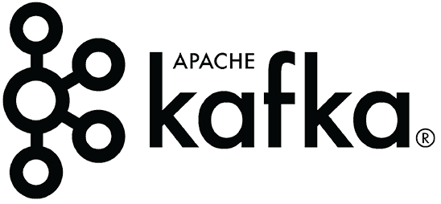

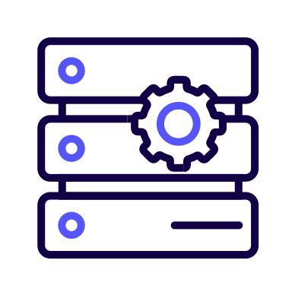
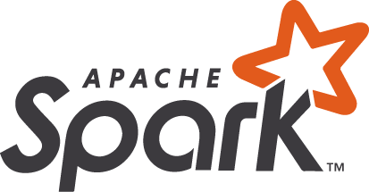

From Raw Data to AI-enabled Financial Crime Detection
Graph Data Science
Graph Neural Networks
Semantic Search
Graph-RAG
Agentic Workflows
Agent Studio
Fraud Ring Detection
AML Screening
CUSTOMER
ACCOUNT
TRANSACTION
MERCHANT
COUNTERPARTY
Graph Ingestion Processors
DEVICE
ALERT
LINK
ISO 20022
LEI
SWIFT
MCC
OFAC
FIBO
Custom
Harmonized Tables
Entity Resolved Tables
Staging Tables
DATAFLOW
& STREAMING
DATA
ENGINEERING
Open Data
Licensed Data
Internal Data
Multimodal Data
Platform + Applied AI together — this is what raw data → production fincrime AI actually takes.
Notes:
Cloudera does not have a native graph database offering however we have all the plumbing needed to build high quality knowledge graphs.
NiFi can ingest directly to Neo4j or any other graph database.
CDE can do the ontology mapping, and iceberg can store versioned ontology tables.
CAI can provide discovery compute to run genomic analysis or other AI/ML tools which can help enrich the graph, or do pagerank over massive graphs when native graph database tools dont scale.

Slide 36
Applied AI: Co-Builds the Platform, Not Just the Solutions
Forward Deployed Engineering — Applied AI engineers work alongside your centralized AI team, on two fronts.
Business solutions on your data
Platform tooling co-build
· Financial crime detection — graph + agents on the lakehouse
· Source of Wealth reporting — 10 days → under 1 hour
· Banking chatbot with memory — on-prem, your data
High-ROI problems → deployed Private AI solutions.
· Knowledge & ontology layer
· Centralized vector DB & agent memory
· MCP gateway & new MCP servers
· Agent self-evolvement tooling
The frontier pieces DBS IT wants to own.
When the solution is on your data — and when the infra itself must evolve — Applied AI builds it with you.
Notes:
Divider. Everything after this is optional; pick based on the request form's audience/industry.

Slide 37
Co-Build 1 — Knowledge & Ontology Layer
Current state: no built-in ontology, knowledge graph or domain reasoning layer in CAI.
TODAY IN CAI
Entity Resolution
Agents reason over unstructured text only
Disambiguate same-name accounts & counterparties across the lakehouse
Knowledge Graph
Map relationships across transactions, entities and alerts
Guessed entity links · missed regulatory precision
Domain Ontology
Banking / regulatory taxonomy agents query at inference time

Slide 38
Co-Build 2 — Centralized VectorDB & Multimodal Search
Current state: no centralized vector index or multimodal metadata store across projects.
TODAY IN CAI
Centralized Vector Index
Each project builds its own RAG store in isolation
One LanceDB-style store shared across all projects
Multimodal Embeddings
Text, image & structured metadata in one queryable index
No shared embeddings · context lost between sessions
Shared Retrieval API
Every Agent Studio workflow calls one governed endpoint
Applied AI co-build: centralized index + embedding pipeline + retrieval API — no more per-project RAG rebuild.

Slide 39
Co-Build 3 — MCP Ecosystem & Agent Context Memory
Delivered: Iceberg MCP (Preview) · Workbench MCP (~105 tools) · CDV MCP — but no central gateway or enterprise memory.
TODAY IN CAI
New MCP Servers
3 MCP servers; no central gateway
Object storage, Kafka, model registry — more governed tool coverage
MCP Gateway
Centralized auth, rate-limiting & audit for every tool call
LightMem per-workflow only — no governed enterprise memory
Agent Memory Layer
Session state persists across workflow runs, agents and teams
Applied AI co-build: new MCP servers + gateway + enterprise memory layer — integrated with SDX governance.

Slide 40
The Bigger Picture, Covered
Delivered by Cloudera AI · roadmap with partners · co-built with Applied AI — the complete agent-ready platform for IT and AI Infra Owner.
✅ Delivered — GA today
🟡 Roadmap & Partners
🔴 Co-Build with Applied AI
· AI Inference — CAII · NIM · vLLM
· Open Lakehouse — Iceberg
· AI Registry → CICD promotion
· NVIDIA co-engineering (36× inference)
· Iceberg MCP — Preview
· Custom model onboarding & serving wrappers
· Agent Studio 3.0 — low-code builder
· Studios: RAG · Synthetic Data
· Deploy-as-endpoint
· MCP servers of Platform: Workbench · CDV · Atlas· Taikun · & More
· Knowledge & ontology layer
· Centralized vector search & API
· Agent marketplace UX & governance
· SDX — Ranger access · Atlas lineage
· CAI Eval · Phoenix / OTEL tracing
· Agent Studio guardrails
· Galileo.AI — Eval · Observe · Protect
· Galileo Protect — real-time firewall
· MCP gateway — auth · rate-limit · audit
· Enterprise memory · self-evolvement

Slide 41
Thank You
Cloudera AI: the AI-ready data foundation + Agent Studio harness for your centralized Private-AI platform.
Applied AI co-builds the frontier pieces with you: ontology, agent memory, AI gateway, agent self-evolvement.

