Slide 1
Farmer Price Intelligence Dashboard
Empowering Ghanaian Smallholder Farmers Through Data-Driven Price Transparency & Regional Arbitrage Analytics
Team Data 2 • AmaliTech Capstone Internship
AMALITECH

Slide 2
The Problem: $1.9B Annual Economic Loss
Core Challenge
Ghana loses approximately $1.9 Billion annually due to post-harvest losses and market access inefficiencies (World Food Programme).
Today's Reality for Smallholder Farmers
• Rural farmers produce plantain, yam, cassava, maize without visibility into urban wholesale prices
• They sell to local middlemen at heavily discounted rates without knowing true market values
• Information asymmetry costs farmers thousands in lost revenue per harvest season
Real-World Example
A yam farmer in Techiman sells 50 bags at GH₵500/bag (GH₵25,000 total). The same yams sell in Greater Accra for GH₵750/bag (GH₵37,500). Lost revenue: GH₵12,500 per farmer, per season.
AMALITECH

Slide 3
DATA 2
Members
Elvis Frimpong — Team Lead & Dashboard Developer
Emmanuel Quarshie — Foundations (Presentation & Documentation)
Ferdinand Afful Bentum — Foundations (Research & KPI Analysis)
Fuseini Suleyman — Builder (Dashboard Development)
Leon Kimene Ibobi — Foundations (Data Cleaning & Validation)
AMALITECH

Slide 4
Solution Overview & Core Questions
What This Dashboard Does
An interactive Power BI tool providing real-time commodity price visibility, regional price comparisons, and decision-support analytics across 36 markets in Ghana.
Four Core Questions Answered
• Income Impact: How much revenue am I leaving on the table locally?
• Regional Arbitrage: What is my ROI if I transport produce to high-value markets?
• Seasonal Timing: Which months offer peak pricing for my crop?
• Smart Recommendations: Where should I sell right now to maximize returns?
Key Design Decisions
• Pure Price-Only Scope: All metrics show gross commodity value (Phase 1 excludes transport costs)
• Standardized Units: All commodities evaluated on a per-bag metric for consistent comparison
AMALITECH

Slide 5
Data Pipeline & Methodology
Data Sources
• Primary: MoFA SRID Agricultural Commodity Prices (36 markets, 76 commodities)
• Secondary: Ghana Open Data Portal, World Bank, Ghana Statistical Service (GSS)
Technology Stack
• ETL/EDA: Python (Pandas, NumPy, Seaborn, Matplotlib)
• Dashboard: Power BI Desktop & Web with DAX modeling
• Version Control: GitHub
Python Data Cleaning Pipeline
• Name Standardization: Cleaned inconsistent market and crop naming across regions
• Imputation: Regional median prices used to handle missing values
• Unit Standardization: Converted all package types to uniform per-bag metrics
AMALITECH

Slide 6
Dashboard Architecture & KPI Formulations
Core KPIs Delivered
1. Average Price (GH₵)
The average wholesale price per bag across selected markets.
Formula:
Average Price = Total Wholesale Prices ÷ Total Market Listings
2. Minimum & Maximum Price (GH₵)
The lowest and highest wholesale prices recorded across all 36 regional markets.
Formula:
Minimum Price = Lowest Market Price
Maximum Price = Highest Market Price
3. Price Spread (GH₵)
The difference in price per bag between the highest-priced and lowest-priced markets.
Formula:
Price Spread = Maximum Price − Minimum Price
4. Farmer Income Impact (GH₵)
The potential additional income a farmer could earn by selling in the highest-priced market instead of the lowest-priced market.
Formula:
Income Impact = Price Spread × Harvest Volume (Bags)
5. Regional Arbitrage Gain (%)
The percentage increase in revenue that could be achieved by moving produce from the lowest-priced market to the highest-priced market.
Formula:
Arbitrage Gain = [(Maximum Price − Minimum Price) ÷ Minimum Price] × 100
6. Smart Recommendation
An automated market recommendation identifying the best available market and potential additional earnings per bag.
Example:
Sell in Tema Community One Main Market at GH₵666.67/bag. Potential gain: +GH₵665.77/bag.
AMALITECH

Slide 7
Regional Arbitrage Gain (%)
Definition
Measures the percentage increase in gross revenue a farmer could achieve by moving produce from a lower-priced local market to a higher-priced urban or regional market.
Formula
Arbitrage Gain (%) = [(Maximum Price − Minimum Price) ÷ Minimum Price] × 100
Step-by-Step Calculation
1. Calculate the Price Spread
Find the extra cash earned per bag.
Extra Cash per Bag = Maximum Price − Minimum Price
2. Calculate the Proportion
Compare the additional earnings with the original local market price.
Proportion = Extra Cash per Bag ÷ Minimum Price
3. Convert to Percentage
Multiply the proportion by 100.
Arbitrage Gain (%) = Proportion × 100
Example
Metric | Value
Local Market — Takoradi | GH₵280/bag
Peak Market — Accra | GH₵450/bag
Price Spread | GH₵170/bag
Proportion | 0.6071
Arbitrage Gain | 60.71%
Interpretation
A farmer selling in Accra instead of Takoradi could generate 60.71% more gross revenue per bag, before accounting for transportation and other selling costs.
Key Insight: The 60.71% figure represents the gross revenue difference, not the farmer's final profit.
AMALITECH

Slide 8
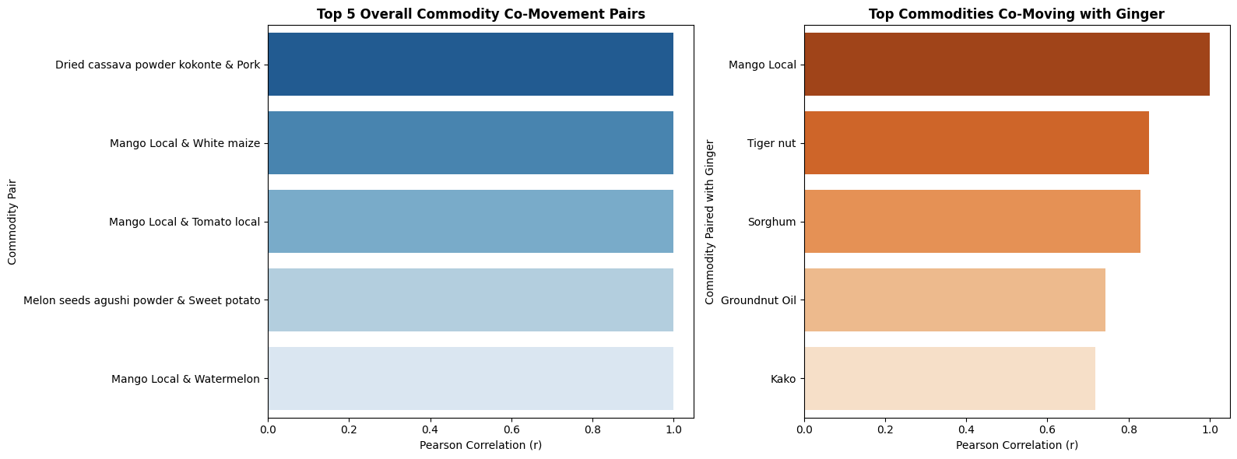
Analytical Deep Dive: Commodity Co-Movement
AMALITECH

Slide 9
Analytical Deep Dive: Commodity Co-Movement
Key Finding 1: Strong Price Correlations
Top commodity pairs move in near-perfect synchronization (r ≈ 1.0), revealing deep market interconnectedness.
Top Correlated Commodity Pairs
Dried Cassava Powder (Kokonte) & Pork — r = 1.0
Mango Local & White Maize — r = 1.0
Mango Local & Tomato Local — r = 1.0
Melon Seeds (Agushi Powder) & Sweet Potato — r = 1.0
Mango Local & Watermelon — r = 1.0
Core Explanation
These pairs show perfect correlation (r = 1.0) because they experience similar harvest and supply cycles, synchronized market arrivals, and similar responses to regional supply and pricing changes across the 36 markets.
AMALITECH
Notes:
Pearson correlation (r) measures how closely the prices of two commodities move together over time and across markets. A value of +1 means they move perfectly together, values between +0.8 and +0.99 indicate a very strong positive relationship, while 0 means there is no linear relationship between their price movements.

Slide 10
Analytical Deep Dive: Commodity Co-Movement
Key Finding 2: Strong Price Correlations
Top commodity pairs move in near-perfect synchronization (r ≈ 1.0), revealing deep market interconnectedness.
Ginger Co-Movement Insights
Ginger & Mango Local — r = 1.000000
Ginger & Tiger Nut — r = 0.851004
Ginger & Sorghum — r = 0.829429
Ginger & Groundnut Oil — r = 0.743576
Ginger & Kako — r = 0.717720
Core Explanation
Ginger shows strong positive co-movement with these commodities, likely reflecting shared sourcing regions, overlapping trade routes, and similar market demand patterns, which cause their wholesale prices to move in similar directions.
AMALITECH
Notes:
Pearson correlation (r) measures how closely the prices of two commodities move together over time and across markets. A value of +1 means they move perfectly together, values between +0.8 and +0.99 indicate a very strong positive relationship, while 0 means there is no linear relationship between their price movements.

Slide 11
Scope, Technical Requirements & Constraints
In-Scope Features (Delivered)
• Interactive filtering by region, market, month, and commodity
• Dynamic volume slider for harvest calculations
• KPI cards displaying Income Loss and Arbitrage Gain
• Automated Smart Recommendation text box
Explicitly Out of Scope for Phase 1
• Predictive price forecasting models
• Live API web scraping
• Native mobile iOS/Android apps
• Net profit calculations after transport costs
Connectivity & Access
• Local Power BI Desktop: Offline viewing with pre-loaded data
• Web Dashboard: Requires active internet connection for interactions and updates
AMALITECH

Slide 12
Dashboard Walkthrough
Live Dashboard Demonstration
AMALITECH

Slide 13
Future Roadmap: Phases 2-4
Phase 2: Net Profit Calculator
Integrate freight costs (GHS/km), road network distances, and toll tariffs for exact net arbitrage calculations after transport.
Phase 3: Mobile USSD/SMS Extension
Enable feature-phone access for rural farmers without smartphones via basic SMS codes and USSD protocols.
Phase 4: Machine Learning Price Forecasting
Implement time-series ARIMA/Prophet models for 2-4 week price trend forecasting, helping farmers plan ahead.
Data-Driven Agriculture for Smallholder Prosperity
AMALITECH

