Slide 1
A Presentation on Big Data Security
Group Members:
Name: Miss Rokeya Akter(160210)
Ferdousi Haque(160228)

Slide 2
Background Topics :
Data - Data is limitless and present everywhere in the universe
Big data:
Big data is defined as massive data sets having large, more varied and complex structure with the difficulties of storing, analyzing and visualizing for further processes.
Security – Security means to protect something.

Slide 3
Problem Definition :
BIG Data is actually increasing day by day in many aspect such as scientific research, finance, business and social medias etc.
All the fields produces huge amount of data.
So, the tasks of ensuring Big Data security become more difficult as information is increased.

Slide 4
CHARACTERISTICS OF BIG DATA:
A. HACE Theorem:
HACE theorem means Heterogeneous, Autonomous, Complex and Evolving .
Exploring Big Data is identical to combining information from various heterogeneous sources that indicate variety of data.

Slide 5
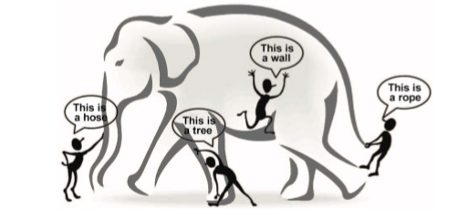
Represent big data
Elephant is treated as “Big Data”,:
It is not surprising that each blind man feels elephant like a rope, a hose or a wall as shown in Fig1
Fig1: Big Data

Slide 6
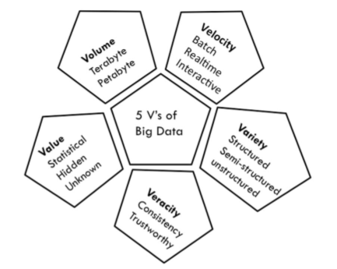
CHARACTERISTICS OF BIG DATA: (cont….)
B. The 5V’s of Big Data :
Big Data can be characterized by 5Vs - volume, velocity, variety, veracity, and value as in the below fig.2
Fig:2

Slide 7
CHALLENGES OF BIG DATA
The CHALLENGES OF BIG DATA are given in the below A. Heterogeneity B. Data Life Cycle Management C. Scalability D. Data Processing E. Data preparation F. Data Visualization G. Programming models H. Security and Privacy

Slide 8

Security Issues Of Big Data:
CIA means Confidentiality, Integrity, Availability
PAIN means Privacy, Authentication, Integrity, Non-repudiation
Hence favoring the literature study , main security and privacy issues of big
Data are…………………..
1.Confidentiality –
2. Integrity –
3. Availability
4. Monitoring and auditing
5. Key management
6. Data privacy

Slide 9
BiG DATA SECURITY TECHNIQUES
We can categorized the techniques of big data security into four. They are
Oral and written pledges –
2. Cryptography -
3. Tracking, monitoring or auditing software -
4. integrated Rule-Oriented Data (iRODS) -

Slide 10
Conclusion
The scope of big data security is limited not only to the current data set but also historical data. Some possible methods and techniques to ensure security and privacy in Big Data have been discussed above. Moreover, we noted that correlation of massive data is the key which is the basis of use of Big Data as well as the reason of Big Data security and privacy issues.

Slide 11
Summary
In the real time data, volume, velocity, variety increases at the very high rate so to deal with these challenges simultaneously, modifications in already implemented algorithms are required to develop more reliable and flexible system.
Some problems are already solved and some are about to be solved and some solved issues wants further attention to modify the algorithms to maximize the accuracy and speed.

Slide 12
References:
Nikunj Joshi, Bintu Kadhiwala , Big Data Security and Privacy Issues – A Survey ,2017 pp 2-6
S. Sudarsan, R. Jetley and S. Ramaswamy, "Security and Privacy of Big Data", Studies in Big Data, 2015, pp. 2-9.
MATTURDI Bardi1, ZHOU Xianwei2, LI Shuai2, LIN Fuhong2 , Big Data Security and Privacy: A Review
B. Matturdi, X. Zhou, S. Li, F. Lin, “Big Data security and privacy: A review”, Big Data, Cloud & Mobile Computing, China Communications vol.11, issue: 14, 2014, pp. 135 – 145.
M. Chen, S. Mao and Y. Liu, "Big Data: A Survey", Mobile Networks and Applications, vol. 19, no. 2, 2014, pp. 171-209.
E. Bertino, "Big Data - Security and Privacy", 2015 IEEE International Congress on Big Data, 2015, pp. 57-61.
L. Xu and W. Shi, "Security Theories and Practices for Big Data", Big Data Concepts, Theories, and Applications, 2016, pp. 157-192.
Y. Demchenko, C. Ngo, C. de Laat, P. Membrey and D. Gordijenko, "Big Security for Big Data: Addressing Security Challenges for the Big Data Infrastructure", Lecture Notes in Computer Science, 2014, pp. 76-94
Nikunj Joshi,Bintu Kadhiwala,Big Data Security and Privacy Issues A Survey, 2017,pp.1-5

Slide 13

Transaction

