Slide 1
TEAM Phoenix Resort Management System
Fergus Kelley
Andrew Truong
Ryan Ocampo
Deividas Rutkauskas
Viraj Shah

Slide 2
PROJECT RATIONALE
We wanted to pick a topic that would challenge our critical thinking and problem solving skills, while at the same time resembling a project we might encounter in our careers.
We decided to create a piece of resort management software because it would require careful thinking to fully understand the needs of hotel guests and employees.
We want to explore the complexity of the business operations and create a piece of software that is both powerful and easy to use.

Slide 3
WORK SCHEDULE DIAGRAM
Team Phoenix
Fergus Kelley
Andrew Truong
Ryan Ocampo
Deividas Rutkauskas
Viraj Shah
Client
Client
Developer
Developer
Developer
Front-end Developer
Back-end Developer
Front-end Developer
Back-end Developer
Back-end Developer
Coordinator

Slide 4
System SPECIFICATIONS
To fulfill the requirements of this course, we designed the front-end of the software using JavaFx and the backend using SQLite.
This software is intended for employees of the resort so it is designed to be used on a desktop computer.

Slide 5
Requirement SPECIFICATIONS
1.0 Introduction Phoenix Resort Management System (PRMS) is a resort software system that allows employees to management day to day functions of the resort.
2.0 Interface
The PRMS shall provide a graphic user interface (GUI) with tabs. Each tab of the interface shall profile functionality for employees to interact with the PRMS, as described in sections 3.0 through 7.0. When the employee clicks on a tab, the PRMS shall display a new interface with the appropriate functionality for that tab.
3.0 Employee Profiles
The PRMS shall provide a tab of the interface for creating and managing employee profiles. The employee profiles shall be stored in a local database. Each profile shall contain information about the employee. Each profile will contain information about the employee’s access to the PRMS (authentication).

Slide 6
Requirement SPECIFICATIONS
3.1 Profile Information
The PRMS shall provide an interface where the new employee profiles are created. Each employee profile shall contain the employee’s name, the employee’s title, and the employee’s unique ID number. The PRMS shall allow the entry of the employee’s name and title into the new profile window, and shall create the employee’s unique ID number with cannot be changed. The PRMS will provide functionality for suitably authorized employees to modify the information contained in already existing profiles.
3.2 Authentication
The PRMS will limit access by way of a 4-digit access PIN. The access PIN will be created when the employee profile is created. The PRMS will provide functionality for suitably authorized employees to modify the access PIN contained in already existing profiles.
The employee profile will contain information about which interface tabs are available to each employee based on the employee’s title.
The PRMS will log employee interactions with the PRMS in a text file.
4.0 Hotel Rooms
The PRMS shall allow the management and reservation of the resort’s hotel rooms.

Slide 7
requirements TRACEABILITY MATRIX
Entry # | Para # | PRMS Requirements Traceability Matrix | Type | Use Case
1 | 2.0 | The PRMS shall provide a graphic user interface (GUI) with tabs. | SW
2 | 2.0 | Each tab of the interface shall profile functionality for employees to interact with the PRMS. | SW
3 | 2.0 | When the employee clicks on a tab, the PRMS shall display a new interface with the appropriate functionality for that tab. | SW
4 | 3.0 | The PRMS shall provide a tab of the interface for creating and managing employee profiles | SW
5 | 3.0 | The employee profiles shall be stored in a local database. | SW
6 | 3.0 | Each profile shall contain information about the employee. | SW
7 | 3.0 | Each profile will contain information about the employee’s access to the PRMS (authentication). | NTH
8 | 3.1 | The PRMS shall provide an interface where the new employee profiles are created. | SW
9 | 3.1 | Each employee profile shall contain the employee’s name, job title, unique ID number, username, and password. | SW
10 | 3.1 | The PRMS shall allow the entry of the employee’s profile information into the new profile window. | SW | UC2
11 | 3.1 | The PRMS shall create the employee’s unique ID number with cannot be changed. | SW
12 | 3.1 | The PRMS will provide functionality for suitably authorized employees to modify the information contained in already existing profiles. | SW | UC2

Slide 8
requirements TRACEABILITY MATRIX
13 | 3.2 | The PRMS will limit access by way of a username and password | SW | UC1_UserLogin
14 | 3.2 | The employee profile will contain information about which interface tabs are available to each employee based on the employee’s title. | SW
16 | 3.2 | The PRMS will log employee interactions with the PRMS. | NTH
17 | 4.0 | The PRMS shall allow the management and reservation of the resort’s hotel rooms. | SW | UC3_ManageHotelRooms
18 | 4.1 | The PRMS shall provide a tab of the user interface for managing the resort’s hotel rooms. | SW | UC3_ManageHotelRooms
19 | 4.1 | The PRMS shall provide functionality for describing the number of floors of the hotel, and the number of rooms on each floor. | SW | UC3_ManageHotelRooms
20 | 4.1 | The PRMS shall assign each room a number based on which floor of the hotel the room is located. | SW
21 | 4.1 | The PRMS shall provide functionality to enter and modify default attributes about each room. | SW | UC4_ModifyHotelRoom
22 | 4.1 | Each room profile shall have attributes and a list of the rooms inventory. | SW | UC4_ModifyHotelRoom
23 | 4.1 | For each item in the room, the room inventory shall keep track of the name, quantity, expected quantity, and whether the item is consumable. | SW
24 | 4.1 | The PRMS shall keep track of the number of each item in the rooms inventory that has been replaces. | SW
25 | 4.1 | The room profiles shall be stored in a local database. | SWC
26 | 4.2 | The PRMS shall provide a tab of the user interface that provides functionality for employees to create and modify reservations for each room. | SW | UC5_CreateReservation

Slide 9
requirements TRACEABILITY MATRIX
27 | 4.2 | The room reservations shall be stored in a local database. | SWC
28 | 4.2 | Each reservation shall contain attributes. | SW
29 | 4.2 | The reservation’s billing information shall contain fields. | SW
30 | 4.2 | The PRMS shall allow employees to query the list of rooms by the room’s attributes and whether a reservation exists for a given timespan. | SW | UC5_CreateReservation
31 | 4.2 | The PRMS shall allow employees to create reservations for any room that does not have a reservation for a given time span. | SW | UC5_CreateReservation
32 | 4.2 | The PRMS shall require the employee to enter valid information for all the fields in the room reservation information. | SW
33 | 4.2 | The PRMS shall allow employees to modify a reservation’s billing information by adding or removing additional charges. | SW | UC6_Billing
34 | 4.2 | The PRMS shall allow employees to modify a reservations timespan to extend or shorten a guest’s stay. | SW | UC5_CreateReservation
35 | 4.2 | The PRMS shall allow employees to output an itemized invoice containing all information about the room, including the calculated cost of the reservation based on the price per night and timespan. | SW | UC6_Billing
36 | 4.3 | The PRMS shall provide a tab of the user interface that provides functionality for employees to manage room maintenance and inventory. | SW | UC7_Maintenance
37 | 4.3 | The PRMS shall allow the employee to note modify the number of items in the room inventory to indicate whether replacements are needed. | SW | UC7_Maintenance
38 | 4.3 | The PRMS shall provide an interface to note when the room has been cleaned or the inventory has been replaced and update the necessary fields in the room profile. | SW | UC7_Maintenance
39 | 4.3 | The PRMS shall allow the employee to output a report of all rooms which haven’t been cleaned in a given time period, rooms which have maintenance notes, or rooms with insufficient inventory. | SW | UC7_Maintenance
40 | 5.0 | The PRMS shall allow the management and reservation of the resort’s events rooms. | SW

Slide 10
SOFTWARE SYSTEM DESIGN
Classes were developed for the following components and objects: employees, hotel rooms, hotel room reservations, inventory, used inventory, invoice, billed items, event rooms, event room booking, event room reservations, restaurant items, in-resort restaurant, and catered meal items.
The reason we distinguished the hotel room class and the reservation is because one class considers the attributes of the room, and the other considers the billing and amount of time the room can be reserved. For the sake of organization and ease, we concurred that this organization satisfies those principles. Employee objects are created so as to login with their profiles to access the functionalities of the system. We distinguished used inventory from initial inventory for the sake of documenting reports and statistics behind replenishing the hotel’s resources.
Finally, classes were considered for keeping track of data concerning an in-resort restaurant.

Slide 11
USE CASES
We developed use cases to clearly specify how users might interact with the software. These use cases and rationales formed the basis for the front-end of the software:
User Login: To allow only authorized employees to access the system.
Create Profile: To manage employee profiles to ensure correct access to employees with proper credentials as well as keeping employee information updated.
Manage Hotel Rooms: To provide flexibility in the number and type of hotel rooms available. The software is designed to accommodate resorts with differing numbers of hotel rooms.
Modify Room Profile: To provide flexibility in the types of rooms available. Rooms may differ in their amenities offered.
Create Hotel Reservation: To allow employees to find available rooms fulfilling certain criteria and create reservations for any given room and timespan.

Slide 12
USE CASE : CREATE PROFILE
Overview:
Managerial and administrative users (M/A) are enabled to create profiles for new users
Preconditions:
M/A users are logged in to the main system
The “Create” Button is not selectable until all expected parameters have been filled
M/A users are on their employee profile information page of the system
Action | Software Reaction
1.) M/A enters username literal | Displays new username literal
2.) M/A enters title literal | Displays new title literal
3.) M/A enters a 4 digit user pin literal | Displays new pin literal; enables selectable “Create” button
4.) M/A clicks the create button | New employee object is created, credentials not found, database is updated, success message appears

Slide 13
USE CASE : CREATE PROFILE
Scenario Notes:
Items 1, 2, and 3 can be done in any order, but all must be initiated before proceeding to action item 4 . It is mandatory that the PIN entered in item 3 comprises of 4 integer values.
Post condition:
Database is updated (if “Create” button was selected)
Required GUI: PRMS_Desktop_View | Use Cases Utilized: None
Exceptions: Clicking the Create button when all fields have not been completed. Resolved by the precondition #3 Entering a PIN literal that is less than or greater than 4 literals. Resolved by the precondition #3 | Timing Constraints: None
Rationale: To manage employee profiles to ensure correct access and credentials

Slide 14
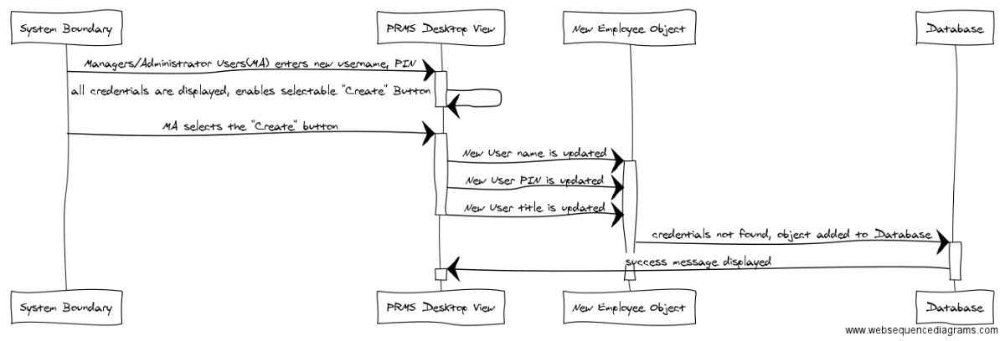
USE CASE : CREATE PROFILE

Slide 15
TEST CASES
In order to sufficiently test the current build of our software, we decided to use a vertical integration testing strategy.
For each component, we developed a simple test case that corresponds to a small section of source code, allowing errors to be easily found and corrected. Additionally, by using vertical integration testing, we were able to quickly develop just a portion of our overall system and ensure that it was working correctly before creating full horizontal layers.
In performing testing, we were pleased to find that in each test case our software passed.

Slide 16
TEST CASE : CREATE PROFILE
Attributes | Description
Name | Create Employee
Tester | Deividas Rutkauskas
Input | By default, the "Create" radio button is selected, but in case it is not, the user selects it. The user enters information for each field required to create an employee, namely "first name", "last name", "job title", "username", "password" and "confirm password." The user then clicks the "Apply button."
Oracle | The employee table is correctly updated to include the new Employee with the information provided by the user. If the user doesn't provide the appropriate information in the relevant fields, a message appears saying that a field or fields have been left blank. If the password confirmation doesn't match the password field, a message appears that the provided passwords don't match.
Log | Results match expected output.

Slide 17
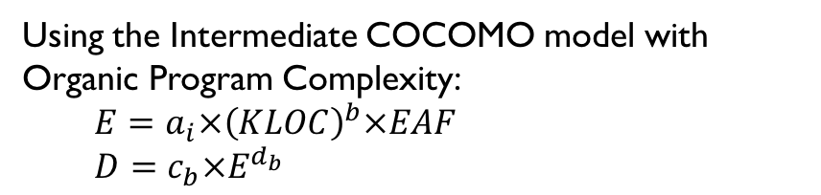
Constructive Cost Model (COCOMO)
EAF Cost Drivers
RELY: 1 DATA: 0.94 CPLX: 0.7
TIME: 1 STOR: 1 VIRT: 0.87
TURN:0.87 ACAP: 1 AEXP: 1
PCAP: 1 VEXP: 1 LEXP: 1
MODP:0.89 TOOL: 1.24 SCED: 1
Calculated EAF = 0.55
Using the Intermediate COCOMO model with Organic Program Complexity:
$E=a_{i}×{\left(KLOC\right)}^{b}×EAF$
$D=c_{b}×E^{d_{b}}$

Slide 18
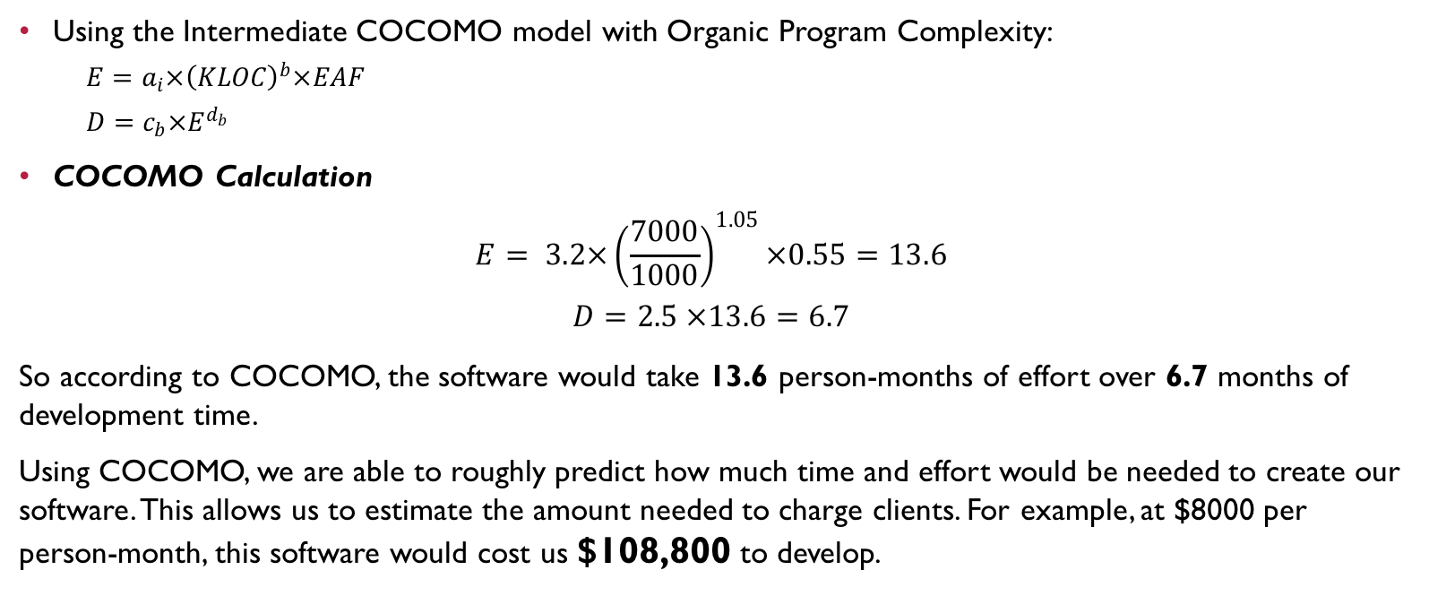
Constructive Cost Model (COCOMO)
Using the Intermediate COCOMO model with Organic Program Complexity:
$E=a_{i}×{\left(KLOC\right)}^{b}×EAF$
$D=c_{b}×E^{d_{b}}$
COCOMO Calculation
$$E= 3.2×{\left(\frac{7000}{1000}\right)}^{1.05}×0.55=13.6$$
$$D=2.5 ×13.6=6.7$$
So according to COCOMO, the software would take 13.6 person-months of effort over 6.7 months of development time.
Using COCOMO, we are able to roughly predict how much time and effort would be needed to create our software. This allows us to estimate the amount needed to charge clients. For example, at $8000 per person-month, this software would cost us $108,800 to develop.

Slide 19
FUNCTION POINT COST
Measurement parameter | count |  | average
Number of user inputs | 38 | × | 4 | = | 152
Number of user outputs | 14 | × | 5 | = | 70
Number of user inquires | 10 | × | 4 | = | 40
Number of files | 1 | × | 10 | = | 10
Number of external interfaces | 1 | × | 7 | = | 7
Total |  |  |  |  | 279
Weight Factor Estimation

Slide 20
FUNCTION POINT COST
Factor | Value
Backup & recovery | 2
Data communications | 2
Distributed processing | 0
Performance critical | 2
Existing operating environment | 5
Online data entry | 5
Input transaction over multiple screens | 4
Master files updated online | 3
Information domain values complex | 2
Internal processing complex | 1
Code designed for reuse | 3
Conversion/installation in design | 0
Multiple installations | 5
Application designed for change | 5
Complexity adjustment factor | 1.17
Total | 40.17
Complexity Adjustment
Factor

Slide 21
FUNCTION POINT COST
Software engineering requires understanding the costs of development. By using function point cost analysis, we can roughly estimate the cost of developing any given piece of software based on its requirements and complexity. This allows developers to make smarter decisions about future development and provide appropriate time and costs estimates to clients.
FP = 279 × (0.65 + 0.01 × 40.17) = 279 × 1.0517 = 293.424
At 6.5 FP per month and $8000.00 per month, the total cost of the software would be
( 293 / 6.5 ) * 8000 = $360,615

Slide 22
GANTT CHART
Start Date: August 22, 2016
Week: | 1 |  |  |  |  | 2 |  |  |  |  | 3 |  |  |  |  | 4 |  |  |  |  | 5
 | M | T | W | T | F | M | T | W | T | F | M | T | W | T | F | M | T | W | T | F | M | T | W | T | F
Document 1
Fergus
Andrew
Ryan
Devidas
Viraj
Document 2
Fergus
Andrew
Ryan
Devidas
Viraj
Document 3
Fergus: Gantt chart, FP, RTM
Andrew: Use cases and diagrams
Ryan: Use cases and diagrams
Devidas: Use cases and diagrams
Viraj: Use cases and diagrams

Slide 23
GANTT CHART
Week: | 6 |  |  |  |  | 7 |  |  |  |  | 8 |  |  |  |  | 9 |  |  |  |  | 10
 | M | T | W | T | F | M | T | W | T | F | M | T | W | T | F | M | T | W | T | F | M | T | W | T | F
Document 3
Fergus: Gantt chart, FP, RTM
Andrew: Use cases and diagrams
Ryan: Use cases and diagrams
Devidas: Use cases and diagrams
Viraj: Use cases and diagrams
Document 4
Fergus: Gantt chart, WSD, RTM
Andrew: Object design
Ryan: Object design
Devidas: Object design
Viraj: Object design
Document 5
Fergus: Rationale, Gantt, WSD
Andrew
Ryan
Devidas
Viraj
Document 6
Fergus: Source Code, Test Case,
RTM, Gantt, WSD
Andrew: Source Code, Test Case,
COCOMO
Ryan: Source Code, Test Case
Devidas: Source Code, Test Case
Viraj: Source Code, Test Case

