Slide 1
Assignment 1
(Chap 1, Chap 2)

Slide 2
1.7 List four significant differences between a file-processing system and a DBMS.
You can refer to the slide Chapter 1: Introduction File page 1.11-1.12.
Example:
A database management system could coordinate both the physical and the logical access to the data, but a file-processing system coordinates only the physical access.
Database management systems allow flexible access to data but file-processing system is designed to allow predetermined access to data
Database management systems are designed to coordinate simultaneous access to the same data by multiple users. File processing systems are often designed to allow one or more programs to access different data files simultaneously.
A database management system reduces the amount of data duplication by ensuring that a physical piece of data is available to all programs authorized to have access to it, whereas data written by one program in a file-processing system may not be readable by another program.

Slide 3
1.8 Explain the concept of physical data independence and its importance in database systems.
Refer to Chapter 1: Introduction File page 1.21.
Main point: physical data independence refers to the independence between applications and the physical storage structure.
Example：
Physical data independence is the ability to modify the physical scheme without making it necessary to rewrite application programs. Such modifications include changing from unblocked to blocked record storage, or from sequential to random access files. Such a modification might be adding a field to a record; an application program’s view hides this change from the program.

Slide 4
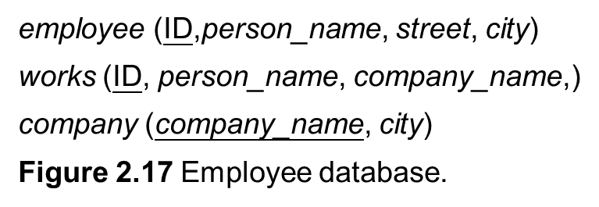
2.14 Consider the employee database of Figure 2.17. Give an expression in relational algebra to express each of the following queries:
Find the ID and name of each employee who works for “BigBank”.
First, join employee and works via id.
Then, select the data which’s company_name is BigBank.
Last, project the ID and name.

Slide 5
2.14 Consider the employee database of Figure 2.17. Give an expression in relational algebra to express each of the following queries:
Find the ID, name, and city of residence of each employee who works for “BigBank”.
First, join employee and works via id.
Then, select the data which’s company_name is BigBank.
Last, project the ID, name and city.

Slide 6
2.14 Consider the employee database of Figure 2.17. Give an expression in relational algebra to express each of the following queries:
Find the ID, name, street address, and city of residence of each employee who works for “BigBank” and earns more than $10000.
First, join employee and works via id.
Then, select the data which’s company_name is BigBank and salary is bigger than 10000.
Last, project the ID, name,street and city.

Slide 7

2.14 Consider the employee database of Figure 2.17. Give an expression in relational algebra to express each of the following queries:
Find the ID and name of each employee in this database who lives in the same city as the company for which she or he works.
First, join employee and works via id denotes as ew.
Then, join ew with company via company_name.
Next, select the data which’s employee.city and company.city is the same.
Last, project the ID and name.

Slide 8
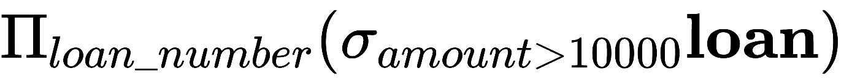
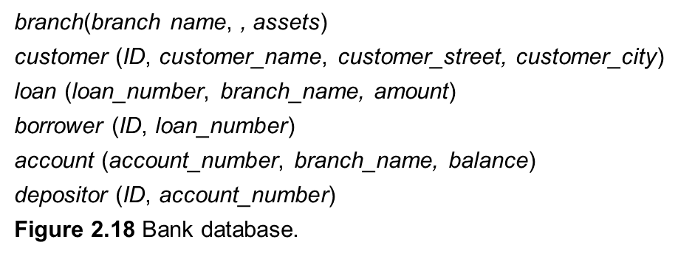
2.15 Consider the bank database of Figure 2.18. Give an expression in the relational algebra for each of the following queries:
Find each loan number with a loan amount greater than $10000.
First, select the data which’s amount is bigger than 10000.
Last, project the loan number.

Slide 9
2.15 Consider the bank database of Figure 2.18. Give an expression in the relational algebra for each of the following queries:
Find the ID of each depositor who has an account with a balance greater than $6000.
First, join depositor and account via account_number.
Then, select the data which’s balance is bigger than 6000.
Last, project the ID.

Slide 10
2.15 Consider the bank database of Figure 2.18. Give an expression in the relational algebra for each of the following queries:
Find the ID of each depositor who has an account with a balance greater than $6000 at the “Uptown” branch.
First, join depositor and account via account_number.
Then, select the data which’s balance is bigger than 6000 and the branch_city is uptown.
Last, project the ID.

Slide 11
Assignment 2
(Chap 3)

Slide 12
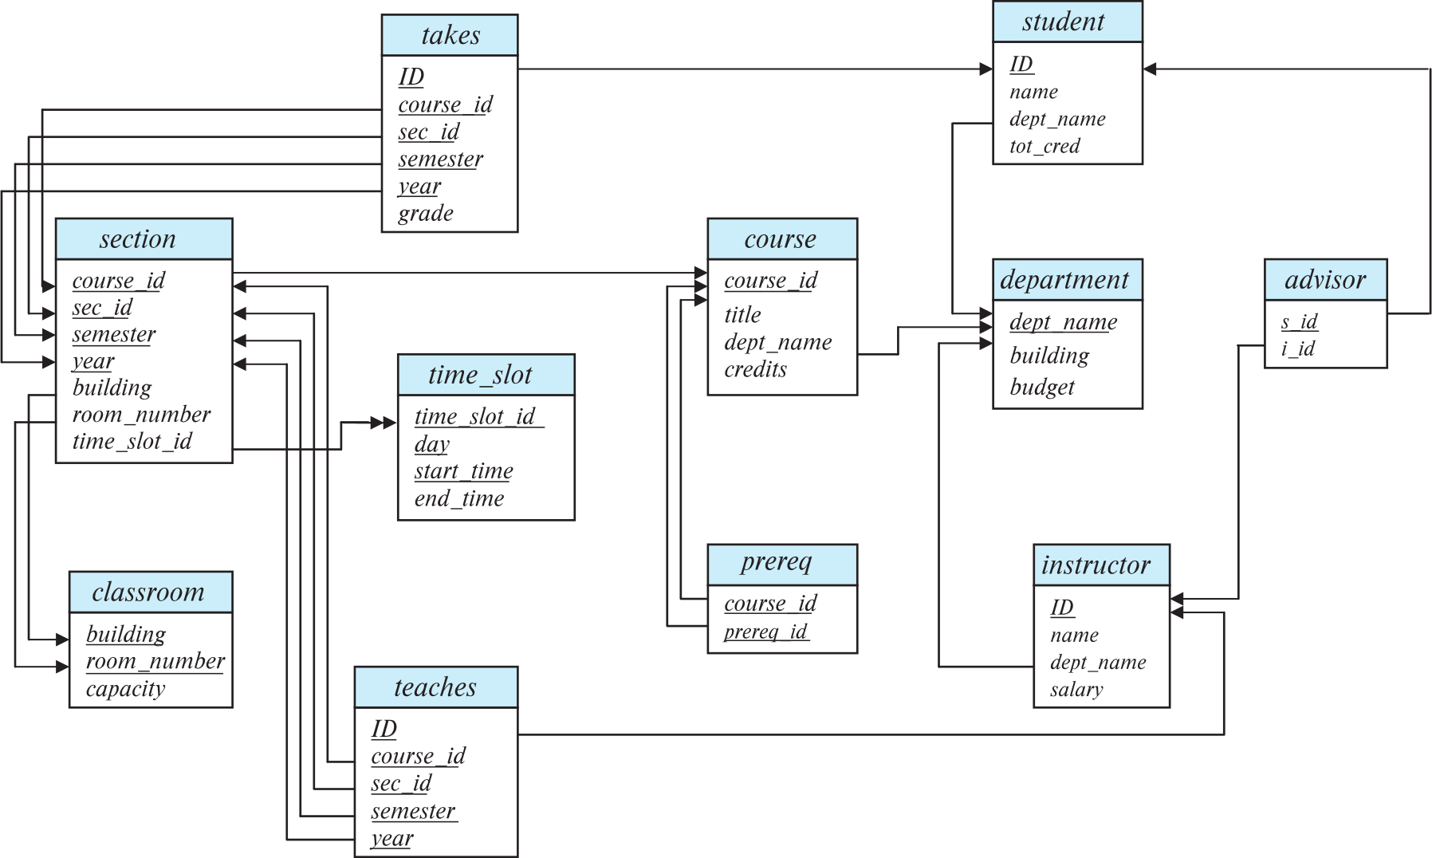
Schema Diagram for University Database

Slide 13
3.1 Write the following queries in SQL, using the university schema (as shown in the lecture ppt or the textbook).
Find the titles of courses in the Comp. Sci. department that have 3 credits.
select title
from course
where dept name = ‘Comp. Sci.’ and credits = 3

Slide 14
3.1 Write the following queries in SQL, using the university schema (as shown in the lecture ppt or the textbook).
Find the IDs of all students who were taught by an instructor named Einstein; make sure there are no duplicates in the result.
Key Idea:
student connects to takes through ID (student ID).
instructor connects to teaches through ID (instructor ID).
takes and teaches connect through course_id, sec_id, semester, and year.

Slide 15
Find the IDs of all students who were taught by an instructor named Einstein; make sure there are no duplicates in the result.
Step 1: Get student-course relationships from student and takes.
(student join takes using(ID))
Step 2: Get instructor-course relationships from instructor and teaches.
(instructor join teaches using(ID))
Step 3: Match students and instructors through the details of course.
(... join ... using(course_id, sec_id, semester, year))
Step 4: Filter for instructor “Einstein”.
where instructor.name = ‘Einstein’
Step 5: Remove duplicates and return unique student IDs.
select distinct student.ID

Slide 16
Find the IDs of all students who were taught by an instructor named Einstein; make sure there are no duplicates in the result.
select distinct student.ID
from (student join takes using(ID))
join (instructor join teaches using(ID))
using(course_id, sec_id, semester, year)
where instructor.name = ‘Einstein’

Slide 17
3.1 Write the following queries in SQL, using the university schema (as shown in the lecture ppt or the textbook).
Find the highest salary of any instructor.
select max(salary)
from instructor

Slide 18
3.1 Write the following queries in SQL, using the university schema (as shown in the lecture ppt or the textbook).
Find all instructors earning the highest salary (there may be more than one with the same salary).
Key Idea:
Use an aggregate function (max) to find the highest salary in the instructor table.
Use a subquery to compare each instructor's salary to the highest salary.

Slide 19
3.1 Write the following queries in SQL, using the university schema (as shown in the lecture ppt or the textbook).
Find all instructors earning the highest salary (there may be more than one with the same salary).
Step 1: Subquery to find the maximum salary.
select max(salary) from instructor
Step 2: Compare each instructor’s salary to the maximum salary.
where salary = (select max(salary) from instructor)
Step 3: Select relevant ID and name.
select ID, name from instructor

Slide 20
3.1 Write the following queries in SQL, using the university schema (as shown in the lecture ppt or the textbook).
Find all instructors earning the highest salary (there may be more than one with the same salary).
select ID, name
from instructor
where salary = (select max(salary) from instructor)

Slide 21
3.1 Write the following queries in SQL, using the university schema (as shown in the lecture ppt or the textbook).
Find the enrollment of each section that was offered in Fall 2017.
Key Idea:
Use the section table to find all sections offered in Fall 2017.
Use a subquery to count the number of students enrolled in each section by matching the takes table with the details of section.

Slide 22
Find the enrollment of each section that was offered in Fall 2017.
Step 1: Filter sections offered in Fall 2017.
from section where semester = ‘Fall’ and year = 2017
Step 2: Select course_id and sec_id.
select course_id, sec_id, …
Step 3: Use a subquery to count enrollment.
(select count(ID)
from takes
where takes.year = section.year
and takes.semester = section.semester
and takes.course_id = section.course_id
and takes.sec_id = section.sec_id)
It counts the number of students in the takes table who match the specific section with the where clause.

Slide 23
3.1 Write the following queries in SQL, using the university schema (as shown in the lecture ppt or the textbook).
Find the enrollment of each section that was offered in Fall 2017.
select course_id, sec_id,
(select count(ID)
from takes
where takes.year = section.year
and takes.semester = section.semester
and takes.course_id = section.course_id
and takes.sec_id = section.sec_id)
from section where semester = ‘Fall’ and year = 2017

Slide 24
3.1 Write the following queries in SQL, using the university schema (as shown in the lecture ppt or the textbook).
Find the maximum enrollment, across all sections, in Fall 2017.
Key Idea:
Use a nested query to calculate the enrollment for each section.
Use an aggregate function (max) in the outer query to find the highest enrollment.

Slide 25
Find the maximum enrollment, across all sections, in Fall 2017.
Step 1: Filter sections offered in Fall 2017.
where semester = ‘Fall’ and year = 2017
Step 2: Calculate the enrollment for each section.
select count(ID) as enrollment
from section natural join takes
where semester = ‘Fall’ and year = 2017
group by course_id, sec_id)
Step 3: Find the maximum enrollment.
select max(enrollment) from (…)
Combines the section and takes tables based on common columns (course_id, sec_id, semester, and year) to to find the students enrolled in each section.

Slide 26
3.1 Write the following queries in SQL, using the university schema (as shown in the lecture ppt or the textbook).
Find the maximum enrollment, across all sections, in Fall 2017.
select max(enrollment)
from (select count(ID) as enrollment
from section natural join takes
where semester = ‘Fall’ and year = 2017
group by course_id, sec_id)

Slide 27
3.1 Write the following queries in SQL, using the university schema (as shown in the lecture ppt or the textbook).
Find the sections that had the maximum enrollment in Fall 2017.
Key Idea:
Use a with clause to define a temporary relation.
Use a subquery to compare each section’s enrollment with the maximum enrollment and filter the results.

Slide 28
Find the sections that had the maximum enrollment in Fall 2017.
Step 1: Define a temporary relation.
with sec_enrollment as …
Step 2: Calculate the enrollment for each section.
select count(ID) as enrollment
from section natural join takes
where semester = ‘Fall’ and year = 2017
group by course_id, sec_id)
Step 3: Find the maximum enrollment.
select max(enrollment) from (…)
Step 4: Select sections with the maximum enrollment.
select course_id, sec_id from sec_enrollment
where enrollment = (select max(enrollment) from sec_enrollment)
Combines the section and takes tables based on common columns (course_id, sec_id, semester, and year) to to find the students enrolled in each section.

Slide 29
3.1 Write the following queries in SQL, using the university schema (as shown in the lecture ppt or the textbook).
Find the sections that had the maximum enrollment in Fall 2017.
with sec_enrollment as (select course_id, sec_id, count(ID) as enrollment
from section natural join takes
where semester = ‘Fall’ and year = 2017
group by course_id, sec_id)
select course_id, sec_id
from sec_enrollment
where enrollment = (select max(enrollment)
from sec_enrollment)

Slide 30
3.3 Write the following inserts, deletes, or updates in SQL, using the university schema.
Increase the salary of each instructor in the Comp. Sci. department by 10%.
update instructor
set salary = salary * 1.10
where dept name = ‘Comp. Sci.’

Slide 31
3.3 Write the following inserts, deletes, or updates in SQL, using the university schema.
Delete all courses that have never been offered (i.e., do not occur in the section relation).
Key Idea:
Use a subquery to identify courses that appear in the section table.
Use the NOT IN operator to delete courses whose course_id does not match any course_id in the section table.

Slide 32
3.3 Write the following inserts, deletes, or updates in SQL, using the university schema.
Delete all courses that have never been offered (i.e., do not occur in the section relation).
Step 1: Find courses that have been offered.
Step 2: Find courses that have never been offered.
Step 3: Delete courses that have never been offered.
delete from course
where course_id not in
(select course_id from section)

Slide 33
3.3 Write the following inserts, deletes, or updates in SQL, using the university schema.
Insert every student whose tot_cred attribute is greater than 100 as an instructor in the same department, with a salary of $10,000.
insert into instructor
select ID, name, dept_name, 10000 from student
where tot_cred > 100

Slide 34
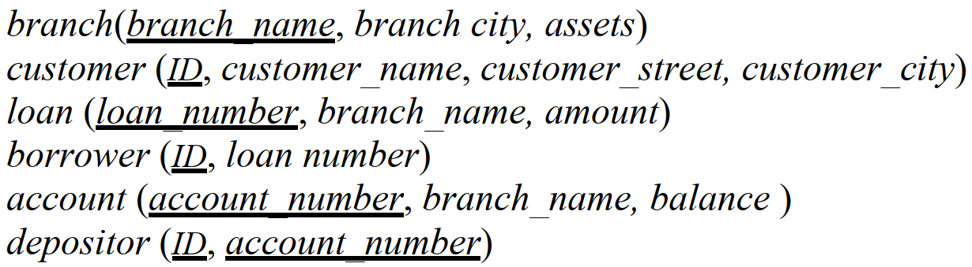
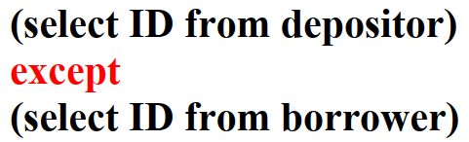



3.8
set difference

Slide 35

3.8
ID | Address
10001 | A
10002 | A
10003 | B
10004 | C
12345 | B
ID | Address
10001 | A
10002 | A
10003 | B
10004 | C
12345 | B
F.ID | S.ID | Address
10001 | 10001 | A
10001 | 10002 | A
……
10003 | 12345 | B
12345 | 12345 | B
join
customer F
customer S

Slide 36





3.8

Slide 37
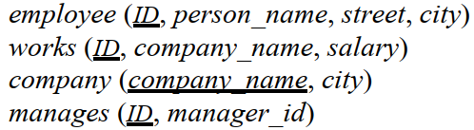





3.9

Slide 38

3.9
boolean of membership in a set

Slide 39
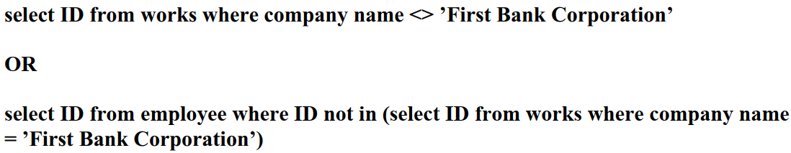



3.9
boolean of non-membership in a set

Slide 40

3.9
> maximum of a set

Slide 41
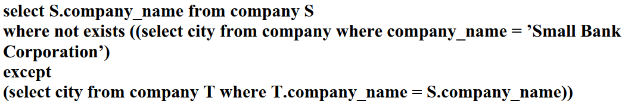




3.9
S
$$SBC$$
boolean of being an empty set

Slide 42
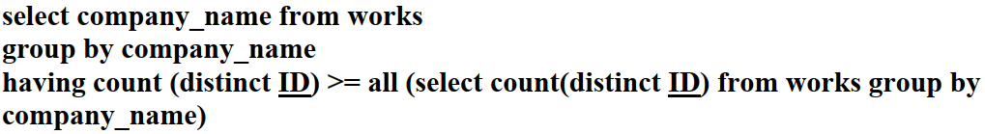



3.9
>= maximum of a set
ID | company_name
10001 | A
10002 | A
10003 | A
10004 | B
10005 | B
count(distinct ID) = number of employees | company_name
3 | A
2 | B
grouping

Slide 43
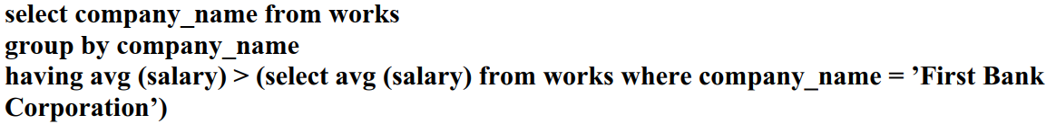

3.9
company_name | salary
A | 5000
A | 6000
A | 7000
B | 8000
B | 9000
company_name | avg(salary)
A | 6000
B | 8500
grouping

Slide 44
Assignment 3
(Chap 4)

Slide 45
4.2 Write the following queries in SQL: a. Display a list of all instructors, showing each instructor’s ID and the number of sections taught. Make sure to show the number of sections as 0 for instructors who have not taught any section. Your query should use an outer join, and should not use subqueries. Step: 1. Display what? 2. From which table?
Answer:
select ID, count(course_id)
from instructor natural left outer join teaches
group by ID;
select ID, count(course_id)
instructor’s ID the number of sections taught
instructor teaches
3. The total number? group by ID

Slide 46
b. Write the same query as in part a, but using a scalar subquery and not using outer join.
Step: 1. Display what? 2. From which table?
3. How to connect two tables? The same attribute ID
select ID, count(course_id)
Answer:
select id, (select count(course_id)
from teaches
where teaches.id=instructor.id) as num_of_course
from instructor;
instructor’s ID the number of sections taught
instructor teaches

Slide 47
c. Display the list of all course sections offered in Spring 2018, along with the ID and name of each instructor teaching the section. If a section has more than one instructor, that section should appear as many times in the result as it has instructors. If a section does not have any instructor, it should still appear in the result with the instructor name set to “—”.
Step: 1. Display what? select course_id, sec_id, ID, coalesce(name, '—')
2. From which table? section teaches instructor
3. Condition? in Spring 2018
Answer:
select course_id, sec_id, ID, coalesce(name, '—') as name
from (section natural left outer join teaches) natural left outer join instructor
where semester = 'Spring' and year = 2018;

Slide 48
d. Display the list of all departments, with the total number of instructors in each department, without using subqueries. Make sure to show departments that have no instructors, and list those departments with an instructor count of zero.
Step: 1. Display what? select dept_name, count(ID)
2. From which table? department instructor
3. The total number? group by dept_name
Answer:
select dept_name, count(ID) as instructor_num
from department natural left outer join instructor
group by dept_name;

Slide 49
4.3 Outer join expressions can be computed in SQL without using the SQL outer join operation. To illustrate this fact, show how to rewrite each of the following SQL queries without using the outer join expression.
a. select * from student natural left outer join takes
If we use natural join, what is the difference?
1.natural join: the common value on the same attribute
left outer join: the common value + value only in the left table
2. natural join: all attribute has values
left outer join: value only in the left table will show NULL on the attribution only in the right table
Answer:
select * from student natural join takes
union
select ID, name, dept_name, tot_cred, NULL, NULL, NULL, NULL, NULL
from student S1 where not exists
(select ID from takes T1 where T1.id = S1.id);
select * from student natural join takes
select from student S1 where not exists
(select ID from takes T1 where T1.id = S1.id);
select ID, name, dept_name, tot_cred, NULL, NULL, NULL, NULL, NULL

Slide 50
b. select * from student natural full outer join takes
Full outer join = Left outer join union Right outer join
Answer:
select * from student natural join takes
union
(select ID, name, dept_name, tot_cred, NULL, NULL, NULL, NULL, NULL
from student S1
where not exists
(select ID from takes T1 where T1.id = S1.id))
union
(select ID, NULL, NULL, NULL, course_id, sec_id, semester, year, grade
from takes T1
where not exists
(select ID from student S1 where T1.id = S1.id));

