Slide 1
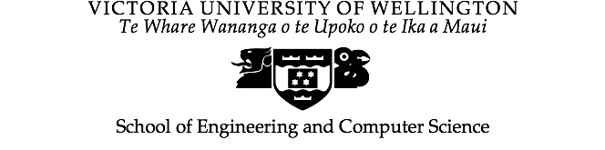
COMP422 — Week 11
Evolutionary Multi-Objective Optimisation
Dr Yi Mei
School of Engineering and Computer Science
Victoria University of Wellington
Yi.Mei@ecs.vuw.ac.nz

Slide 2
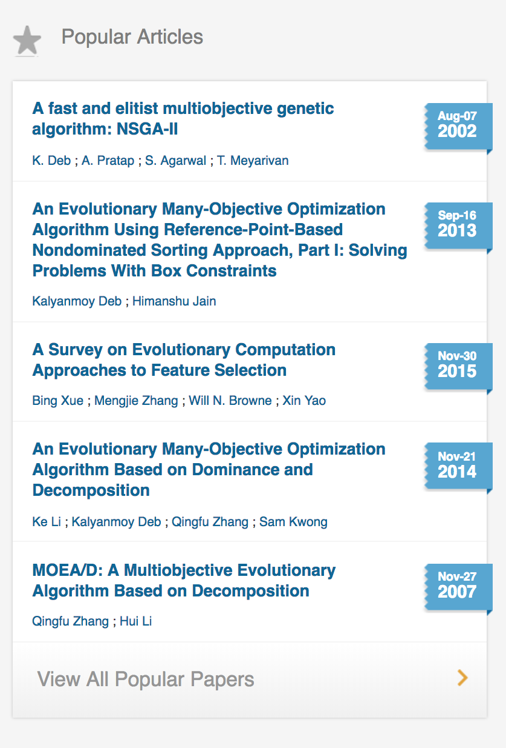
Outline
Multi-objective Optimisation
Evolutionary Multi-objective Optimisation
Issues in Evolutionary Multi-objective Optimisation
Fitness Assignment
Diversity Preservation
Elitism
Resources

Slide 3
Multi-objective Optimisation--Example
Suppose you need to fly on a long trip: Should you choose the cheapest ticket (more connections) or shortest flying time (more expensive)?
The following tickets, which option is better ?
Ticket | Travel Time (hrs) | Ticket Price ($)
A | 10 | 1700
B | 9 | 2000
C | 8 | 1800
D | 7.5 | 2300
E | 6 | 2200

Slide 4
Comparison of Solutions
If we compare tickets A & B, we can’t say that either is superior without knowing the relative importance of Travel Time vs. Price.
However, comparing tickets B & C shows that C is better than B in both objectives, so we can say that C “dominates” B.
So, as long as C is a feasible option, there is no reason we would choose B.
“A feasible solution is a set of values for the decision variables that satisfies all of the constraints in an optimisation problem. The set of all feasible solutions defines the feasible region of the problem.”

Slide 5
Dominance Relation
Types: non-dominated solutions and dominated solutions
Dominance Relation
x is said to dominate y if
x is no worse than y in all the objectives
x is better than y in at least one objective
x and y are non-dominated to each other, if neither x dominates y, nor y dominates x
Feasible Region
D
B
E
A
C

Slide 6
Pareto-optimal Solutions
Pareto-optimal solutions: not dominated by any other solution
Pareto front: the set of all the Pareto-optimal solutions.
f₁ & f₂ are minimized

Slide 7
Multi-objective Optimisation
Multiple objectives do NOT necessarily lead to multi-objective optimisation
Make sure the objectives are conflicting!
Real-world examples: Stock investment: return v.s. risk
Other examples: find someone to marry?
There is no single global optimum,
optimal decisions need to be taken in the presence of trade-offs between two or more conflicting objectives
Multiple criteria decision making: normally two or three objectives, many-objective optimisation if more than three.
Multi-objective optimisation aims to find the solutions as close as possible to the Pareto front & as far along it as possible.

Slide 8
Two Types of Approaches
Preference-Based method

Slide 9
Two Types of Approaches
Ideal Multi-Objective procedure

Slide 10
Traditional Approaches
Difficulties with classical methods:
Being sensitive to the shape of the Pareto-optimal front (e.g. weighting method).
Need for problem knowledge which may not be available.
Restrictions on their use in some application areas.
Need to several optimization runs to achieve the best parameter setting to obtain an approximation of the Pareto-optimal set.

Slide 11
Why Evolutionary Multi-objective Optimisation?
Can obtain multiple (Pareto-optimal) solutions in a single run
deal simultaneously with a set/population of possible solutions
Less sensitive to the shape or continuity of the Pareto front
e.g., they can easily deal with discontinuous or concave Pareto fronts), whereas these two issues are normally a real concern for mathematical programming techniques.
Individuals in the population can help each other

Slide 12
Issues in EMO
Evolutionary Multi-objective Optimisation (EMO)
Fitness Assignment – Defining a scalar fitness value based on multiple objective values
Diversity Preservation
Ensure the coverage of the entire Pareto front
Elitism – Do not lose non-dominated solutions

Slide 13
Fitness Assignment
Aggregating functions
E.g. weighted sum
Criteria-based methods
Vector Evaluated Genetic Algorithms
Domination-based methods
A fast and elitist multi-objective genetic algorithm: NSGA-II
Decomposition-based methods
MOEA/D: A multi-objective evolutionary algorithm based on decomposition

Slide 14
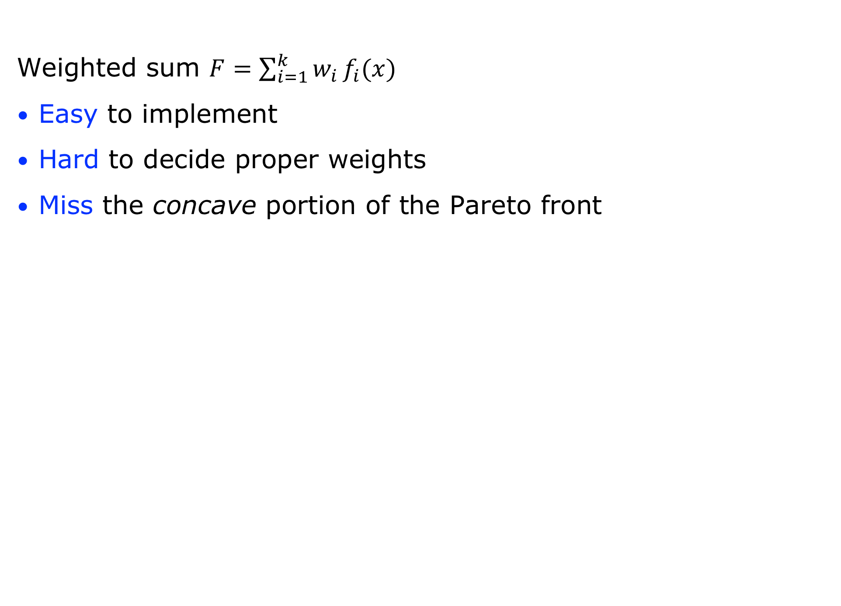
Aggregating Functions
Weighted sum $F=\sum_{i=1}^{k}{w_{i }f_{i}(x) }$
Easy to implement
Hard to decide proper weights
Miss the concave portion of the Pareto front
Notes:
the point of tangency

Slide 15

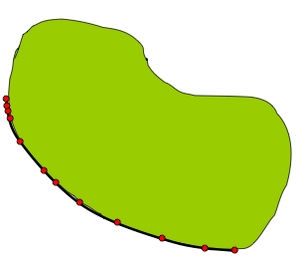

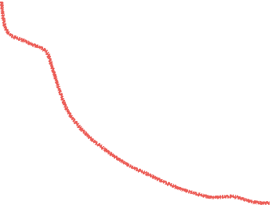



Dominance-based Methods
NSGAII
Assign ranks to the individuals
Fill the new population from the lowest rank
In the same rank, sort by crowding distance
Parents
Children
min(f2)
Rank 5
Rank 4
Rank 3
Rank 2
Rank 1
min(f1)

Slide 16
Decomposition-based Methods
MOEA/D
Similar to aggregating functions
Predefine a set of uniform weight vectors
Crossover with neighboring individuals

Slide 17
Diversity Preservation

Slide 18
Diversity Preservation
Crowding Distance (NSGA-II)
Notes:
Crowding distance is in the objective space

Slide 19
Elitism
External Archive to store all the non-dominated solutions found so far
Keep the best Parent Child individuals from the parent and child population – NSGAII

Slide 20
Quality Indicators
Hypervolume
The area dominated by the solution set
A reference point (worst point)
Inverted Generational Distance (IGD)
Spacing
Issues:
Normalisation
Proper reference point/set
One value for each run, then do statistical test

Slide 21
Flowchart of NSGAII
Generate initial population: size N
Evaluate fitness
Non-dominated Ranking
Selection
Return the final Pareto Front
Stop ?
Crossover
Yes
No
Generate Children Population
Mutation
Select N individuals
Evaluate Objectives
Non-dominated Ranking and Crowding distance
Combine Parent and Children Populations
Elitism

Slide 22
Flowchart of SPEA2
Initial Population, and
empty Archive (maxSize: S)
Fitness Assignment:
both Population and Archive
Generate offsprings population:
Binary tournament selection on Union,
then crossover, mutation
Copy non-dominated solutions in Population and Archive to new Archive
Combine Population and Archive to Union
Remove duplicates and dominated solutions in
Archive
Environmental selection
No
Archive Truncation
delete if |Archive|>S
add dominated ones if |Archive|<S
Stop ?
Return the Solutions in Archive
Yes
22￼

Slide 23
Resources
Mukhopadhyay, Anirban, et al. "A survey of multiobjective evolutionary algorithms for data mining: Part I." IEEE Transactions on Evolutionary Computation 18.1 (2014): 4-19.
Mukhopadhyay, Anirban, et al. "Survey of multiobjective evolutionary algorithms for data mining: part II." IEEE Transactions on Evolutionary Computation 18.1 (2014): 20-35.
Zhang, Qingfu, and Hui Li. “MOEA/D: A multiobjective evolutionary algorithm based on decomposition.” IEEE Transactions on evolutionary computation 11.6 (2007): 712-731.
Coello, CA Coello. "Evolutionary multi-objective optimization: a historical view of the field." IEEE computational intelligence magazine 1.1 (2006): 28-36.
Deb, Kalyanmoy. Multi-objective optimization using evolutionary algorithms. Vol. 16. John Wiley & Sons, 2001.
Bing Xue, Mengjie Zhang, Will Browne."Particle swarm optimization for feature selection in classification: A multi-objective approach", IEEE Transactions on Cybernetics, vol. 43, no. 6, pp. 1656-1671, 2013
Stewart, Theodor, et al. "Real-world applications of multiobjective optimization." Multiobjective Optimization. Springer Berlin Heidelberg, 2008. 285-327.
http://delta.cs.cinvestav.mx/~ccoello/EMOO/
jMetal: Java-based framework for multi-objecive optimization with metaheuristics.

